Slide 1

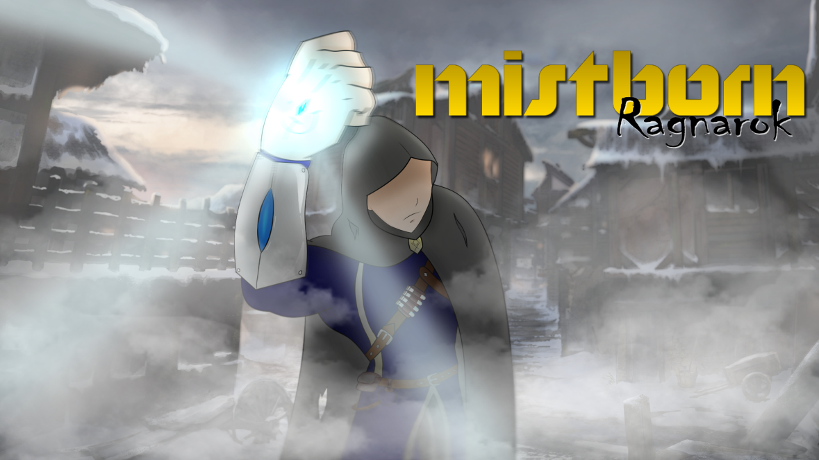
Mistborn – Ragnarok Aggressive Pigeon Game Studio COMP 376 Project Proposal
Christian Plourde – 26572499
Ayush Kharade - 40042388
Daniel Vellucci – 27416288
Samer Yazbeck – 40049573
Luciano Porchet - 40048537
“All Paths Lead To Ruin”

Slide 2
Introduction
Action/Platformer/Puzzle (3D)
PC
Everyone ages 12 and up
Trine (2009) meets Captain Claw (1997)
Medieval/Fantasy/Apocalyptic setting
Mistborn Trilogy – Brandon Sanderson

Slide 3
Story AND SETTING
Cold, desolate world where ash falls constantly from the sky and mists come out during the night
Fiery red sun
Yora
Cast ashore after attack at sea
Abandoned village
Snapping after traumatic events
Thumping sound coming from Well of Ascension
Mastery of new found abilities to overcome what awaits at the Well
Notes:
After a brutal attack at sea, Yora, the main character, wakes up after being cast ashore in a small rescue boat to the sights of an abandoned village. The world around him is cold and desolate and ash perpetually falls from the sky, covering the landscape in a black blanket. Due to the Lord Ruler’s influence after seizing the power at the Well of Ascension 1000 years ago, the planet lies dangerously close to the sun – a fiery red ball in the sky. The Well has since been replenished and our protagonist feels it beckoning to him. The traumatic experience of the attack preceding his shipwreck have snapped Yora, awakening the Mistborn powers he was genetically predisposed to. As the prophecies foretold, the Hero of Ages must once again travel to the Well of Ascension and seize its power. What awaits him there will require mastery of his newly acquired powers to overcome and save the world from impending doom.

Slide 4
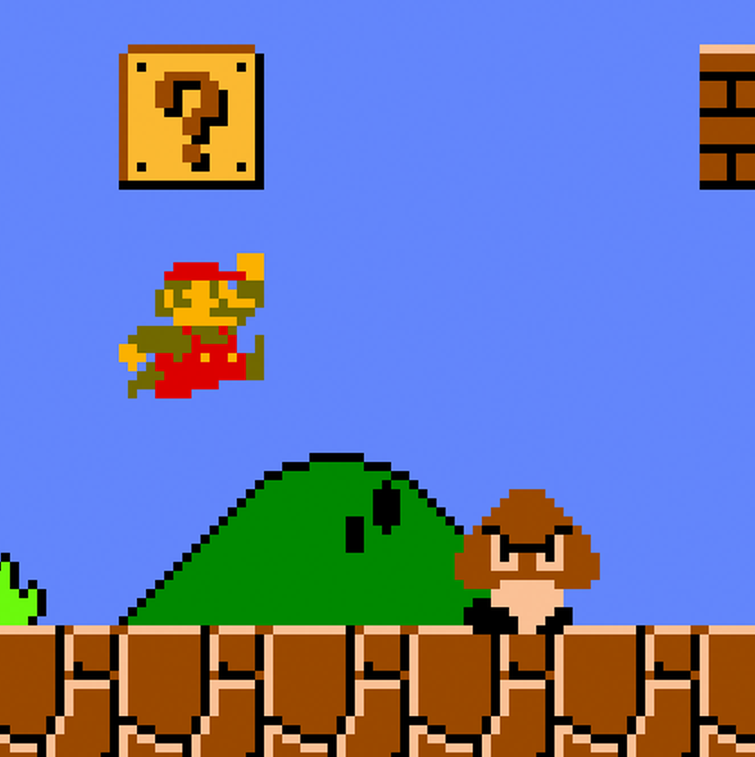
Game Mechanics
Traditional Platforming Mechanics such as running and jumping popularized during the days of the NES.
A tried and true formula that people still enjoy to this day.

Slide 5
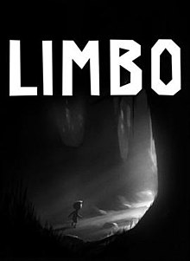
Game Mechanics
We also aim to have puzzles in our levels inspired by games such as Limbo.
Our aim is to have the player think to reach certain rewards.

Slide 6
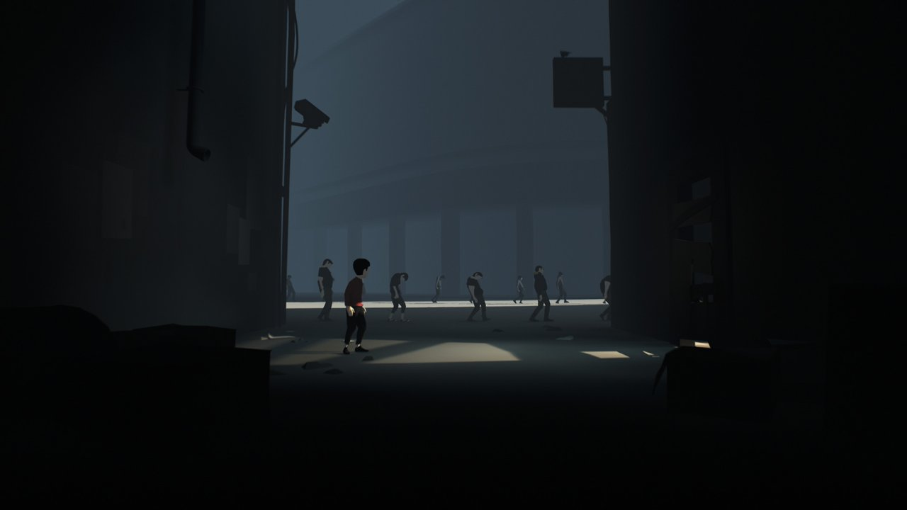
Related Games

Slide 7
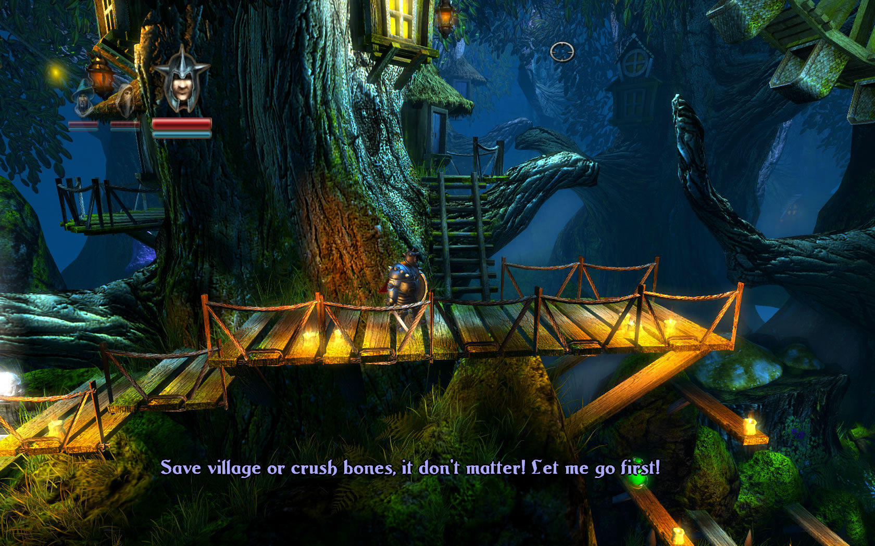
Trine (2009)
Mistborn has a similar visual representation style like Trine, a 3D world with side scrolling gameplay
Enemies can be fought as long as we have pewter, other wise the player can always manipulate
the environment to deal with enemies.
Consuming iron or steel allows you to interact with objects like rocks or smaller debris which can be used
against enemies.
Like Trine, mistborn would have a logical
platforming game design:
meaning, there would not be any platforms
floating in mid air.
Every platform would exist logically, whether
being a part of a wall
or a rock.
This would be a realistic design approach

Slide 8
Inside (2016)
Inside presents to us, a dark setting where the damage has already been done.
Mistborn has a similar dark post apocalyptic setting where you seek answers
In Inside, all other people except you are being mind controlled
The enemies in mistborn resembles this as all of them
are being mind controlled by Ruin (the antagonist)
Jora, who has free will happens to be just reaching the
village where people have been mind controlled,
so he is not affected …. Yet
Player would have to deal with the mind controlled enemies.

Slide 9
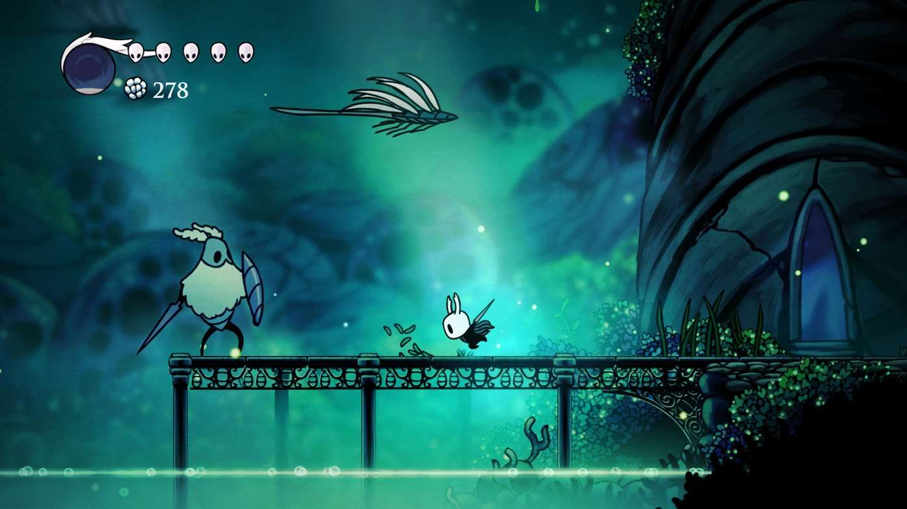
Hollow Knight (2017)
Hollow Knight lets the player learn new abilties
as they progress through the game.
Mistborn has a similar mechanic where players
would need to use their abilities to progress
through the game world
Hollow Knight’s endgame consist of a boss fight.
Mistborn has a similar final level structure where you would settle you score with Ruin.

