Slide 1
Parameter | FACHILD | FACOMS (MS assay) | FACOMS ( Laterla flow assay)
Age at baseline ( years)
Sex ( % male)
GAA1 (repeats)
Age at onset
Number of Non GAA mutations
Baseline mFARS (mean + SD)
Age at LOA
USS ( FARS E) ( Mean + SD)

Slide 2
FACHILD blood isoform.e
FACHILD blood mature
FACOMS blood
FACOMS buccal
2.0
1
2
1.5
FXN, log10, [ng/ml]
FXN, log10, [% of normal]
1
1.0
0
0.5
0
0.0
-1
patient
carrier
control
patient
carrier
control
patient
patient.ext
carrier
control
unknown
patient
patient.ext
carrier
control
unknown
status
status

Slide 3
study | origin | type | Pair | r | r2 | p | Obs.
 |  |  | fxn-aoo | 0.28 | 0.08 | 7.4E-11 | 532
FACOMS | buccal |  | fxn-gaa1 | -0.30 | 0.09 | 7.6E-13 | 532
 |  |  | aoo-gaa1 | -0.71 | 0.50 | 3.5E-81 | 532
 |  |  | fxn-aoo | 0.53 | 0.28 | 2.6E-32 | 428
FACOMS | blood |  | fxn-gaa1 | -0.56 | 0.31 | 3.5E-36 | 428
 |  |  | aoo-gaa1 | -0.73 | 0.53 | 3.8E-71 | 428
 |  |  | fxn-aoo | 0.36 | 0.13 | 7.0E-04 | 87
FACHILD | blood | mature | fxn-gaa1 | -0.55 | 0.30 | 3.2E-08 | 87
 |  |  | aoo-gaa1 | -0.49 | 0.24 | 1.2E-06 | 87
 |  |  | fxn-aoo | 0.34 | 0.12 | 1.1E-03 | 87
FACHILD | blood | isoform.e | fxn-gaa1 | -0.47 | 0.22 | 4.0E-06 | 87
 |  |  | aoo-gaa1 | -0.49 | 0.24 | 1.2E-06 | 87

Slide 4
blood
isoform.e
1.5
R
2
0.10
P
0.004
83
R
2
0.26
P
<
0.001
n
387
=
,
=
,
n
=
=
,
,
=
2
1.0
0.5
1
0.0
-0.5
0
-1.0
FXN, log10, [ng/ml]
heterozygous
heterozygous
FXN, log10, [% of normal]
buccal
mature
homozygous
homozygous
1.5
R
2
0.11
P
0.002
83
R
2
0.06
P
<
0.001
n
485
=
,
=
,
n
=
=
,
,
=
2
1.0
0.5
1
0.0
-0.5
0
-1.0
0
10
20
30
40
0
10
20
30
40
age at onset
age at onset

Slide 5
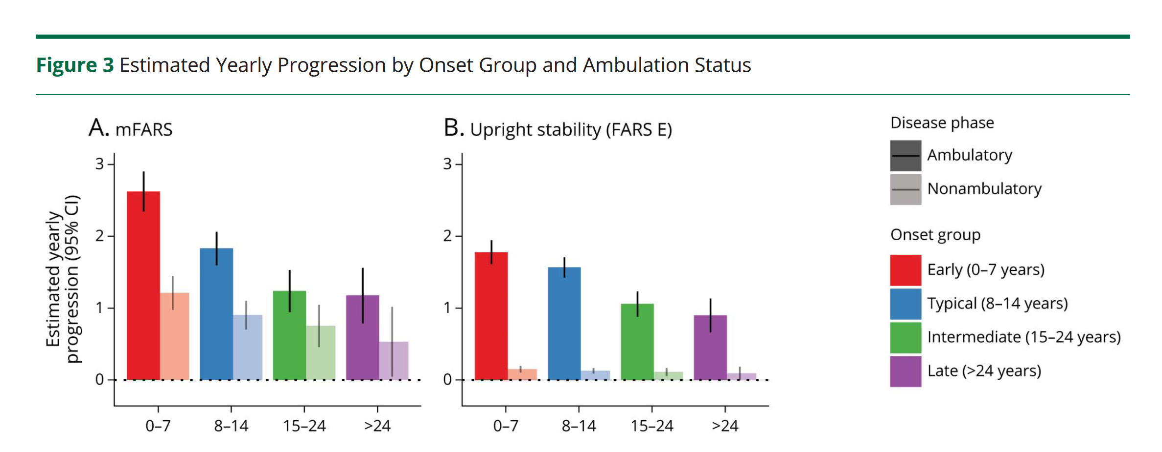

Slide 6
Group | Onset Group | n | fxn (log-scale) | fxn (10^x) | unit | group_diff [in units] | group_mult
FACOMS blood | 0-7y | 102 | 1.01 | 10.18 | % of ctrl | 0.00 | 1.00
FACOMS blood | 8-14y | 166 | 1.23 | 17.02 | % of ctrl | 6.83 | 1.67
FACOMS blood | 15-24y | 89 | 1.49 | 30.99 | % of ctrl | 20.81 | 3.04
FACOMS blood | >24y | 40 | 1.65 | 44.83 | % of ctrl | 34.64 | 4.40
FACHILD mature | 0-7y | 36 | 0.08 | 1.19 | ng/ml | 0.00 | 1.00
FACHILD mature | 8-14y | 37 | 0.29 | 1.96 | ng/ml | 0.77 | 1.64
FACHILD mature | 15-24y | 9 | 0.41 | 2.60 | ng/ml | 1.41 | 2.18
FACHILD mature | >24y | 1 | 0.61 | 4.10 | ng/ml | 2.91 | 3.44

Slide 7
Group | Onset Group | n | fxn (log-scale) | fxn (10^x) | unit | group_diff [in units] | group_mult
FACOMS blood | 0-7y | 102 | 1.01 | 10.18 | % of ctrl | 0.00 | 1.00
FACOMS blood | 8-14y | 166 | 1.23 | 17.02 | % of ctrl | 6.83 | 1.67
FACOMS blood | 15-24y | 89 | 1.49 | 30.99 | % of ctrl | 20.81 | 3.04
FACOMS blood | >24y | 40 | 1.65 | 44.83 | % of ctrl | 34.64 | 4.40
FACHILD mature | 0-7y | 36 | 0.08 | 1.19 | ng/ml | 0.00 | 1.00
FACHILD mature | 8-14y | 37 | 0.29 | 1.96 | ng/ml | 0.77 | 1.64
FACHILD mature | 15-24y | 9 | 0.41 | 2.60 | ng/ml | 1.41 | 2.18
FACHILD mature | >24y | 1 | 0.61 | 4.10 | ng/ml | 2.91 | 3.44

Slide 8
FACHILD blood isoform.e
FACHILD blood mature
R
2
=
0.14
,
P
=
0.021
,
n
=
39
R
2
=
0.19
,
P
=
0.006
,
n
=
39
60
40
20
0
LoA.age
FACOMS blood NA
FACOMS buccal NA
R
2
=
0.29
,
P
<
0.001
,
n
=
174
R
2
=
0.10
,
P
<
0.001
,
n
=
203
60
40
20
0
-1
0
1
2
-1
0
1
2
fxn

Slide 9
FACHILD blood isoform.e
FACHILD blood mature
60
40
20
Age at LoA
FACOMS blood NA
FACOMS buccal NA
60
40
20
1
2
3
4
1
2
3
4
FXN percentiles

Slide 10
Model | term | estimate | std.error | statistic | p.value | conf.low | conf.high
 | aoo | 0.75 | 0.06 | -4.67 | 3.1E-06 | 0.67 | 0.85
FACHILD /iso.e | gaa1 | 1.35 | 0.11 | 2.79 | 5.3E-03 | 1.09 | 1.66
 | fxn | 0.41 | 0.42 | -2.14 | 3.2E-02 | 0.18 | 0.93
 | aoo | 0.89 | 0.01 | -8.37 | 5.7E-17 | 0.87 | 0.92
FACOMS /blood | gaa1 | 1.30 | 0.03 | 8.29 | 1.1E-16 | 1.23 | 1.39
 | fxn | 0.18 | 0.19 | -8.70 | 3.3E-18 | 0.13 | 0.27

Slide 11
Model | term | estimate | std.error | statistic | p.value | conf.low | conf.high
 | aoo | 0.70 | 0.06 | -5.90 | 3.7E-09 | 0.62 | 0.79
FACHILD /iso.e | gaa1 | 1.31 | 0.09 | 3.00 | 2.7E-03 | 1.10 | 1.56
 | fxn | 0.51 | 0.36 | -1.84 | 6.6E-02 | 0.25 | 1.05
 | aoo | 0.87 | 0.01 | -11.23 | 3.0E-29 | 0.84 | 0.89
FACOMS /blood | gaa1 | 1.37 | 0.03 | 10.52 | 7.1E-26 | 1.29 | 1.45
 | fxn | 0.13 | 0.18 | -10.95 | 6.8E-28 | 0.09 | 0.19

Slide 12
Group / Model | paramcd | m | term | estimate | std.error | conf.low | conf.high | p.value
FACOMS buccal | FARS.E | FF | fxn | -0.17 | 0.32 | -0.81 | 0.46 | 0.592
FACOMS buccal mature | FARS.E | FF | aoo | -0.01 | 0.01 | -0.04 | 0.01 | 0.350
FACOMS buccal mature | FARS.E | FF | gaa100 | 0.11 | 0.05 | 0.01 | 0.21 | 0.035
FACOMS buccal mature | FARS.E | 3FF | fxn | -0.01 | 0.34 | -0.67 | 0.66 | 0.983
FACOMS buccal mature | FARS.E | 3FF | aoo | 0.01 | 0.02 | -0.02 | 0.05 | 0.507
FACOMS buccal mature | FARS.E | 3FF | gaa100 | 0.14 | 0.08 | -0.01 | 0.29 | 0.073
FACOMS blood | FARS.E | FF | fxn | -0.81 | 0.35 | -1.50 | -0.12 | 0.021
FACOMS blood mature | FARS.E | FF | aoo | -0.02 | 0.01 | -0.04 | 0.01 | 0.134
FACOMS blood mature | FARS.E | FF | gaa100 | 0.14 | 0.05 | 0.04 | 0.25 | 0.009
FACOMS blood mature | FARS.E | 3FF | fxn | -0.56 | 0.45 | -1.43 | 0.32 | 0.213
FACOMS blood mature | FARS.E | 3FF | aoo | 0.01 | 0.02 | -0.02 | 0.05 | 0.449
FACOMS blood mature | FARS.E | 3FF | gaa100 | 0.14 | 0.09 | -0.03 | 0.31 | 0.101
FACHILD mature | FARS.E | FF | fxn | -1.41 | 0.60 | -2.59 | -0.22 | 0.021
FACHILD blood mature | FARS.E | FF | aoo | 0.00 | 0.04 | -0.09 | 0.08 | 0.975
FACHILD blood mature | FARS.E | FF | gaa100 | 0.10 | 0.11 | -0.12 | 0.33 | 0.349
FACHILD blood mature | FARS.E | 3FF | fxn | -1.32 | 0.69 | -2.70 | 0.07 | 0.062
FACHILD blood mature | FARS.E | 3FF | aoo | 0.02 | 0.05 | -0.08 | 0.12 | 0.719
FACHILD blood mature | FARS.E | 3FF | gaa100 | 0.03 | 0.14 | -0.25 | 0.31 | 0.814
FACHILD isoform.e | FARS.E | FF | fxn | -0.80 | 0.55 | -1.90 | 0.29 | 0.149
FACHILD blood isoform.e | FARS.E | FF | aoo | 0.00 | 0.04 | -0.09 | 0.08 | 0.975
FACHILD blood isoform.e | FARS.E | FF | gaa100 | 0.10 | 0.11 | -0.12 | 0.33 | 0.349
FACHILD blood isoform.e | FARS.E | 3FF | fxn | -0.63 | 0.62 | -1.87 | 0.62 | 0.319
FACHILD blood isoform.e | FARS.E | 3FF | aoo | 0.01 | 0.05 | -0.09 | 0.12 | 0.791
FACHILD blood isoform.e | FARS.E | 3FF | gaa100 | 0.08 | 0.14 | -0.21 | 0.36 | 0.586

