Slide 1
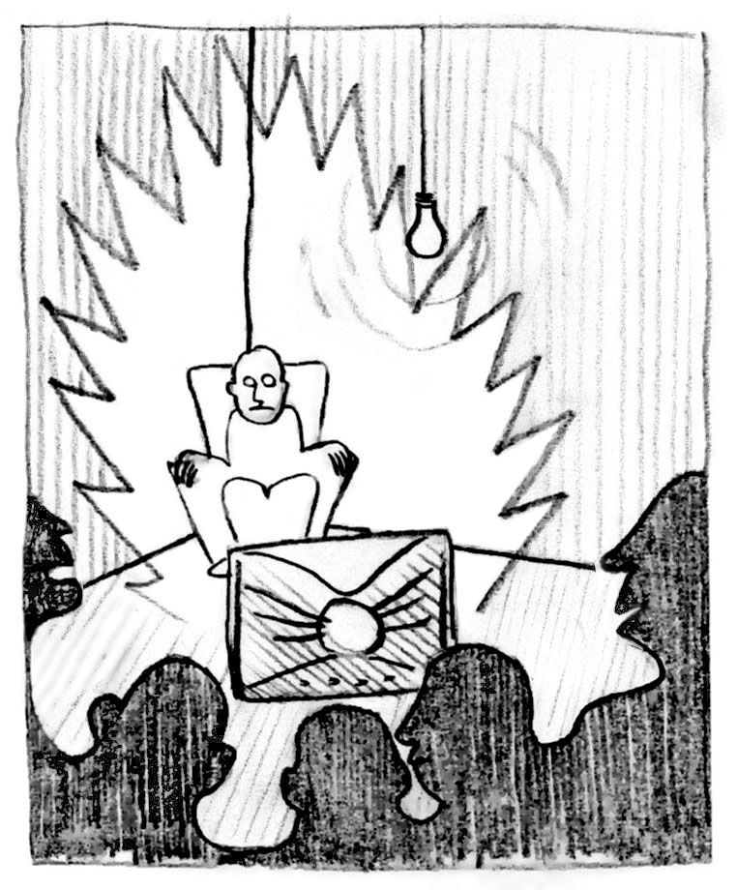
TO BLINK OR NOT TO BLINK
Alvaro Cassinelli & Stephane Perrin
EARLIDS
Alvaro Cassinelli
Assistant Professor / Meta Perception Group
Department of Information Physics and Computing
University of Tokyo

Slide 2
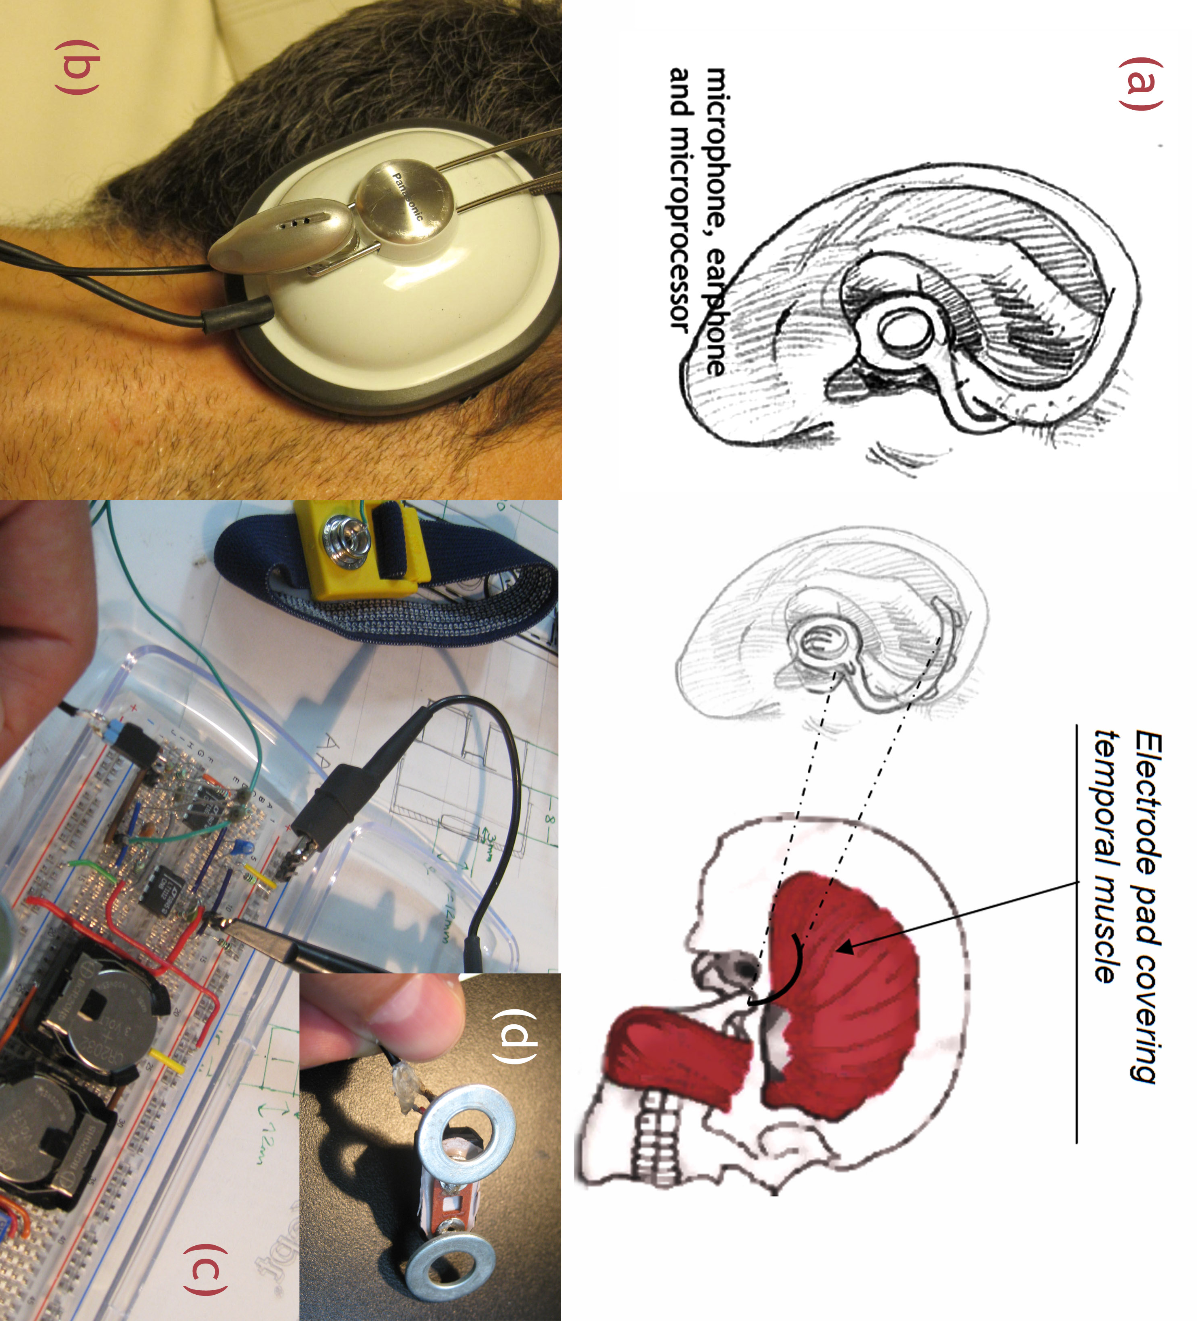
EARLIDS
Providing the means for voluntary control of auditory gain
Reflex-reaction to harmful noise (including facial muscle contraction) has a natural effect on auditory gain – the proposed device seeks to amplify this effect.

Slide 3
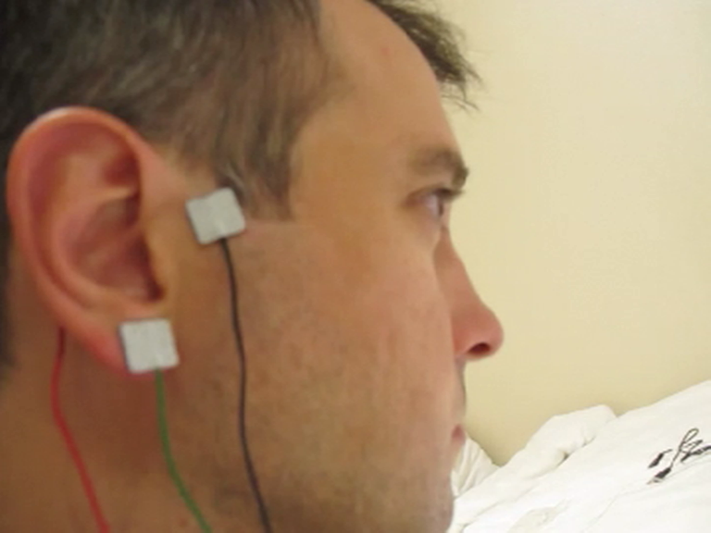
Demo (with pre-recorded sound so everybody can hear!)

Slide 4
Applications:
Protection:
  useful for entering/leaving harmful noisy places without having to use hands or earplugs.
Augmented sensing:
  augmented dynamic range for human auditory perception (attenuation and gain).
  new “ability” leading to a new form of hearing (conscious or unconscious; for instance modulation may be proportional to arousal, heart beat, etc).
all analog early prototype (did not work well…)
Notes:
When conscious modulation: this could lead to entacoustic music?

Slide 5
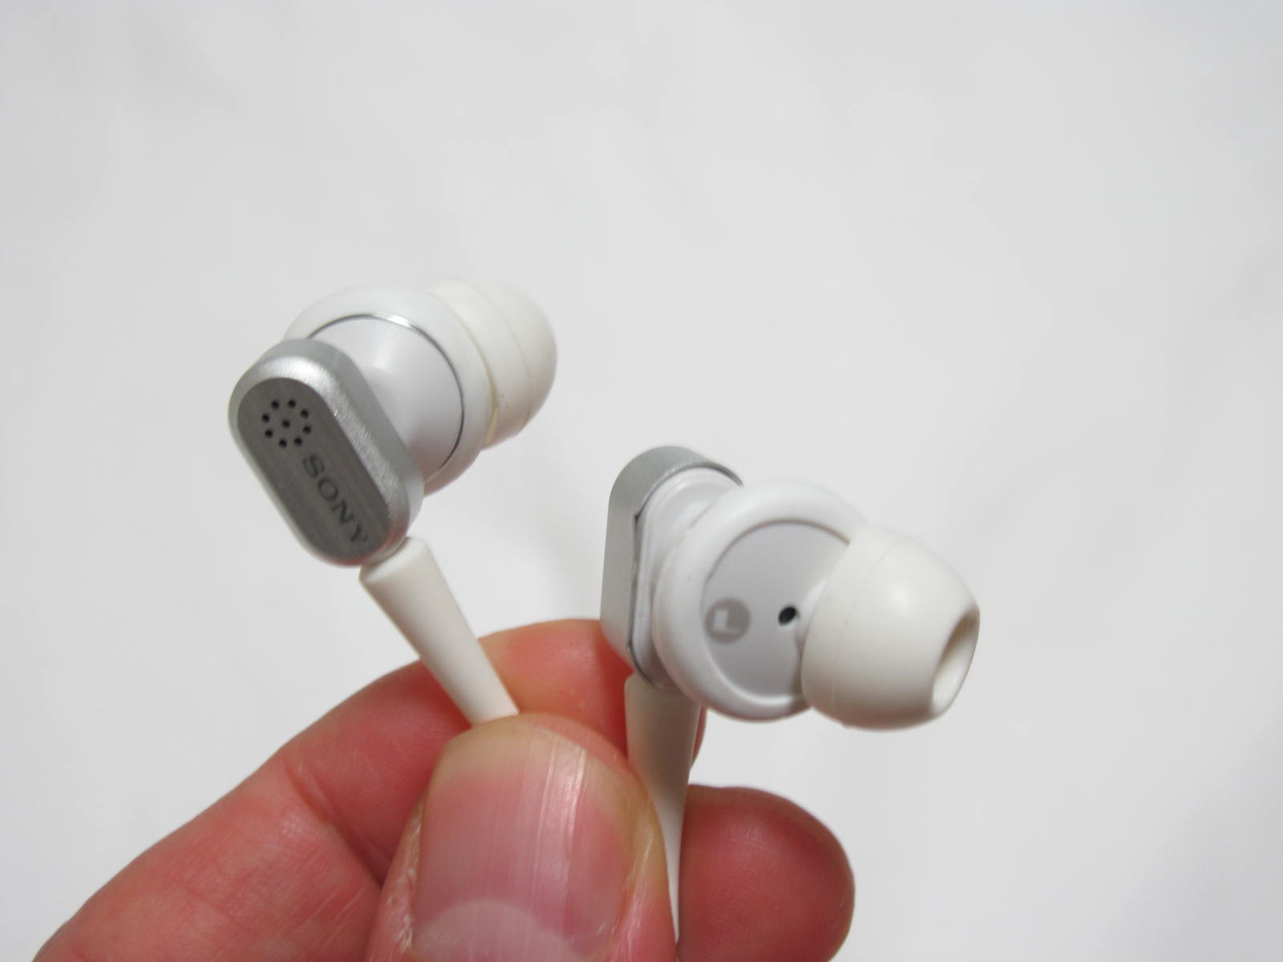
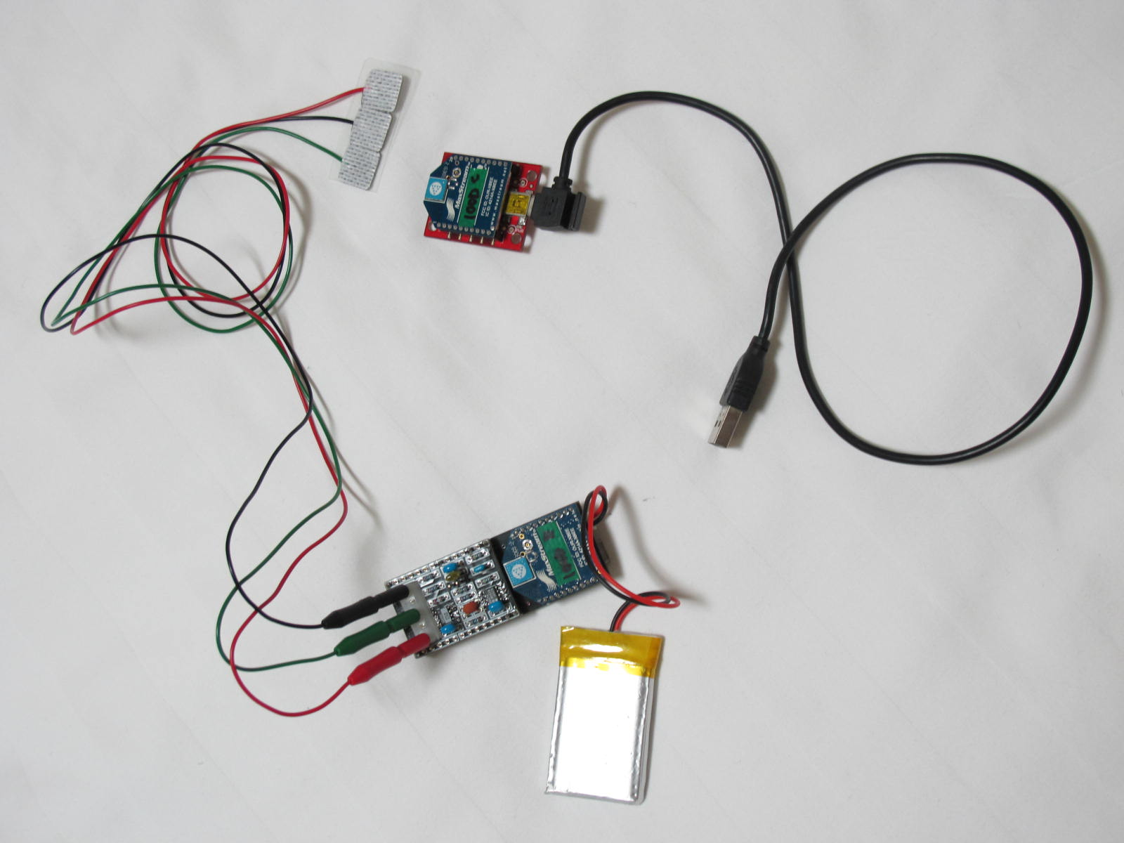
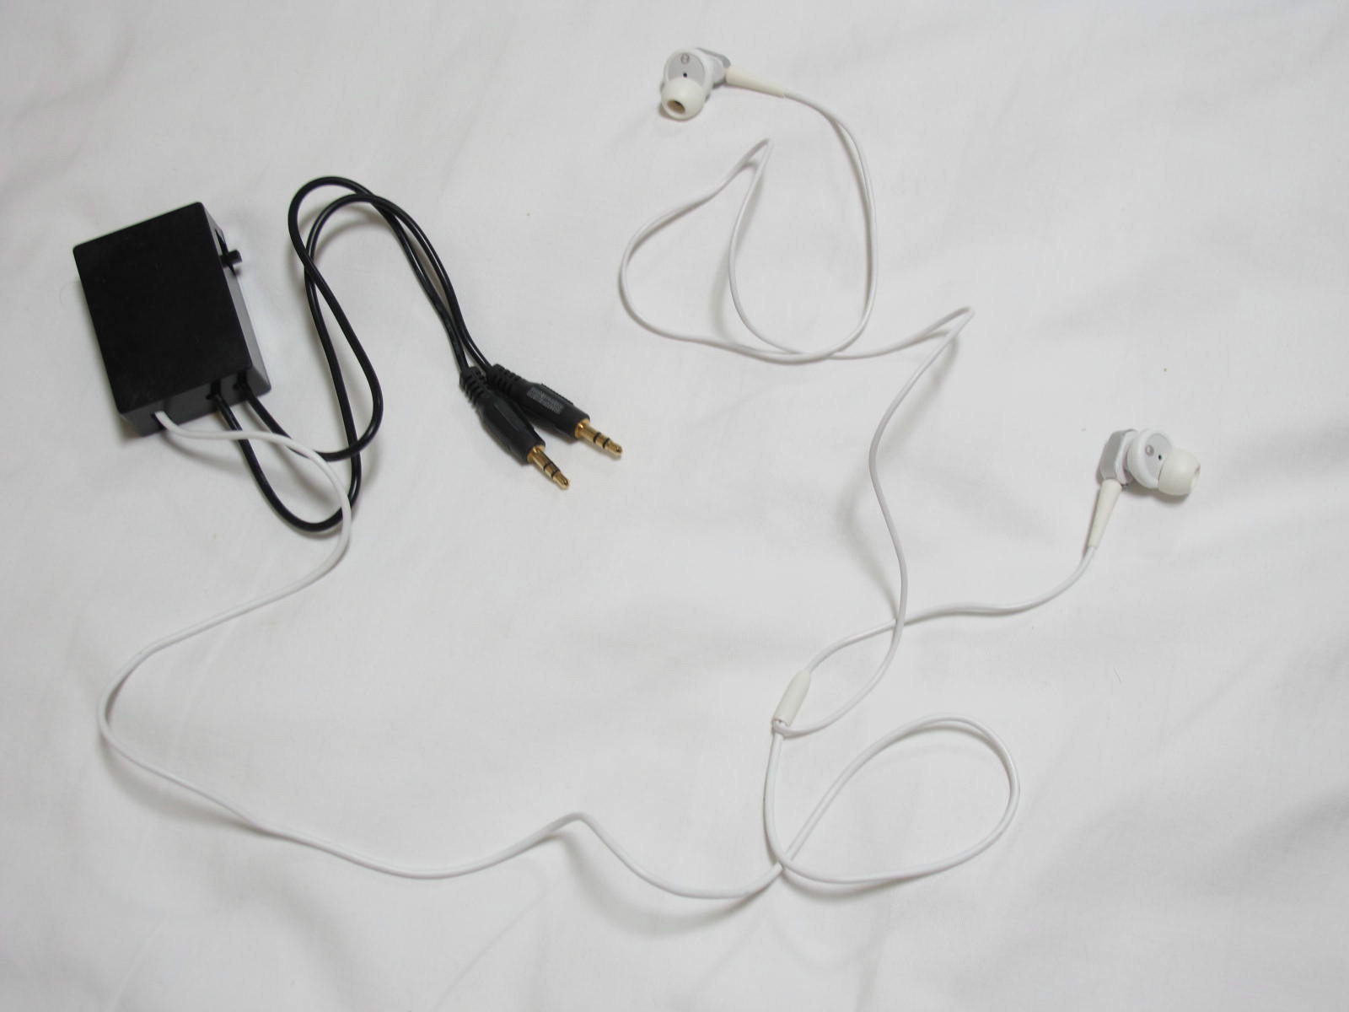
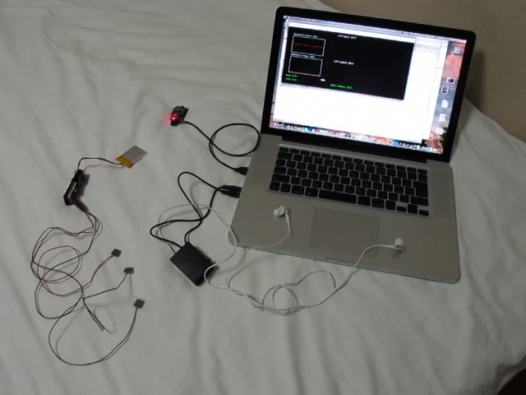
New prototype:
In-ear speakers + microphones
Funel Arduino + EMG detector + XBee
electrec power + stereo in and stereo out
Computer (openFrameworks)

Slide 6
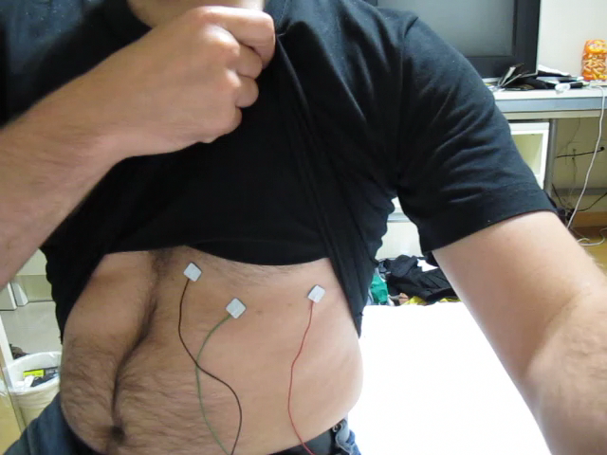
Modulating music with your heartbeat…

Slide 7
(time for a real demo?)

Slide 8
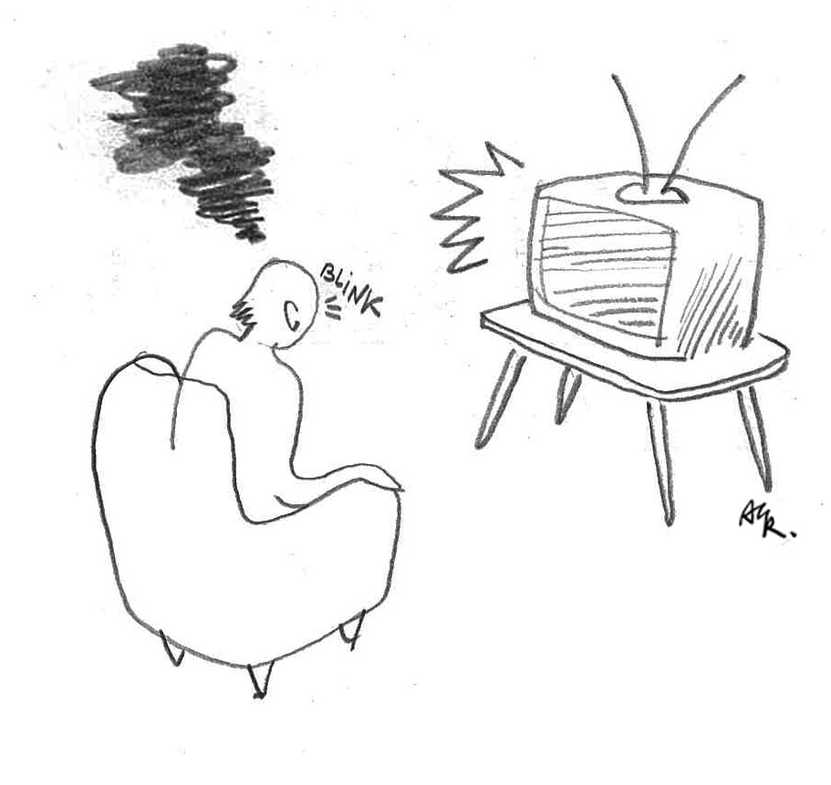
TO BLINK OR NOT TO BLINK
A reflection on the supposedly innocent act of blinking

Slide 9


Slide 10
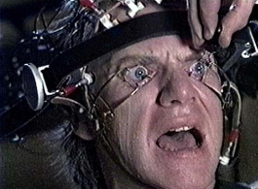
The “problem”:
…it may take a whole day to generate five seconds of a stop motion movie; this means that blinking even for a fraction of a second equates to skipping several hours of hard work!
The installation:
To blink or not to blink seeks to amplify the consequences of blinking, so as to make them clear to the spectator. This is done by disrupting the narrative, by switching pre-recorded or live video channels with each blink of the spectator.
If you blink, you will loose track of the story; if you don’t, you will force yourself in an unnatural attitude that will make your attention drop anyway…
The conclusion:
To blink or not to blink is a one-liner, forcing the spectator to understand that their organic body plays a fundamental role in modulating visual content.

Slide 11
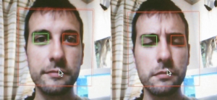
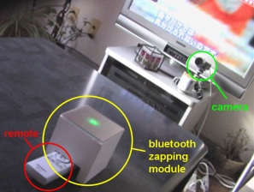
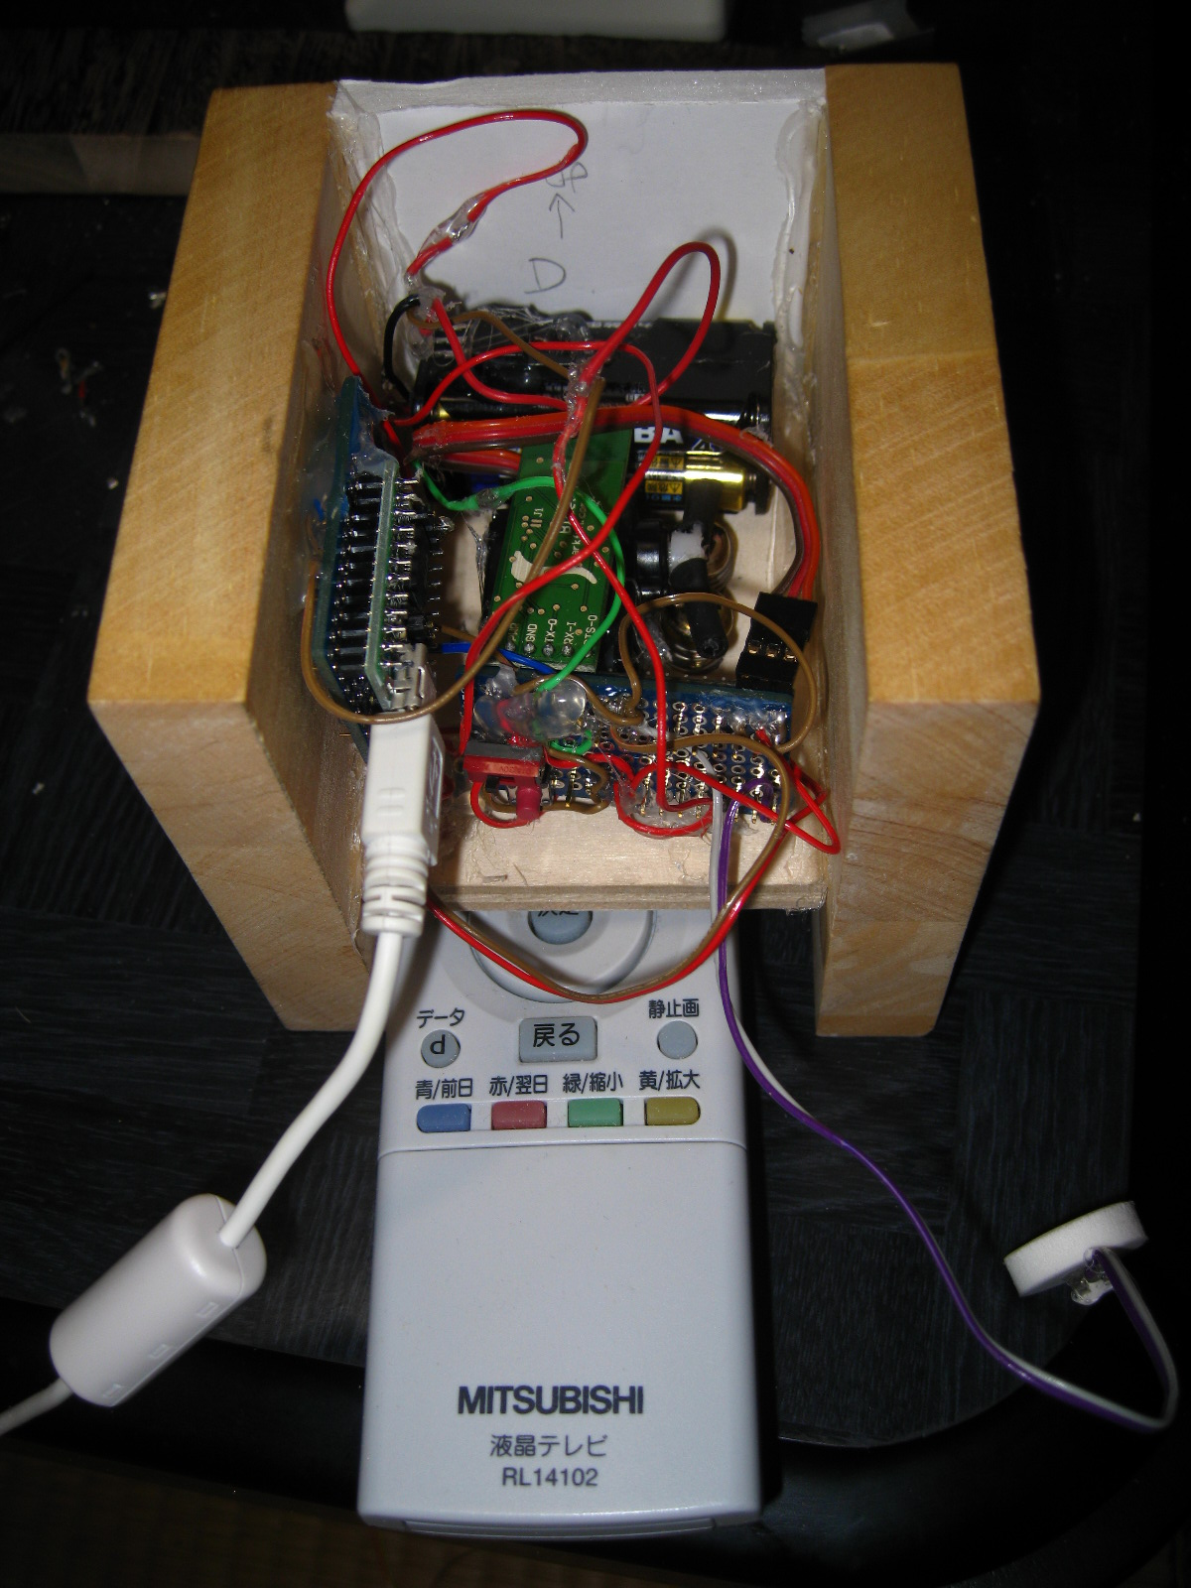
Technical details
Face detection
openCV Haar-classifier library, integrated in openFrameworks).
Blink detection
Find eye regions (proportions), then compute average size of white zone.
Video disruption
Computer sends a wireless signal (bluetooth) to a standalone Arduino;
a servo motor pushes randomly on the buttons of a generic remote.
Notes:
For more, ask me or read the paper.

Slide 12
DISCUSSION
DAPs in the light of the Action in Perception Theory
BODY
WORLD
DAP

Slide 13

BODY
WORLD
This intuitive/enactive knowledge of the functional interrelation between actions and sensed consequences is what we call perception (and at a higher level understanding)
DAP
?
BODY
WORLD
Devices that alter perception interfere the natural sensory-motor feedback, in order to create new “sensory-motor contingencies”
Notes:
Note: this is only possible if the interference produce stable SMCs.

Slide 14
BODY
WORLD
DAP
DAP
spectacles,
(but also sensory substitution systems…)
BODY
WORLD
BODY
WORLD
DAP
EARLIDS
Vocoder,
(but also a car…)
(*) Yes, a car: pressing lightly on the pedal, make us fly at high speed: isn’t that a beautiful example of “altered action-perception”?
Notes:
Yes, a CAR: pressing lightly on the

Slide 15
Earlids: amplification of an otherwise subtle effect on auditory gain
To Blink…: amplification of disruptive effect of blinking
DAP
BODY
WORLD
BODY
WORLD
DAP
EARLIDS
TBNTB
Other forms of alteration are possible of course (artificial synesthesia, inverted goggles and inverted audio, etc), but I was interested here in making the subjects aware of a process that remains invisible to themselves because it is all too natural.
Notes:
Another basic example of “controlled amplification” are of course the microscope, the micromanipulator…

Slide 16
Putting some order (idiosyncratic reflections!)
What happens before the subject masters the new sensory-motor contingencies?
At first, the subject observe the consequences of actions without completely engaging with the world. The device is just a “controller” (ex: I can use TBNTB to change the TV channels). It is not yet a functional part of the user.
As with the inverted goggles experiment, follows a phase of passive wonder (or fear), as the world has became alien.
Cautious exploration of this “naked” reality; realization that there is more to the eyes that meets the eye (time for reflection on meta cognition?)
Order slowly reappears; regain of conscious (but still not intuitive) control.
The experience facilitates deconstruction of the “old” senses in search of new meaningful experiences: time for artistic or scientific exploration
And what happens when the new sensory-motor skills are finally integrated?
The subject may still be capable of decoupling the action from the percept: this leads to the use of such interfaces as controllers, but with improved skill (ex: piano player).
Augmentation of the senses, emergence of new senses (and sensibilities), X-men interfaces and transhumans.
Notes:
invisible yet complex functional relation between the body and the world:
Think: I can ask you to contract your biceps, or to lift a weight: different mental goals, same consequence.
(as Inami-sensei would put it)

Slide 17
Summary and Conclusion
What are DAP?
…devices that tamper with the SMCs!
For what purpose?
  sensory substitution
  sensory augmentation (improving or creating new senses)
  can be used as controllers (but this is a by-product)
  insights on the process of perception
  help overcome blockages in personal perception (social, art, medical applications)
TBNTB:
3, 4 & 5
EARLIDS
2, 3, 4 & 5
How to design them? There are practical as well as ethical concerns
Notes:
… that it would be interesting to discuss in this workshop.

Slide 18
For more:
BODY HACK WORKSHOP, TEI10 2010.01.26 by bodyhack team

Slide 19
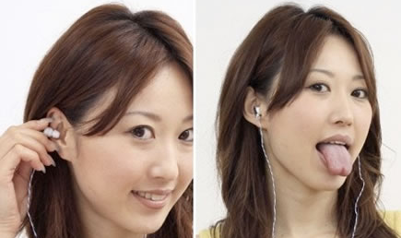
Related research
As a controller:
“Imagine a world where you can control all your gadgets with a wink or small gesture…” from the “mimi switch”.

