Slide 1
Learning Utility-changes for Rule-based Adaptation of Dynamic Architectures
Sona Ghahremani, Christian M. Adriano, and Holger Giese
To be presented at International Conference on Autonomic Computing (ICAC2018)
Notes:
SG

Slide 2
Context
Self-adaptive systems that are rule-based and utility-driven
Architecture-based self-healing and self-optimization
Common practice:
Analytically elicit the system utility by hand-picking the features of the architecture
Determine the adaptations based on the user preferences rather than the system utility directly
Assumption:
The system has a utility function
Monitor
Analyze
Plan
Execute
Monitor runtime model
Mark all issues in runtime model
Mark applicable rules for all issues
Compute utility-changes of rules
Sort rules by utility-changes
Execute rules in given order
Notes:
Assumptions and challenges

Slide 3
Motivation:
It is challenging to analytically construct a system utility, because…
Non-linearities
Uncertainty caused by complex dynamic architectures
Black-box models
Subjectivity of utility elicitation which requires domain analyst
M
A
P
E
Compute utility-changes of rules
Learning utility- changes of rules
Notes:
CA

Slide 4

Research questions
RQ1:
Is it possible to systematically learn a prediction model for the utility-changes in a utility-driven rule-based self-adaptive system (particularly when the detailed knowledge of the system is not available)
Can we learn?
Notes:
RQ2:
Do the prediction models lead to a system performance that approximates an analytic-defined optimum (real loss lower than 10% ), considering that different arbitrary bounds could be chosen to trade between model accuracy and model runtime effort?

Slide 5
Research questions[2]
RQ2:
Do the prediction models lead to a system performance that approximates an analytically-defined optimum (real loss lower than 10% )?
of performance
How good?
Notes:
RQ2:
Do the prediction models lead to a system performance that approximates an analytic-defined optimum (real loss lower than 10% ), considering that different arbitrary bounds could be chosen to trade between model accuracy and model runtime effort?

Slide 6
Research questions[3]
RQ3:
Can the suggested methodology properly select the best prediction model without requiring the models to be deployed on a real system?
Do we make the right selection ?
Notes:
To be simplified

Slide 7
Methodology overview
RQ1
RQ2
RQ3
1.Preparing
2.Training
3.Validating
4*. Selecting
1.1* Generate data
1.2 Method choice & tuning
1.3* Feature selection
Train prediction models
3.1 Check prediction error
3.2* Check runtime effort
Select prediction model
Notes:
Mapping to RQs
Modification and extensions
* Feature selection : rule-baed adaptation defines the scope for rules that can be systematically extended.

Slide 8
Application and evaluation
Application and evaluation
RQ1
RQ2
RQ3
1.Preparing
2.Training
3.Validating
4*. Selecting
Real system
or
Simulator
Real system
or
Simulator
Adaptation Engine
predicts impact of adaptation rules
Adaptation Engine
predicts impact of adaptation rules
Utility Change Predictor
Utility Change Predictor
adapts
observes
adapts
observes
Simulator
Simulator
generates prediction models (.pmml )
generates prediction models (.pmml )
Provides ground truth
Provides ground truth
Adaptation Engine
Adaptation Engine
simulates
simulates
R Studio
R Studio
Managed resource
adapts
Managed resource
observes
adapts
observes
Managed resource
Managed resource
generates data for machine learning
generates data for machine learning
Notes:
Mapping to RQs
Modification and extensions
Need a simulator for evaluation

Slide 9
Application and evaluation
Application and evaluation
Application and evaluation
Analytical Utility Computer
computes impact of adaptation rules
Real system
or
Simulator
Real system
or
Simulator
Adaptation Engine
predicts impact of adaptation rules
Adaptation Engine
predicts impact of adaptation rules
Utility Change Predictor
Utility Change Predictor
adapts
observes
adapts
observes
Simulator
Simulator
Provides ground truth
generates prediction models (.pmml )
Provides ground truth
generates prediction models (.pmml )
Adaptation Engine
Adaptation Engine
simulates
simulates
R Studio
R Studio
Managed resource
adapts
Managed resource
observes
adapts
observes
Managed resource
Managed resource
generates data for machine learning
generates data for machine learning
Notes:
Mapping to RQs
Modification and extensions
Need a simulator for evaluation

Slide 10
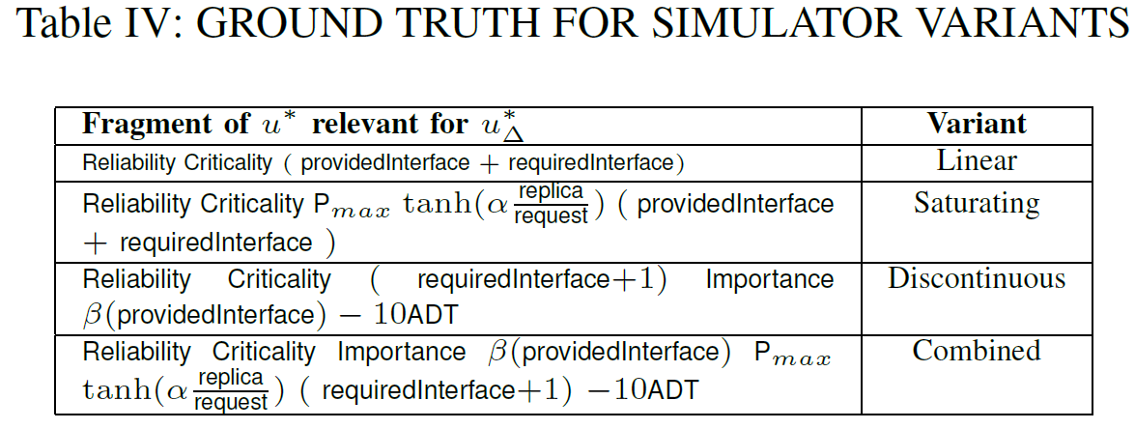
Ground Truth

Slide 11
Which machine leaning methods?
OUR DESIGN CONSTRAINTS:
Non-linear regression
Automatic feature selection
Fast to train
Fast to execute
Comparable methods
Explainable predictions (white box)
CHOICE: Ensemble Methods based on Decision Trees

Slide 12
Machine Learning methods
Reliability
0.9
Criticality
4
Criticality
7
Importance
13
Requests
578
Response Time 1.1247
Connectivity
5
≦
>
≦
>
≦
>
≦
>
≦
>
≦
>
≦
>
60.93
108.57
538.42
1357.21
1737.35
2043.06
4743.15
19101.68

Slide 13
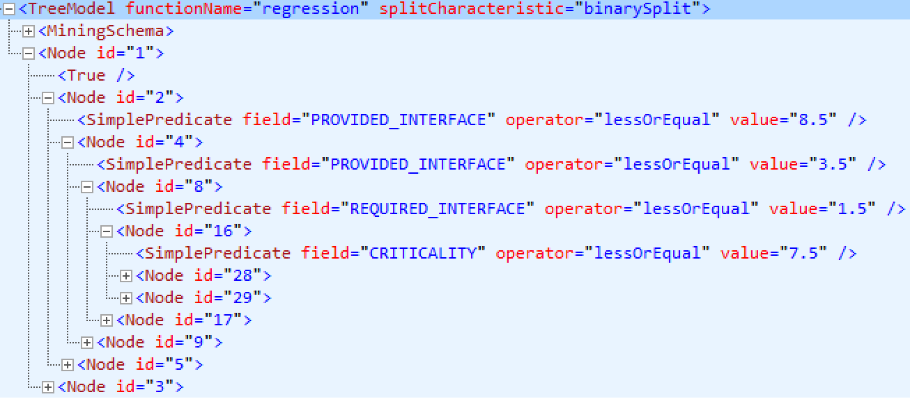
Ensemble methods
Bagging
(Boostrap Aggregating)
Independent learners
Mitigates overfitting
Random Forest
GBM Trees
XGBoost Trees
Reduces variance
Ensemble
methods
May overfit
Boosting
Sequential learners
Reduces bias & variance
Advantages?
Non-linear regression
Automatic feature selection
Fast to train
Fast to execute
Comparable methods
Explainable (white box methods)
PMML file

Slide 14
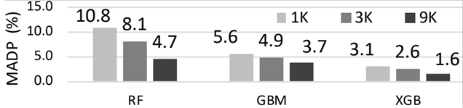
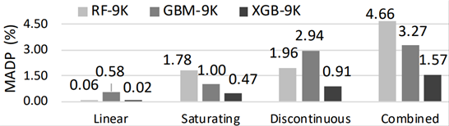
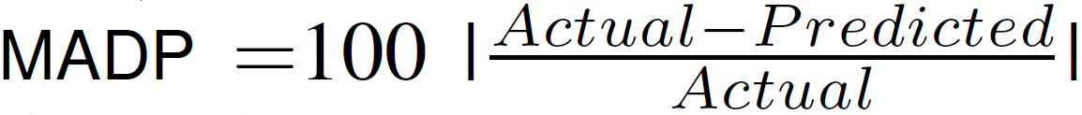
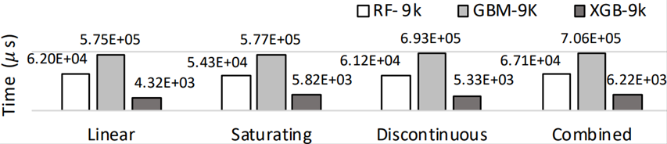
RQ1:
Can we build the prediction models?
YES
Training results for linear function
Training results for all functions
Response time for machine learning component

Slide 15


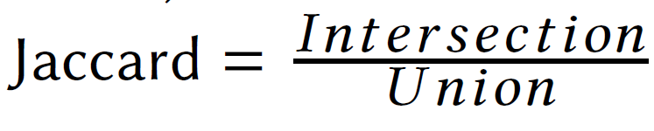
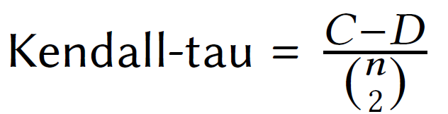
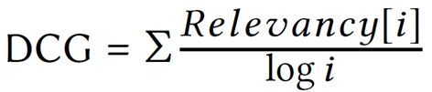
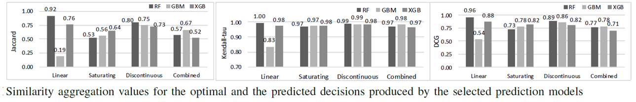
Selecting Prediction models
Predicted
Ground Truth
R2 C6
R3 C5
R1C2
R1C2
R1 C4
R1 C4
R3 C5
R2 C3
R2 C3
R2 C6
Count-based metric
Distance-based metric
Point-based metric

Slide 16
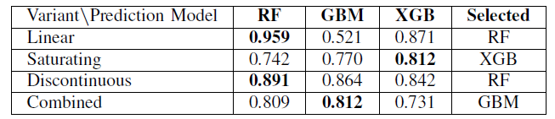
Selecting Prediction models [2]

Slide 17

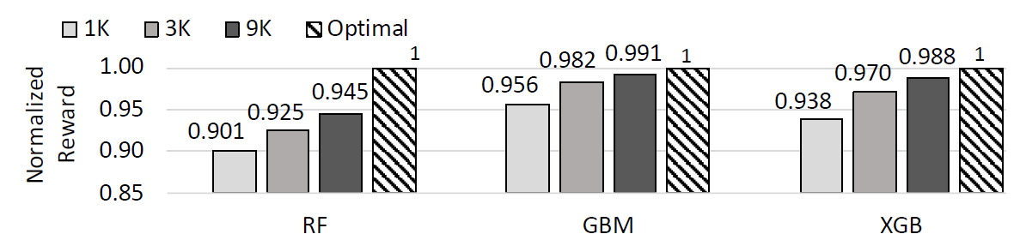
RQ2:
Does the performance approximate the analytic-defined optimum?
YES
Normalized rewards across prediction models for the combined variant
Notes:
For the final prediction models trained with 9K datasets, the worst reward loss was 5.5%, i.e., a considerably smaller error than the 10% error bound.

Slide 18
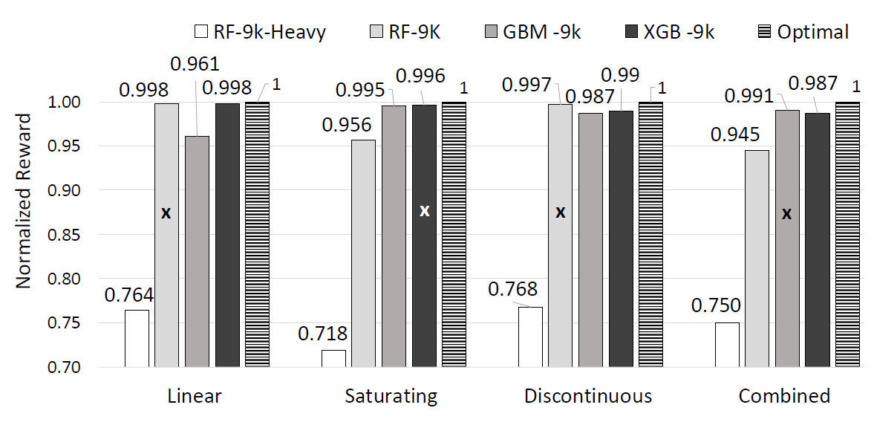
RQ3:
Can we select the best prediction model without requiring the models to be deployed on a real system?
YES
The best performing prediction models in the chart are the same as the ones suggested by the aggregated similarity metrics (SAM Table).
Notes:
The best performing prediction models in Fig. 9 are the same as the ones suggested by the aggregated
similarity metrics (SAM Table III). The selected models presented reward loss of less than 1% (relative to the optimal
reward). This confirms that our methodology, in (step-4), properly selected the best prediction models. Moreover, each
of the lower performing models were correctly ranked, as they presented the same ranking positions by SAM values (III) as by
normalized reward (9). Ultimately, this was possible because during the model tuning iterations (steps 2, 3, and 1) we did
not discard any prediction model that could have potentially outperformed the alternatives (section IV-B).

Slide 19
Threats to validity
Internal validity - similarity metrics were possibly optimistic
External validity:
size/quality of the failure traces
specification of the components/shops
available adaptation rules
Notes:
Internal validity – optimistic similarity metrics can be too optimistic, because we do not count as a mismatch the cases of components with the same utility-change (i.e., same ranking position). However, this happened only for the Linear utility function, which already presented low prediction errors.
Conclusion validity - Different failure traces can cause different adaptation outcomes. Therefore, we carefully generated and tested failure
traces to be independent and identically distributed across the different ranges of dataset sizes and utility functions. This involved testing the generated traces for inconsistent output from the simulator (zero utility values).
External validity – Three factors hinder the generalization of our findings: size/quality of the failure traces, the specification of the components/shops, and the available adaptation rules. For a different setup of these factors, the current prediction errors might be unacceptable (even when small). This might happen if the adaptation decisions must present variances in utility that are smaller than the prediction errors.

Slide 20
Future work

Slide 21
Online learning ( closing the loop)
Offline
Online
Evolving utility functions
Minimize the initial effort
Generate data
Train/Test prediction models
Validate prediction models
Predict utility changes
Make adaptation decisions
Apply adaptation decisions
Export prediction models to pmml
Evaluate adaptation decisions
Generate Data
Apply Machine Learning
Evaluate
methodology

Slide 22
Learning for adaptation rules
…in addition to the system attributes
Rule attributes such as cost
[1…1]
[0…*]
Shop
[0…*]
Component
ComponentType
[1…1]
importance
aDT
criticality
[1…1]
request
[1…1]
reliability
replica
p_{max}
[1…*]
[0…*]
saturatingPoint
providedInterface
requiredInterface

Slide 23
Ranking learning
INSIGHT: Train the model to predict the decisions directly, instead of on the utility-changes
Predicted
Ground Truth
APPROACHES
Pointwise
ordinal regression
Pairwise
bynary classifcation
Listwise
metric over the list as loss function
R2 C6
R3 C5
R1C2
R1C2
R1 C4
R1 C4
R3 C5
R2 C3
R2 C3
R2 C6
CHALLENGES:
What granularity of decisions?
How to choose a metric (MAP, ROC)?
How to deal with ties?
Notes:
Listwise SVM MAP = http://www.cs.cornell.edu/people/tj/publications/yue_etal_07a.pdf

Slide 24

The End Finally !

