Slide 1
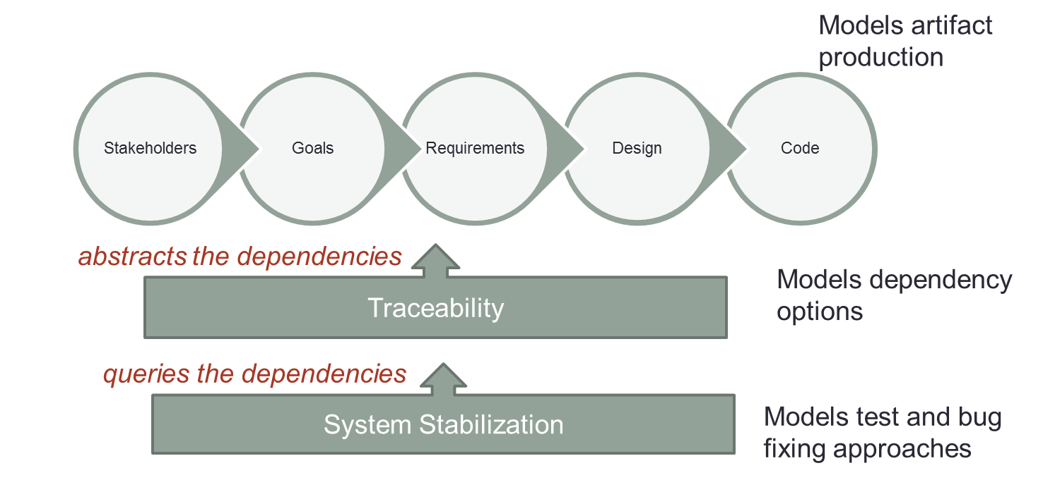
Model-based Traceability for System Stabilization – Christian M. Adriano
Research Questions:
How to obtain traceability data?
How much granularity is needed for sequencing?
Goals: Incremental, Hierarchical, Extensible
Assumptions: Not copin g with change, nor
automatic generation, nor visualization.
Level of Formality = to validate and populate
Design Structure Matrix, Artifact, Dependency
Traceable, Function Make Dependency
Bug/ Feat | F1 | F2 | F3 | F4
Bx | 1 | 0 | 0 | 0
By | 1 | 1 | 0 | 0
Bw | 0 | 0 | 1 | 0
Bz | 0 | 0 | 0 | 1
Code/Feat | α | β | Ω | μ
F-1 | 1 | 0 | 0 | 0
F-2 | 0 | 1 | 0 | 0
F-3 | 0 | 1 | 1 | 0
F-4 | 0 | 0 | 1 | 1
RESULTS
Sequencing Criteria | 1st | 2nd | 3rd | 4th
1 Cost | Bx | By | Bw | Bz
2 Ownership | By | Bx | By | Bw
3 In-Degree | Bz | Bw | Bx | By
4 User Satisfac. | Bz | Bw | By | Bx
5 Robust /Reliab. | Bw | By | Bx | Bz
6 Concurrency | Bx | By | Bw | Bz

Slide 2
Questions for Traditional Development
How to investigate the effect of granularity on the precision and accuracy of the sequencing criteria?
How to enable the use of the suggested sequences for bug triage and task delegation?
Is there space for complex forms of dependencies (typed and multi-dimensional)?

Slide 3
Questions for Crowd Development
What micro-tasks do we have in test planning and execution tasks?
Planning: Define operation, define initial state, define entry value, define output values, define final state
Executing: Choose, Setup, Execute, Interpret, Report

Slide 4
Questions for Crowd Development
Does Crowd Development have special requirements concerning integration and quality?
Deliverable-based
Integration is inherent to product breakdown
Privileges vertical (fully workable units) delegations
Exploit loosely coupled structures
Example: delegate the specification, design, coding and testing of a whole functionality to a developer (or two, if pair programming).
Task-based
Integration is a task
Privileges horizontal (explore risks faster) delegations
Exploits similarity among tasks
Example: delegate tasks of internationalization of different user interfaces and data to many developers. Integration is simple and involves populating a database and running unit tests.

Slide 5
