Slide 1
Bug and Test Sequencing Alternatives

Slide 2
Index
Problem Framing
Definitions
What we can aim at proving?
How to?
Literature Review

Slide 3
Problem Framing
Give teams options to explore instead of a formula to optimize.
How:
Visualization techniques
Search based on sequencing criteria
So we help how teams make sense of bugs and how they find or retrieve previous decisions.
Why did we decide to fix this bug here and this way? What were our priorities at the time? What else was fixed? What were we testing?

Slide 4
Definitions
Prioritization
Sequencing
Stabilization
Convergence

Slide 5
What we can aim at proving?
Prove that people can use different explicit prioritization approaches.
Prove that choosing different approaches lead to different quality and cost outcomes.
Prove that people can use prioritization approaches to retrieve previous decisions.

Slide 6
Scenario
SUBUI
System for teacher substitution

Slide 7
Scenario
Goals:
Administration:
Seamlessly (automatically) provide options of teachers to substitute an absent teacher
Mitigate the risk of not having teachers to substitute
Permanent Teachers:
Know which are the possible substitute teachers so they can exchange information and best practices.
Substitute Teachers:
Obtain classes which match they preferences.
Be able to decline an offer without much emotional pressure

Slide 8
Requirements
R1: Edit Substitute Preferences
R2: Edit Regular Teacher Information
R3: Compute Ranking of Substitutes
R4: Generate Statistical Report
R5: Accept/Decline Substitution Opportunity

Slide 9
Failures

Slide 10
Self-Dependency Matrices
Represent the relation among adjascent sets, for example, goals x features, features x code.

Slide 11
Goals x Requirements
Goals/Requirements | R1- Edit Substitute Pref. | R2- Edit Regular Teacher Information | R3-Compute Ranking of Substitutes | R4- Generate Statistical Report | R5- Accept/Decline Substitution Opportunity
A. Options of teachers to substitute an absent teacher | 1 | 1 | 1
B. Mitigate the risk |  |  |  | 1
C. Know the possible substitutes | 1 | 1 | 1
D.Match preferences | 1 |  | 1
E. Decline an offer | 1 | 1 |  |  | 1

Slide 12
Requirements x Requirements
Requirement/ Requirement | R1- Edit Substitute info. | R2- Edit Regular Teacher Info. | R3-Compute Ranking of Substitutes | R4- Generate Statistical Report | R5- Accept/Decline Substitution | SUM
R1-Edit Substitute Info. | 0 | 0 | 0 | 0 | 0 | 0
R2- Edit Permanent Teacher Information | 0 | 0 | 0 | 0 | 0 | 0
R3-Compute Ranking of Substitutes | 1 | 1 | 0 | 0 | 0 | 2
R4- Generate Statistical Report | 1 | 1 | 1 | 0 | 1 | 3
R5- Accept/Decline Substitution | 1 | 0 | 1 | 0 |  | 2

Slide 13
Failures x Requirements
Failure/Requirments | R1- Edit Substitute Info. | R2- Edit Permanent Teacher Information | R3-Compute Ranking of Substitutes | R4- Generate Statistical Report | R5- Accept/Decline Substitution Opportunity
Fx | 1 | 0 | 0 | 0 | 0
Fy | 0 | 1 | 0 | 0 | 0
Fw | 0 | 0 | 1 | 0 | 0
Fz | 0 | 0 | 0 | 1 | 0

Slide 14
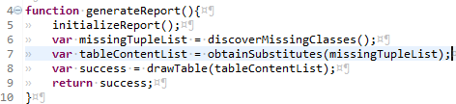
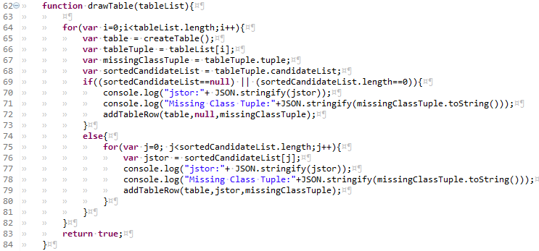
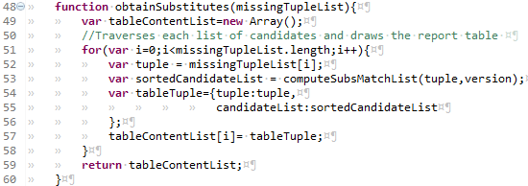
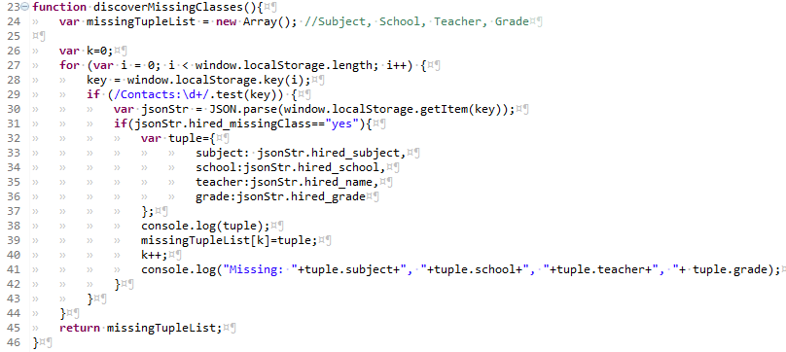
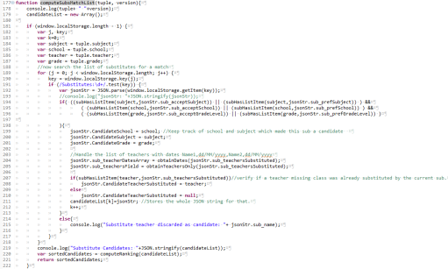
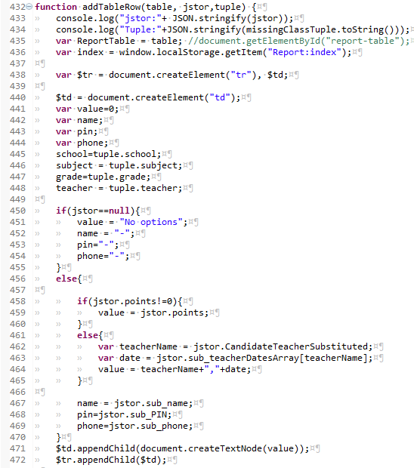
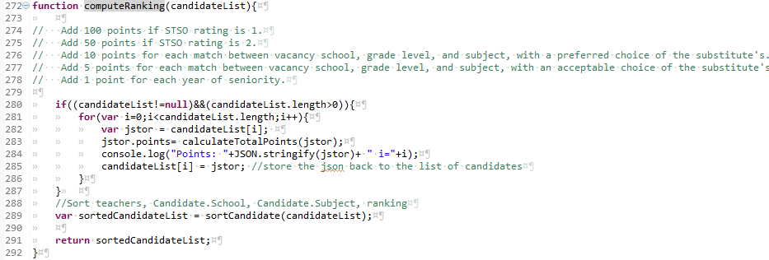
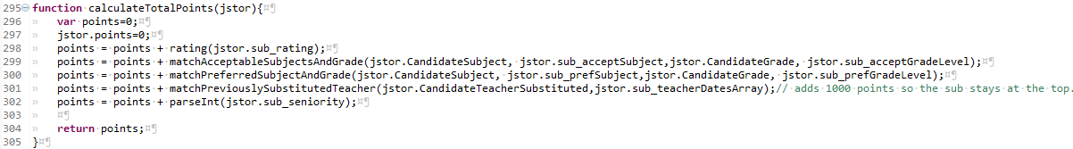
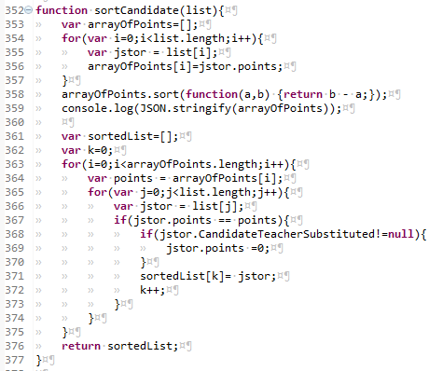

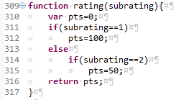

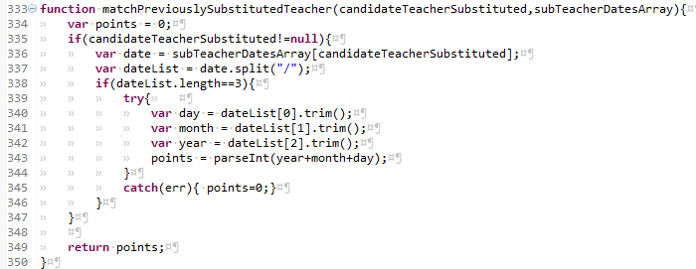
Code components
generateReport
3
obtainSubstitutes
drawTable
discoverMissingClasses
3
3
Dataflow Ref
Weak Control
computeSubMatchList
addTableRow
6
3
4
7
computeRanking
2
3
4
7
calculateTotalPoints
4
7
Dataf low Def
Weak Control
matchPreferredSubjectAndGrade
rating
sortCandidates
matchAcceptableSubjectAndGrade
matchPreviouslySubstitutedTeacher
3
Strong Syntactic
5
Notes:
Mtask-1: User inspects output, point to fields, provided values and describe failure.
>What if I had an sorting problem? The user might be looking at the wrong line?
Mtask-2: Since the HTML table is produced by multiple calls to function addTableRow. We can open a microtask for each iteration asking the following:
“Does the variable value should have content 152 instead of <actual content>? “. This way we would let users inspect the whole content.
>Failure is a missing line in the table.
Mtask-2: Provide the user with a list of fields being displayed in addRowTable and ask. “Could you fill in the following fields so the expected table matches the desired output?”
>Failure is uniquely mapped to a field
Mtask-2: Found the entry point that generated the output. User look at execution log and request that value = 152, reruns and request that jstor.points=0.
“Please change the code so the variable named “value” which has content “Calorine Herschel 04/04/2013” could receive value 152 instead”.
//Considering the failure is a unique field (last Microtask).
System: New expectation set for the parameter jstor received by addTableRow. Every time a new expectation for a paremeter is set, the system will look at the following dependencies:
Does the field already exist?
Yes, it does.
- For the field in questions, what is the slice from which addTableRow is directly semantic dependent?
- For the caller function whose actual call is affected by the new parameter expectation, what are the dependency types of the current slice (addTableRow) to the affected caller?
The systems computes which are the last definitions for the specific jstor.points field. The system finds the following lines ordered from most to last recent and aggreated with brackets by same function - [369], [302,301,300,299,298,297,296].
System: Weak control dependency affecting the variable definition?
Does the value of jstor.points is part of any control flow in which jstor.points is modified? This is the case of line 369
NO. So, the value computed in more recent definitions does not affect later definitions. Which means we could parallelize by opening microtasks for each definition at same time.
YES, So, open a microtask for the most recent definition
Mtask-3: Debug function sortCandidates, highlight line 369, provide the expected value for jstor.points as 152 for the same input received which produced jstor.points=0; User debugs the function, removes the condition that produces value =0. The user although discovers that sortCandidates function receives jstor.points with 20130404. So the user sets the expected parameter for 152 instead of 20130404.
System: Strong Syntactic dependencies affecting the variable definition?
I.e., are previous values of jstor.points used to compute later values of it without passing any weak control dependency? This is the case of [lines 302,301...]
Open parallel microtask for each Strong Control Dependent Slices (see functions below).
Mtask.4: function calculateTotalPoints (controls all below)
System: Possible functions selected for debugging based on the result of Mtask4
Mtask-5a: function matchPreviouslySubstitutedTeacher*
Mtask-5b: function matchPreferredSubjectAndGrade Mtask-5c: function matchAcceptableSubjectsAndGrade
Mtask-5d: function rating
Fix is found in matchPreviouslySubstitutedTeacher*
New parameter is requested to be received
System: What were the function with Dataflow Ref dependency with matchPreviouslySubstitutedTeacher*?
Mtask-6: User is provided with the caller function signatures and asked – “Where the parameter can be created and passed to matchPreviouslySubstitutedTeacher*?”
Mtask7a: Modify function signature of calculateTotalPoints and call to matchPreviouslySubstitutedTeacher
Mtask7b: Modify function signature of computeRanking and call to calculateTotalPoints
Mtask7c: Modify function signature of computeSubsMatchList and call to computeRanking

Slide 15
Requirements x Code (functions)
Requirement/ Code | α | β | Ʊ | μ
R1-Edit Substitute Information | 1 | 0 | 0 | 0
R2- Edit Permament Teacher Information | 0 | 1 | 0 | 0
R3-Compute Ranking of Substitutes | 0 | 1 | 1 | 0
R4- Generate Statistical Report | 0 | 0 | 1 | 1
R5- Accept/Decline Substitution | 1 | 0 | 0 | 1

Slide 16
Code Dependencies
Code/Code | α | β | Ω | μ | Afferent #
α | 0 | 1 | 1 | 0 | 2
β | 0 | 0 | 0 | 0 | 0
Ω | 0 | 0 | 0 | 1 | 1
μ | 0 | 0 | 0 | 0 | 0

Slide 17
Failure x Code
Bugs/Code | α | β | Ω | μ
Fx | 1 | 0 | 0 | 0
Fy | 0 | 1 | 0 | 0
Fw | 0 | 1 | 1 | 0
Fz | 0 | 0 | 0 | 1

