Slide 1
iAssetsPro
Maintenance Repairs — Work Order Workflow
End-to-End Process Walkthrough
Enterprise Asset Management Platform · Lightworld Technology
iAssetsPro
Cover

Slide 2
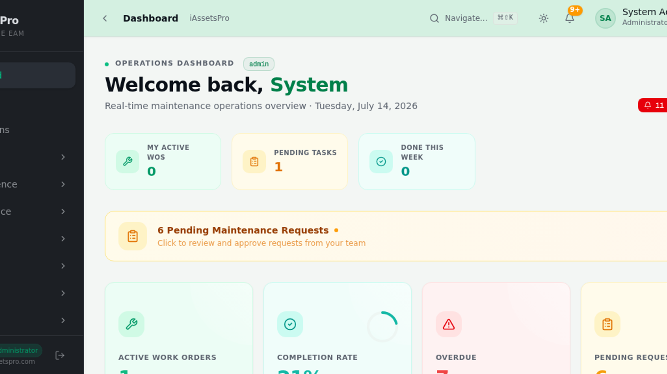

PLATFORM OVERVIEW
Your Complete Asset Management Command Center
18+ Modules
Role-Based Access
Real-Time KPIs
iAssetsPro
Platform at a Glance

Slide 3
End-to-End Workflow
From Issue Identification to Performance Reporting
01
02
03
04
05
06
Request Initiation
→
Review & Approval
→
Planning & Assignment
→
Execution & Logistics
→
Completion & Verification
→
Reporting & Analytics
Operator identifies issue and submits request
Supervisor triages and approves request
Work order created with resources assigned
Tools and materials requisitioned
Work documented and verified
Insights and KPI performance data
iAssetsPro
Workflow Overview

Slide 4
Built for Industrial Maintenance Teams
W
Work Order Lifecycle
R
Request Triage & Approval
T
Tool Management
Full CRUD operations with complete status tracking from creation to closure
Multi-level workflow for reviewing and approving maintenance requests
Checkout, transfer, and damage reporting for repair tools and equipment
M
Material Requisition
D
Real-Time Dashboards
A
Downtime Analysis
Spare parts tracking with store issuance integration and return management
Live KPIs and analytics for instant visibility into operations
Production impact tracking with root cause categorization
S
Team Assignment
E
Comprehensive Reporting
P
Multi-Plant Support
Supervisor, technician, and planner role-based task distribution
Template-based report generation with PDF and Excel export options
Tema, Kumasi, and Takoradi unified under a single platform instance
iAssetsPro
Key Capabilities

Slide 5
01
Request Initiation
Operator identifies an issue and submits a maintenance request with full details
Step 1 of 6
iAssetsPro
Request Initiation

Slide 6
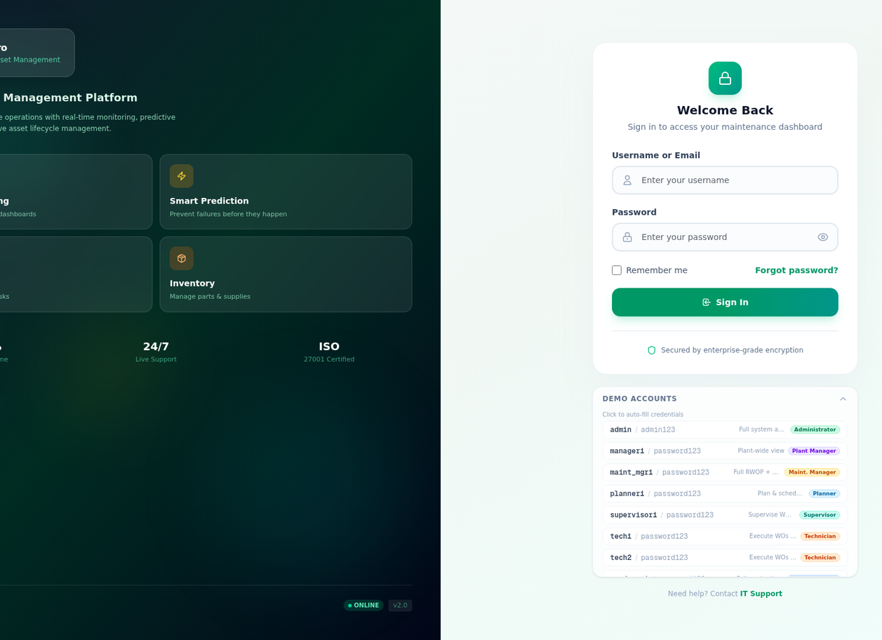
STEP 01
Secure Login
Role-Based Access Control
Demo Accounts Available
Multi-Plant Authentication
iAssetsPro
Login & Role-Based Access

Slide 7
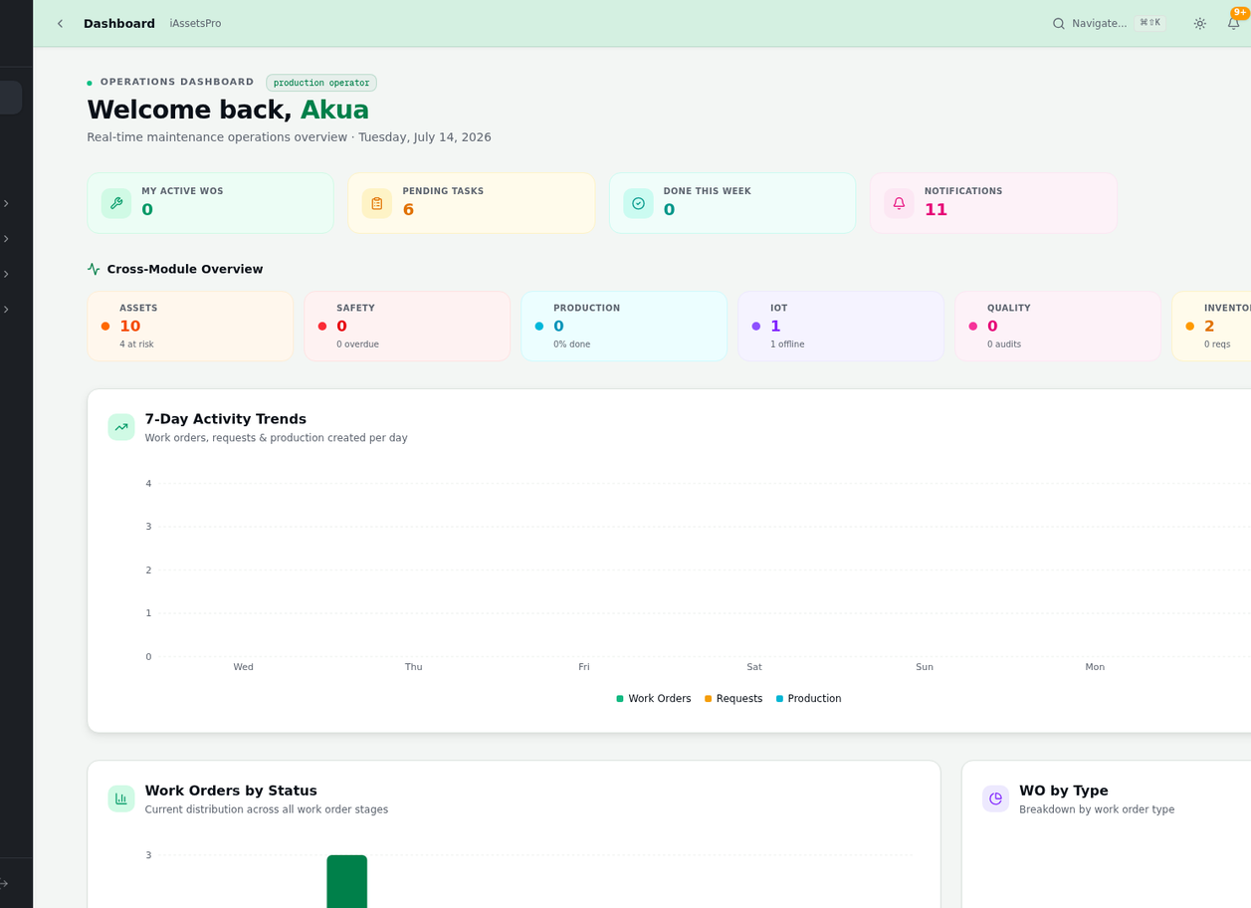
STEP 01
Operator Workspace
Quick Action Buttons
Recent Activity Feed
Cross-Module Overview
iAssetsPro
Operator Dashboard

Slide 8
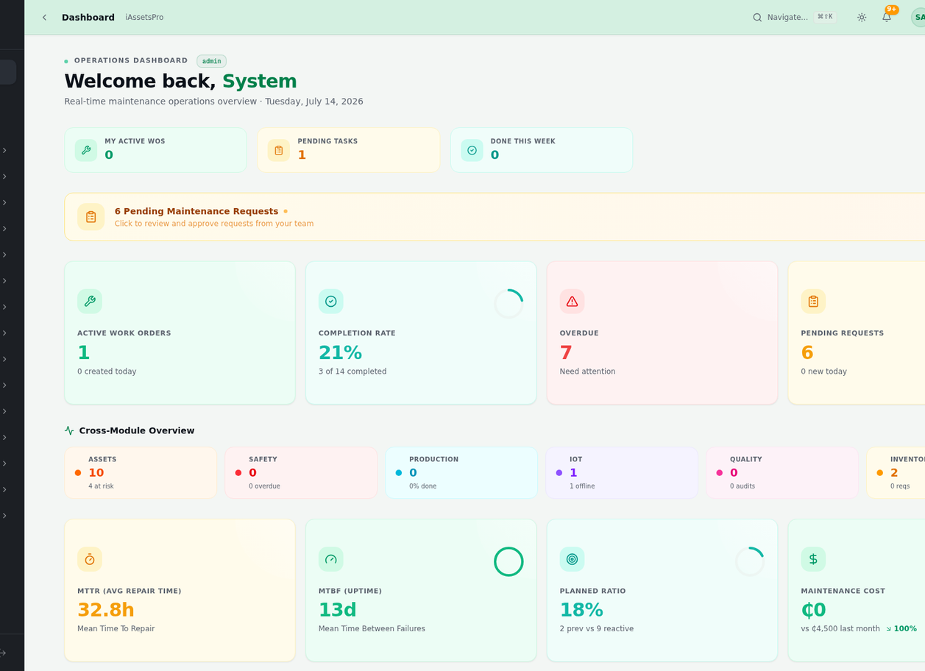
STEP 01
Admin Dashboard
Real-Time KPIs
Pending Action Alerts
Module Quick Navigation
iAssetsPro
Admin Command Center

Slide 9
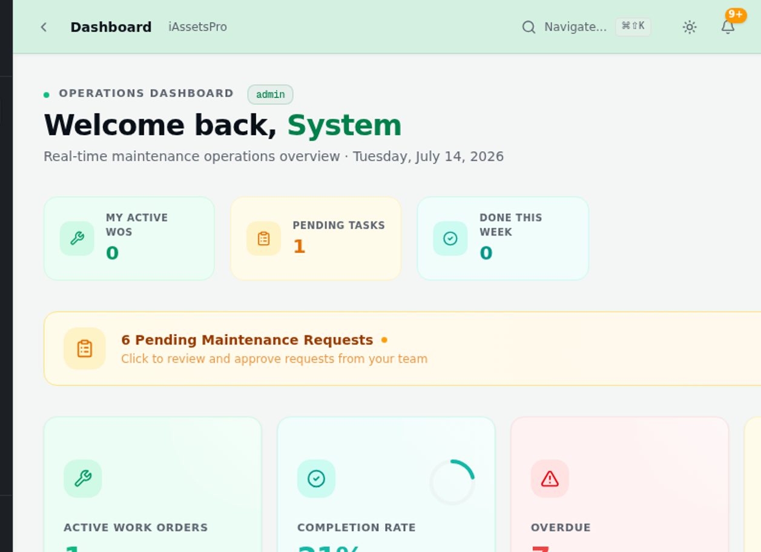
STEP 01
Complete Module Ecosystem
18+ Integrated Modules
Contextual Sub-Menus
Collapsible Navigation
iAssetsPro
Full Module Navigation

Slide 10
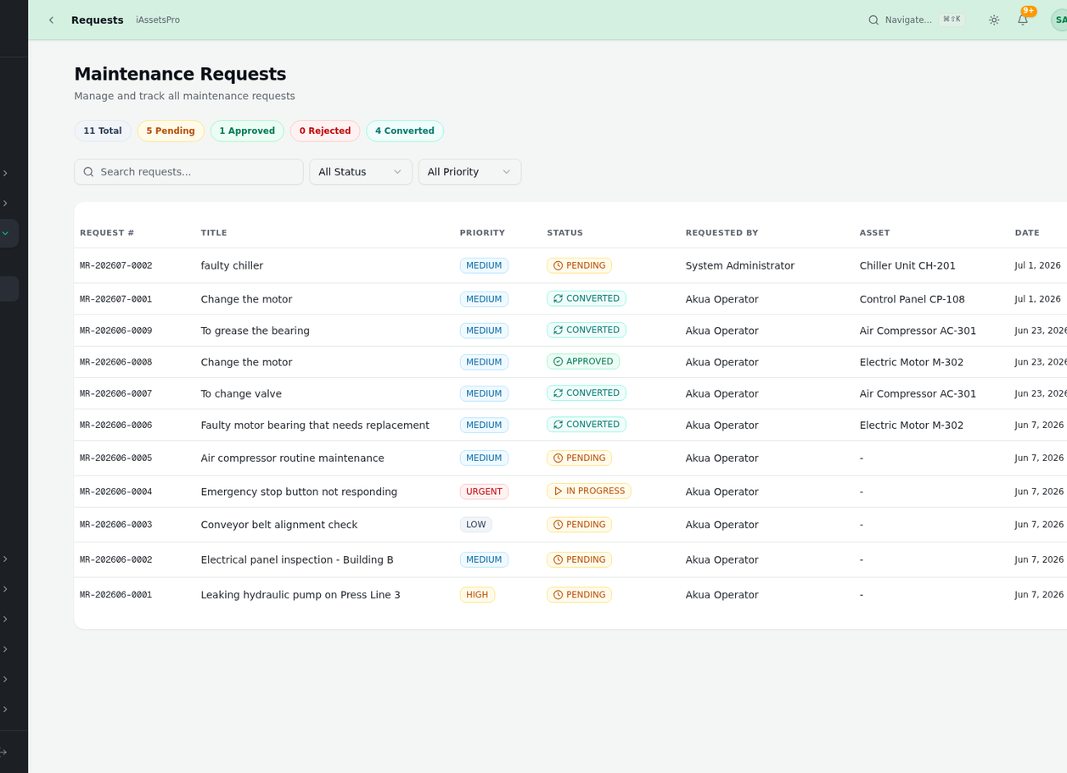
STEP 01
New Request Form
Title & Description
Asset Selection
Priority & Downtime Status
iAssetsPro
Create Maintenance Request

Slide 11
STEP 01
Request Tracking
Filterable Data Table
Status & Priority Badges
One-Click Detail View
iAssetsPro
Request List & Tracking

Slide 12
02
Review & Approval
Supervisor reviews, triages, and approves the request for work order creation
Step 2 of 6
iAssetsPro
Section 02 — Review & Approval

Slide 13
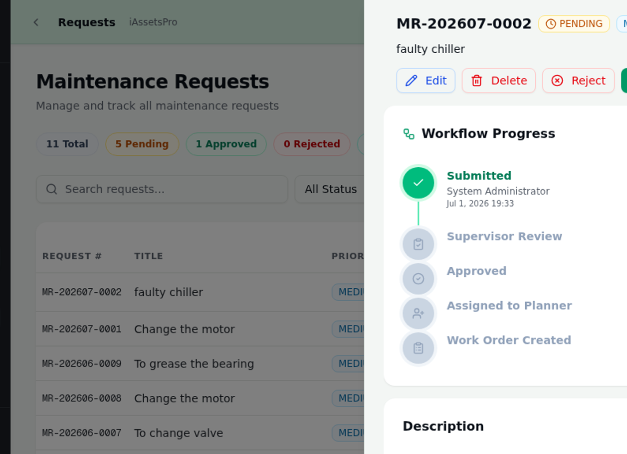
STEP 02
Workflow Progress Tracker
Visual Workflow Stepper
Submitted → Approved → WO Created
Full Audit Trail
iAssetsPro
Request Detail & Workflow Status

Slide 14
03
Planning & Work Orders
Approved requests are converted into executable work orders with resource assignment
Step 3 of 6
iAssetsPro
Section 03 — Planning & Work Orders

Slide 15
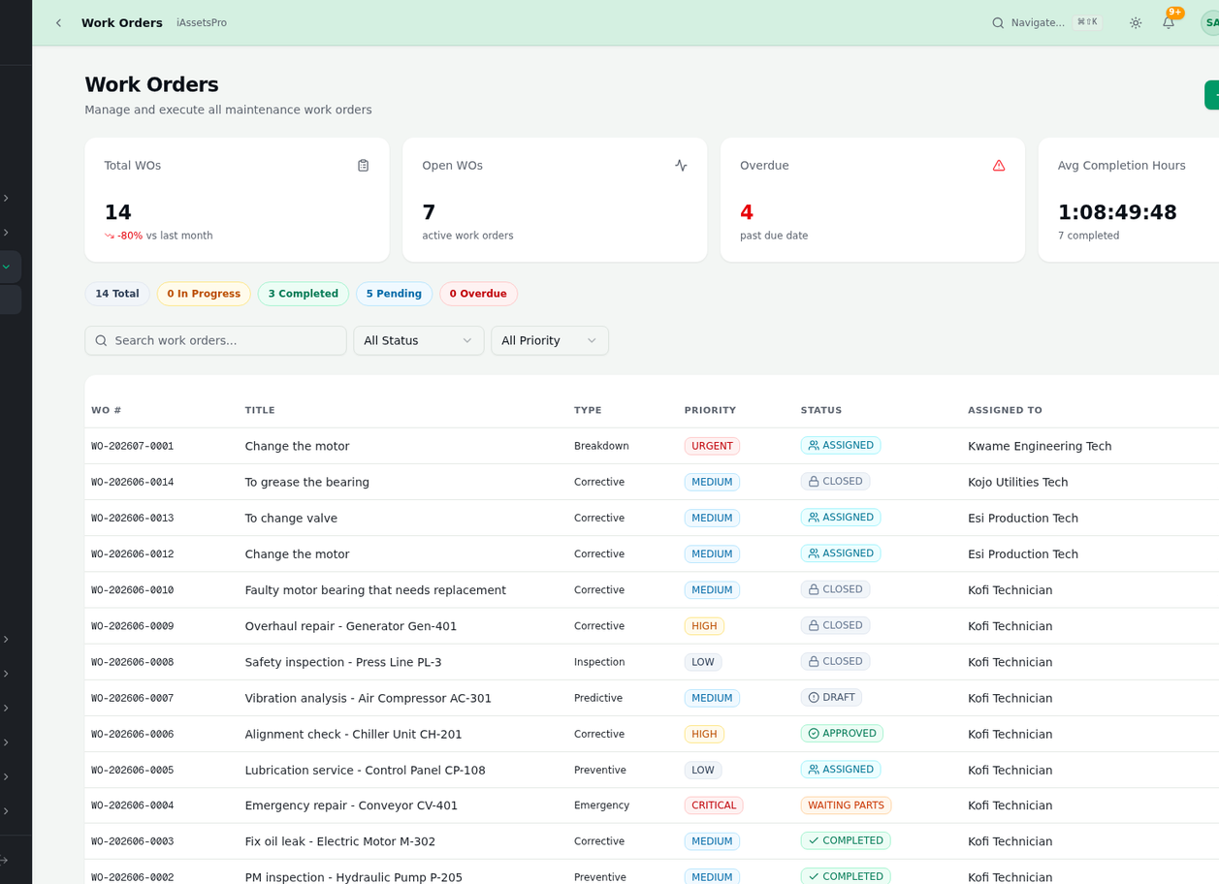
STEP 03
Work Order Management
Type: Breakdown / Corrective / Preventive
Priority-Based Sorting
Status Tracking Across WOs
iAssetsPro
Work Orders Hub

Slide 16
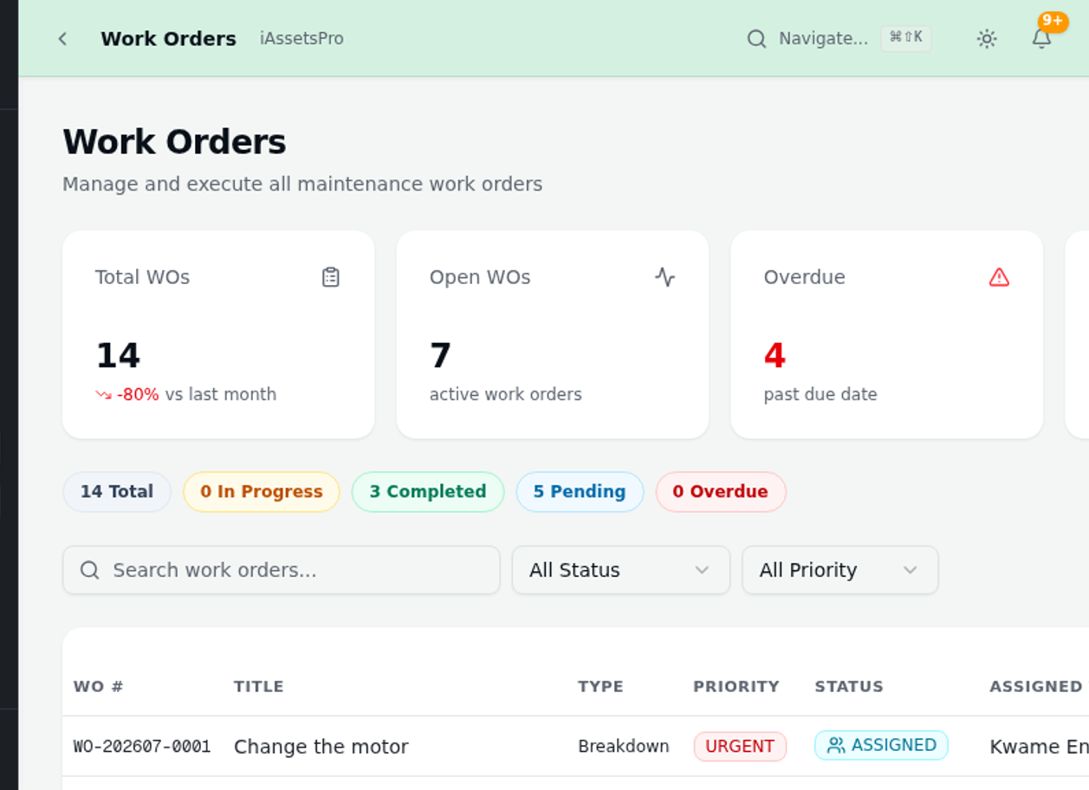
STEP 03
WO Creation Form
Auto-Link to Request
Type & Priority Selection
Technician Assignment
iAssetsPro
Create Work Order

Slide 17
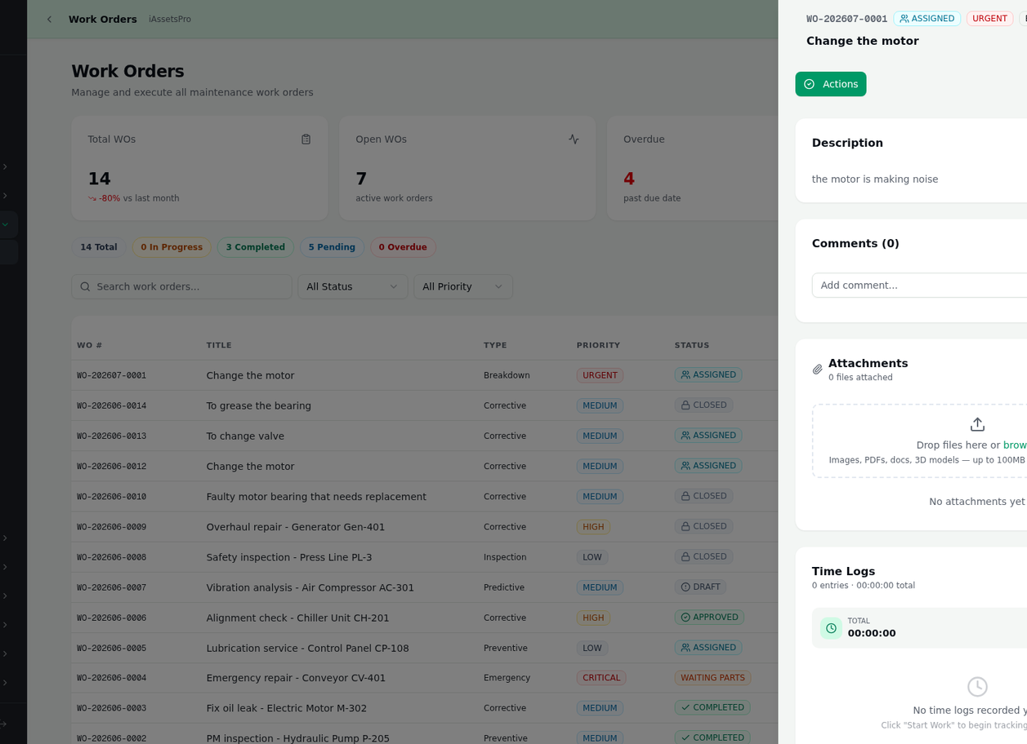
STEP 03
WO Detail & Actions
Start / Complete Actions
Task Checklist
Time & Labor Logging
iAssetsPro
Work Order Execution View

Slide 18
04
Tools & Materials
Technicians request specialized tools and spare parts needed for work order execution
Step 4 of 6
iAssetsPro
Section 04 — Tools & Materials

Slide 19
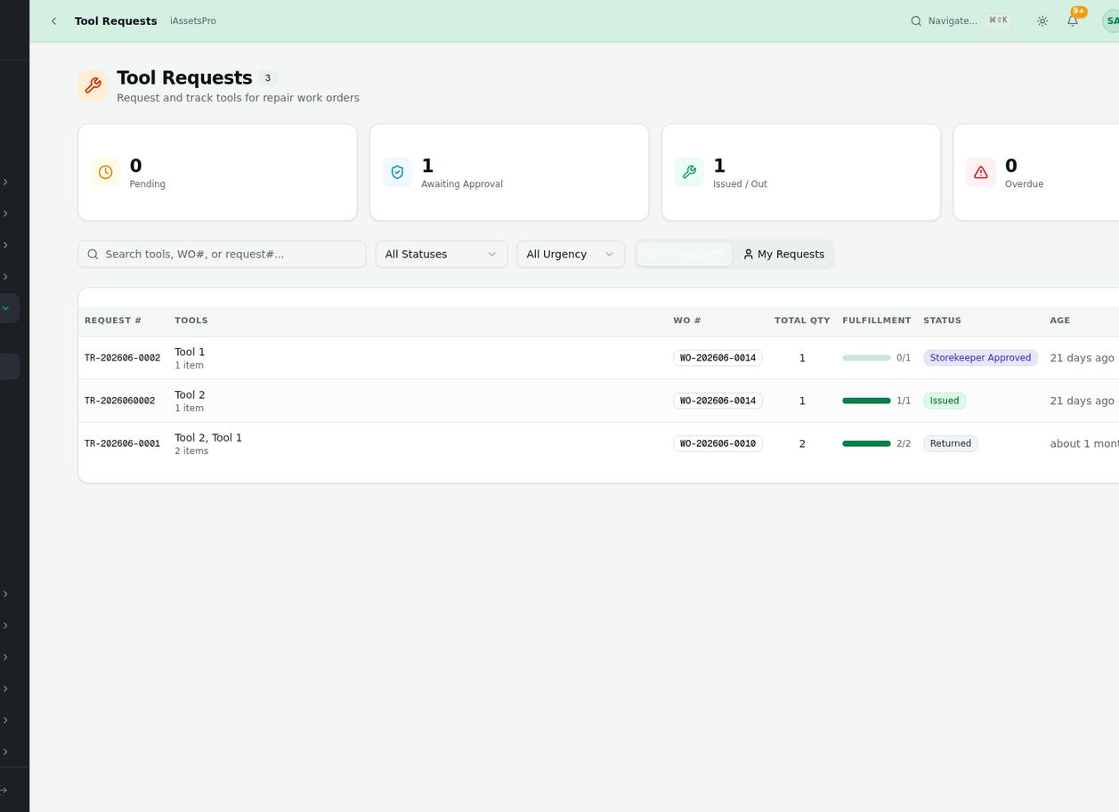
STEP 04
Repair Tool Requests
WO-Linked Requests
Approval Workflow
Issuance Tracking
iAssetsPro
Tool Requests

Slide 20
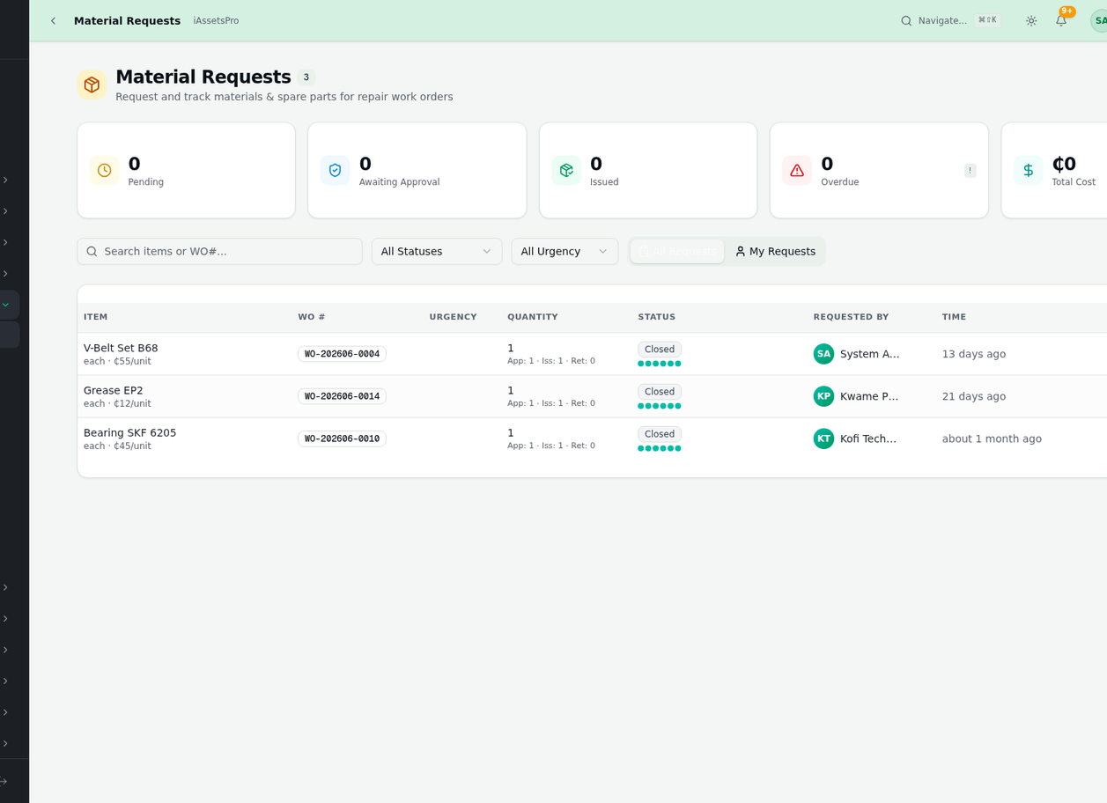
STEP 04
Spare Parts & Materials
Parts Requisition
Quantity & Specification
Store Issuance Integration
iAssetsPro
Material Requests

Slide 21
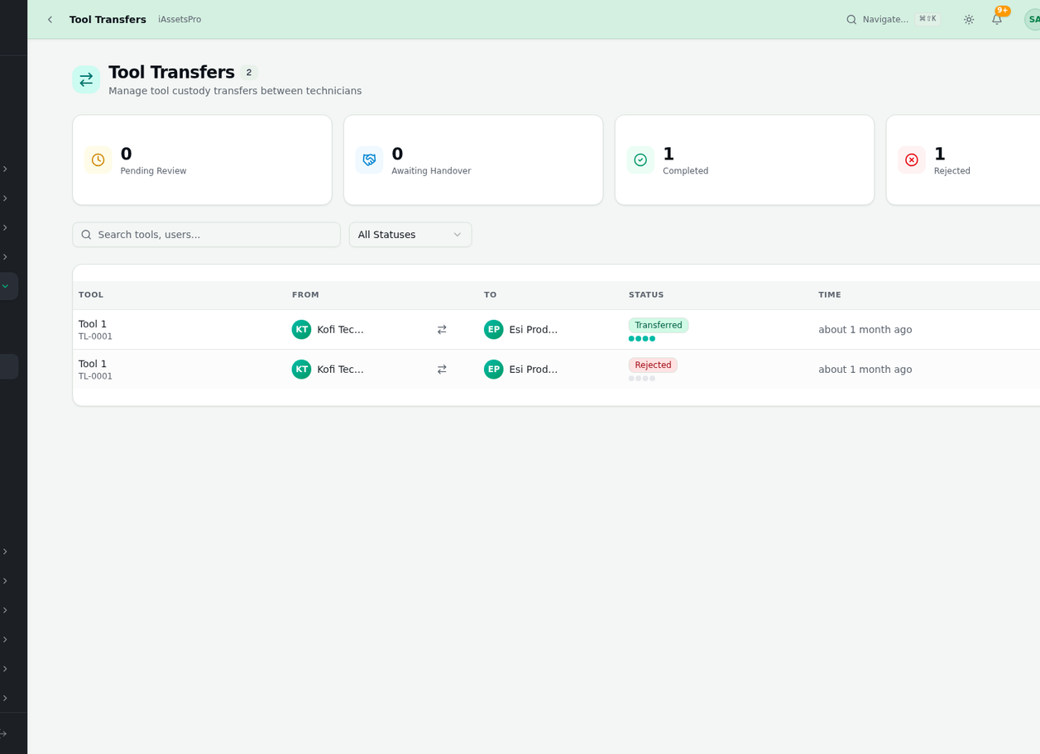
STEP 04
Inter-Plant Tool Transfers
Cross-Plant Movement
Sender & Receiver Tracking
Full Audit Trail
iAssetsPro
Tool Transfers

Slide 22
05
Completion & Verification
Work is documented, verified by supervisors, and closed with full traceability
Step 5 of 6
iAssetsPro
Completion & Verification

Slide 23
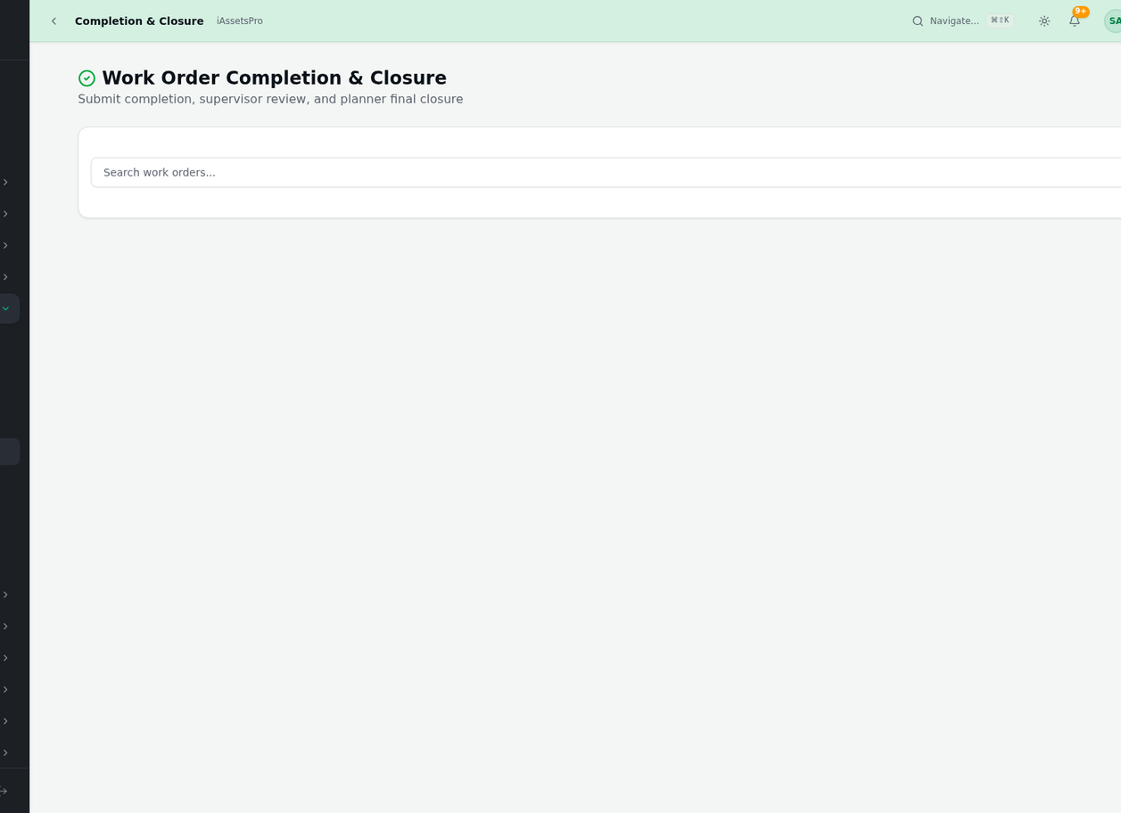
STEP 05
Mark Work Complete
Completion Documentation
Actual Work Recorded
Parts & Tools Consumed
iAssetsPro
WO Completion

Slide 24
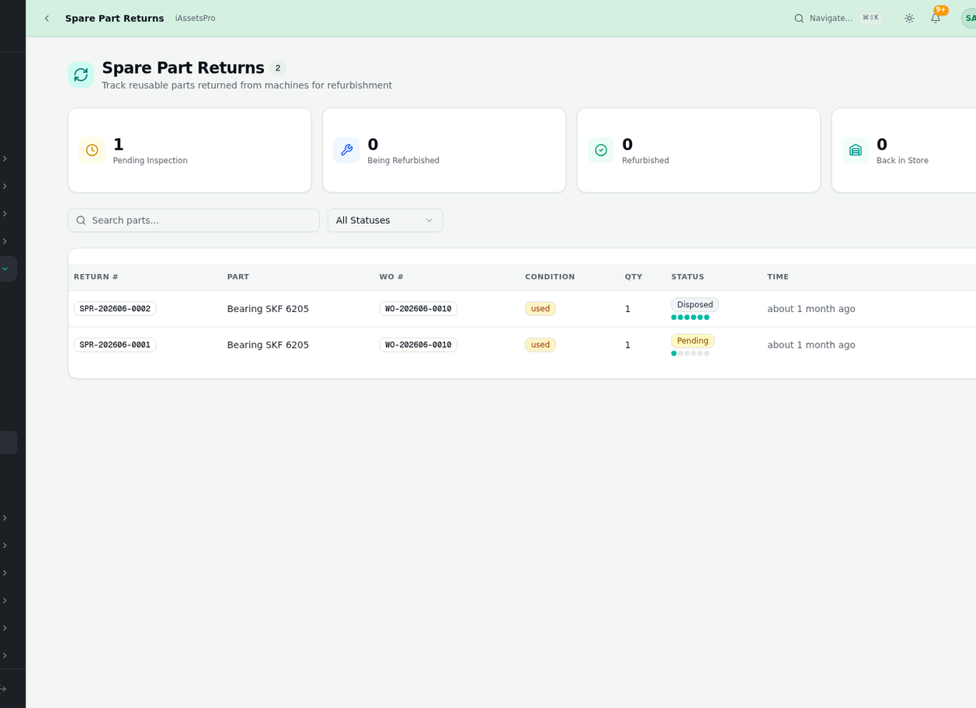
STEP 05
Unused Part Returns
Return from Completed WOs
Quality Inspection
Inventory Restocking
iAssetsPro
Spare Part Returns

Slide 25
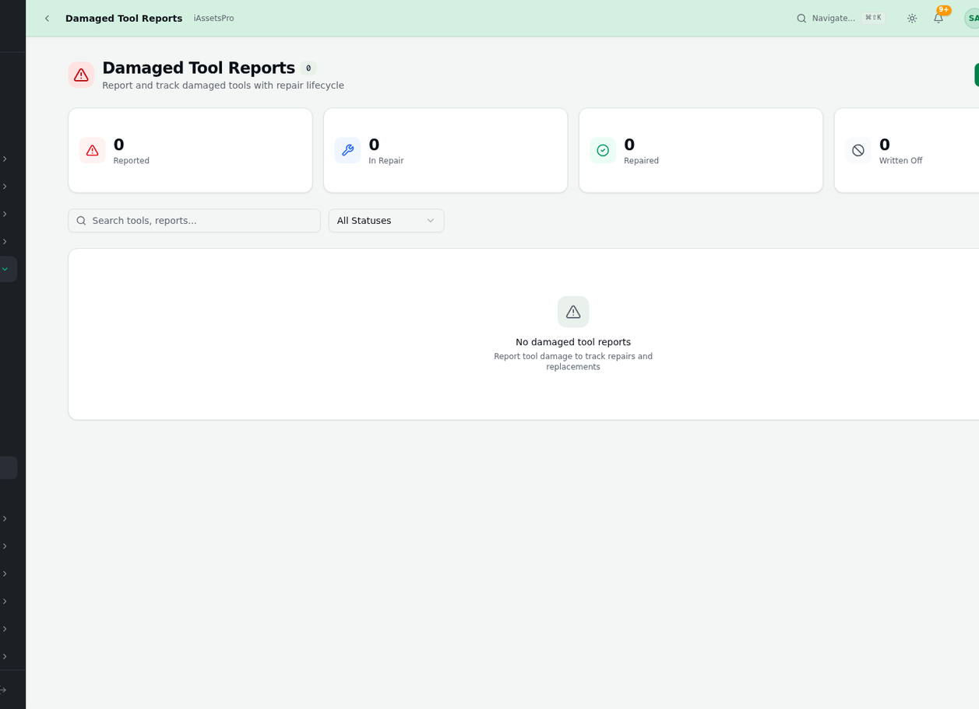
STEP 05
Damage Reporting
Damage Classification
Replacement Initiation
Warranty Claim Support
iAssetsPro
Damaged Tool Reports

Slide 26
06
Analytics & Reporting
Data-driven insights into maintenance performance, downtime trends, and resource utilization
Step 6 of 6
iAssetsPro
Analytics & Reporting

Slide 27
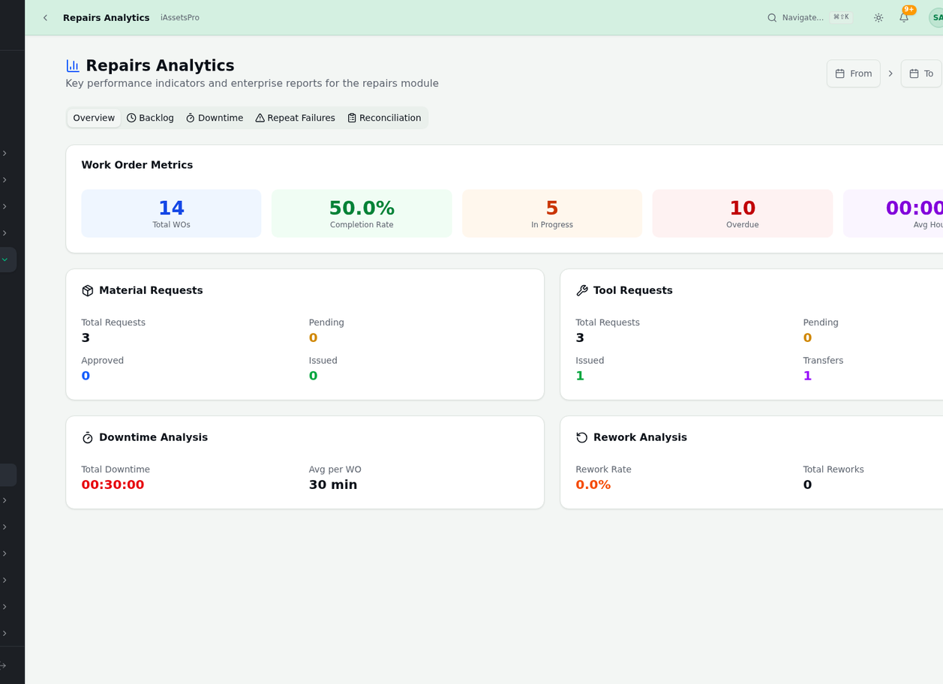
STEP 06
Repair Analytics Dashboard
Visual KPI Charts
Completion Rate Trends
Technician Productivity
iAssetsPro
Repairs Analytics

Slide 28
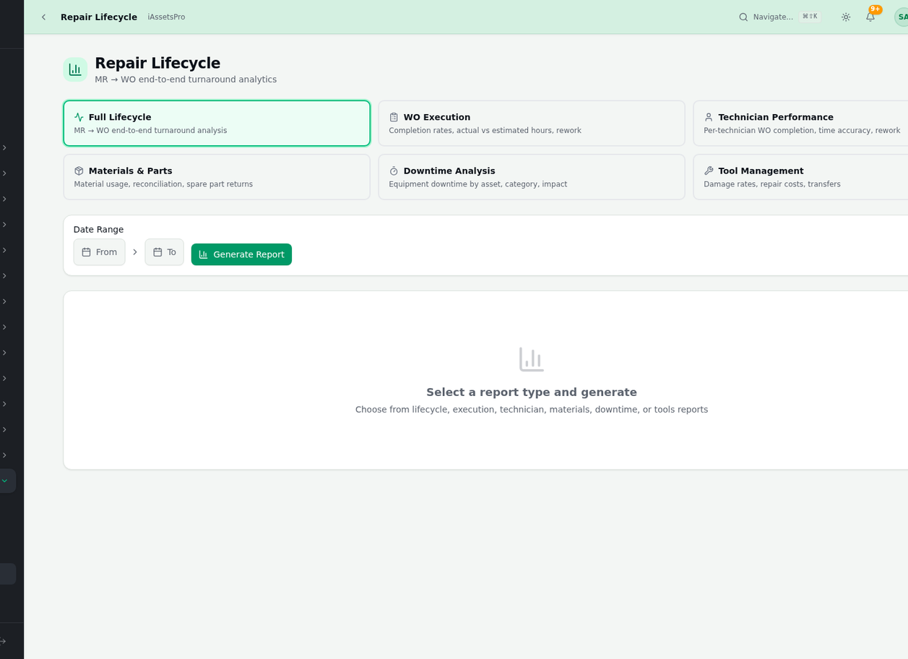
STEP 06
Report Builder
Template-Based Reports
PDF & Excel Export
Scheduled Distribution
iAssetsPro
Reports Generation

Slide 29
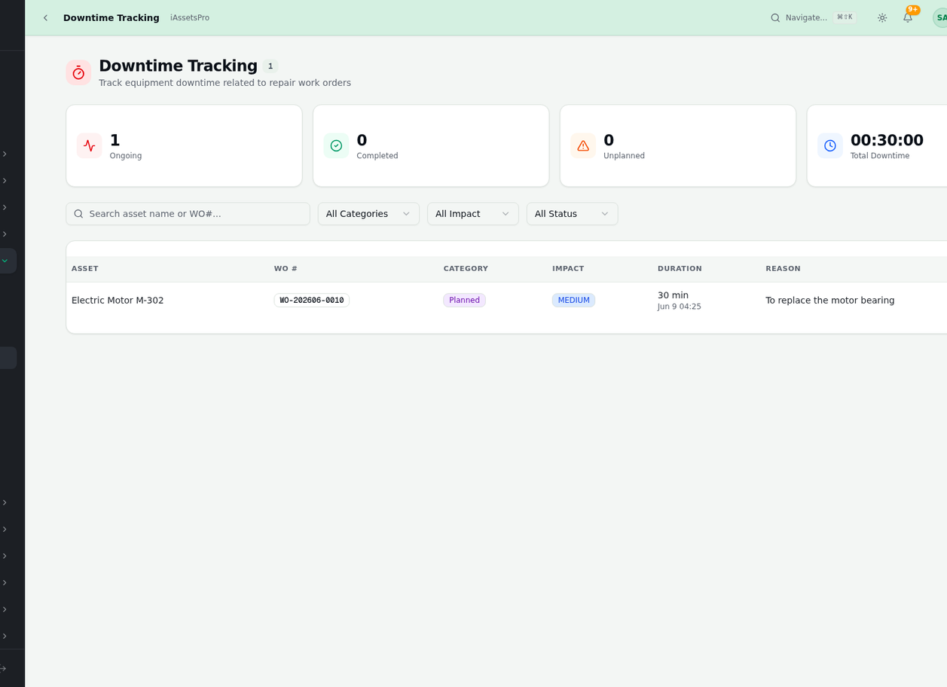
STEP 06
Downtime Analysis
Production Impact Tracking
Root Cause Categorization
Reduction Strategies
iAssetsPro
Downtime Tracking

Slide 30
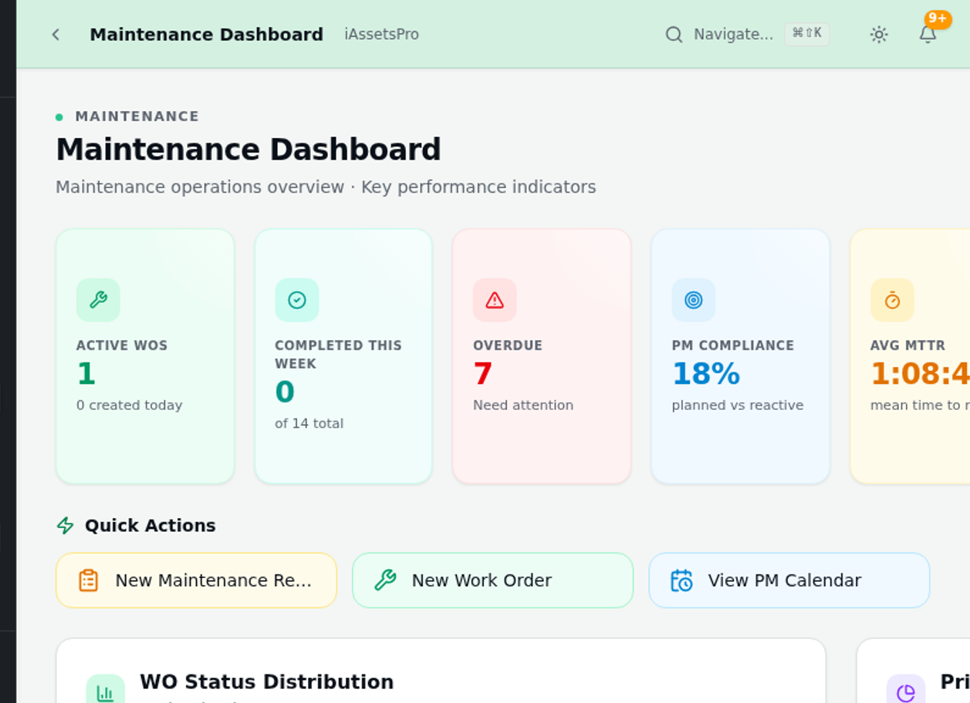
STEP 06
Maintenance Command Dashboard
Executive Overview
Trend Visualization
Proactive Planning
iAssetsPro
Maintenance Dashboard

Slide 31
Platform Impact
↻
▦
✓
◎
Real-Time
6
100%
3
Active Modules
Audit Trail
Plant Sites
Fully integrated maintenance ecosystem
Every action tracked and traceable
Tema, Kumasi, Takoradi unified
Data Sync
Instant KPI updates across all modules
iAssetsPro
By The Numbers

Slide 32
Comprehensive Module Ecosystem
Asset Management
Maintenance
Operations
Intelligence
Assets
Requests
Production
Analytics
Equipment
Work Orders
Shifts
Reports
Assemblies
PM Schedules
Downtime
IoT
BOM
Calibration
Quality Checks
Predictive
Tools
iAssetsPro
Platform Modules Overview

Slide 33
Thank You
iAssetsPro — Intelligent Asset Management Platform
Lightworld Technology
https://iassetspro.lightworldtech.com
iAssetsPro
Maintenance Repairs — Work Order Workflow

