Slide 1
iAssetsPro
Enterprise Asset Management Platform
Maintenance Repairs Work Order Module
Complete Workflow Presentation — From Request to Closure
Prepared for Client Presentation
Lightworld Technologies

Slide 2
WORKFLOW OVERVIEW
End-to-End Maintenance Repair Process
Phase 1
Phase 2
Phase 3
Phase 4
Request & Approval
Work Order Execution
Repair Resources
Completion & Reporting
• Operator submits Maintenance Request • Supervisor reviews & approves • Request tracked in real-time
• Approved MR converts to Work Order • WO assigned to technician • Work started with time tracking
• Tool requests & checkout • Material requisition & issue • Tool returns & transfers
• Work completion sign-off • Supervisor closure & lock • Analytics & KPI reporting
→
→
→
iAssetsPro — Maintenance Repairs Work Order Module

Slide 3
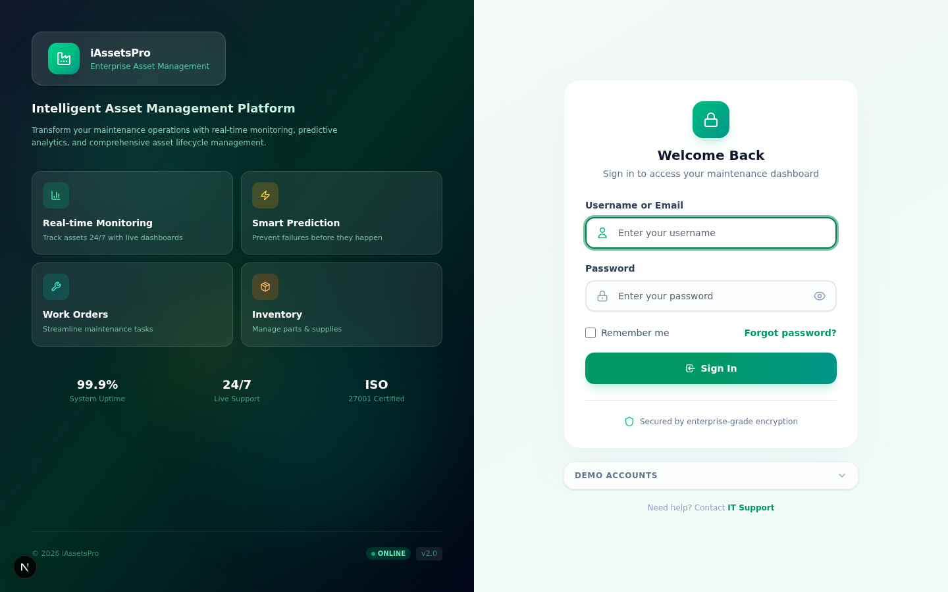
PHASE 1 · REQUEST & APPROVAL
Step 1
Login & Authentication
Users authenticate via a secure login page with role-based access control. The system supports multiple user roles including Administrators, Supervisors, Technicians, Operators, and Store Keepers — each with specific permissions for the WO lifecycle.
iAssetsPro — Maintenance Repairs Work Order Module

Slide 4
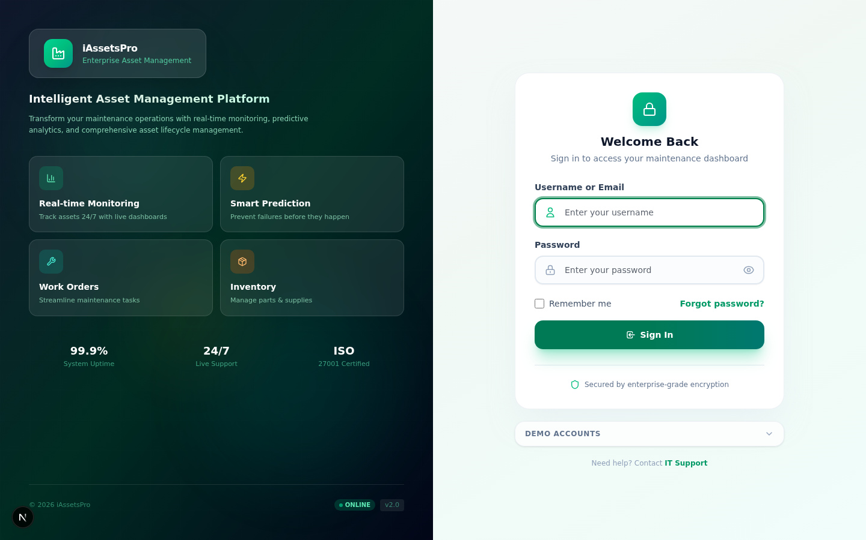
PHASE 1 · REQUEST & APPROVAL
Step 2
Dashboard Overview
After login, users are presented with a comprehensive dashboard showing key metrics: pending work orders, open maintenance requests, asset health status, and recent activity. The dashboard provides quick navigation to all modules.
iAssetsPro — Maintenance Repairs Work Order Module

Slide 5

PHASE 1 · REQUEST & APPROVAL
Step 3
Maintenance Requests List
The Maintenance Requests module displays all submitted requests in a filterable, sortable table. Users can filter by status (Draft, Pending, Approved, Rejected), priority, asset, and date range. The table shows request details at a glance.
iAssetsPro — Maintenance Repairs Work Order Module

Slide 6
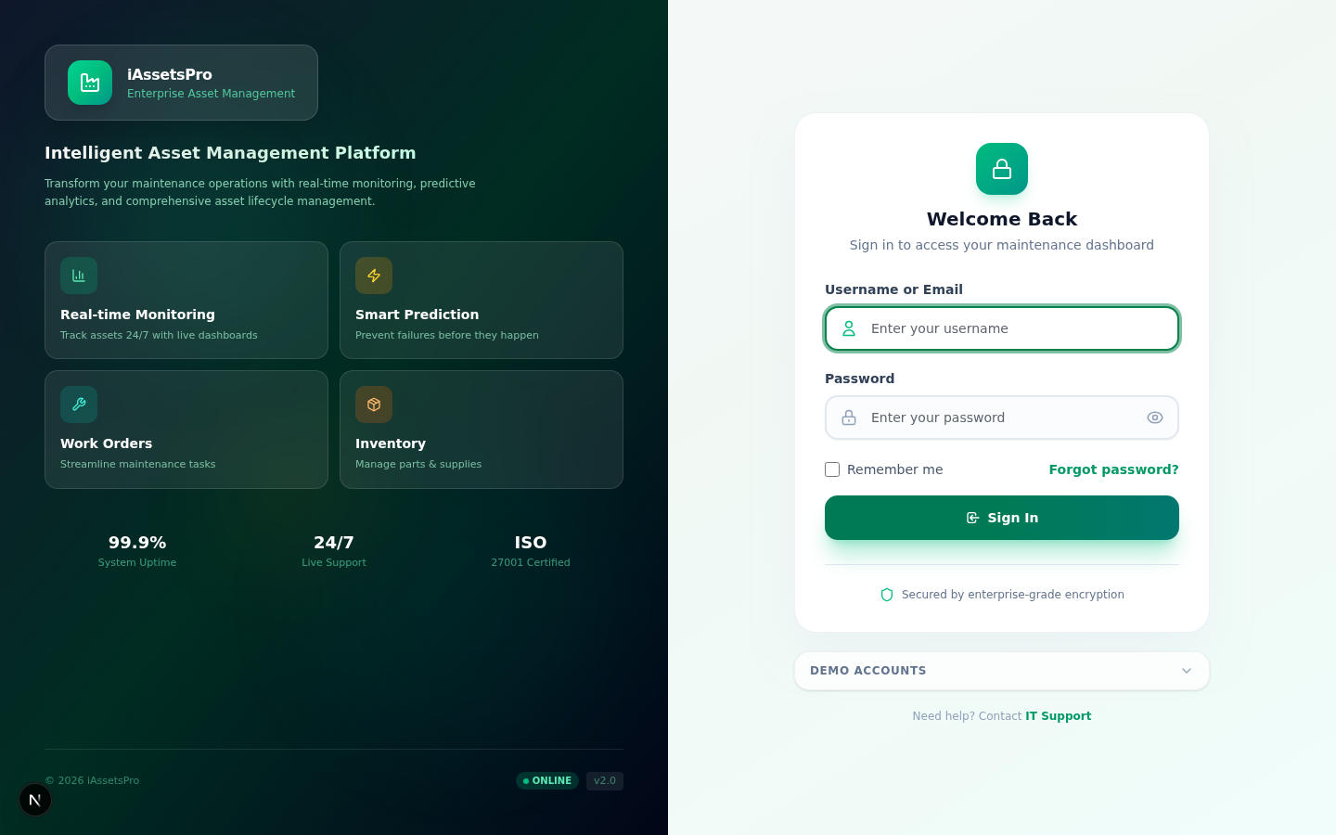
PHASE 1 · REQUEST & APPROVAL
Step 4
Maintenance Request Detail
Each Maintenance Request has a detailed view showing the problem description, requested priority, affected asset/equipment, required trades, and the full approval chain with timestamps. Authorized users can approve, reject, or request more information.
iAssetsPro — Maintenance Repairs Work Order Module

Slide 7

PHASE 2 · WORK ORDER EXECUTION
Step 5
Work Orders List
Approved Maintenance Requests are converted into Work Orders. The WO list provides a comprehensive view of all work orders with status indicators, assigned technicians, due dates, and priority levels. Powerful filtering and search capabilities help users find specific orders.
iAssetsPro — Maintenance Repairs Work Order Module

Slide 8

PHASE 2 · WORK ORDER EXECUTION
Step 6
Work Order Detail
The Work Order detail page provides complete visibility into the work order lifecycle — including assigned technician, planned vs actual hours, task checklist, linked maintenance request, tool/material consumption, and all activity history with timestamps.
iAssetsPro — Maintenance Repairs Work Order Module

Slide 9

PHASE 3 · REPAIR RESOURCES
Step 7
Tool Requests
Technicians can request tools needed for their assigned work orders. The Tool Requests module tracks each request's status — from submission through approval, issuance by the tool shop, and return. Full traceability of tool movements is maintained.
iAssetsPro — Maintenance Repairs Work Order Module

Slide 10
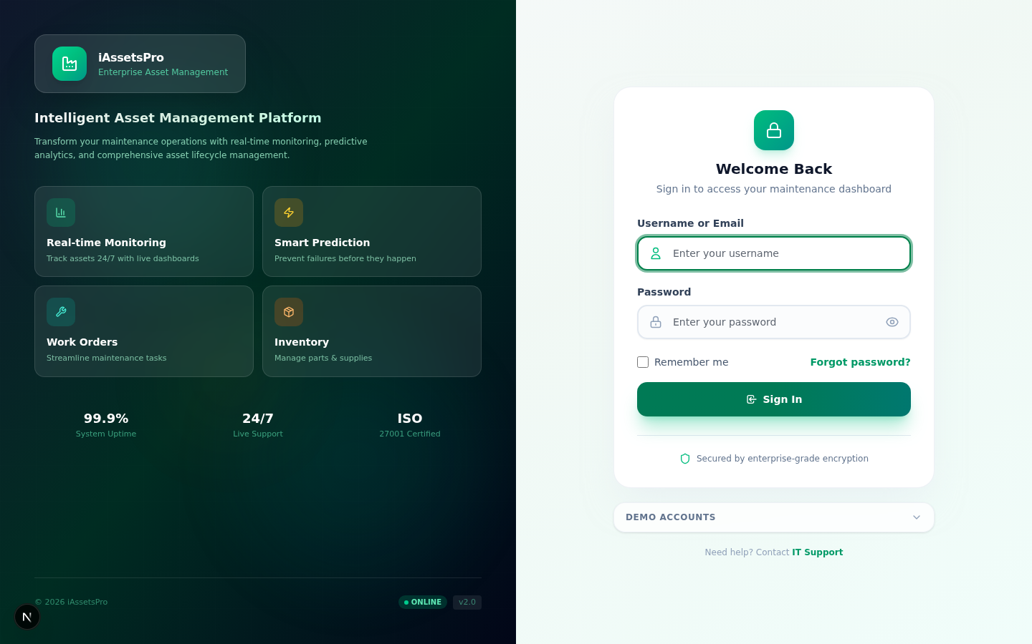
PHASE 3 · REPAIR RESOURCES
Step 8
Material Requests
The Material Requests module handles spare parts and consumable requisitions for repair work. Requests flow from technician submission → supervisor approval → store keeper issuance → consumption tracking against the work order.
iAssetsPro — Maintenance Repairs Work Order Module

Slide 11
PHASE 3 · REPAIR RESOURCES
Step 9
Tool Transfers
Tools can be transferred between technicians or returned to the tool shop. The Tool Transfers module tracks the complete chain of custody — who held the tool, when it was transferred, and the current holder. Damaged tools are flagged for reporting.
iAssetsPro — Maintenance Repairs Work Order Module

Slide 12

PHASE 4 · COMPLETION & REPORTING
Step 10
Completion & Closure
The Completion & Closure module allows technicians to mark work as complete with detailed findings, replaced parts, and time logs. Supervisors and planners review and formally close the work order, which then becomes locked and archived.
iAssetsPro — Maintenance Repairs Work Order Module

Slide 13

PHASE 4 · COMPLETION & REPORTING
Step 11
Repair Analytics
The Analytics dashboard provides real-time insights into repair operations — including WO completion rates, average resolution times, technician productivity, equipment reliability metrics, and trend analysis for proactive maintenance planning.
iAssetsPro — Maintenance Repairs Work Order Module

Slide 14

PHASE 4 · COMPLETION & REPORTING
Step 12
Repair Reports
Comprehensive reporting module with multiple report types: by asset/machine, overview statistics, technician productivity, materials & cost analysis, downtime impact, and detailed data exports to Excel, PDF, and print formats.
iAssetsPro — Maintenance Repairs Work Order Module

Slide 15

PHASE 4 · COMPLETION & REPORTING
Step 13
Downtime Tracking
Track and analyze equipment downtime events with impact level classification. The module records downtime duration, affected production lines, root causes, and correlates with maintenance activities for total cost of downtime analysis.
iAssetsPro — Maintenance Repairs Work Order Module

Slide 16

PHASE 4 · COMPLETION & REPORTING
Step 14
Spare Part Returns
Manage the return of unused spare parts and consumables after work order completion. Parts are inspected, restocked to inventory, and credited back to the original material request, maintaining accurate inventory levels.
iAssetsPro — Maintenance Repairs Work Order Module

Slide 17

PHASE 4 · COMPLETION & REPORTING
Step 15
Damaged Tool Reports
Document and track damaged or worn tools discovered during repair work. The system creates records for tool replacement, links damage to specific work orders, and helps maintenance management plan tool procurement and replacement cycles.
iAssetsPro — Maintenance Repairs Work Order Module

Slide 18

PHASE 4 · COMPLETION & REPORTING
Step 16
Maintenance Dashboard
The dedicated Maintenance Dashboard provides a holistic view of all maintenance operations — KPIs, pending actions, equipment health scores, PM compliance rates, and maintenance cost trends. It serves as the command center for maintenance management.
iAssetsPro — Maintenance Repairs Work Order Module

Slide 19
iAssetsPro
Thank You
Ready to transform your maintenance operations
Contact: info@iassetspro.com | www.lightworldtech.com
© 2025 Lightworld Technologies. All rights reserved.

