Slide 1
iAssetsPro
Enterprise Asset Management Platform
Maintenance Repairs Work Order Module
Complete Workflow Presentation — From Request to Closure
Prepared for Client Presentation
Lightworld Technologies

Slide 2
WORKFLOW OVERVIEW
End-to-End Maintenance Repair Process
Phase 1
Phase 2
Phase 3
Phase 4
Request & Approval
Work Order Execution
Repair Resources
Completion & Reporting
• Operator submits
Maintenance Request
• Supervisor reviews
& approves request
• Real-time status tracking
• Convert approved MR
to Work Order
• Assign to technician
• Start work & log time
• Track progress
• Tool request & checkout
• Material requisition
• Tool transfers
• Downtime logging
• Inventory tracking
• Work completion sign-off
• Supervisor closure
• WO locked & archived
• Analytics & KPIs
• Compliance reports
→
→
→
iAssetsPro — Maintenance Repairs Work Order Module

Slide 3
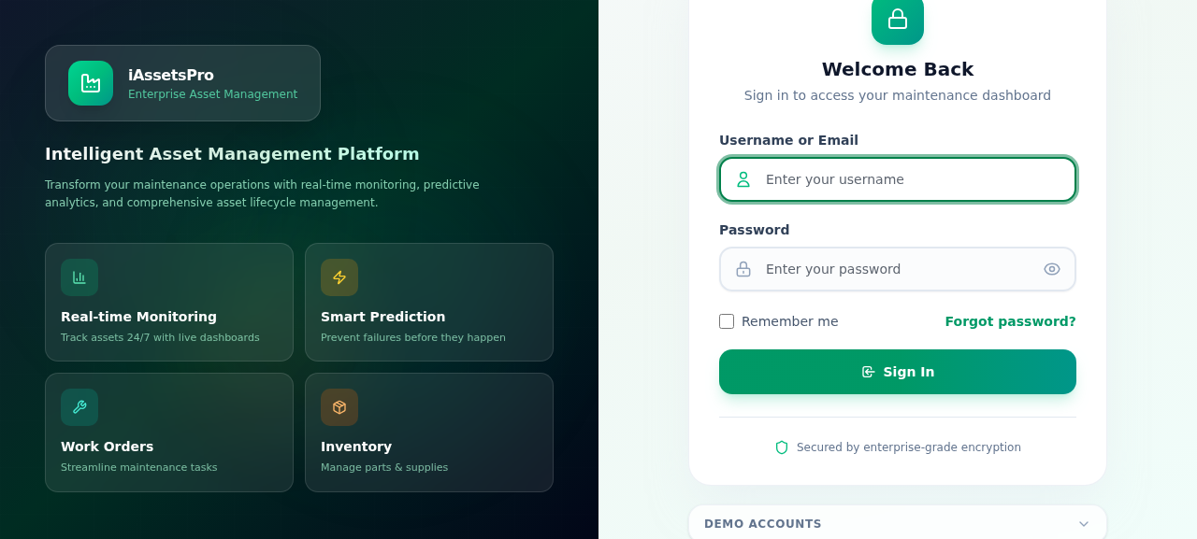
PHASE 1 · REQUEST & APPROVAL
Step 1
Dashboard
Central command center showing pending WOs, maintenance requests, asset health, and quick navigation to all modules.
iAssetsPro — Maintenance Repairs Work Order Module

Slide 4
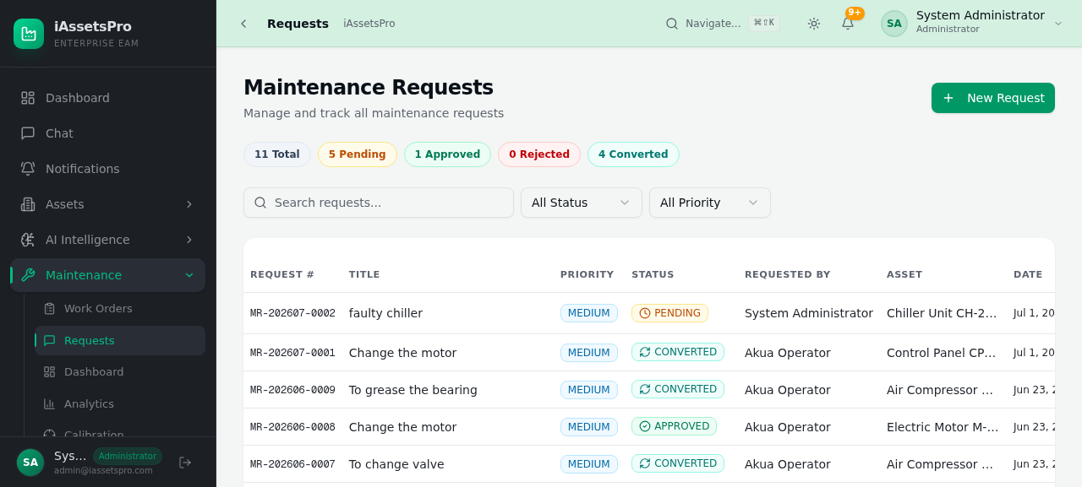
PHASE 1 · REQUEST & APPROVAL
Step 2
Maintenance Requests
All submitted requests in a filterable table. Filter by status, priority, asset, and date. Supervisors approve/reject from here.
iAssetsPro — Maintenance Repairs Work Order Module

Slide 5
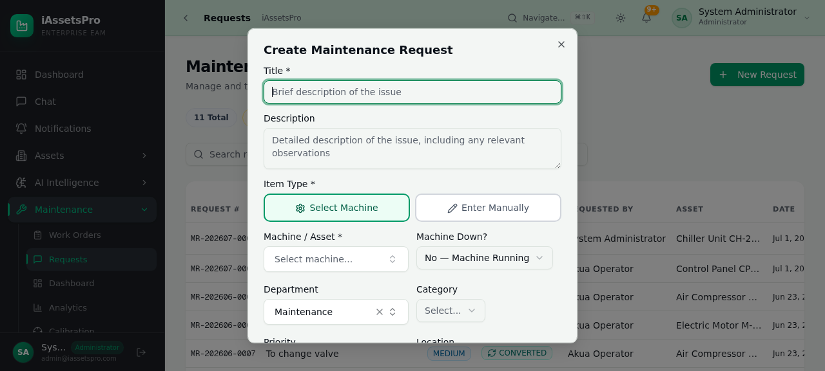
PHASE 1 · REQUEST & APPROVAL
Step 3
Create New Request
Operators fill out the request form: describe the problem, select asset, set priority, and choose required trades.
iAssetsPro — Maintenance Repairs Work Order Module

Slide 6
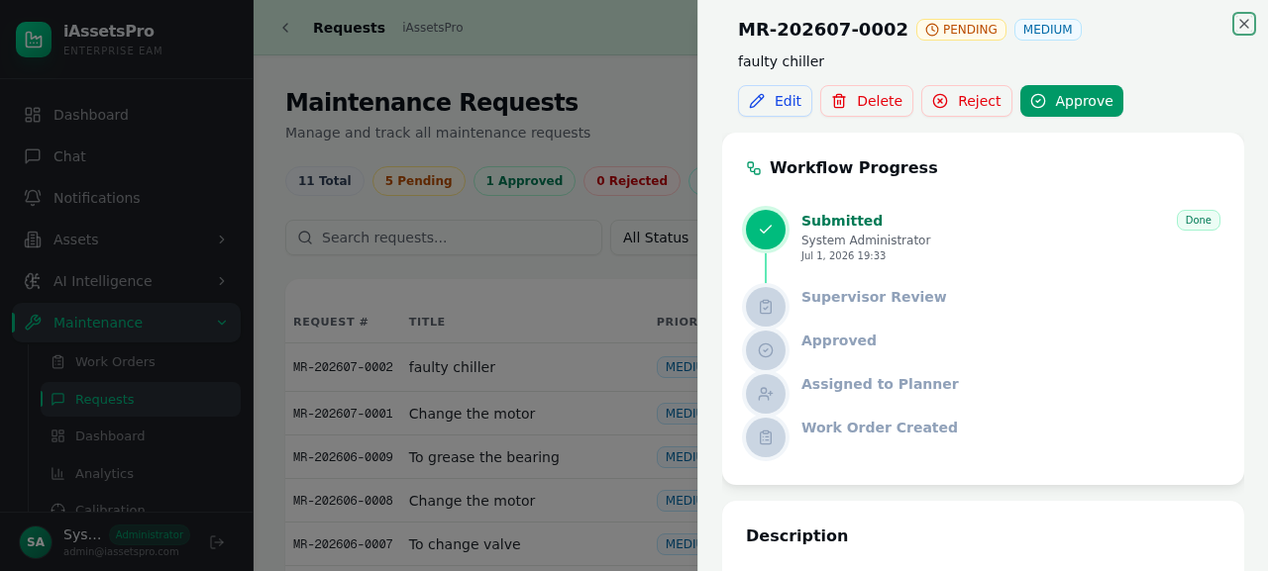
PHASE 1 · REQUEST & APPROVAL
Step 4
Request Detail
Full view of each request showing description, priority, asset details, approval chain with timestamps, and communication thread.
iAssetsPro — Maintenance Repairs Work Order Module

Slide 7
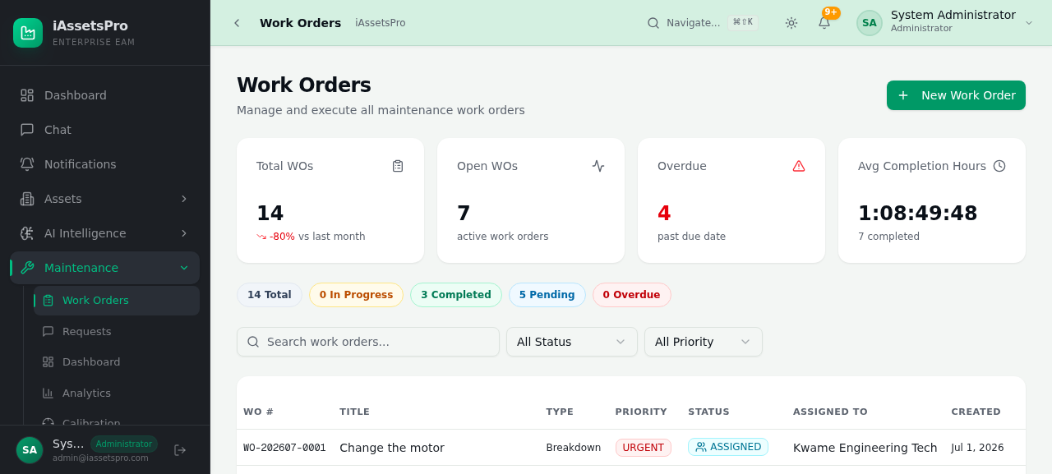
PHASE 2 · EXECUTION
Step 5
Work Orders List
Approved MRs converted to Work Orders. Track status, assigned technician, due dates, and priority levels at a glance.
iAssetsPro — Maintenance Repairs Work Order Module

Slide 8
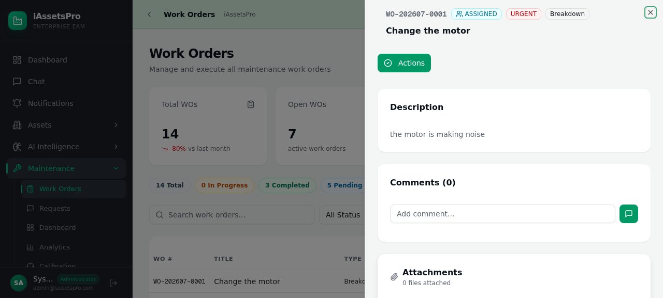
PHASE 2 · EXECUTION
Step 6
Work Order Detail
Complete WO lifecycle: assigned technician, task progress, time tracking, linked MR, and action buttons for tools, materials, and completion.
iAssetsPro — Maintenance Repairs Work Order Module

Slide 9
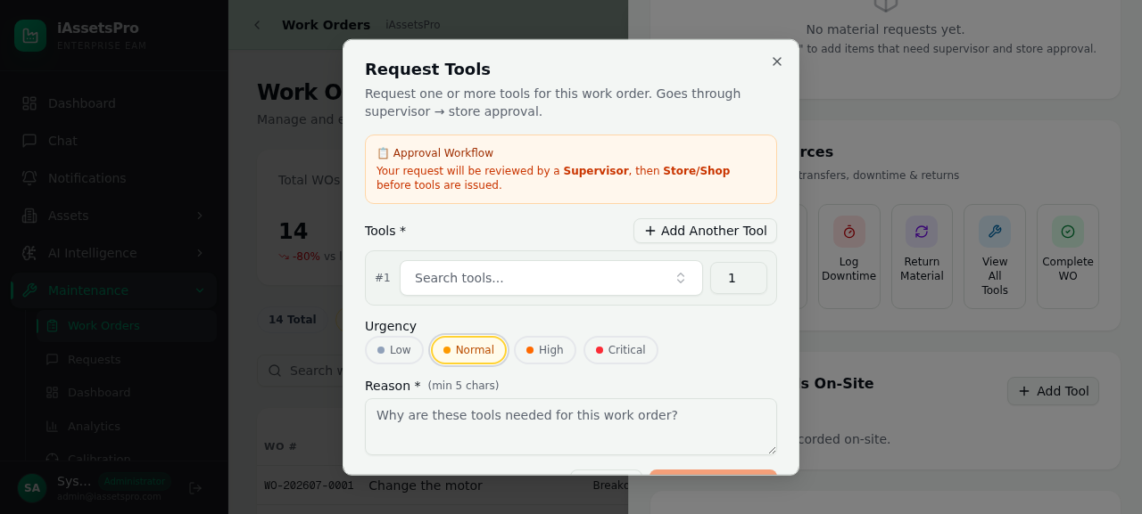
PHASE 3 · REPAIR RESOURCES
Step 7
Tool Request
From the WO detail, technicians request tools needed for the repair. Requests go to the tool shop for approval and issuance.
iAssetsPro — Maintenance Repairs Work Order Module

Slide 10
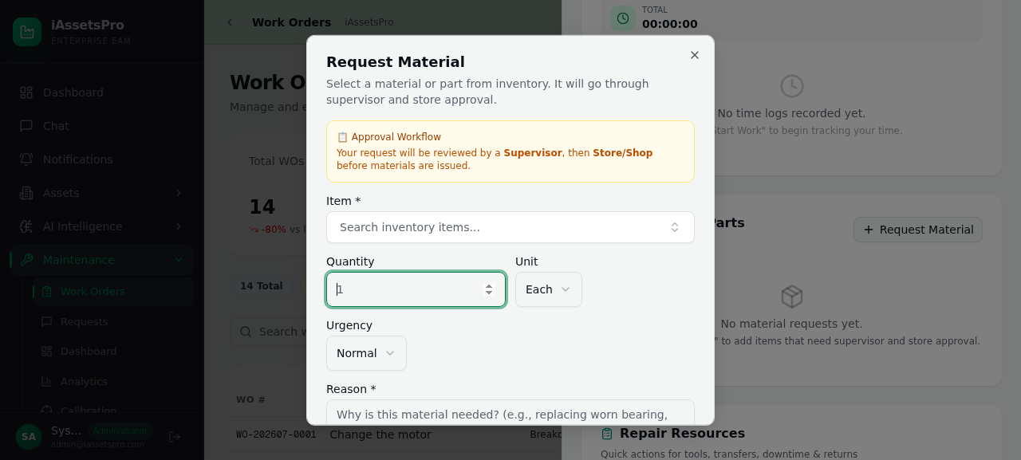
PHASE 3 · REPAIR RESOURCES
Step 8
Material Request
Request spare parts and consumables. The requisition flows from technician → supervisor → store keeper → issuance.
iAssetsPro — Maintenance Repairs Work Order Module

Slide 11
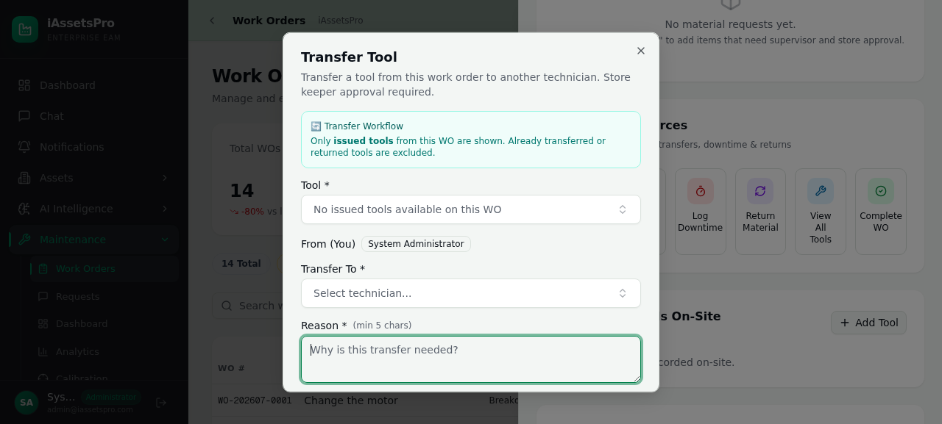
PHASE 3 · REPAIR RESOURCES
Step 9
Tool Transfer
Transfer tools between technicians or return them to the tool shop. Full chain-of-custody tracking maintained.
iAssetsPro — Maintenance Repairs Work Order Module

Slide 12
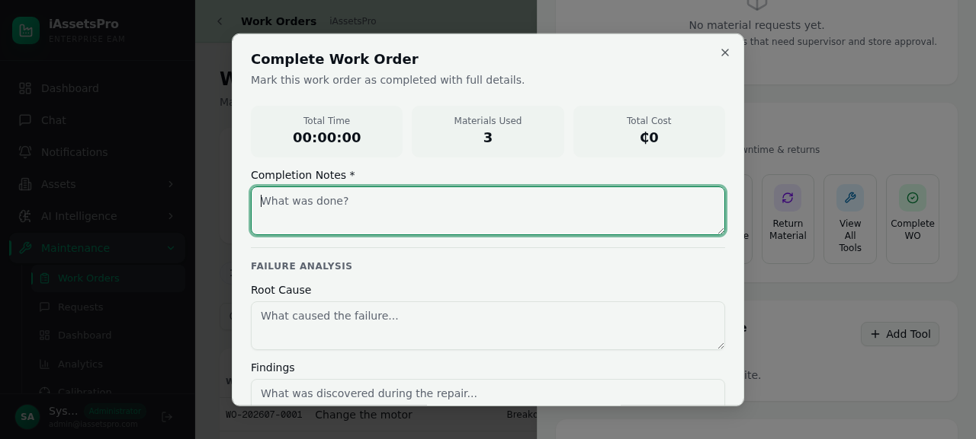
PHASE 3 · REPAIR RESOURCES
Step 10
Complete Work Order
Mark work complete with findings, replaced parts, and final time log. Triggers supervisor review workflow.
iAssetsPro — Maintenance Repairs Work Order Module

Slide 13
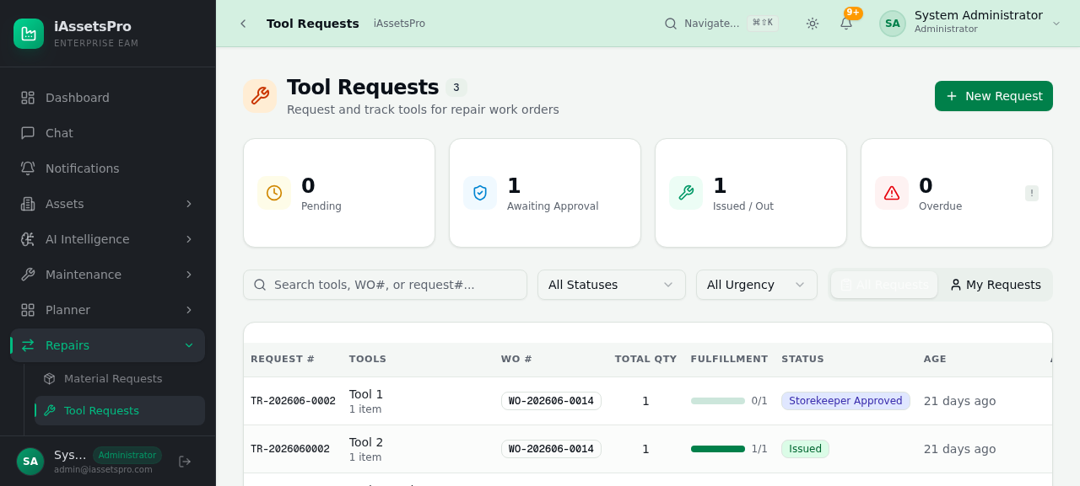
PHASE 3 · REPAIR RESOURCES
Step 11
Tool Requests List
Central view of all tool requests across work orders. Track status from submission through issuance to return.
iAssetsPro — Maintenance Repairs Work Order Module

Slide 14
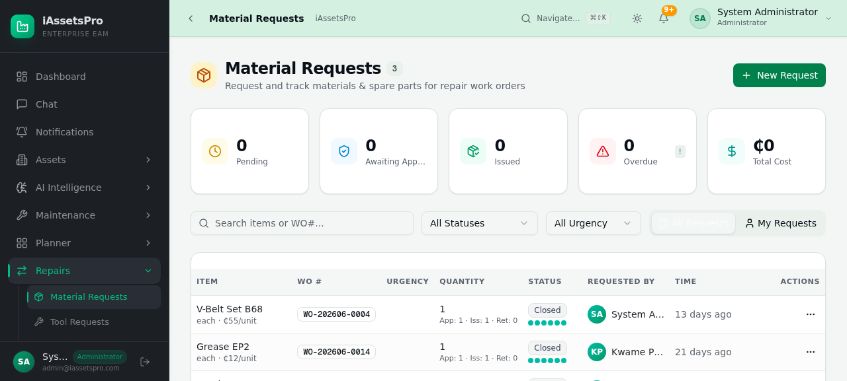
PHASE 4 · COMPLETION & REPORTING
Step 12
Material Requests List
All material requisitions in one place. Monitor approval status, issuance progress, and consumption tracking.
iAssetsPro — Maintenance Repairs Work Order Module

Slide 15
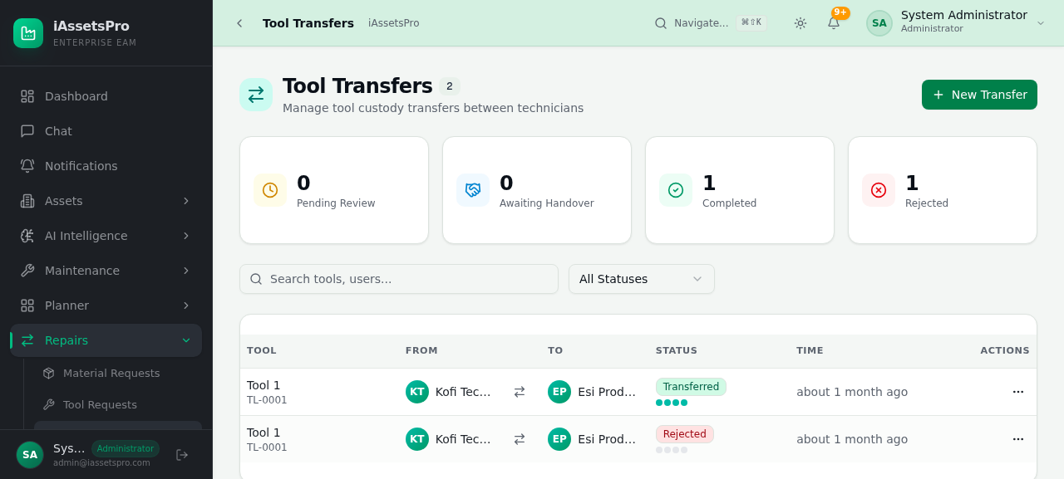
PHASE 4 · COMPLETION & REPORTING
Step 13
Tool Transfers
Track all tool movements between technicians and the tool shop. Ensures accountability and proper tool management.
iAssetsPro — Maintenance Repairs Work Order Module

Slide 16
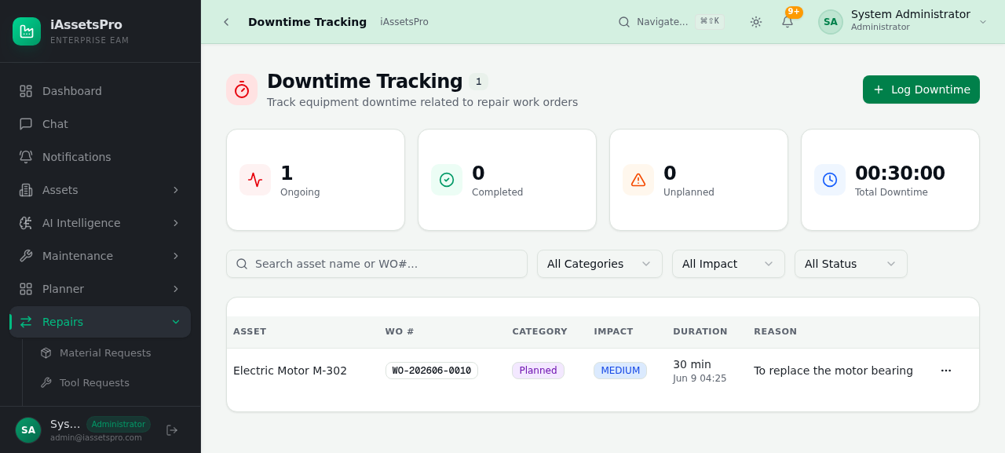
PHASE 4 · COMPLETION & REPORTING
Step 14
Downtime Tracking
Record and analyze equipment downtime. Classify impact levels and correlate with maintenance activities for cost analysis.
iAssetsPro — Maintenance Repairs Work Order Module

Slide 17
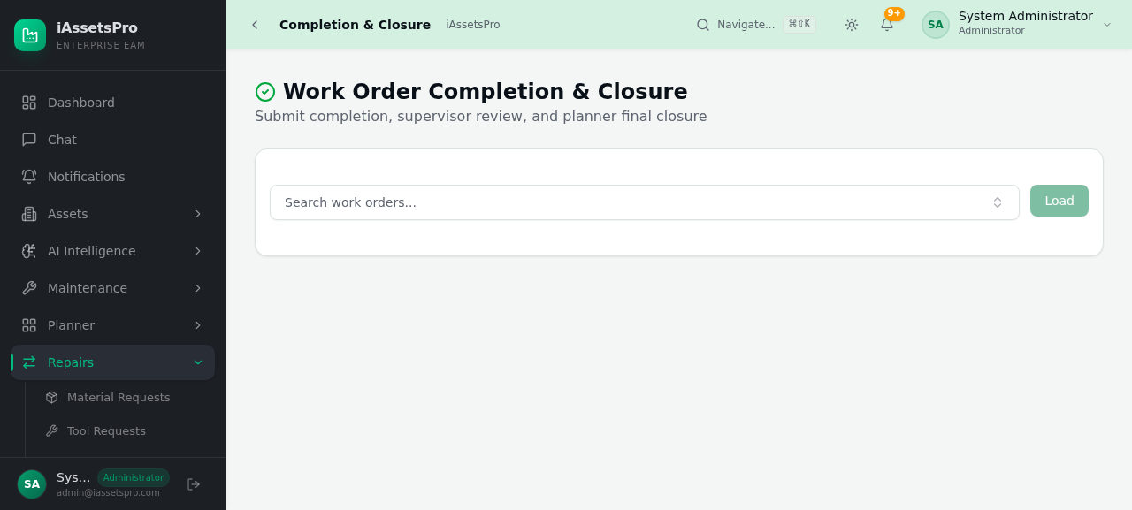
PHASE 4 · COMPLETION & REPORTING
Step 15
Completion & Closure
Formal WO completion review. Supervisors verify work quality, close the order, and lock it for archival.
iAssetsPro — Maintenance Repairs Work Order Module

Slide 18
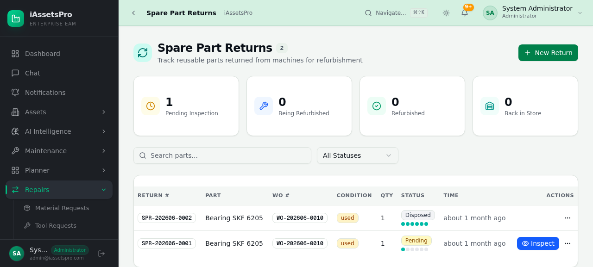
PHASE 4 · COMPLETION & REPORTING
Step 16
Spare Part Returns
Return unused parts after WO completion. Parts are inspected, restocked, and credited back to the original request.
iAssetsPro — Maintenance Repairs Work Order Module

Slide 19
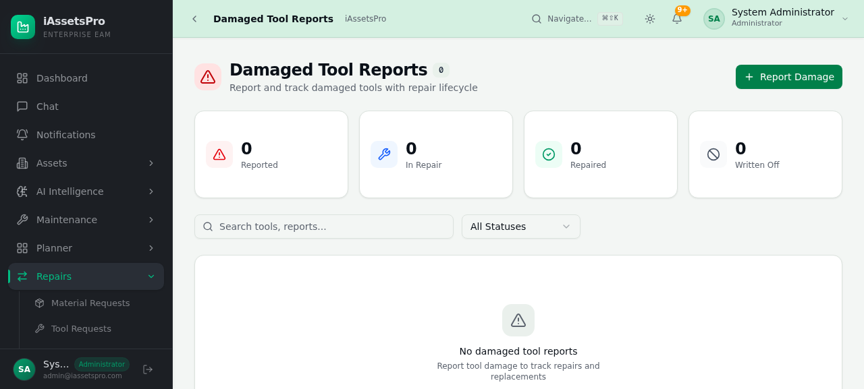
PHASE 4 · COMPLETION & REPORTING
Step 17
Damaged Tool Reports
Document and track damaged tools discovered during repair. Supports replacement planning and procurement budgets.
iAssetsPro — Maintenance Repairs Work Order Module

Slide 20
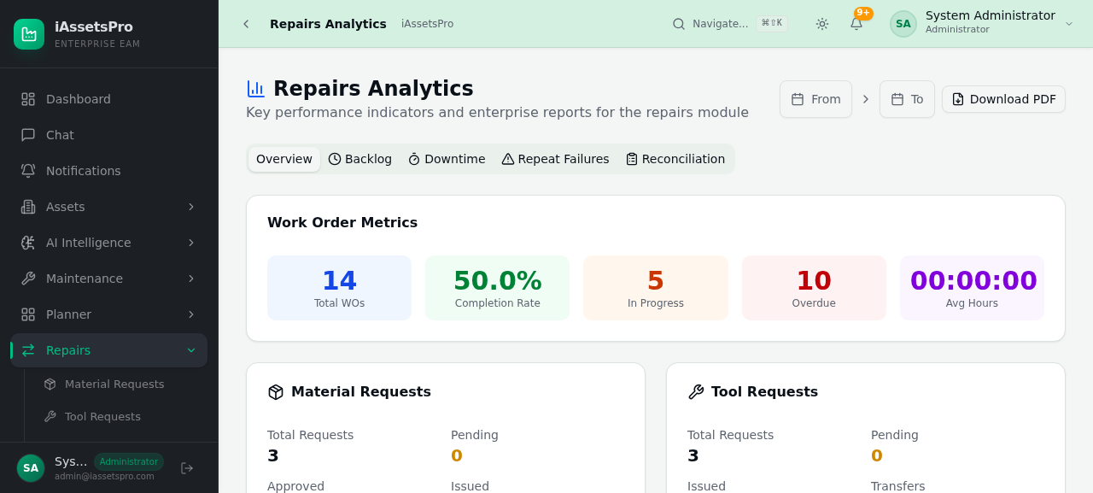
PHASE 4 · COMPLETION & REPORTING
Step 18
Repair Analytics
Real-time insights: WO completion rates, resolution times, technician productivity, equipment reliability, MTBF/MTTR, and trend analysis.
iAssetsPro — Maintenance Repairs Work Order Module

Slide 21
PHASE 4 · COMPLETION & REPORTING
Step 19
Repair Reports
Comprehensive reporting: by asset, overview stats, technician productivity, materials & costs, downtime impact. Export to Excel, PDF, or Print.
iAssetsPro — Maintenance Repairs Work Order Module

Slide 22
iAssetsPro
Thank You
Ready to transform your maintenance operations
Contact: info@iassetspro.com | www.lightworldtech.com
© 2025 Lightworld Technologies. All rights reserved.

