Slide 1
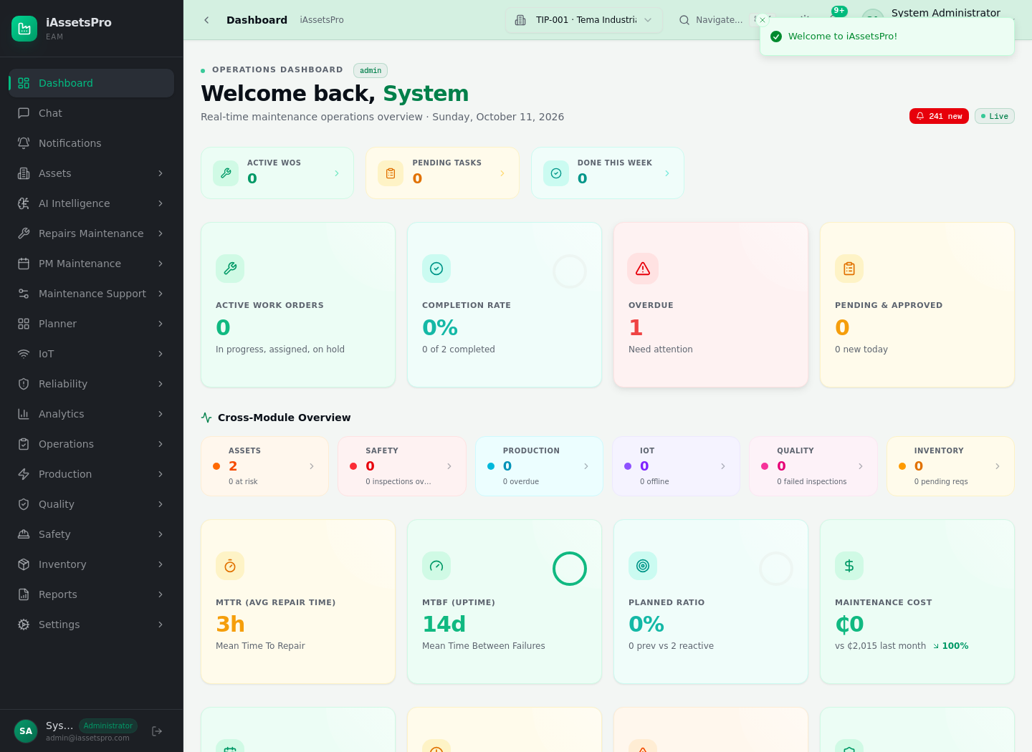
iAssetsPro
Enterprise Asset Management System
Asset hierarchy • Repairs maintenance • Preventive maintenance
Illustrated system presentation
Production-validated workflows
October 2026
iAssetsPro EAM | Lightworld Technologies Ltd 1

Slide 2
What iAssetsPro Controls
One connected record from physical asset to maintenance history
Asset master
Engineering hierarchy
Repairs / RWOP
Materials & tools
PM schedules
Analytics & audit
Plant/department-aware asset register
Machine → assembly → subassembly → component → part
Corrective and preventive work share one governed work-order engine
Condition-aware stock/tool custody prevents false availability
RBAC, auditability and operational KPIs
iAssetsPro EAM | Lightworld Technologies Ltd 2

Slide 3
System access and role-based navigation
Dashboard view used to enter specialist maintenance modules
iAssetsPro EAM | Lightworld Technologies Ltd 3

Slide 4
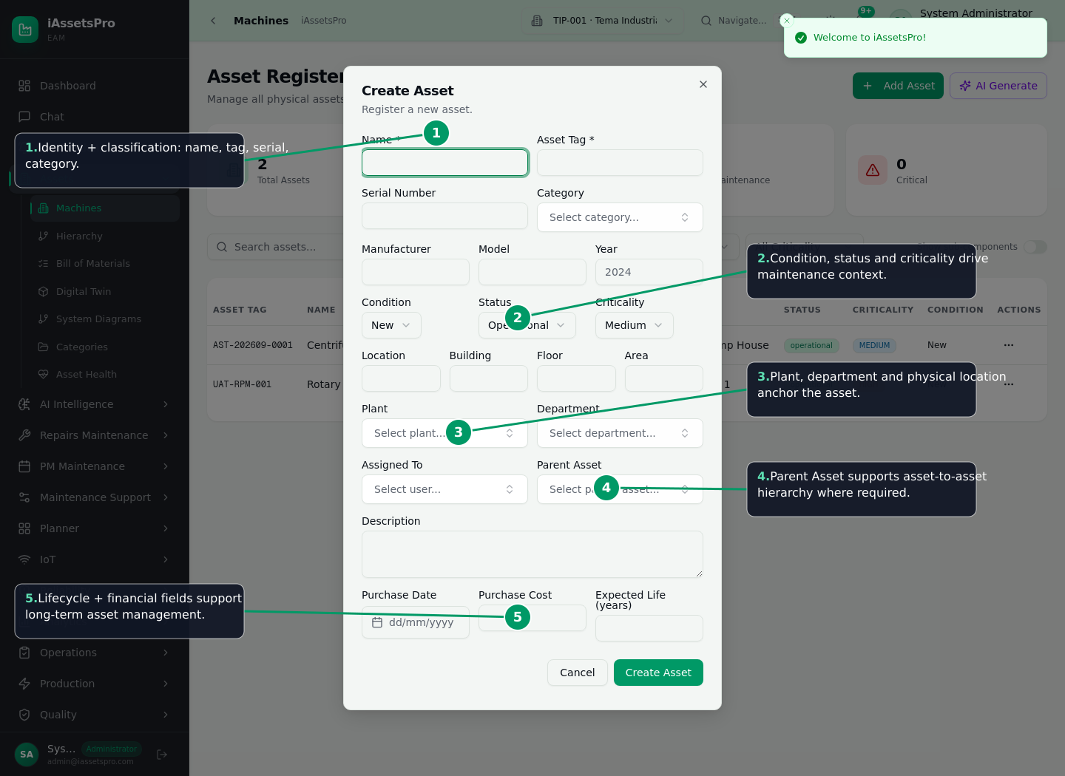
Create the parent machine / asset
The asset master anchors engineering identity, ownership, criticality and lifecycle
iAssetsPro EAM | Lightworld Technologies Ltd 4

Slide 5
Commission the maintainable hierarchy
Every child remains linked to its parent machine
MACHINE
ASSEMBLY
SUBASSEMBLY
COMPONENT
PART / SUB-PART
Example: Rotary Printing Machine 01
Main Drive Assembly
Drive Train
Main Drive Motor
Drive-End Bearing
iAssetsPro EAM | Lightworld Technologies Ltd 5

Slide 6
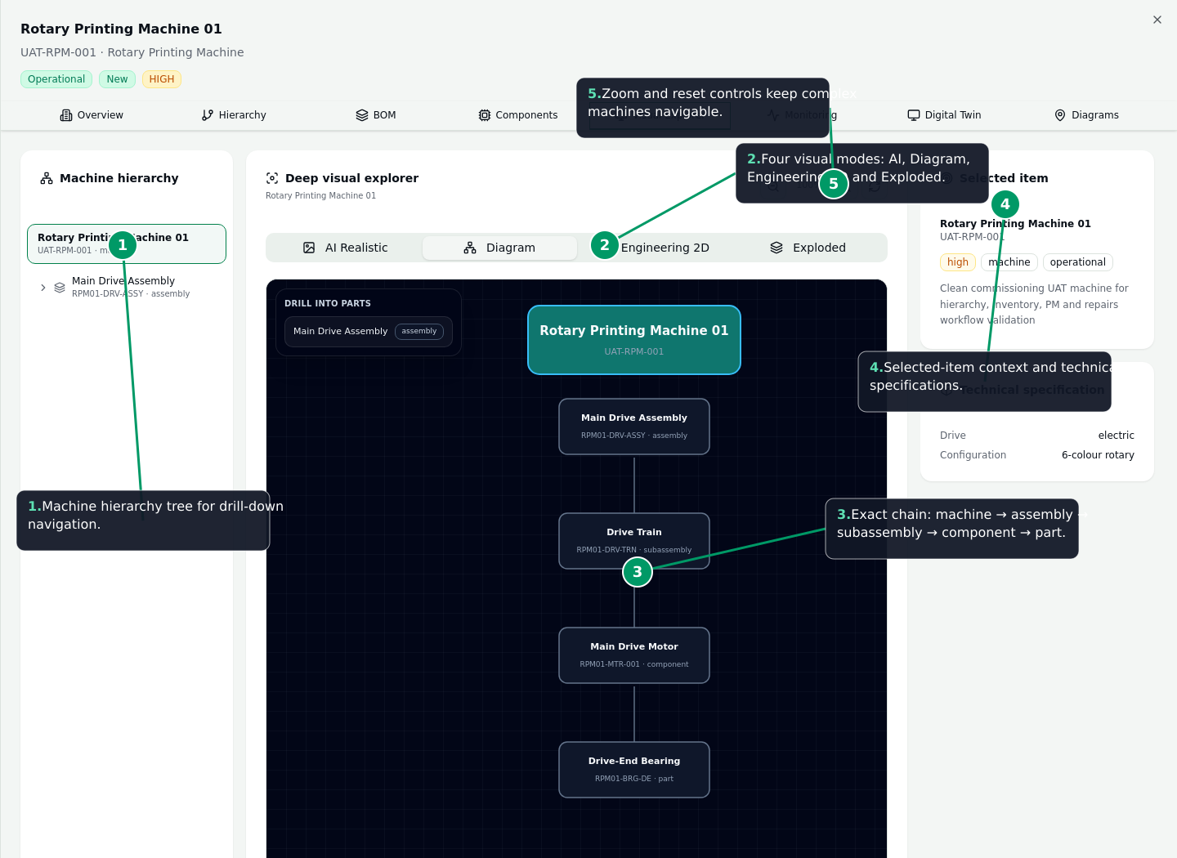
Deep Visual Explorer
Drill, visualize and inspect the exact engineering context of a maintainable item
iAssetsPro EAM | Lightworld Technologies Ltd 6

Slide 7
Corrective Repairs lifecycle
Controlled from defect intake through verified closure
Request
Review / convert
Plan & approve
Execute
Materials / tools
Complete
Review & close
The work order is the traceability hub
Time, downtime, people, tasks, evidence and resource usage remain attached
Closed history supports reliability and cost analytics
iAssetsPro EAM | Lightworld Technologies Ltd 7

Slide 8
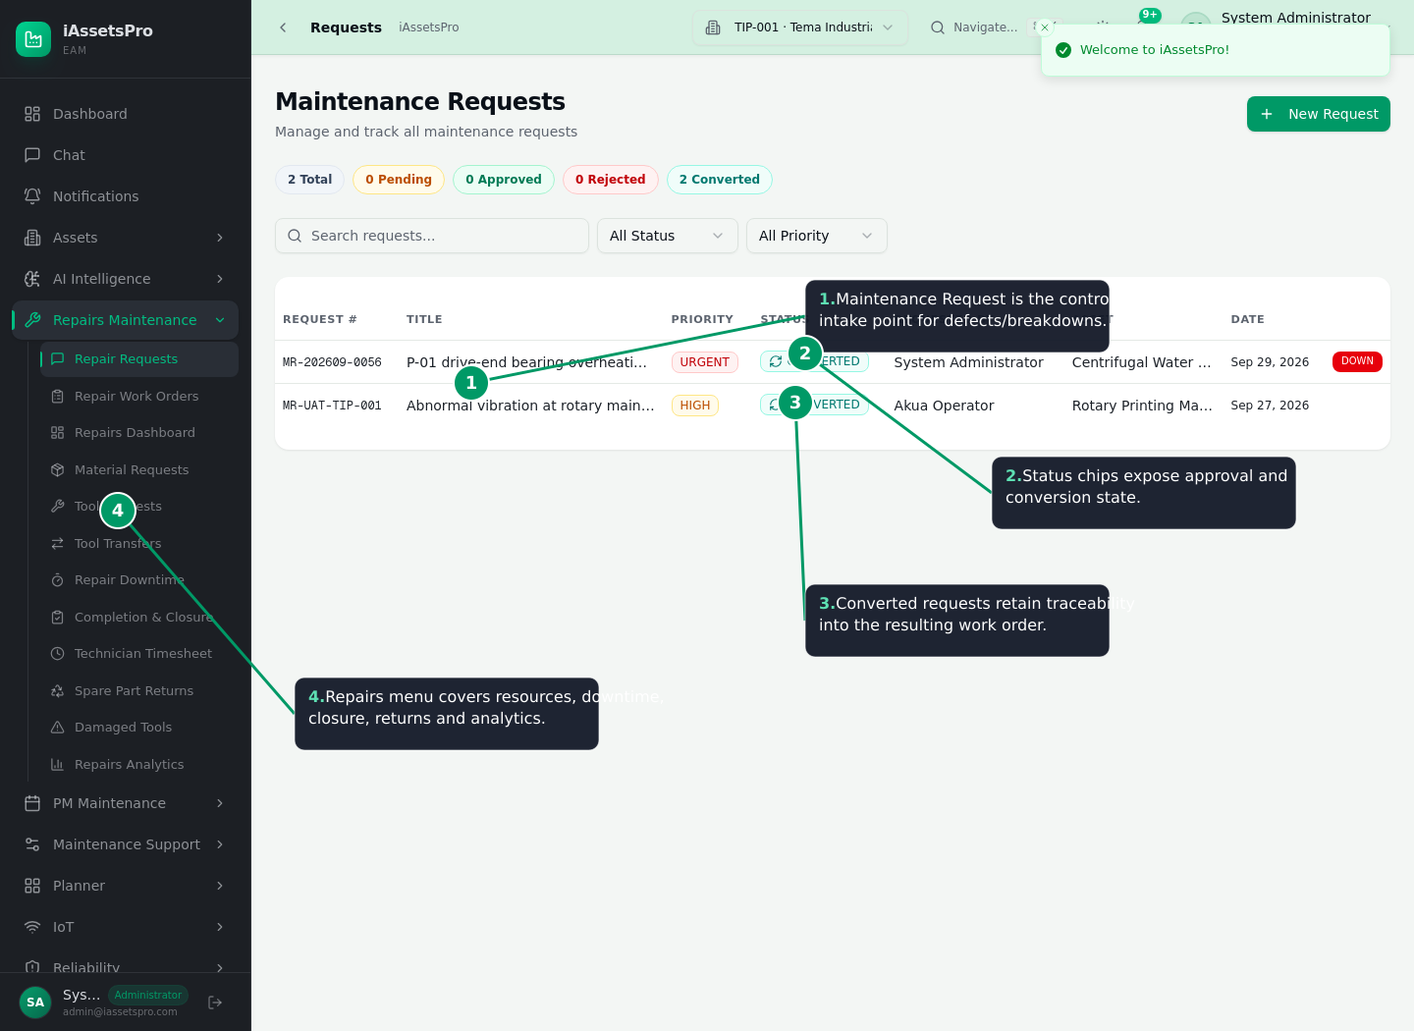
1. Maintenance Request - controlled defect intake
iAssetsPro EAM | Lightworld Technologies Ltd 8

Slide 9
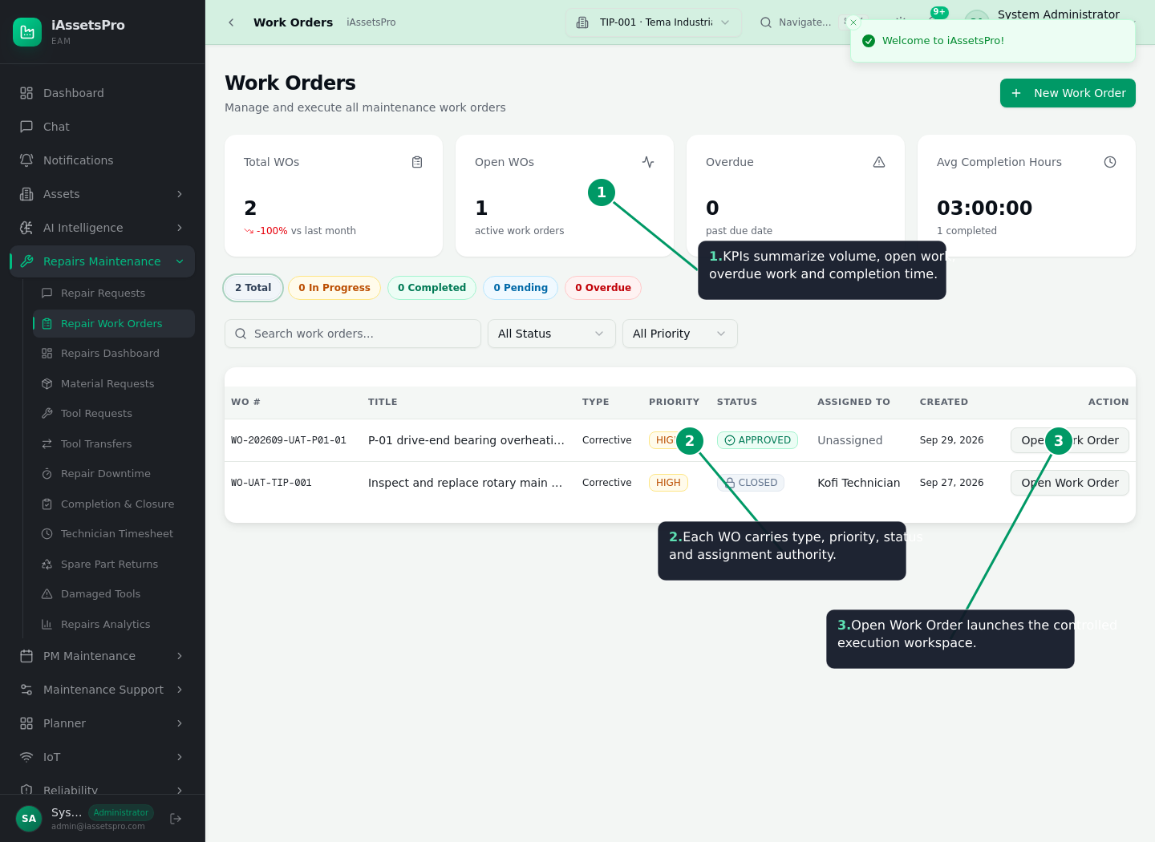
2. Repair Work Order - planning and execution authority
iAssetsPro EAM | Lightworld Technologies Ltd 9

Slide 10
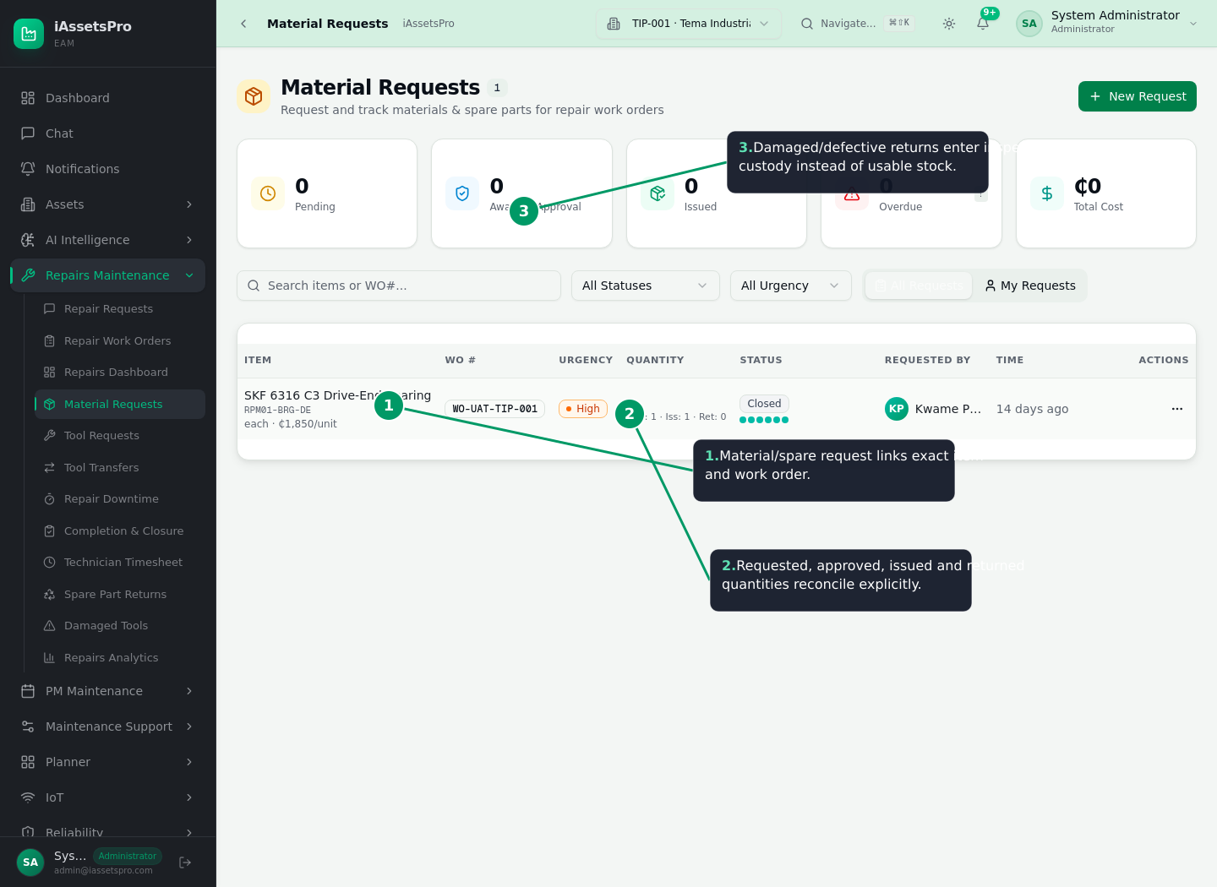
3. Material & spare-part custody
iAssetsPro EAM | Lightworld Technologies Ltd 10

Slide 11
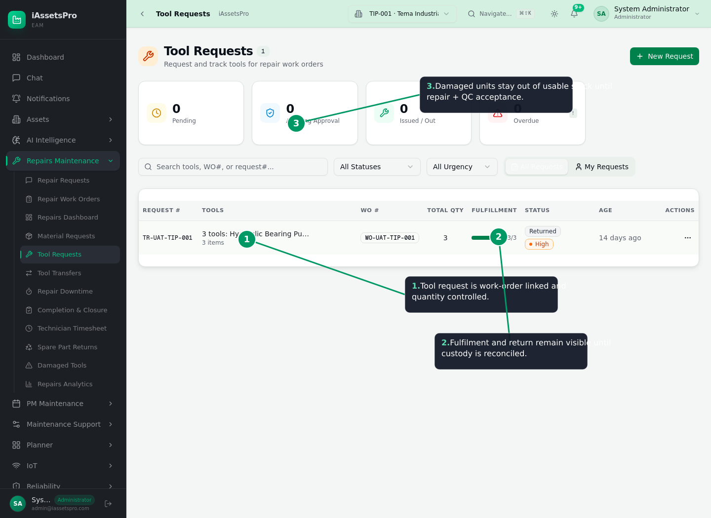
4. Tool custody and damaged-tool control
iAssetsPro EAM | Lightworld Technologies Ltd 11

Slide 12
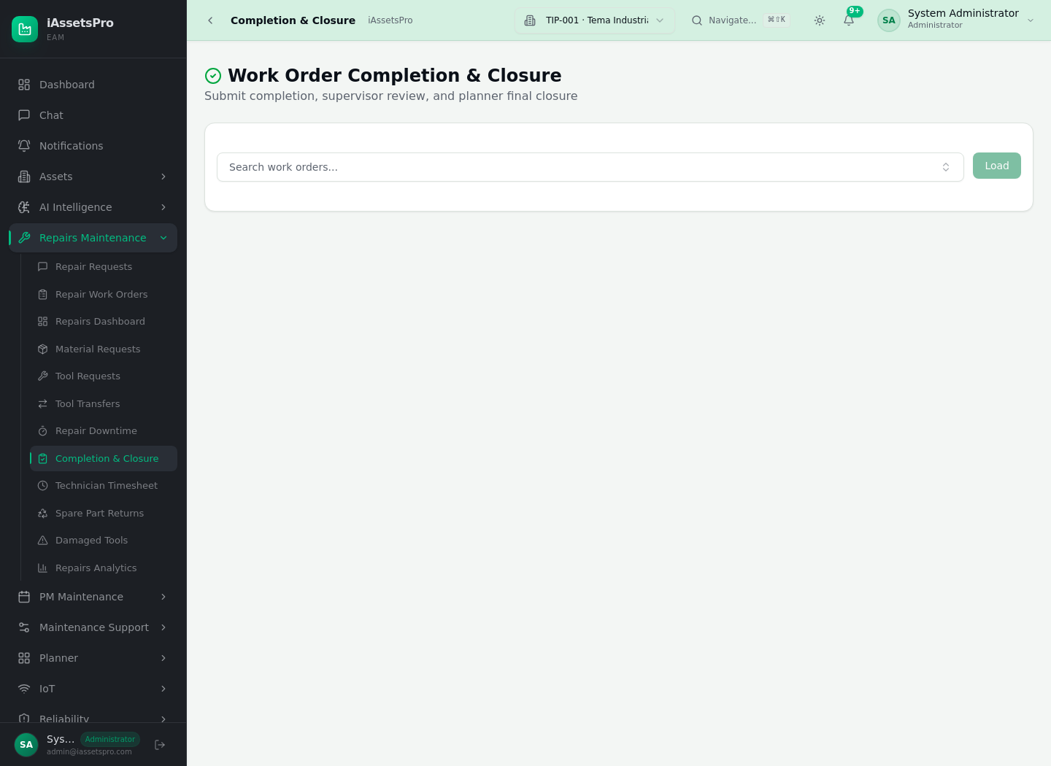
5. Completion & Closure
Technician completion is reviewed before final work-order closure
iAssetsPro EAM | Lightworld Technologies Ltd 12

Slide 13
Preventive Maintenance lifecycle
Standardized work before failure
PM template
Schedule
Select asset
Exact target
Time / meter trigger
Auto WO
Execute & close
Same hierarchy used by Repairs
Templates standardize checklists
Schedules can be time-based or meter-based
Generated PM work orders retain parent asset + exact component target
iAssetsPro EAM | Lightworld Technologies Ltd 13

Slide 14
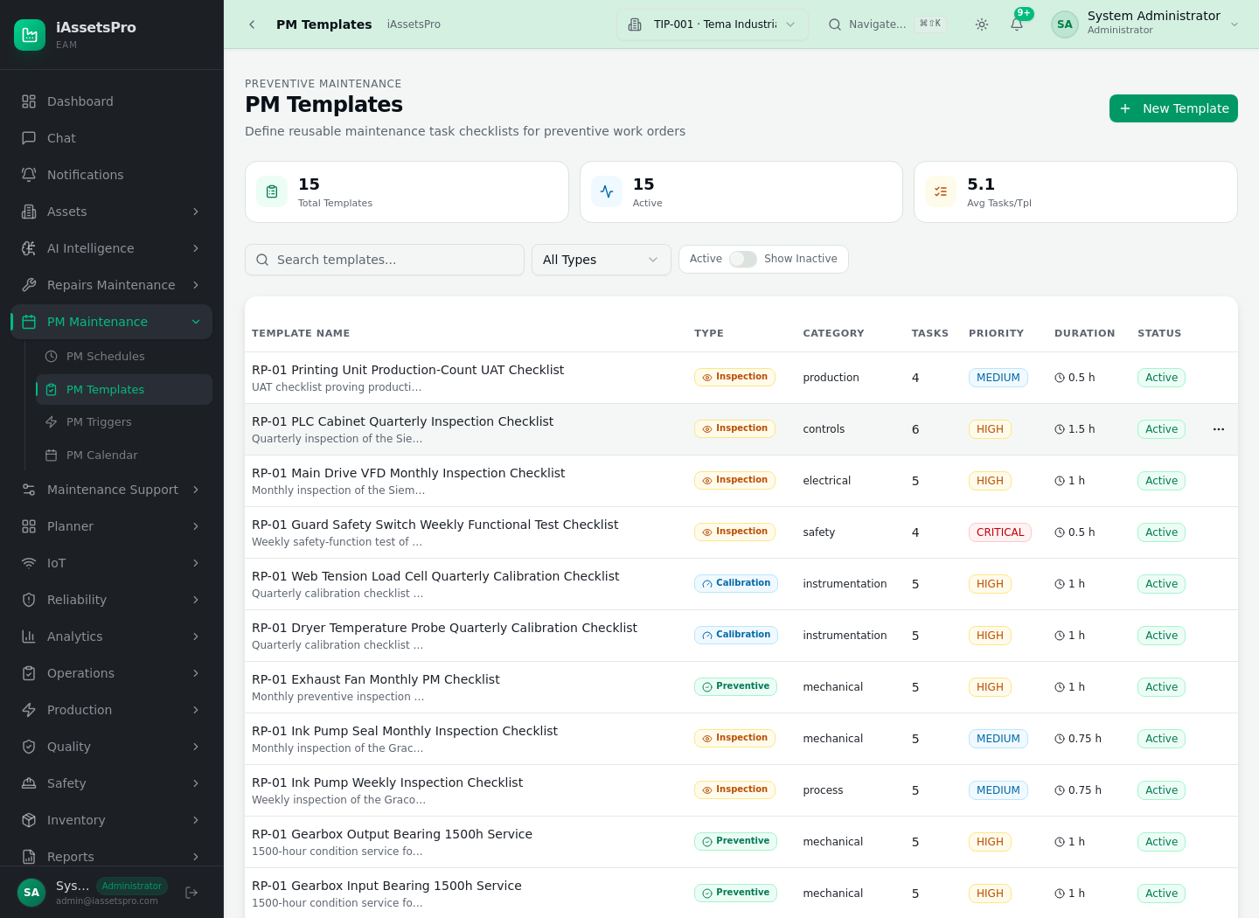
PM Templates - standardized maintenance content
iAssetsPro EAM | Lightworld Technologies Ltd 14

Slide 15
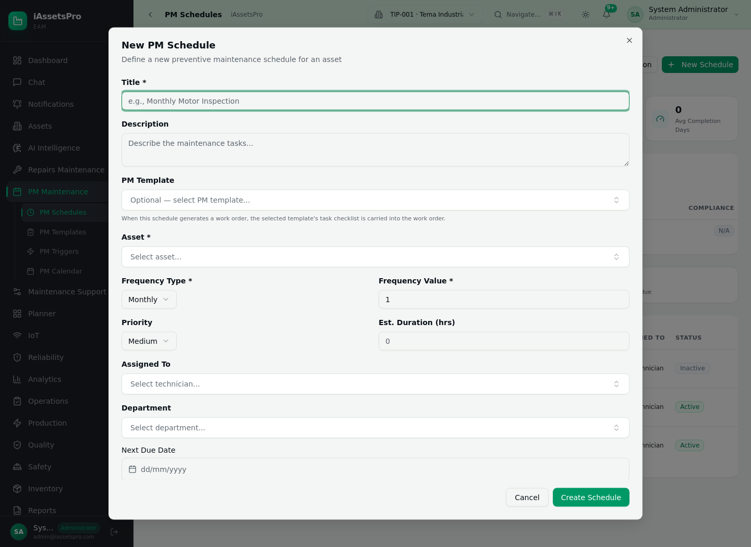
Create PM Schedule
Choose cadence, priority, assignee, template and auto-generation rules
iAssetsPro EAM | Lightworld Technologies Ltd 15

Slide 16
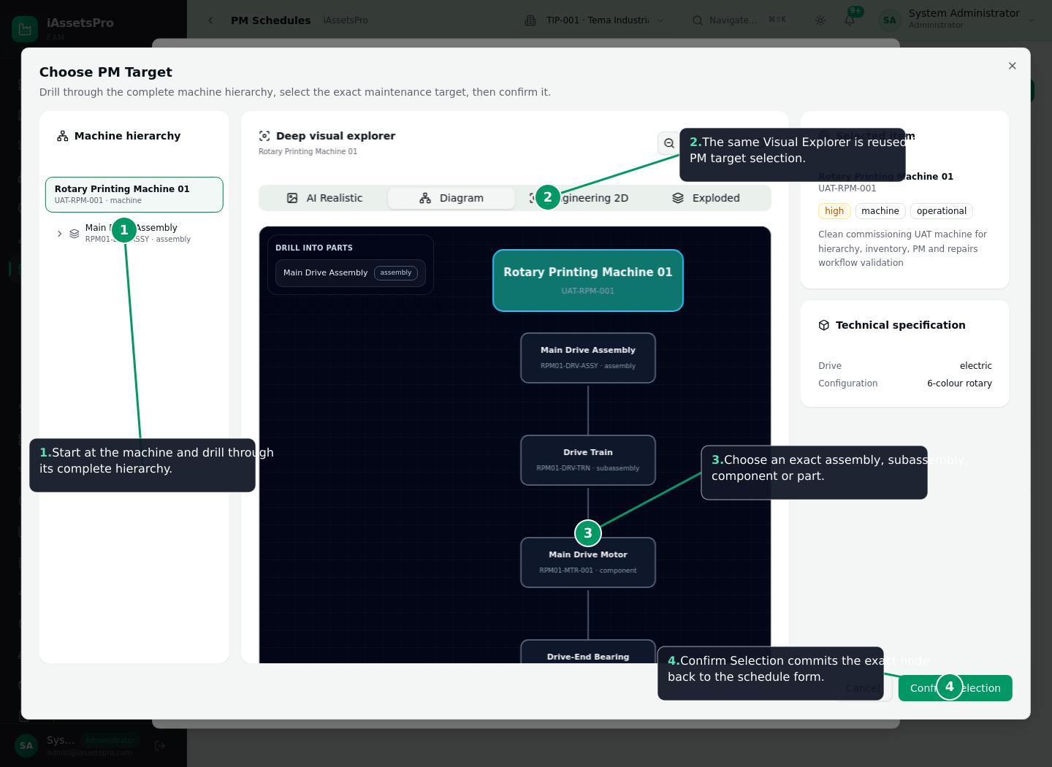
PM exact-target Visual Explorer
Drill to the assembly, subassembly, component or part and Confirm Selection
iAssetsPro EAM | Lightworld Technologies Ltd 16

Slide 17
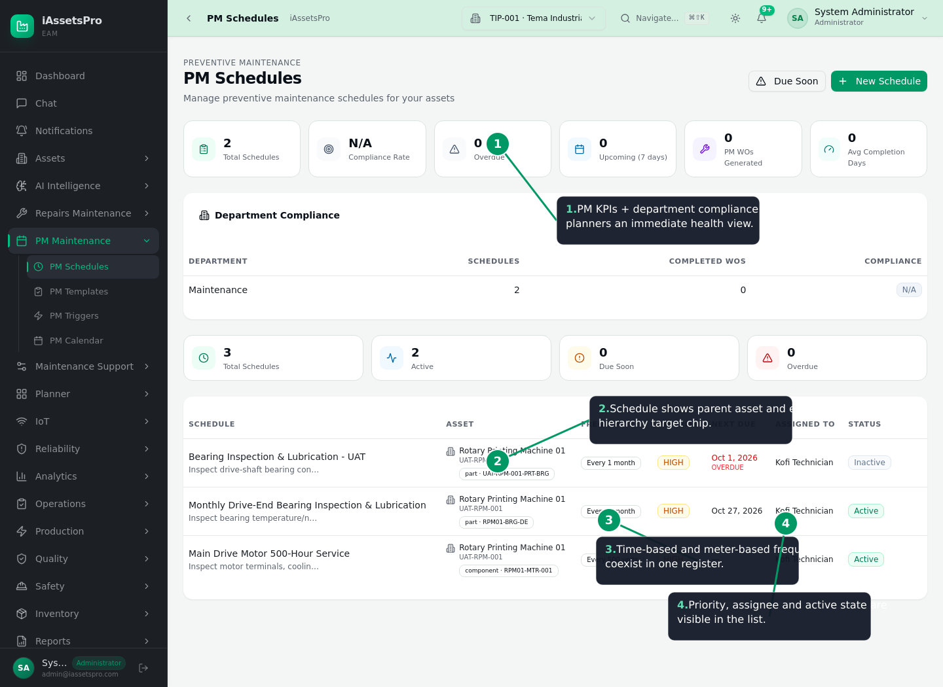
PM Schedules and compliance control
iAssetsPro EAM | Lightworld Technologies Ltd 17

Slide 18
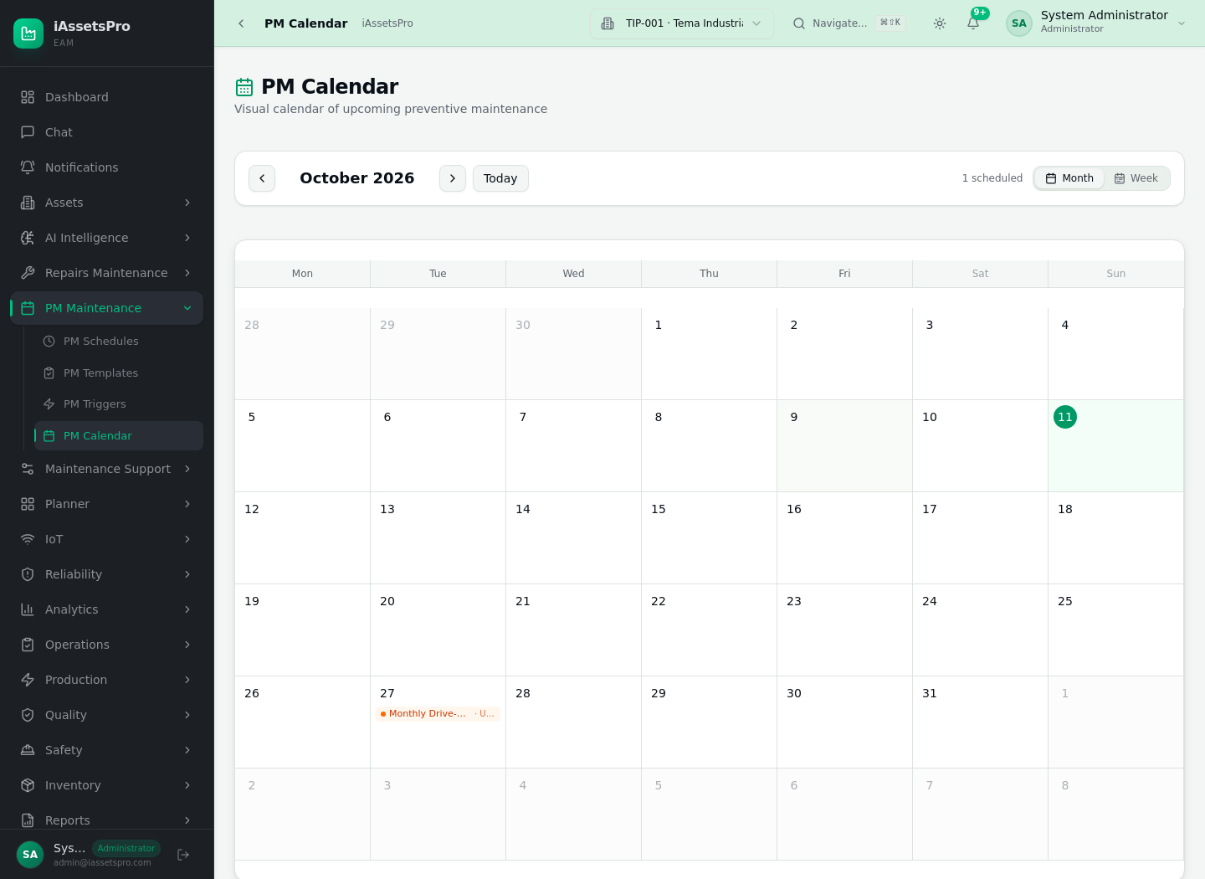
PM Calendar
Visual planning of upcoming preventive maintenance workload
iAssetsPro EAM | Lightworld Technologies Ltd 18

Slide 19
Inventory quality and maintenance custody
Condition-aware returns protect the integrity of usable stock
Issue to WO
Use / inspect
Serviceable return
Defective quarantine
Repair / refurbish
QC accept / supplier / scrap
Serviceable returns can re-enter usable stock
Damaged/defective material returns enter inspection custody
Damaged tools remain unavailable until repair + QC acceptance
Receiving quality hold supports supplier return and replacement quantity
iAssetsPro EAM | Lightworld Technologies Ltd 19

Slide 20
Governance and enterprise controls
Role-based access for operator, planner, supervisor, technician, store and administration
Plant-aware authorization and audit trail
PostgreSQL transactional persistence
Redis/BullMQ background processing and operational queues
Offline/sync architecture for intermittent-connectivity operations
Automated lint, unit, build, container, platform E2E and Repairs UAT release gates
iAssetsPro EAM | Lightworld Technologies Ltd 20

Slide 21
Release validation
The demonstrated PM/runtime release passed the full Required CI Gate
Lint ✓
Repairs TypeScript hard gate ✓
Full Vitest unit suite ✓
Optimized production build + container build ✓
Platform Playwright E2E ✓
Repairs/RWOP Playwright UAT ✓
Required CI Gate ✓
iAssetsPro EAM | Lightworld Technologies Ltd 21

Slide 22
Live demo route for tomorrow
A 12-15 minute story that shows value, not menus
1. Add Asset
2. Drill hierarchy
3. Raise defect
4. Open WO
5. Materials/tools
6. Create PM
7. Select exact target
Close by showing PM calendar/compliance and explaining the single traceable history from machine to part.
Keep this deck/PDF available offline as presentation backup.
iAssetsPro EAM | Lightworld Technologies Ltd 22

Slide 23
iAssetsPro
From asset structure to controlled maintenance execution.
Thank you
iAssetsPro EAM | Lightworld Technologies Ltd 23

