Slide 1
TIPid: Decision Support System On E-shopping Products Through Graphical Visualization And Data Mining
BSCS 4-2
AVEROS, CHRISTIAN M.
DELICANO, JOBEA ANN F.

Slide 2
CHAPTER 1
THE PROBLEM AND ITS BACKGROUND

Slide 3
INTRODUCTION
Shoppers want to bargain to get the best when buying products.
Today’s technological trend: online shopping.
Problems encountered
Data Mining
Graphical Visualization

Slide 4
STATEMENT OF THE PROBLEM
Using the Apriori algorithm, what is the accuracy of getting the relevant data from online shopping websites?
What is the accuracy of applying Bayesian Estimation and Interleaved Ranking in getting the best deals?
What is the average degree of maximizing graph in plotting the best deals?

Slide 5
SCOPE AND LIMITATION
The study will focus on the accuracy of the finding the best deals of a product selected by the user at the top online shopping websites.
The system will:
Mine data from popular retailer online shopping websites
NOT include second hand online shopping websites
Assess best deals according to price and numerical reviews
Display prices on Philippine Peso currency

Slide 6
CHAPTER 2
REVIEW OF RELATED LITERATURE AND STUDIES

Slide 7
REVIEW OF RELATED STUDIES
Comparison of E-Commerce Products Using Web Mining
Usage of crawlers to periodically fetch information from websites, shows comparison of specifications in output but simple comparison and does not identify the best deals.
Data Mining: Concepts, Background and Methods of Integrating Uncertainty in Data Mining
Using of different clustering techniques to deal with uncertainty on fetched data but problems in minimizing the sum error in clustering the uncertain data.
HCRS: A hybrid clothes recommender system based on user ratings and product feature
Usage of user ratings and attributes as parameters to fetch correct data and use of clustering to reduce the noise data. Lacks more parameters that could narrow down the fetched data.

Slide 8
CHAPTER 3
RESEARCH METHODOLOGY

Slide 9
RESEARCH DESIGN
Experimental Research Design is used to determine the answers in questions stated in the statement of the problem.
The independent variable in the study is the keyword/search term that will be used to fetch data from online shopping websites.

Slide 10
SOURCE OF DATA
The primary source of data are search terms from the respondents. Fifty(50) search terms will be feed to the system and will be used to search for the best deals.

Slide 11
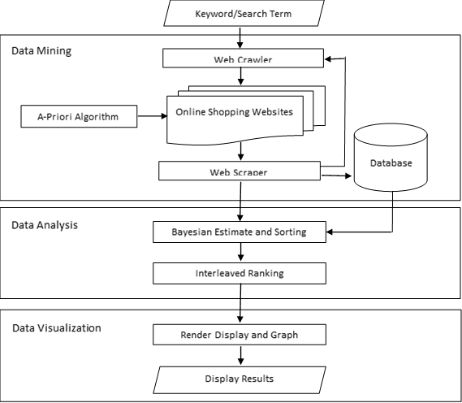
System architecture

Slide 12
DEVELOPMENT DETAILS
The following tools will be used in developing the system:
Python
Django Framework
Scrapy
Diffbot
Graphos

Slide 13
RESEARCH INSTRUMENT
Experiment Paper will be used to measure and record results while testing the system.
The paper will include the following parameters:
search term/keyword
number of irrelevant items
degree of graph maximization
no. of candidate - best deal
no. of non-candidate - best deal
no. of candidate - non-best deal
no. of non-candidate – non-best deal

Slide 14
DATA GENERATION
Software Related Data
Fifteen (15) product data sets per OSW each for a maximum of sixty (60) products data sets were gathered will be stored in a database.
The data acquired from the four (4) OSWs are then further reduced and extracted only the best out of all the data.
The data sets of 'best deals' are sorted according to the respondent's preference and finally displayed.

Slide 15
DATA GENERATION
Survey & Testing Data
A regression tests of fifty (50) unique search terms are used as testing data sets. The testing data sets are then evaluated for accuracy in getting the extracted best data sets.
Ranked reviews and prices will be categorized to two: first half as candidates and other half as non-candidates. And will be counted by evaluating best deals based on the categories.
The degree of graph maximization is evaluated according to: highly maximized, averagely maximized and lowly maximized.

Slide 16

DATA ANALYSIS
In order to solve for the first problem, accuracy of the scraped set by A-priori algorithm is computed by the following formula:
$$x=\frac{n}{N}×100$$
where: $x$ = accuracy
$n$ = number of relevant item in set
$N$ = total number of item in set

Slide 17

DATA ANALYSIS
The formula of Bayesian Estimation in the second problem is used for evaluation of the ranking in the 'scraped' data sets:
$$x=w ∗R+1 \left( 1 −w \right) ∗C$$
where: $x$ = Bayesian estimate
$R$ = mean over the ratings for the items.
$C$ = mean over all items
$w$ = v/(v+m)
v = number of reviews
m = threshold parameter

Slide 18
DATA ANALYSIS
The formula of Bayesian Estimation in the second problem is used for evaluation of the ranking in the 'scraped' data sets:
$$x=w ∗R+1 \left( 1 −w \right) ∗C$$
where: $x$ = Bayesian estimate
$R$ = mean over the ratings for the items.
$C$ = mean over all items
$w$ = v/(v+m)
v = number of reviews
m = threshold parameter

Slide 19

DATA ANALYSIS
The formula of Recall will be used on solving second problem:
$$x=\frac{cb}{cb+nb}$$
where: $x$ = Bayesian estimate
$cb$ = no. of candidate - best deal item
$nb$ = no. of non-candidate – best deal item

Slide 20

DATA ANALYSIS
To solve the third problem, formula for frequency distribution is used:
$$x= \frac{Σfw}{N}$$
where: $x$ = mean
$f$ = frequency
$w$ = weight
$N$ = number of items

