Slide 1

Development of A Secure Communication System Based On Steganography For Mobile Devices A Master Thesis
17th Nov 2014
By
Dasarathan Selvaraj
Matriculation No:1028405
Advisor : Prof. Dr. Christian Baun
Co – Advisor : Prof. Dr. Matthias Wagner

Slide 2
Agenda
Introduction
Objective
Application Feature
Design
Implementation
Conclusion

Slide 3
Introduction
Steganography
Different type of steganography
Additional security by encryption
Development of Android app called “protectMSG” for mobile devices

Slide 4
Objective
To develop an android app which implements steganography.
It should support Android 4.0 Ice Cream Sandwich to Android 4.4 KitKat.
Hide message into a cover file.
Additional security for protecting the message using password.

Slide 5
Application Feature
Encode Text To Image
Encode Text To Audio
Encode Audio To Image
Decode Text From Image
Decode Text From Audio
Decode Audio From Image
Select Image
Capture Image
Select audio
Record audio
Share
Help

Slide 6
Design LSB Technique
Message Byte
1
0
1
0
1
1
0
0
Extract the bit from message byte
Replace the LSB of Cover Byte
MSB
LSB
1st Byte
1
0
1
0
1
1
0
0
1
0
0
1
1
0
1
0
1
0
1
1
1
0
0
0
0
1
1
Cover Bytes
1
0
1
0
1
1
0
0
0
1
1
0
0
0
0
0
0
1
0
1
1
0
1
1
0
0
1
1
0
0
0
1
1
0
1
0
8th Byte
0
1
1
1
1
0
0
0
0

Slide 7
Design
Encode Data Packet
Message Length – Size of the message to be hidden
Flag – Used for error detection
Message – Message to be hidden
Frame Size
Message Length – 32 bits
Flag – 32 bits
Message – Variable
Message Length
Flag
Message
Header

Slide 8
Implementation Encryption
AES Encryption
128 bits cipher key size
User password is used to generate key
Password padding for appropriate key size
Base64 encoding scheme
Message
Encrypt
Encode

Slide 9
Implementation
Enter text to hide
Enter password for optional encryption
Select cover Image from device storage
Capture image using device camera to use it as a cover image.
Share encoded image
Select encoded image
Enter password if the image was protected by password
Encode Text To Image
Decode Text From Image

Slide 10
Implementation Program Input Validation
Input | Valid Criteria
Encode Text | Not null and length between 1 to 50 characters. It can be numeric, alphabets and special characters.
Password | Null or length between 3 to 15 character. It can be numeric, alphabets and special characters.
Image | JPG, JPEG, PNG file formats are accepted.
Audio | WAV file formats is accepted.

Slide 11
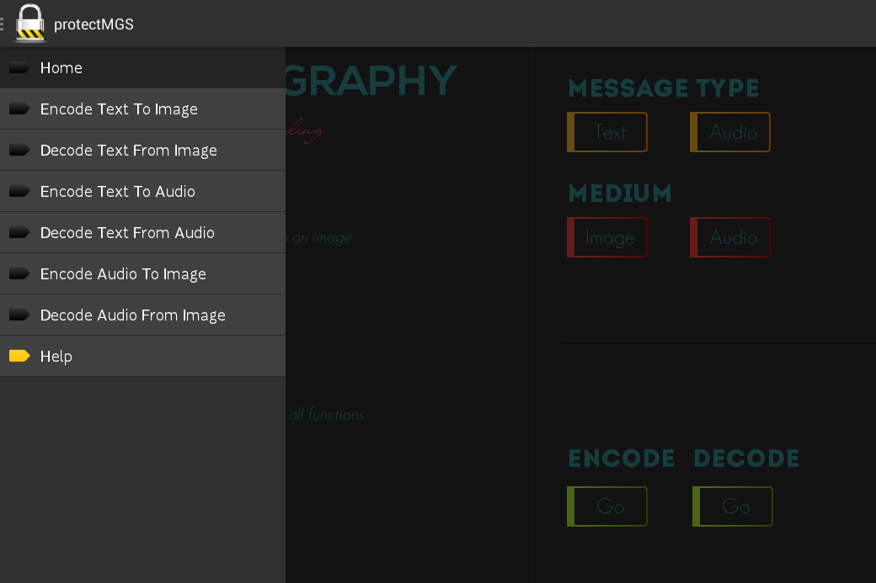
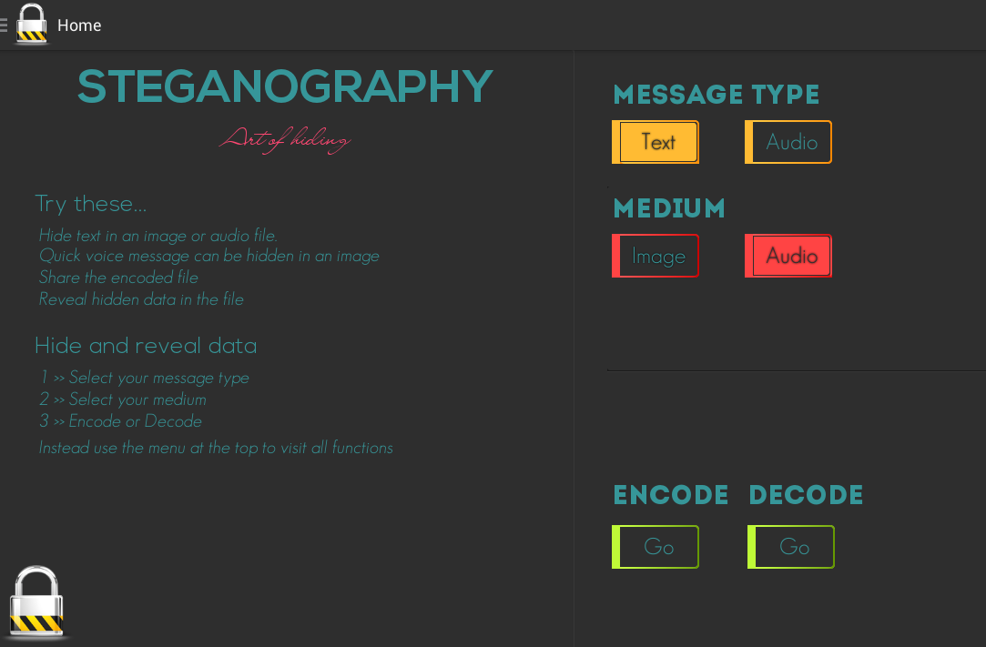
Implementation Home and Navigation

Slide 12
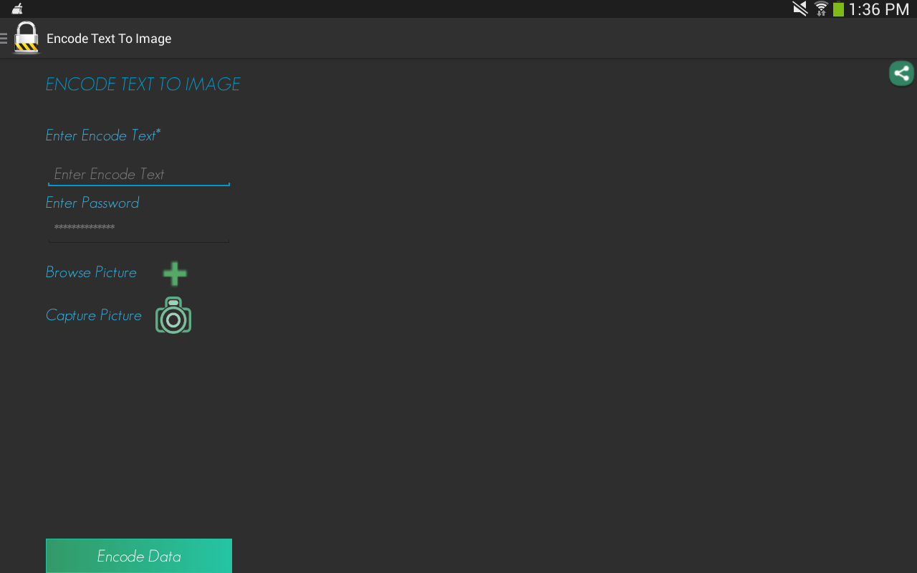
Implementation Encode Text To Image

Slide 13
Share file
Message
Password
Choose cover object
Selected cover object
Error or hidden Message
Button to start the process

Slide 14
Implementation Encode Text To Image

Slide 15





Implementation Supporting Features
Browse Audio
Capture Picture
Browse Picture
Share file
Record Audio
Selected Audio file

Slide 16
Conclusion Summary
Implementation of LSB steganography technique in android.
Other requirements are theoretically designed and implemented in practice as an android app named “protectMSG”
The developed app is found to be stable and fulfills all the initial requirements.

Slide 17
Conclusion Future Enhancement
Validity for the message
Other input file types
Hide an image in a cover image
Hide an audio in a cover audio

Slide 18
Thank You
Dasarathan Selvaraj
Master of Science,
High Integrity System,
Frankfurt University of Applied Sciences

