Slide 1

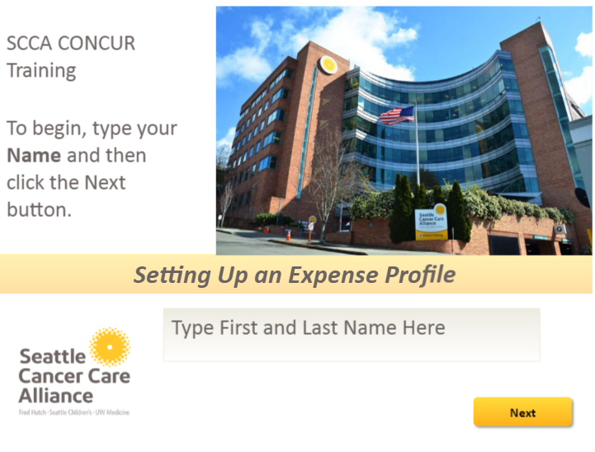
Content Slide
Project Title | CONCUR Training |  | Module Title | Module Title | Setting Up an Expense Profile | Reviewer Notes
Screen # | 1 | Screen Title | Course Title Page/Intro |  |  | Reviewer 1
Visuals (Video/Pics/Characters) |  |  |  |  | Onscreen Text “Setting Up an Expense Profile” “SCCA CONCUR Training. To begin, type your Name and then click the Next Button.” “Type First and Last Name Here”
 |  |  |  |  |  | Reviewer 2
 |  |  |  |  | Animation & Interactivity Layer 1: SCCA logo enters and exits screen via fade (standard SCCA Intro) Layer 2: Learner enters their name and clicks ‘Next’
 |  |  |  |  |  | Reviewer 3
Audio No audio present on this slide
Navigation/ Branching | Linear. User advances by clicking “next” |  |  | Estimated time | 30 seconds

Slide 2



Content Slide
Project Title | CONCUR Training |  | Module Title | Module Title | Setting Up an Expense Profile | Reviewer Notes
Screen # | 2 | Screen Title | Attention Getter/Building Learner Motivation |  |  | Reviewer 1
Visuals Infographics |  |  |  |  | Onscreen Text Layer 1: “60% of employees say they have failed to claim expenses in the past” “The average value of unclaimed expenses was $151 per person” Layer 2: “Put money back in your pocket”
 |  |  |  |  |  | Reviewer 2
 |  |  |  |  | Animation & Interactivity Layer 1: Infographic with animation & text Layer 2: Infographic with animation & text
 |  |  |  |  |  | Reviewer 3
Audio No audio present on this slide
Navigation/ Branching | Linear. User advances by clicking “next” |  |  | Estimated time | 1 minute

Slide 3

Content Slide
Project Title | CONCUR Training |  | Module Title | Module Title | Setting Up an Expense Profile | Reviewer Notes
Screen # | 3 | Screen Title | Objectives |  |  | Reviewer 1
Visuals Concur logo/ SCCA logo |  |  |  |  | Onscreen Text By the end of this training you will know how to: Login to CONCUR Set up your CONCUR expense profile
 |  |  |  |  |  | Reviewer 2
 |  |  |  |  | Animation & Interactivity Text will enter screen with standard animation
 |  |  |  |  |  | Reviewer 3
Audio No audio present on this slide
Navigation/ Branching | Linear. User advances by clicking “next” |  |  | Estimated time | 30 seconds

Slide 4

Content Slide
Project Title | CONCUR Training |  | Module Title | Module Title | Setting Up an Expense Profile | Reviewer Notes
Screen # | 4 | Screen Title | Logging into CONCUR |  |  | Reviewer 1
Visuals SecureAuth login page screenshot |  |  |  |  | Onscreen Text “Go to https://auth.seattlecca.org.SecureAuth46/ and login with your SCCA credentials.”
 |  |  |  |  |  | Reviewer 2
 |  |  |  |  | Animation & Interactivity User types name & pw into boxes and clicks ‘submit’ to advance. Hover interaction pop up help box: “If you need help retrieving your SCCA credentials or resetting your password, call the helpdesk at 206-606-8200”
 |  |  |  |  |  | Reviewer 3
Audio No audio present on this slide
Navigation/ Branching | Linear. User advances by clicking “submit” |  |  | Estimated time | 1 minute

Slide 5
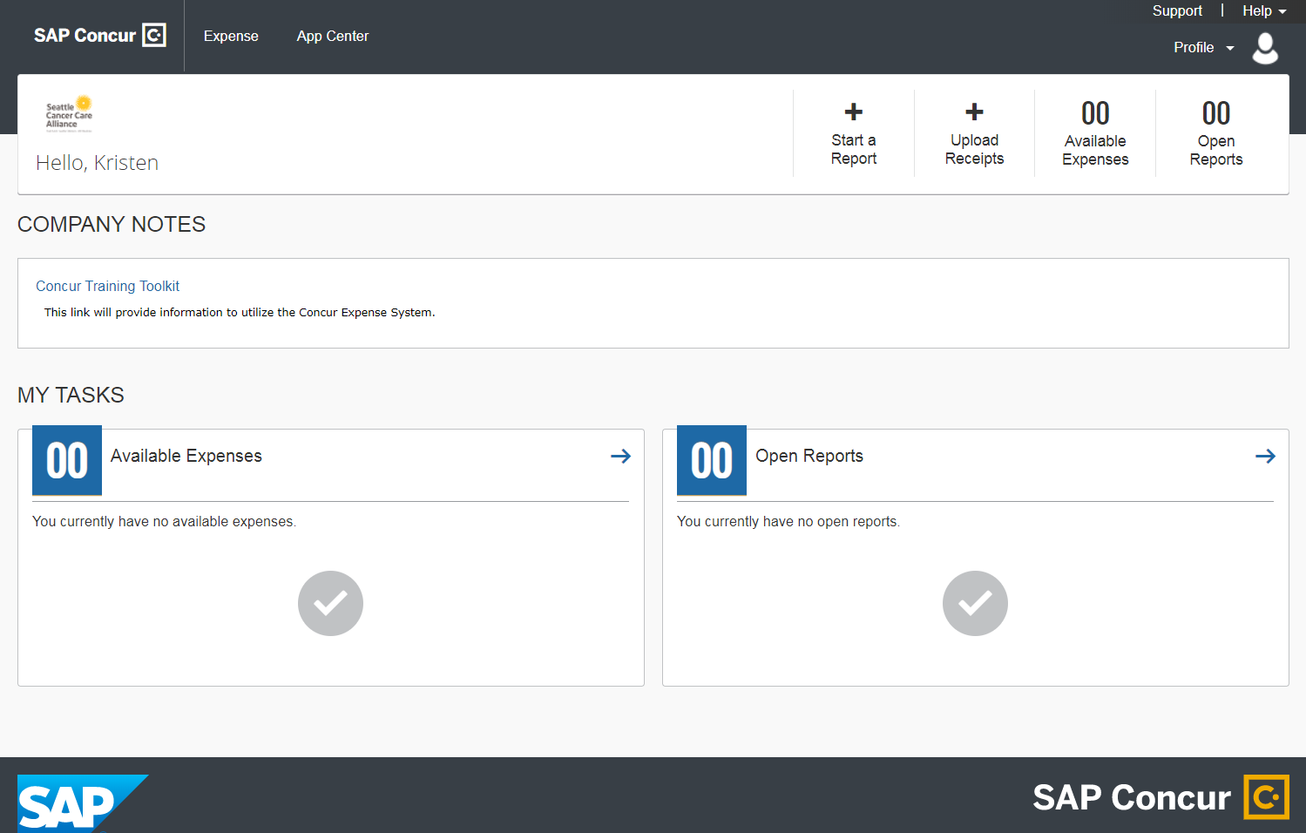
Content Slide
Project Title | CONCUR Training |  | Module Title | Module Title | Setting Up an Expense Profile | Reviewer Notes
Screen # | 5 | Screen Title | Getting to expense profile |  |  | Reviewer 1
Visuals CONCUR homepage screenshot |  |  |  |  | Onscreen Text Layer 1: Click on profile at the top of the page Layer 2: Click on ‘profile settings’
 |  |  |  |  |  | Reviewer 2
 |  |  |  |  | Animation & Interactivity Layer 1: user clicks on ‘profile’ and triggers layer 2 Layer 2: Profile menu pops up, user clicks on ‘profile settings’ to continue onto next slide
 |  |  |  |  |  | Reviewer 3
Audio No audio present on this slide
Navigation/ Branching | Linear. User advances by clicking “profile settings” |  |  | Estimated time | 30 seconds

Slide 6
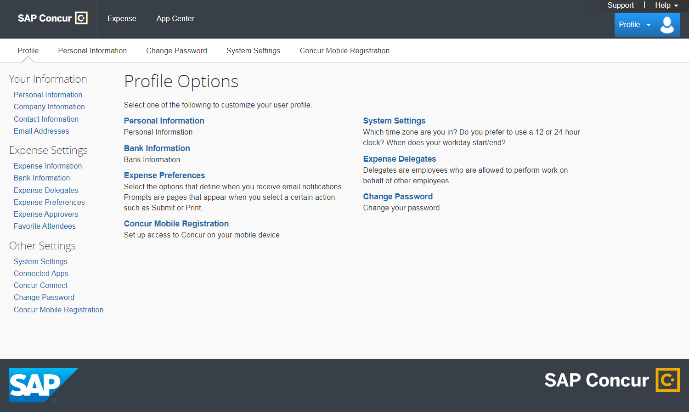
Content Slide
Project Title | CONCUR Training |  | Module Title | Module Title | Setting Up an Expense Profile | Reviewer Notes
Screen # | 6 | Screen Title | Filling out ‘Your information’ |  |  | Reviewer 1
Visuals Profile homepage screenshot |  |  |  |  | Onscreen Text First, we’ll walk you through how to set up ‘your information’. Click on any menu item to continue
 |  |  |  |  |  | Reviewer 2
 |  |  |  |  | Animation & Interactivity Circle will appear around ‘Your Information’ section. Hotspots will be active for each menu item: personal info, company info, contact info, email addresses. User can click any to continue.
 |  |  |  |  |  | Reviewer 3
Audio No audio present on this slide
Navigation/ Branching | Branching, user has 4 options to choose from |  |  | Estimated time | 30 seconds

Slide 7
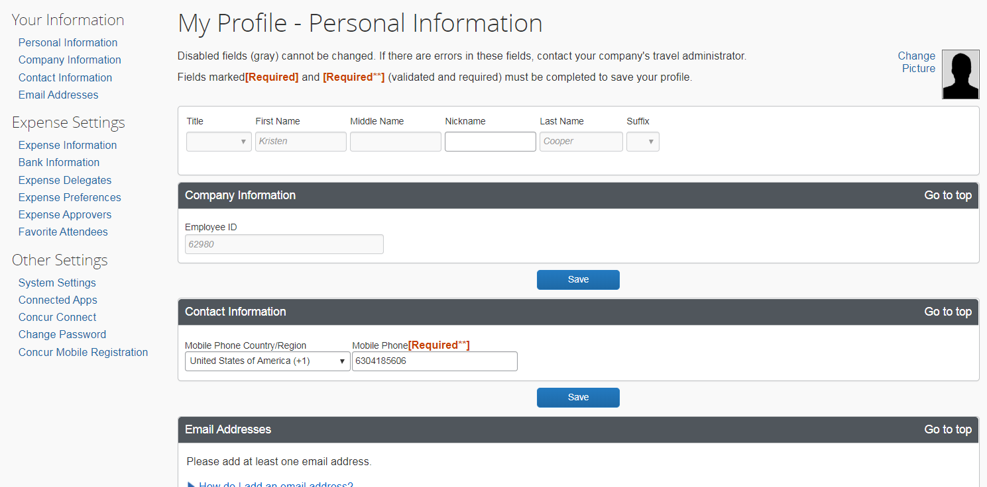
Content Slide
Project Title | CONCUR Training |  | Module Title | Module Title | Setting Up an Expense Profile |  | Reviewer Notes
Screen # | 7 | Screen Title | Personal Information |  |  |  | Reviewer 1
Visuals Personal info page screenshot |  |  |  |  | Onscreen Text “Check to make sure your First and Last name information is correct. You may add a middle name and nickname if you like.” “To continue, enter a middle name and click Save”
 |  |  |  |  |  |  | Reviewer 2
 |  |  |  |  | Animation & Interactivity Hover interaction pop up help box: “If your first or last name is incorrect, please email corpcard_travel@seattlecca.org” User types in name and clicks ‘Save’ to advance. After user clicks ‘Save’ box will appear around ‘Your information’ with pop up: “Select another menu option to continue filling out your profile”
 |  |  |  |  |  |  | Reviewer 3
Audio No audio present on this slide
Navigation/ Branching | Branching, user has 1-3 remaining options to choose from. Checkmark will appear next to ‘personal information’ menu item. |  |  | Estimated time |  | 1 minute

Slide 8
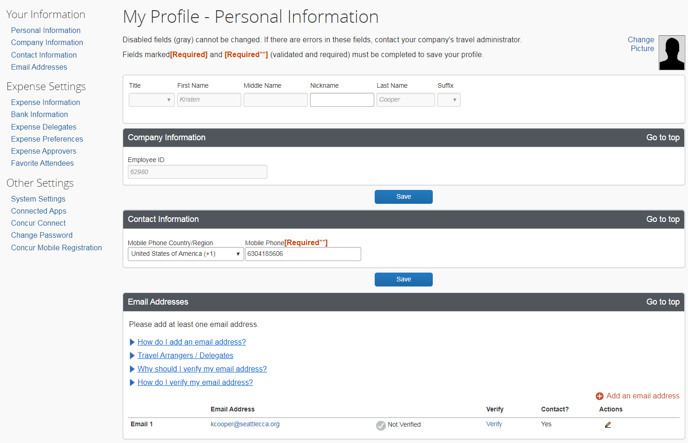
Content Slide
Project Title | CONCUR Training |  | Module Title | Setting Up an Expense Profile |  |  | Reviewer Notes
Screen # | 8 | Screen Title | Company Information |  |  |  | Reviewer 1
Visuals Company info page screenshot |  |  |  | Onscreen Text “Review the information on this page to ensure your employee ID, manager, and cost center code are accurate.
 |  |  |  |  |  |  | Reviewer 2
 |  |  |  | Animation & Interactivity Hover interaction pop up help box: “Your cost center number should reflect your SCCA budget number. Reach out to your manager if you are unsure of your budget number.” Hover interaction pop up help box: “If any of the information in this section is incorrect, please email corpcard_travel@seattlecca.org”
 |  |  |  |  |  |  | Reviewer 3
Audio No audio present on this slide
Navigation/ Branching | Branching, user has 1-3 remaining options to choose from. Checkmark will appear next to ‘company information’ menu item. |  |  |  | Estimated time | 1 minute

Slide 9
Content Slide
Project Title | CONCUR Training |  | Module Title | Module Title | Setting Up an Expense Profile |  | Reviewer Notes
Screen # | 9 | Screen Title | Contact Information |  |  |  | Reviewer 1
Visuals Contact info page screenshot |  |  |  |  | Onscreen Text “Please enter a contact phone number in this section. If you would rather be contacted on your office phone than a mobile phone, you may enter that number.”
 |  |  |  |  |  |  | Reviewer 2
 |  |  |  |  | Animation & Interactivity “Enter a phone number and click save to continue” User must enter a number in the box and press save.
 |  |  |  |  |  |  | Reviewer 3
Audio No audio present on this slide
Navigation/ Branching | Branching, user has 1-3 remaining options to choose from. Checkmark will appear next to ‘contact information’ menu item. |  |  | Estimated time |  | 1 minute

Slide 10
Content Slide
Project Title | CONCUR Training |  | Module Title | Setting Up an Expense Profile |  |  | Reviewer Notes
Screen # | 10 | Screen Title | Email addresses |  |  |  | Reviewer 1
Visuals Email Address page screenshot |  |  |  | Onscreen Text Here you may change or add a second email address. In order to send receipts directly to CONCUR, click ‘Verify’ to activate your email. This will send a verification email to the address listed.
 |  |  |  |  |  |  | Reviewer 2
 |  |  |  | Animation & Interactivity Hover interaction pop-up: “Please note, a delegate CANNOT verify your email address on your behalf” “Add an email address and click ‘Verify’ to continue”
 |  |  |  |  |  |  | Reviewer 3
Audio No audio present on this slide
Navigation/ Branching | Branching, user has 1-3 remaining options to choose from. Checkmark will appear next to ‘email addresses’ menu item. Once all 4 sections have a checkmark, ‘Next’ button appears and user clicks to move on to the next section. |  |  |  | Estimated time | 1 minute

Slide 11
Content Slide
Project Title | CONCUR Training |  | Module Title |  | Setting Up an Expense Profile |  | Reviewer Notes
Screen # | 11 | Screen Title | Expense Settings |  |  |  | Reviewer 1
Visuals Profile options homepage screenshot |  |  |  |  | Onscreen Text Next, we’ll update our expense settings. Click on any menu item to continue.
 |  |  |  |  |  |  | Reviewer 2
 |  |  |  |  | Animation & Interactivity Circle will appear around ‘Expense Settings’ section. Hotspots will be active for each menu item: expense info, bank info, expense delegates, expense preferences, expense approvers. User can click any to continue.
 |  |  |  |  |  |  | Reviewer 3
Audio No audio present on this slide
Navigation/ Branching | Branching, user has 6 options to choose from. |  |  | Estimated time |  | 30 seconds

Slide 12
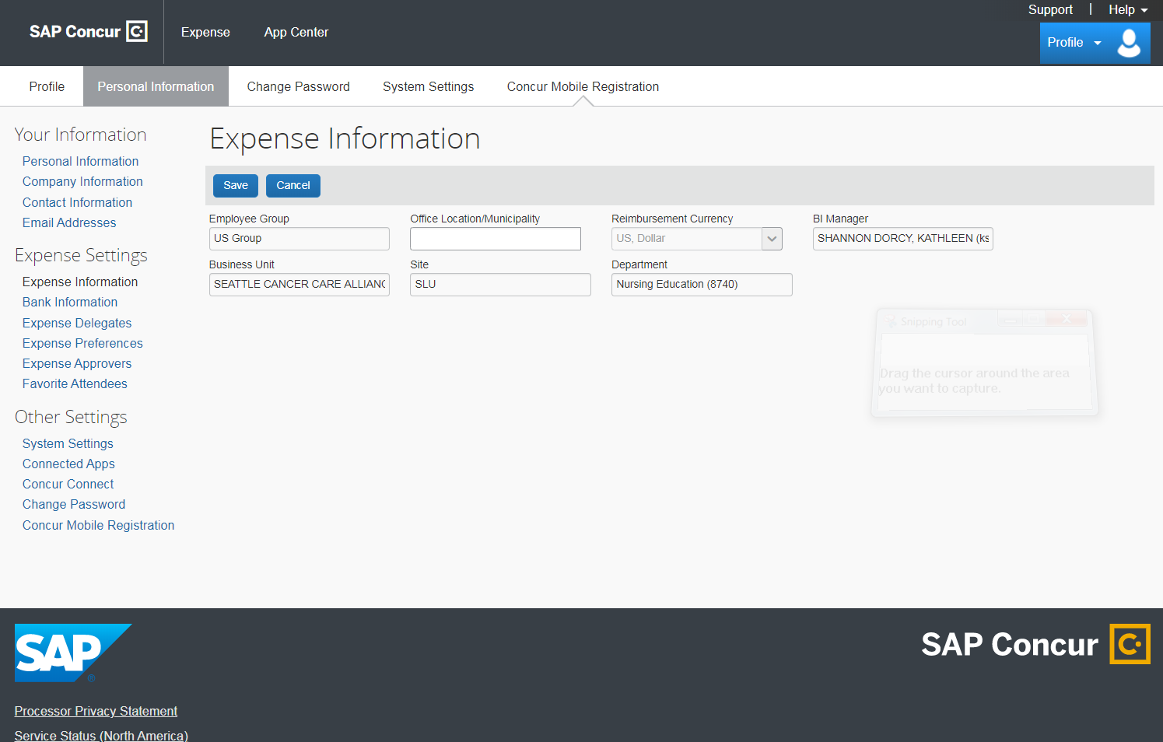
Content Slide
Project Title | CONCUR Training |  | Module Title | Setting Up an Expense Profile |  |  | Reviewer Notes
Screen # | 12 | Screen Title | Expense information |  |  |  | Reviewer 1
Visuals Expense info page screenshot |  |  |  | Onscreen Text “This information is imported directly from HR data. If anything looks incorrect, please email corpcard_travel@seattlecca.org
 |  |  |  |  |  |  | Reviewer 2
 |  |  |  | Animation & Interactivity ‘Click save to continue’
 |  |  |  |  |  |  | Reviewer 3
Audio No audio present on this slide
Navigation/ Branching | Branching, user has 1-5 remaining options to choose from. Checkmark will appear next to ‘expense information’ menu item. |  |  |  | Estimated time | 30 seconds

Slide 13
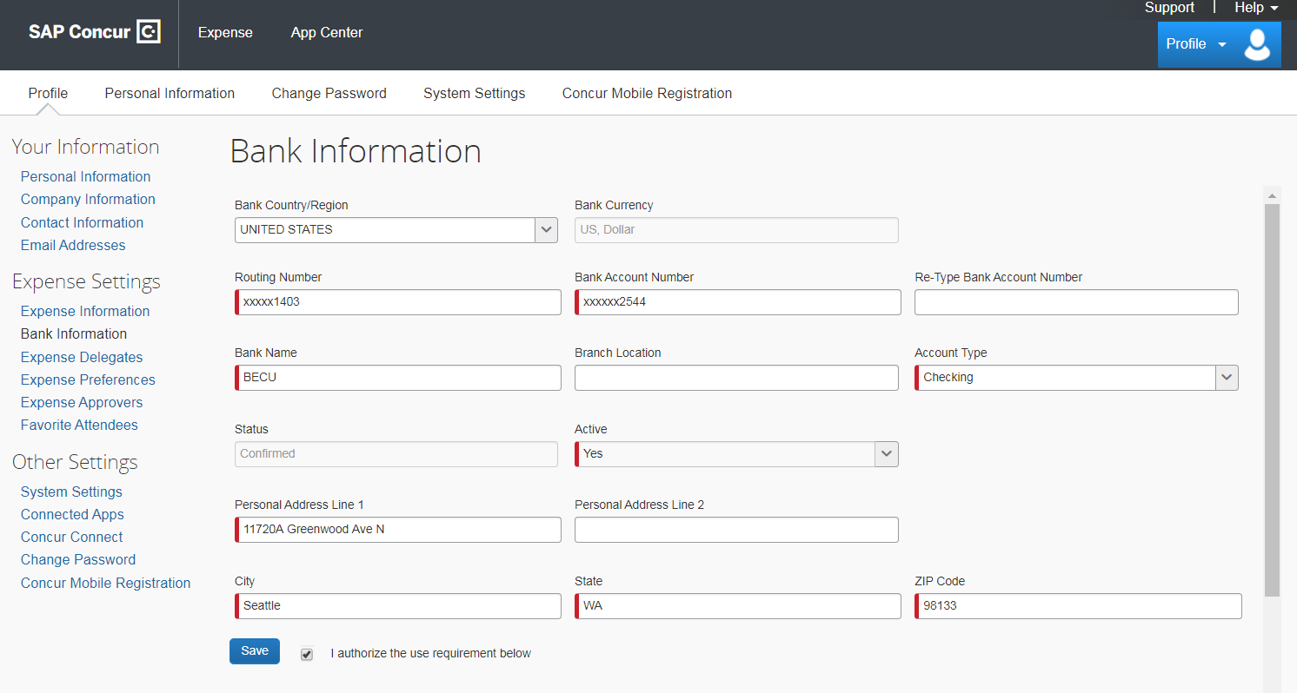
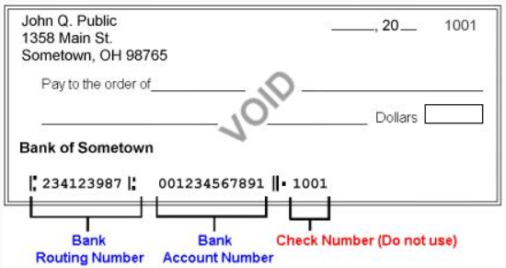
Content Slide
Project Title | CONCUR Training |  | Module Title | Module Title | Setting Up an Expense Profile |  | Reviewer Notes
Screen # | 13 | Screen Title | Bank Information |  |  |  | Reviewer 1
Visuals Bank info page screenshot |  |  |  |  | Onscreen Text “Banking information is used for reimbursement deposit only and is not accessible by any member of CONCUR or SCCA.” “Fill out all required fields in red. Use the information on the example VOID check to complete this page. Click ‘Save’ to continue.”
 |  |  |  |  |  |  | Reviewer 2
 |  |  |  |  | Animation & Interactivity -Example check will be in a click view/hide interaction. -User must fill out red fields and click ‘save to continue’. -Once user clicks save, pop up window will appear: “IMPORTANT: Your account will initially have a status of unconfirmed. CONCUR will deposit one cent in the account you identified. If the transaction is successful, the account is confirmed. This process usually takes 3-4 days and during this time you will be unable to submit reimbursement requests.”
 |  |  |  |  |  |  | Reviewer 3
Audio No audio present on this slide
Navigation/ Branching | Branching, user has 1-5 remaining options to choose from. Checkmark will appear next to ‘Bank information’ menu item. |  |  | Estimated time |  | 2 mins

Slide 14
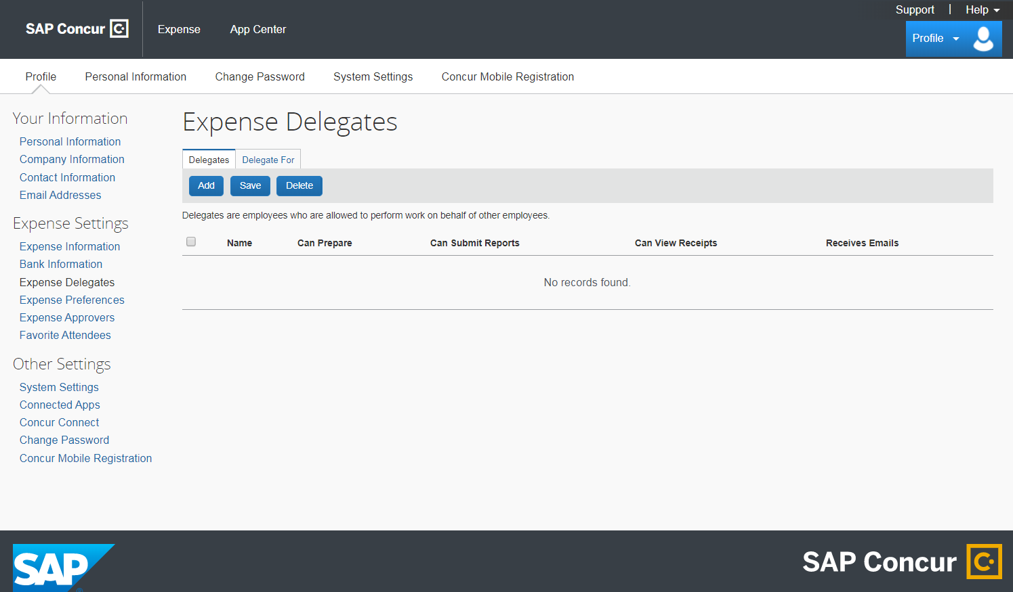
Content Slide
Project Title | CONCUR Training |  | Module Title | Module Title | Setting Up an Expense Profile |  | Reviewer Notes
Screen # | 14 | Screen Title | Expense Delegates |  |  |  | Reviewer 1
Visuals Expense delegate page screenshot |  |  |  |  | Onscreen Text “Delegates are other SCCA employees who can manage expenses on your behalf. This is helpful if you are out of the office or have an executive assistant who manages all credit cards for your team.”
 |  |  |  |  | Animation & Interactivity Click ‘Add’ and search for “Smith. Click each check box to learn more about these permissions” Click interactions: “Can Prepare – This will allow the user to get your statement ready, but they will not be able to submit it. This statement will sit in your queue until you are able to log back in and submit it Can submit- This will allow the user to submit reports for approval on your behalf. You will be notified when your report has been approved Can view receipts- User will allow the user to view any receipts you have uploaded or emailed to receipts@concur.com. This box must be selected if the delegate is given permission to prepare reports. Receives emails- User will receive email notifications on your behalf for status change notifications, email reminders, image received notifications, and new company card transactions notifications. Once all click interactions are complete, pop up will say ‘click Save to continue’
 |  |  |  |  |  |  | Reviewer 2
 |  |  |  |  |  |  | Reviewer 3
Audio No audio present on this slide
Navigation/ Branching | Branching, user has 1-5 remaining options to choose from. Checkmark will appear next to ‘expense delegates’ menu item. |  |  | Estimated time |  | 1 minute

Slide 15
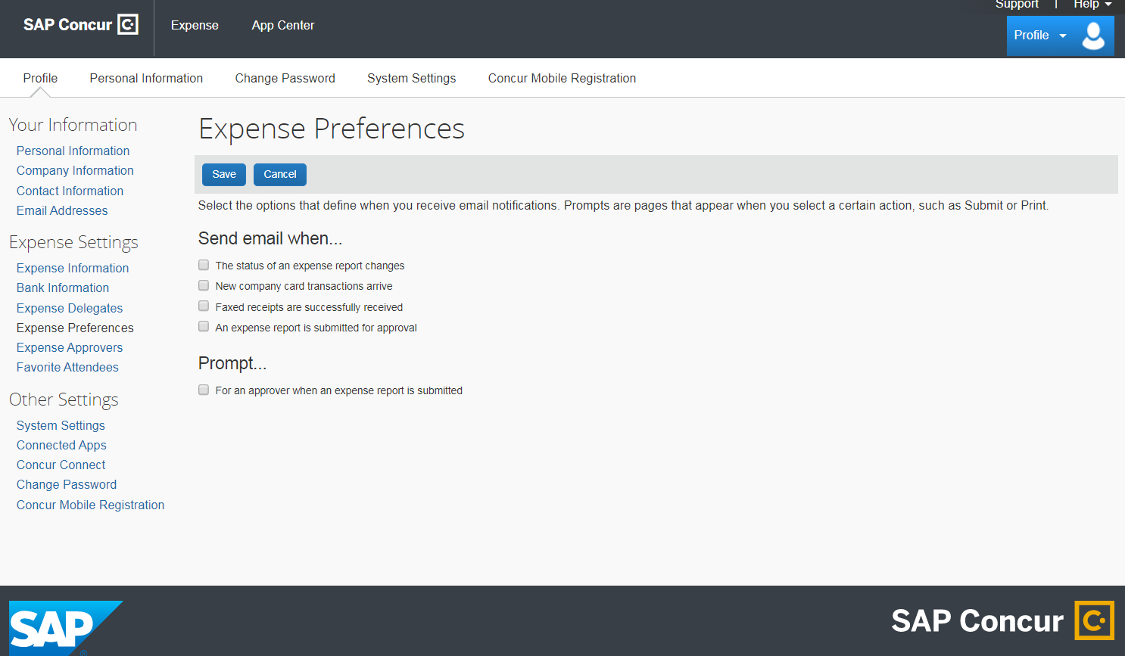
Content Slide
Project Title | CONCUR Training |  | Module Title | Module Title | Setting Up an Expense Profile |  | Reviewer Notes
Screen # | 15 | Screen Title | Expense Preferences |  |  |  | Reviewer 1
Visuals Expense preferences page screenshot |  |  |  |  | Onscreen Text Here you can set your email notification preferences
 |  |  |  |  |  |  | Reviewer 2
 |  |  |  |  | Animation & Interactivity Hover interaction near ‘Prompt’: Info pop up “Prompts are pages that appear when you select a certain action such as submit or print” “Click ‘Save’ to continue”
 |  |  |  |  |  |  | Reviewer 3
Audio No audio present on this slide
Navigation/ Branching | Branching, user has 1-5 remaining options to choose from. Checkmark will appear next to ‘expense preferences’ menu item. |  |  | Estimated time |  | 30 seconds

Slide 16
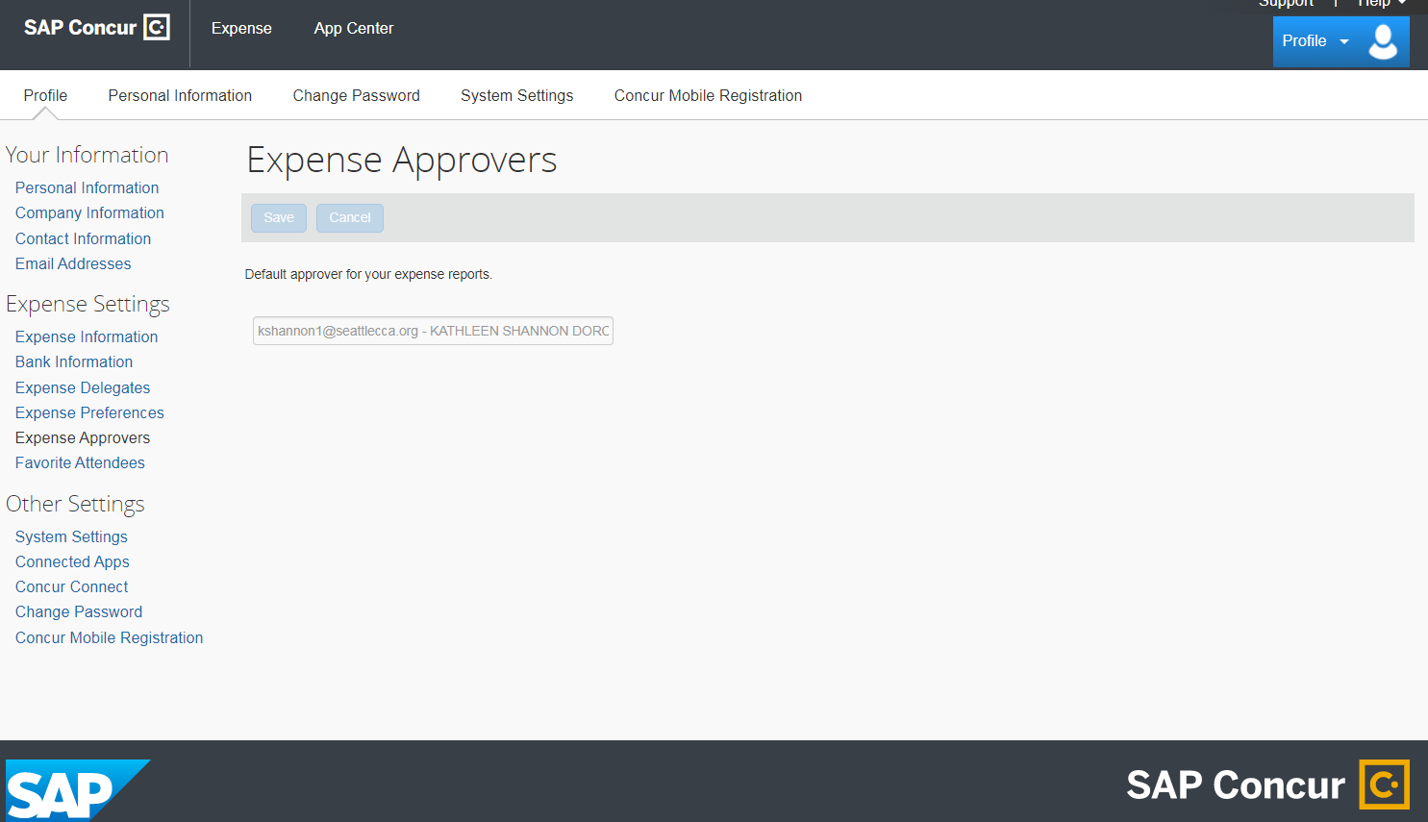
Content Slide
Project Title | CONCUR Training |  | Module Title | Module Title | Setting Up an Expense Profile |  | Reviewer Notes
Screen # | 16 | Screen Title | Expense Approvers |  |  |  | Reviewer 1
Visuals Expense approvers page screenshot |  |  |  |  | Onscreen Text This information is imported directly from HR data. If anything looks incorrect, please email corpcard_travel@seattlecca.org.
 |  |  |  |  |  |  | Reviewer 2
 |  |  |  |  | Animation & Interactivity Click next to continue'
 |  |  |  |  |  |  | Reviewer 3
Audio No audio present on this slide
Navigation/ Branching | Branching, user has 1-5 remaining options to choose from. Checkmark will appear next to ‘expense approvers’ menu item. |  |  | Estimated time |  | 30 seconds

Slide 17
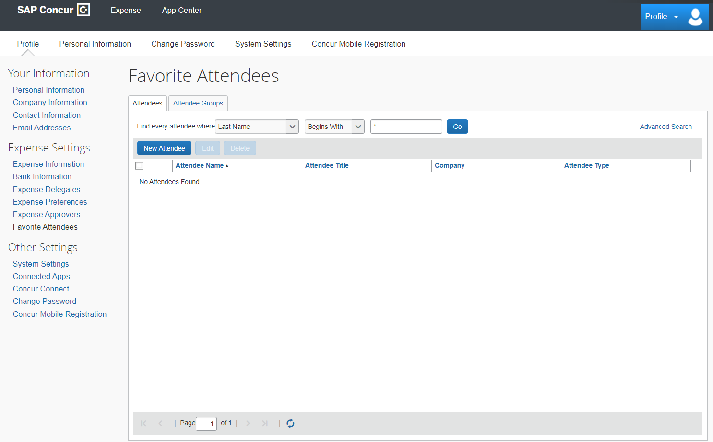
Content Slide
Project Title | CONCUR Training |  | Module Title | Setting Up an Expense Profile |  |  | Reviewer Notes
Screen # | 17 | Screen Title | Favorite Attendees |  |  |  | Reviewer 1
Visuals Favorite Attendees page screenshot |  |  |  | Onscreen Text This section is for adding team members that you often travel with or share expenses on your company credit card. This will save time when completing your expense reports, which will be covered in the next module.
 |  |  |  |  |  |  | Reviewer 2
 |  |  |  | Animation & Interactivity To add an attendee click on ‘advanced search’. Select ‘employee’ from the drop down menu. Type ‘smith’ in the last name field. Click ‘Search’. Select employee and click ‘add selected attendees to favorite attendees’, click ‘cancel’. Attendees are listed. User clicks ‘next’ to advance.
 |  |  |  |  |  |  | Reviewer 3
Audio No audio present on this slide
Navigation/ Branching | Branching, user has 1-5 remaining options to choose from. Checkmark will appear next to ‘favorite attendees’ menu item. Once all 6 sections have a checkmark, ‘Next’ button appears and user clicks to move on to the next section. |  |  |  | Estimated time

Slide 18
Content Slide
Project Title | CONCUR Training |  | Module Title | Module Title | Setting Up an Expense Profile | Reviewer Notes
Screen # | 18 | Screen Title | Wrap-Up Page |  |  | Reviewer 1
Visuals Infographics/SCCA Logo |  |  |  |  | Onscreen Text “This concludes training on how to set up your CONCUR Expense Profile. Next, we will have you run through these steps again on your own. If you need to reference the downloadable job aid, please navigate to the resources menu above”
 |  |  |  |  |  | Reviewer 2
 |  |  |  |  | Animation & Interactivity Text and graphics will fly in with standard animations Arrow pointing to resources menu containing job aid Click ‘Next’ to continue
 |  |  |  |  |  | Reviewer 3
Audio No audio present on this slide
Navigation/ Branching | Linear. User clicks ‘next’ to continue. |  |  | Estimated time | 30 seconds

Slide 19
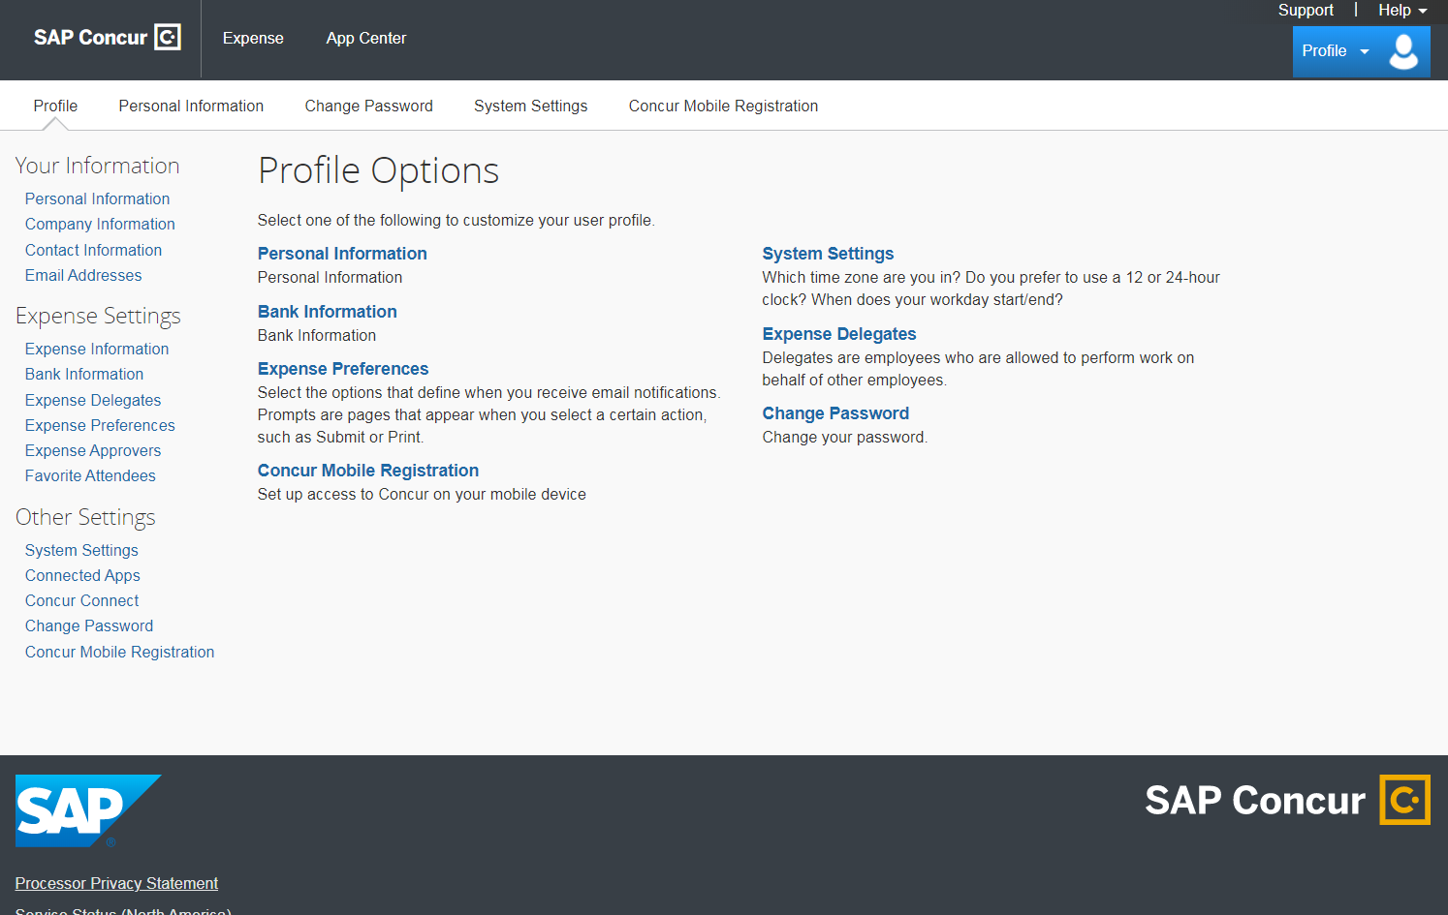
Content Slide
Project Title | CONCUR Training |  | Module Title | Module Title | Setting Up an Expense Profile | Reviewer Notes
Screen # | 19 | Screen Title | Review Activity |  |  | Reviewer 1
Visuals User Activity |  |  |  |  | Onscreen Text
 |  |  |  |  |  | Reviewer 2
 |  |  |  |  | Animation & Interactivity This slide will have the user run through all steps of setting up an expense profile again, this time without help from the system. Checkmarks will appear next to each section the user completes. Once all sections are completed, the next button will appear. User clicking ‘Next’ will trigger completion of the module in the LMS.
 |  |  |  |  |  | Reviewer 3
Audio No audio present on this slide
Navigation/ Branching | Linear. User clicks ‘next’ to continue. |  |  | Estimated time | 5 minutes

Slide 20
Content Slide
Project Title | CONCUR Training |  | Module Title | Module Title | Setting Up an Expense Profile | Reviewer Notes
Screen # | 20 | Screen Title | End |  |  | Reviewer 1
Visuals (Video/Pics/Characters) |  |  |  |  | Onscreen Text Thank you %UserName% for completing this training! Please check out these other modules to complete your SCCA CONCUR training series: How to Complete an Expense Report How to complete a Travel Profile (optional) Click ‘Exit’ to exit out of module.
 |  |  |  |  |  | Reviewer 2
 |  |  |  |  | Animation & Interactivity User clicks ‘Exit’ to exit out of module.
 |  |  |  |  |  | Reviewer 3
Audio No audio present on this slide
Navigation/ Branching | Linear. User clicks ‘exit’ to end the module. |  |  | Estimated time | 30 seconds

