Slide 1


EXPLORING THE TRANSPARENCY OF ARTIFICIAL INTELLIGENCE IN CREDIT RISK PREDICTION THROUGH ENSEMBLE TECHNIQUES AND MODEL AGNOSTIC METHODS
MSc Research Project
Christian Chimezie
ID: 202221654
Notes:
Hi, my name is christian chimezie and i am presenting my research project titled exploring the transparency of artificial intelligence in credit risk prediction through ensemble techniques and model agnostic methods

Slide 2

INTRODUCTION
Credit risk is the risk that a borrower may fail to meet their financial obligations, such as repaying a loan or meeting the terms of a financial contract.
The history of credit risk assessment begins in 1941 with the publication by David Durand of a study that distinguished between good and bad loans made by commercial banks.
Notes:
Credit risk is the risk that a borrower may fail to meet their financial obligations, such as repaying a loan or meeting the terms of a financial contract. Understanding and managing credit risk is crucial for these entities to protect their financial stability and ensure the soundness of their lending or investment activities. The history of credit risk assessment began as far back as 1941 with the publication of a study by David Durand that distinguished between good and bad loans made by commercial banks. Since then, various statistical and operational research methods have been used over the long history of credit risk models.

Slide 3
RELATED WORKS
Guégan & Hassani (2018)
Tree-based ensemble models outperform Logistic Regression. SVM and neural network models significantly underperform Logistic Regression. Paper ignores explainability
Moscatelli et al (2021)
Tree-based ensemble models outperform Logistic Regression No attention paid to model explainability. Although Feature importance measures are derived, they are not explored in detail.
Bussmann et al (2021)
XGBoost tree-based algorithm outperforms Logistic Regression Global Explanations were provided with SHAP
Biecek et al (2021)
Tree-based models outperform individual models. Global and Local Explanations were provided with Permutation Feature Importance and Partial Dependence Plots
Notes:
Credit risk prediction problems often involve complex, non-linear relationships between various factors influencing creditworthiness. The reviewed credit risk publications for this study show that ensemble models perform better than other machine learning models because they are capable of capturing complex relationships, making them more flexible than individual models. These publications paid little or no attention deeply explaining the features that drove model predictions and therein lies the problem
Feature importance refers to the measure of the contribution of individual features (variables or attributes) to the predictive performance of a machine learning model.
PFI helps identify the importance of features in the model, while PDPs provide a visual representation of the relationship between a single feature and the predicted outcome. Together, they offer a comprehensive understanding of feature importance and the impact of individual features on model predictions.

Slide 4
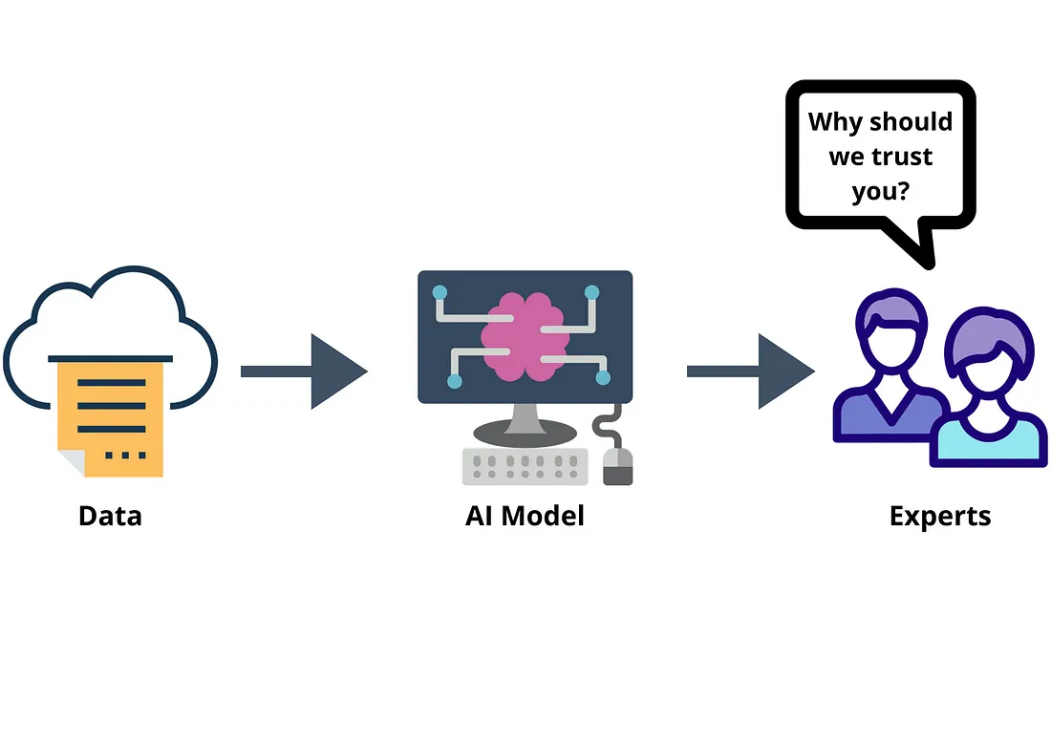
PROBLEM STATEMENT
A model is explainable when it is possible to generate explanations that allow humans to understand
how a result is reached
on what grounds the result is based (similar to a justification).
Problem Statement
EBA (2020)
Notes:
In a discussion paper, the European Banking Authority highlighted two primary challenges related to complex models. These challenges encompass how a result is reached, and on what grounds the result is based. This establishes a minimum threshold for explainability that models must meet to be deemed interpretable.

Slide 5

AIMS AND OBJECTIVES
This study aims to compare bootstrap aggregating (bagging) and boosting tree-based techniques to create a transparent ensemble model for the purpose of credit risk prediction and provide local and global explanations using state of art explainable AI such as SHAP and LIME.
The research questions for this study are:
Do SHAP and LIME consistently identify certain features as crucial to credit risk?
To what extent do the explanations align with the prevailing financial landscape?
To what extent does the research contribute to wider literature?

Slide 6


RESEARCH METHODOLOGY
Data Collection
Data Preprocessing
EDA
Prosper loans from Kaggle Repository
Data Cleaning with variable definitions, statistics and research
Outlier Detection (IQR and Grubb’s Test) and Pearson’s Correlation Test
Experimentation
Model Selection
Feature Engineering
Imbalanced, Oversampling, Undersampling, Normalization, Cross Validation and Hyperparameter Tuning
Two bagging and Two boosting ensemble models
One hot encoding and label encoding
Evaluation Metrics
Explanations
Precision, Recall, AUC and Confusion Matrix
SHAP and LIME
Notes:
In other to achieve the aims of this study and answer the research questions, the research methodology was extensive from data collection, data preprocessing, EDA, Feature Engineering, Model Selection, Experimentation, Evaluation Metrics, and model explanations to provide a 360-degree explanation framework.

Slide 7
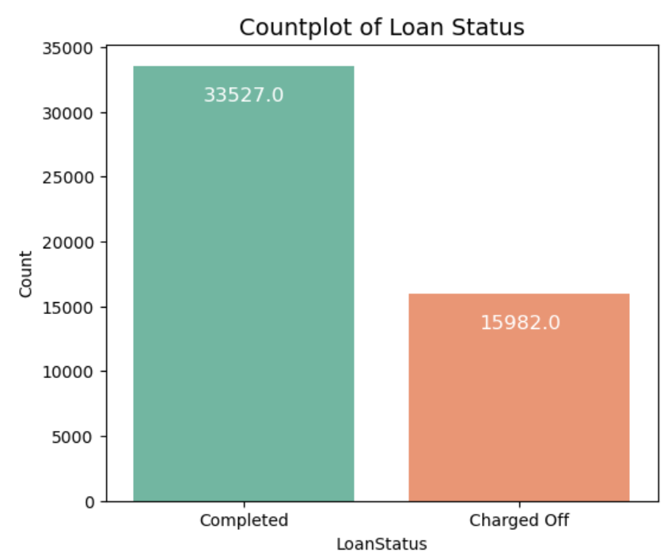
THE DATASET
Prosper is the first peer to peer lending marketplace in the United States. The original dataset contained 113,937 loan entries with 81 features.
Predicting credit risk involves solving a binary classification problem, where the target variable indicates whether a loan is likely to be completed or not.
Current loans were excluded from the Loan Status, as the outcome of these loans (completed or not) is yet unknown. Including them in the modelling process could introduce uncertainty.
After preprocessing and feature engineering, the cleaned dataset contained 49,509 entries and 43 features.
Notes:
Financial institutions typically evaluate diverse financial information, including current account expenditures, credit card information, and payment histories linked to other loans and obtaining this data is frequently challenging due to its sensitive and confidential nature. The dataset chosen for this project is a loan dataset obtained from the Kaggle data repository.

Slide 8
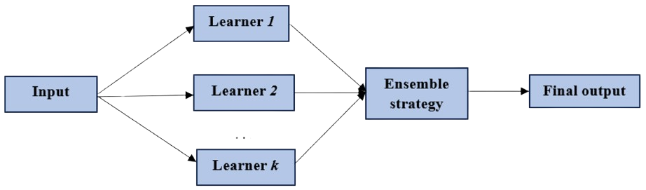
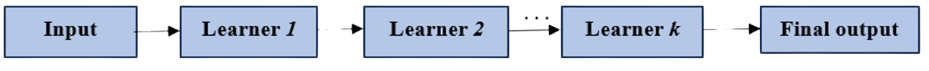
MODEL SELECTION ( ENSEMBLE METHODS)
BASELINE MODEL – Decision Trees
BAGGING MODELS - Different models vote for the result
Random Forest
Bagging Classifier with decision trees)
BOOSTING MODELS - Each model learns from the errors of the previous
Extreme Gradient Boost
Adaptive Boost
Notes:
The models selected for this prediction are Ensemble methods because they improve model performance by building and aggregating multiple different base learners with specific strategies. Bagging model strategy is a parallel ensemble where multiple subsets learner 1, learner 2 to learner k are created from the original dataset and run in simultaneously and are independent of each other. The final predictions are determined by combining the predictions from all the models. The models chosen for this study that employ this strategy are random forest and bagging classifier with decision trees. Boosting model is another ensemble method whose strategy is a sequential to construct multiple learners in sequence, where the latter learner learner k can avoid the errors of the former learners learner 1, learner 2, thus improving the aggregated performance. The models chosen for this study that employ this strategy are Extreme Gradient Boost and Adaptive Boost. The Baseline model is Decision Trees

Slide 9
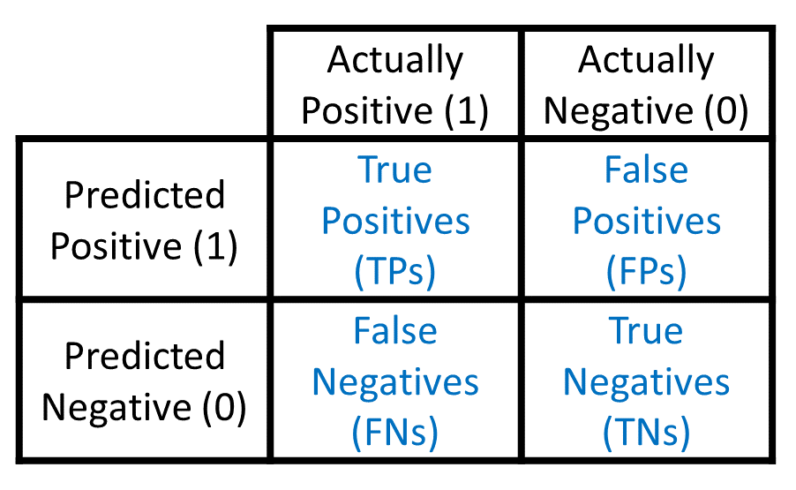


EVALUATION METRICS
CONFUSION MATRIX
PRECISION
RECALL
AUC
True Positive (TP): Instances predicted as Positive (Completed) that are Positive.
True Negative (TN): Instances predicted as Negative (Charged Off) that are Negative.
False Positive (FP): Instances predicted as Positive (Completed) that are Negative.
False Negative (FN): Instances predicted as Negative (Charged Off) that are Positive.
The Area Under the curve (AUC) score is a performance metric used to evaluate the ability of a binary classification model to discriminate between positive and negative instances.
Notes:
Beyond the fundamental performance metric of accuracy, which indicates the ratio of correctly predicted instances to all predicted instances, there is a need for more comprehensive performance evaluation methods tailored to the specific requirements of credit risk. This experiment employs four key metrics— Confusion Matrix, Precision, Recall, and AUCROC.

Slide 10
EXPERIMENT RESULTS
25 experiments were conducted with imbalanced, oversampling, undersampling and normalization and cross validated with 10 iterations to ensure generalization
Bagging Ensemble Performance: Random Forest and Bagging Decision Trees consistently demonstrate high auc, precision, and recall across different scenarios.
Boosting Ensemble Performance: XGBoost and AdaBoost also perform well, with slightly lower recall values than Random Forest and Bagging Decision Trees.
Limited Impact of Normalization: Normalization does not significantly influence model performance.
Comparable Results Across Sampling Scenarios: Oversampled, undersampled, and imbalanced scenarios yield comparable results, suggesting that the sampling method do not heavily impact performance.
Low Variability in Cross-Validation: Standard deviations are generally low, indicating consistent model performance across different folds during cross-validation.
Notes:
25 experiments were conducted by experimenting it with imbalanced, oversampling with SMOTE, undersampling with RandomUndersampler, normalization with Min Max Scaler and K fold cross validation validating the models across 10 subsets of the training data to ensure robustness and accuracy. Key observations are that the bagging models performed better than boosting models in discriminating between completed and charged off loans and a good balance between precision and recall. It also showed a limited impact in normalization and sampling scenarios. The experiments show consistent model performance across different folds during cross validation with low standard deviations.
Oversampling and undersampling techniques were applied to handle class imbalance in "LoanStatus" during credit risk prediction. SMOTE (Synthetic Minority Over-sampling Technique) generated synthetic instances to augment the representation of the minority class, “Charged Off." Simultaneously, RandomUnderSampler addressed imbalance by randomly removing instances from the majority class, "Completed," achieving a more balanced class distribution. cross-validation was performed, validating the models across 10 subsets of the training data to ensure robustness and accuracy.
After splitting the dataset into train and test set through 80:20 ratio using a train-test split. The dataset was normalized through Min-Max scaling ensuring standardized feature scales for consistent model training addressing potential issues related to varying scales.

Slide 11
EXPERIMENT RESULTS
Best Initial Experiment
Undersampled and normalized Random Forest was chosen as the best performing model it has a high mean cross validation score of 97% and low standard deviation of 0.0022, It has a high discriminating power (AUC) of 96% and also has a good balance between precision and recall with 98% and 93% respectively.
Model Experiments | Precision | Recall | AUC
Under Sampled and Scaled RF Model | 98% | 93% | 96%
Model Optimization with RandomizedCV
In other to improve the discriminatory power (AUC) of best performing experiment.
Model Experiments | Precision | Recall | AUC
Tuned RF Model | 98% | 93% | 96%
This indicates that the initial experiment is optimal, as both models demonstrate comparable performance levels.
Notes:
From the initial experiments, the best performing model was the undersampled and normalized random forest because of its mean high cross validation score of 97% and lowest standard deviation of 0.0022. It also demonstrated a high discriminating power to distinguish between completed and charged off loans of 96% and a good balance between precision and recall with 98% and 93% respectively. In order to improve its discriminatory power, the model was optimized with RandomizedCV. The results of the optimization showed that the initial experiment is also optimal as both models demonstrate comparable performance levels.

Slide 12
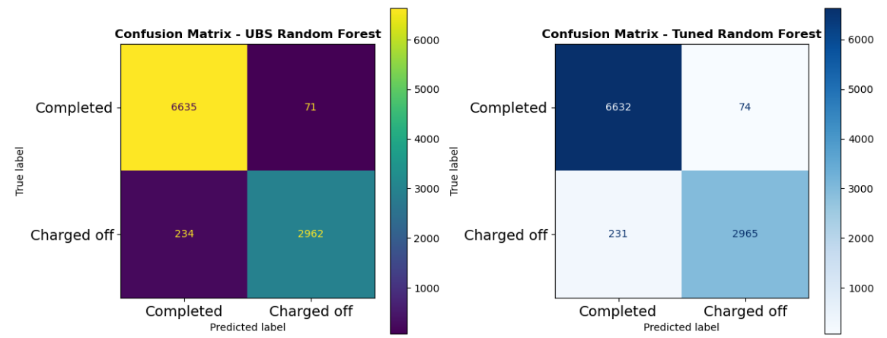
EXPERIMENT RESULTS
A detailed examination of the confusion matrices reveals nuanced distinctions. The tuned model minimises false negatives, while the initial experiment demonstrates proficiency in minimising false positives. The inclination towards the tuned model is rooted in its superior capability to accurately identify instances of loan defaults, thereby reducing potential losses for the company.
Notes:
But by having a detailed examination of their confusion matrices, the tuned model is better at minimizing false negatives, while the initial experiment demonstrates proficiency in minimising false positives. The inclination towards the tuned model is rooted in its superior capability to accurately identify instances of loan defaults, thereby reducing potential losses for the company.

Slide 13


MODEL AGNOSTIC EXPLANATIONS
Shapley Additive Explanations
(SHAP)
Local Interpretable Model-Agnostic Explanation (LIME)
SHAP helps us understand and attribute the contributions of different factors using a game theoretic approach to the model's predictions, making it easier for us to trust and interpret the prediction.
LIME helps us understand the inner workings of complex models by simplifying them for specific cases. It works by approximating the decision boundary of a model at a specific data point through a linear approximation.
Notes:
In order to give a comprehensive explanations for the model performance, we employ model agnostice methods. Model-agnostic methods refer to a class of approaches in machine learning that are not tied to any specific type of model. The advantage of model-agnostic methods is that they provide interpretability and insights into the behavior of machine learning models without relying on detailed knowledge of their internal workings.

Slide 14
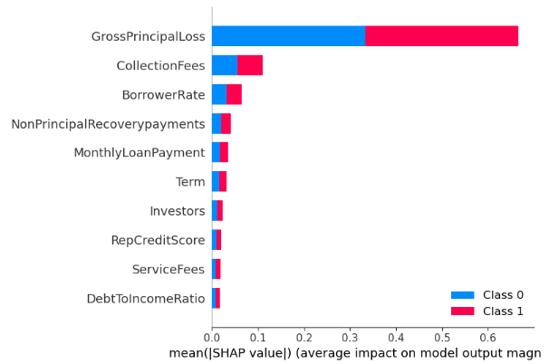
GLOBAL EXPLANATIONS WITH SHAP
Global Insights
Higher values for Gross Principal Loss are associated with an increased likelihood of Charged Off as well as lower values indicate a higher probability of Completed.
SHAP values suggest that borrower's ability to manage monthly debt payments relative to their income do not significantly impact the model's output.
Top 10 features influencing the decisions of the tuned model
Notes:
The SHAP plot shows us the top 10 features that influenced the decisions of the optimized model. From the global insights

Slide 15
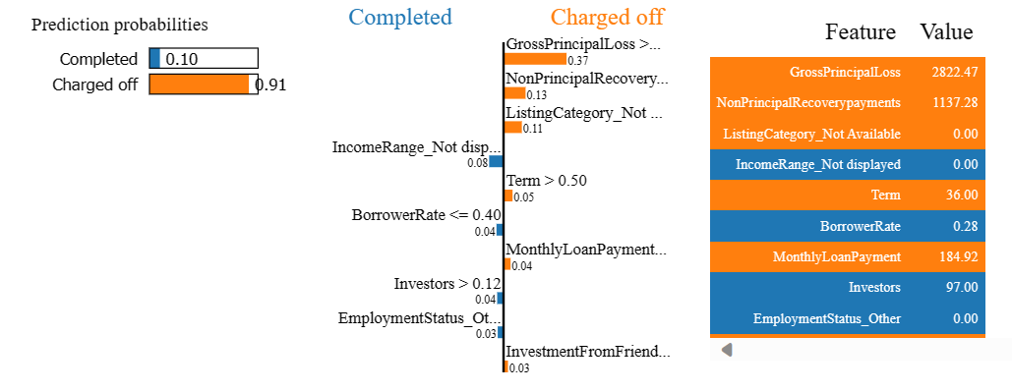
LOCAL EXPLANATIONS WITH LIME
Local Insights
The model exhibits a 91% confidence level in classifying the loan as "Charged Off".
High values for Gross Principal Loss and Non-Principal Recovery Payments contribute to an increased likelihood of the loan being categorized as "Charged Off“.
36-month duration and loans with no purpose and tend to favour the classification as "Charged Off."
Positive indicators such as a substantial number of investors for instance 97 and a Borrow Rate less than or equal to 0.40, such as 0.28, push the prediction toward the "Completed" category.
Notes:
Looking at local explanations with LIME to understand the internal workings of the model predictions, This plot shows that the model exhibits a 91% confidence in classifying this loan as Charged Off

Slide 16
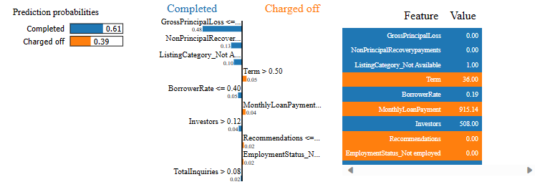
LOCAL EXPLANATIONS WITH LIME
Local Insights
The model indicates a 61% confidence in classifying the loan as "Completed."
No values for Gross Principal Loss and Non-Principal Recovery Payments tends to favor the "Completed" classification.
Positive factors like a large number of investors (508) and a Borrow Rate of 0.19 increase the likelihood of the loan being labeled as "Completed.“
36-month duration, a high monthly payment of $915.14, no recommendations, and unemployment status tend to sway the prediction towards "Charged Off."
Notes:
This LIME plot shows that the model exhibits a 61% confidence in classifying this loan as Completed.

Slide 17
DISCUSSION
Project Research Questions and Answers
Do SHAP and LIME consistently identify certain features as crucial to credit risk?
Yes, The agreement between SHAP and LIME on the importance of specific features reinforces the impact of those features on the model's output for the given instance. This reinforcement can be valuable for stakeholders seeking a clear understanding of the factors driving individual predictions.
To what extent do these features align with the prevailing financial landscape?
Lending companies perform a pre-evaluation of potential losses, costs and borrower details before granting loans as a part of risk assessment and management practices. Assessing potential losses allows lenders to mitigate risks, set appropriate loan terms, and ensure long-term viability.
To what extent does the research contribute to wider literature?
Our findings reveal the superiority of bagging tree-based models over boosting tree-based models in credit risk prediction. The bagging models enhance model accuracy and stability by leveraging diversity (each model trained on a different subset of the data).
Notes:
Now to provide answers to the defined project questions from the indept explanations gotten from SHAP and LIME.
Gross principal loss, Non-Principal Recovery, Investors, Borrower Rate, Monthly Loan Payment, employment status and loan term.

Slide 18
PROJECT SUMMARY USING SWOT ANALYSIS
STRENGTH
Diversity of Techniques: The study employs four ensemble techniques and two model-agnostic methods, showcasing a comprehensive approach to credit risk prediction.
Model Performance: Bagging models perform better than Boosting models because of their training diversity and variance reduction with Random Forest indicating a robust predictive capability
Explainability: SHAP and LIME consistently highlight certain features as necessary for credit risk predictions. This alignment enhances the reliability of the identified features, reinforcing the understanding that they play a crucial role in the model's decision-making process.
WEAKNESS
Limited Algorithmic Diversity: The study primarily focuses on ensemble techniques, potentially limiting the exploration of a broader range of machine learning algorithms.
Exclusion of Macro-Economic Features: The research recognizes the need to incorporate macroeconomic features for enhanced predictive accuracy but does not explore this aspect in the current study.
SWOT
OPPORTUNITIES
Advanced Strategies: Future research could explore advanced strategies, such as stacking or incorporating blending techniques, to further improve predictive accuracy.
Incorporating Macroeconomic Features: Including macroeconomic features such as GDP, Unemployment rate, and Inflation Rate in the dataset could enhance the understanding of credit risk dynamics and contribute to more accurate predictions.
THREATS
Regulatory Challenges: Ongoing changes in regulations related to AI and data privacy could pose challenges to the deployment of credit risk prediction models.
Changing Financial Landscape: The dynamic nature of the financial landscape introduces the threat of model obsolescence if not regularly updated to reflect evolving patterns.
Ethical Concerns: The use of AI in finance raises ethical considerations, and the study needs to ensure ethical practices in data usage, model training, and decision-making.
Notes:
I summarise the project using SWOT analysis to assess the internal strengths and weaknesses of the project, as well as the external opportunities and threats it faces.
Gross Domestic Product (GDP):GDP growth rates and overall economic output can influence employment levels, income stability, and the overall financial health of borrowers.
Unemployment Rate High unemployment rates may lead to increased credit risk as individuals may struggle to find employment and maintain income levels necessary to meet debt obligations.
Inflation Rate:Inflation affects the purchasing power of money. High inflation can erode the real value of income, making it more challenging for individuals to manage debt.

Slide 19
REFERENCES
Biecek, P., Chlebus, M., Gajda, J., Gosiewska, A., Kozak, A., Ogonowski, D., Sztachelski, J. & Wojewnik, P. (2021) Enabling Machine Learning Algorithms for Credit Scoring -- Explainable Artificial Intelligence (XAI) methods for clear understanding complex predictive models. arXiv. Available online: https://doi.org/10.48550/arXiv.2104.06735.
Bussmann, N., Giudici, P., Marinelli, D. & Papenbrock, J. (2021) Explainable Machine Learning in Credit Risk Management. Computational Economics, 57(1), 203–216. Available online: https://doi.org/10.1007/s10614-020-10042-0.
European Banking Authority (2020). Eba report on big data and advanced analytics.
Guégan, D. & Hassani, B. (2018) Regulatory learning: How to supervise machine learning models? An application to credit scoring. The Journal of Finance and Data Science, 4(3), 157–171. Available online: https://doi.org/10.1016/j.jfds.2018.04.001.
Moscatelli, M., Parlapiano, F., Narizzano, S. & Viggiano, G. (2020) Corporate default forecasting with machine learning. Expert Systems with Applications, 161, 113567. Available online: https://doi.org/10.1016/j.eswa.2020.113567.

Slide 20
Q&A
Thank you For Your Attention

