Slide 1
ML Solution for software requirements and Design
Christian Crosser
Divyesh Desai
Halle Fortune
Phillip wilson

Slide 2
Agenda
Introduction / Problem Statement
Program / Data Flow
Dataset Used
Preprocessing Data
NLP Techniques and Program
Results
Model Comparison
Future Work/Enhancements

Slide 3
Introduction/Problem Statement:
How can we train models using ML and NLP techniques to predict classifications of Software requirements?
Finding Machine Learning / Natural Language Processing solution to software requirements processing and definition
Can be used for large sets of requirements with no organization
To aid in labelling where there was no classification or clustering previously done to datasets

Slide 4
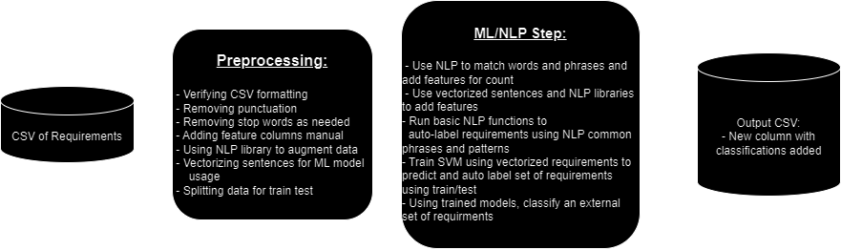
Program/data Flow

Slide 5
Dataset used:
NFR.csv: https://www.kaggle.com/datasets/iamsouvik/software-requirements-dataset/data?select=nfr.txt
Public set of software requirements and classification:
Dataset already had classifications so we could remove column and compare with algorithm results:
Functional (F), Availability (A), Fault Tolerance (FT), Legal (L), Look & Feel (LF), Maintainability (MN), Operational (O), Performance (PE), Portability (PO), Scalability (SC), Security (SE) Usability (US)

Slide 6
Preprocessing the Data:
Natural Language Processing to cleanup and enhance dataset:
Verifying .csv format
Adding proper column labels
Using NLTK to remove punctuation and stop words
Adding additional features columns using NLP phrases and patterns
ML Preprocessing Steps after NLP:
Vectorize requirements for numeric conversion
Predict additional features using vectorized requirements
Clustering data to allow for supervised ML techniques

Slide 7
MAchine Learning and NLP Techniques Used:
NLP Techniques:
Tokenizing words for counting and sentence analysis
Sentence pattern matching for phrases and language use
Use bag of words model to vectorize words and create additional features.
Libraries Used:
import pandas as pd
from sklearn.model_selection import train_test_split
from sklearn.feature_extraction.text import TfidfVectorizer
from sklearn.svm import SVC
from sklearn.metrics import classification_report
from nltk.corpus import wordnet
import random

Slide 8
MAchine Learning and NLP Techniques Used:
ML Techniques:
Predicting values using multiple models:
SVM, Multinomial Naïve Bayes, Random Forest, Logistic Regression
Using these trained models to classify an additional set of requirements
Attempt further analysis using ML libraries
Libraries Used:
import pandas as pd
from sklearn.model_selection import train_test_split
from sklearn.feature_extraction.text import TfidfVectorizer
from sklearn.svm import SVC
from sklearn.metrics import classification_report
from nltk.corpus import wordnet
import random

Slide 9
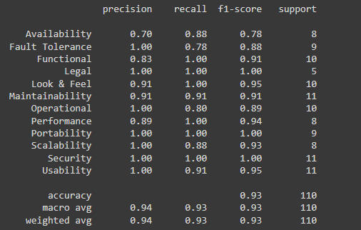
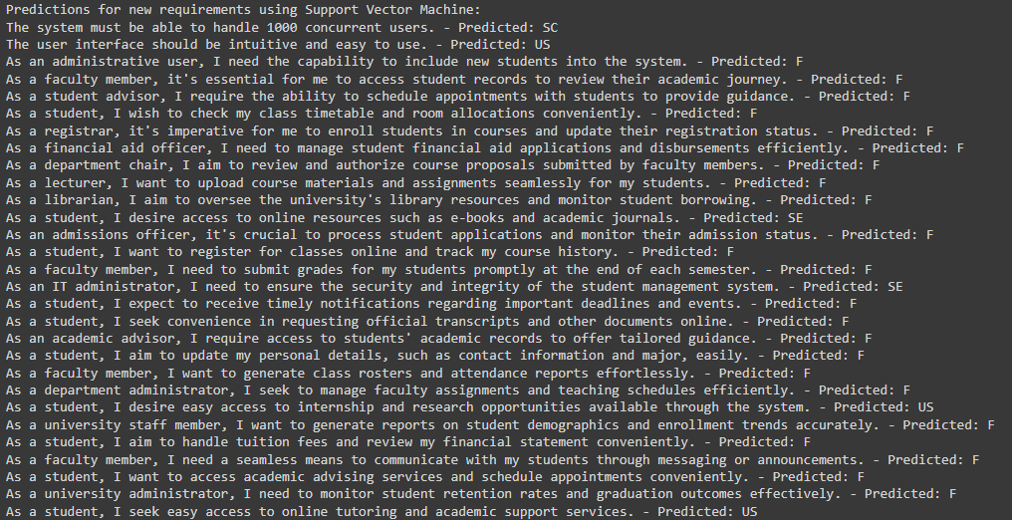
Results and Classified Reqs:
SVM model used to train on a data set of 1500 requirements
Performance of the model based on NLP learning techniques
Run trained model on a new set of requirements

Slide 10
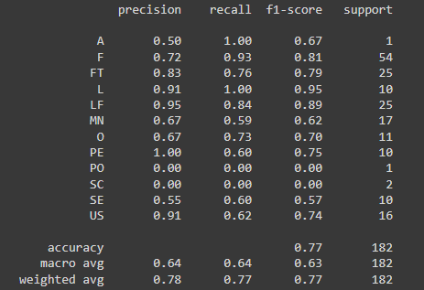
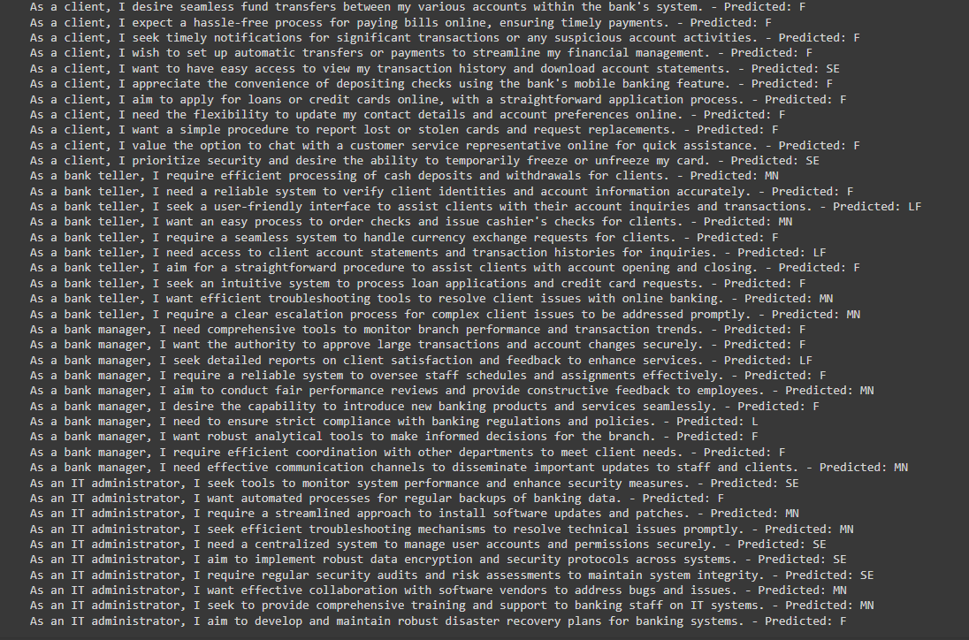
Multiple Runs with Increased dataset size:

Slide 11
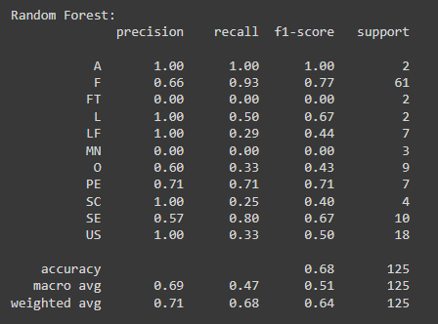
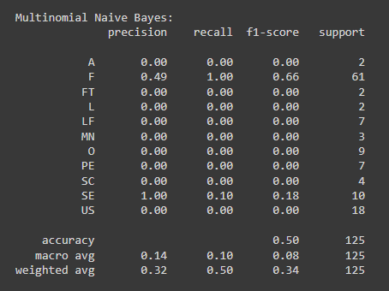
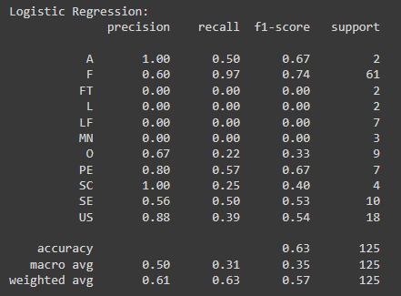
Model Comparison:

Slide 12
Future work and Enhancements
Larger more varied data set
Enhanced NLP phrase, grammar, and semantic matching
Expert input on how to define and classify requirements
Software Design modeling based on classified requirements
General Improvements: cross-validation, hyper-parameter optimization, text cleaning and processing, and feature engineering.

Slide 13
Questions? THANK YOU
Christian Crosser
Divyesh Desai
Halle Fortune
Phillip Wilson

