Slide 1
APPLIED NATURAL LANGUAGE PROCESSING · UNIVERSITY OF TRENTO · MAY 2026
Summarising Football Match Commentaries
A comparative study of prompting and fine-tuning on long-form sports audio transcripts
Marco Panciera · Christian Dalfarra

Slide 2
THE TASK · 02
2.5 hours of radio → a 200-word match report
▸ Input: Whisper transcript of live BBC Radio 5 commentary — mean ~25,000 words, noisy, fragmented, full of irrelevant detail.
▸ Output: a structured match report (~200 words): score line, key events, short tactical note.
▸ Why it is hard: inputs exceed every standard transformer context window (1,024 tokens ≈ 4% of a match); references for training are scarce.
▸ Two empirically answerable questions
1. Chunk-and-aggregate, or a long-context encoder (LED-16384)?
2. For each input strategy — prompting a general model, or fine-tuning on small in-domain data?
Summarising Football Commentaries
02

Slide 3
DATASET · 03
99 matches, 43 years, 12 competition categories
BBC radio audio → Whisper transcription → GPT-4 reference summaries
▸ Audio: BBC Radio 5 Live archive (YouTube, via yt-dlp) — ~19 GB MP3, matches from 1983 to 2026.
▸ Transcription: Whisper-small; full transcript + time-aligned segments with pitch/energy prosodic features.
▸ References: GPT-4 (ChatGPT web, search enabled) prompted per match identifier; facts grounded in web-retrieved match reports, BBC sourcing verified for every match; fixed template, ~190 words. A pragmatic, disclosed compromise — no human summaries exist for radio commentary.
▸ Split: 80 train / 10 val / 9 test, stratified, committed to the repo for reproducibility.
▸ Known noise floor: Whisper systematically corrupts player names (“Bergkamp” → “Burgkamp”) — an irreducible ceiling on surface-overlap metrics.
Summarising Football Commentaries
03

Slide 4
DESIGN · 04
2 input pipelines × 2 learning paradigms
3 architectures · 3 prompt styles · 11 evaluated conditions
 | Chunk + aggregate | Long-context (16,384 tokens)
Prompting (zero / few / CoT) | FLAN-T5-Large (512) BART-Large-CNN (1,024) | LED-base-16384
Fine-tuning | BART as the merge step (“chunk-merger” recipe) | LED on 8,192-token random windows
▸ Chunk + aggregate: segment-aligned chunks → per-chunk summary → merge + dedup. Long-context: whole transcript in one LED pass.
▸ All experiments on free-tier Kaggle (1× T4); seeds fixed; every prediction saved to disk, so all metrics are recomputable post-hoc.
Summarising Football Commentaries
04

Slide 5
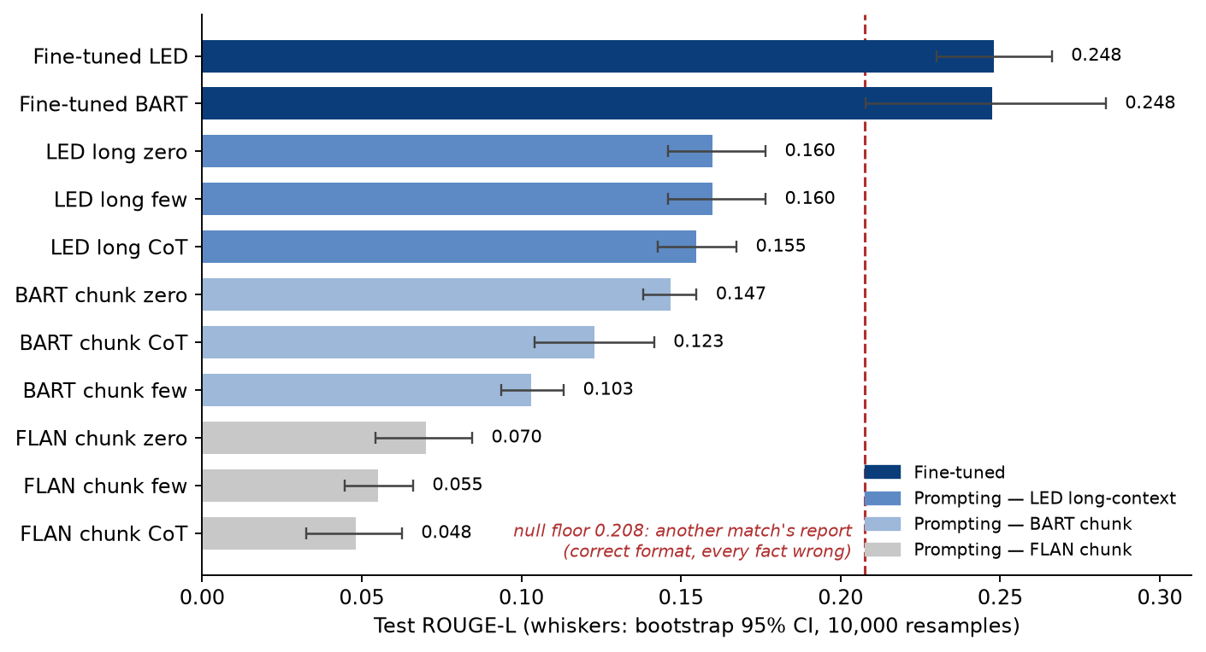
RESULTS · 05
Fine-tuning wins — but only it clears the null floor
Test ROUGE-L on the clean 9-match test set · bootstrap 95% CIs (10,000 resamples)
Every prompting condition is significantly below both fine-tuned models (paired bootstrap; 95% CI of the difference excludes 0) — and below the dashed null floor. Only the fine-tuned models clear it, by +0.040 [+0.022, +0.059]. The LED−BART gap (−0.0004 [−0.042, +0.035]) is NOT significant.
Summarising Football Commentaries
05

Slide 6
FINDING 1 · 06
Match the training distribution, not the context window
The “chunk-merger” fine-tuning recipe
▸ Naive fine-tuning on (transcript[:1024] → reference) shows BART only the first ~5 minutes of a 2.5-hour match.
▸ Chunk-merger recipe: run pre-trained BART on every chunk → concatenate the ~30 mini-summaries (~960 tokens) → fine-tune BART to map that intermediate to the reference report. Training input now matches what the model sees at inference.
▸ Two-phase schedule: encoder frozen 3 epochs, then unfrozen; early stopping on val ROUGE-L.
▸ Same model, same pipeline, same test set
pre-trained BART 0.147 → fine-tuned BART 0.248 ( +69% relative )
+55% over the strongest prompting condition of any architecture (LED zero-shot, 0.160) — but that baseline sits below the null floor; see Finding 3.
Summarising Football Commentaries
06

Slide 7
FINDING 2 · 07
Long context wins at prompting, ties at fine-tuning
▸ Prompting: LED long-context (avg 0.158) beats BART chunk (0.124) and FLAN chunk (0.058) — the 16k window preserves cross-segment information that chunking discards.
▸ Fine-tuning: LED long-context is nominally ahead (0.248 vs 0.248) but the paired difference is not significant at n = 9 — the two fine-tuned pipelines cannot be separated. LED is more consistent (CI [0.230, 0.266]); BART has more variance (CI [0.208, 0.283]).
▸ Why the two pipelines are statistically tied despite architectural differences:
BART learns from a ~960-token pre-distilled intermediate whose features are already informative.
LED must learn what matters inside raw 8,192-token windows from scratch — too few pairs (N = 80) to learn long-range attention patterns reliably.
▸ Secondary finding: zero-shot beats few-shot and CoT in both chunked families — examples eat the input budget; LED few-shot fell back to zero-shot (implementation gap, disclosed in the report), and LED-base is not instruction-tuned, so prompt style barely matters.
Summarising Football Commentaries
07

Slide 8
FINDING 3 · 08
Models learn the format, not the facts
Real test-set outputs; each quote labelled with the true result
Fine-tuned BART (ROUGE rank 2) — 2019 UCL Final (true: Liverpool 2–0 Tottenham, Madrid, no shootout)
“Liverpool 2–2 Tottenham Hotspur (Liverpool win 4–3 on penalties) … 2023 UEFA Champions League Final, Wembley Stadium, London – 31 May 2019 … Liverpool secured a dramatic victory…”
Fine-tuned LED (ROUGE rank 1) — 2001 FA Cup Final (true: Arsenal 1–2 Liverpool, Millennium Stadium)
“Liverpool 1–0 Arsenal · 2023–24 UEFA Cup Final, Millennium Stadium, Cardiff, UK – 24 May 2021 … Mohamed Salah curled a low shot into the top corner…” — wrong score, wrong date, wrong competition, scorers who were toddlers in 2001; the venue is the one grounded detail.
▸ Quantified over all 9 test matches: fine-tuned BART (ROUGE rank 2) states the correct final score in 0 of 9 matches and recalls only 30% of reference scorers. Fine-tuned LED (ROUGE rank 1): 2/9 scores, 13% scorers. BART scorelines are decorative — 1–1, 2–2, 1–0 regardless of the real 0–4, 3–0…
▸ ROUGE rewards the format, and we measured how much: a wrong match’s report — right template, every fact wrong — already scores ROUGE-L 0.208, 84% of our best model. Every prompting condition scores below a template with no match facts at all. Only +0.040 [+0.022, +0.059] of the fine-tuned score is real match content.
▸ And nothing was lost in transcription: all 22 reference scorers appear in the transcripts the models read — a 100% ceiling on scorer recall, of which BART realises 30% and LED 13%. Extraction failure, not ASR noise.
Summarising Football Commentaries
08

Slide 9
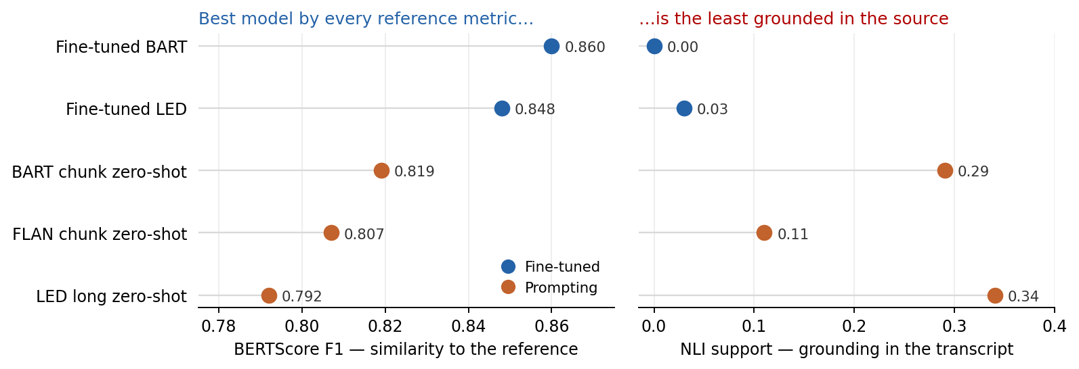
FINDING 4 · 09
Models optimise the reference, not the source
BERTScore vs reference · NLI entailment vs transcript (DeBERTa-MNLI, TF-IDF-retrieved windows)
▸ The rankings invert: fine-tuned LED leads on ROUGE-L and BERTScore yet has only 2% NLI support; fine-tuned BART — zero NLI-supported sentences — is even more extreme. Prompted long-context LED, outranked on every reference metric, is the best-grounded condition (34%) because it copies the commentary.
▸ Fine-tuning on GPT-4 references optimises agreement with the references at the expense of grounding in the input. (NLI rates are conservative lower bounds — register gap, ASR noise — so compare across conditions, not absolutely.)
Summarising Football Commentaries
09

Slide 10
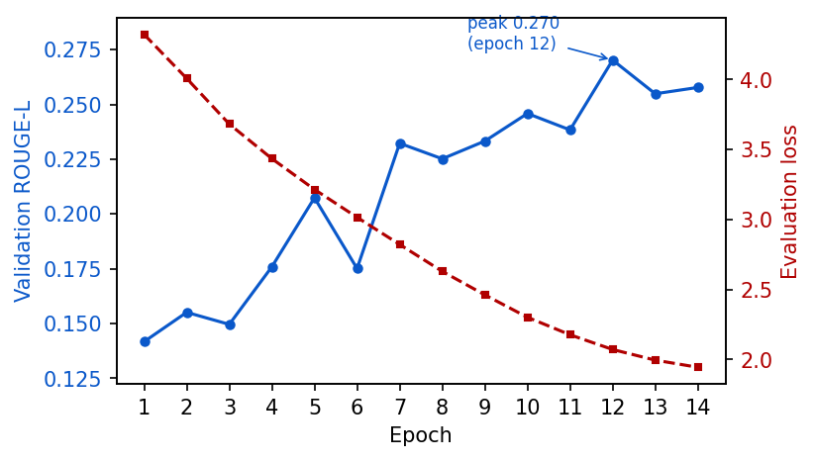
ENGINEERING · 10
The biggest improvement was not a model change
Five silent LED training failures + one dataset bug
▸ 33% of training references were 0-byte files (and 44% of test references) — silently teaching models to emit empty strings and deflating every score ~1.8×.
▸ Predicted correction ratio matched the measured one almost exactly (e.g. fine-tuned BART 0.136 → 0.248 after the fix).
▸ LED also needed 5 bug fixes (defeated random-window sampler, collapse-to-EOS, decoder sentinel overflow, lost checkpoint, CLI truncation).
▸ After the fixes (run 5, clean data): 14 epochs, val ROUGE-L peaks at 0.270 → test 0.248. Earlier collapses were data and code defects, not modelling limits.
LED run 5 (clean dataset): val ROUGE-L peaks at 0.270 (epoch 12) → test 0.248.
Summarising Football Commentaries
10

Slide 11
CONCLUSIONS · 11
What we learned, and where it breaks
▸ 1. Fine-tuning beats prompting at small N; the two fine-tuned pipelines tie — +69% over the same pre-trained model under the same pipeline, +55% over the best prompting baseline; against a format-matched null the honest margin is +0.040 ROUGE-L [+0.022, +0.059]. LED and BART are statistically indistinguishable at n = 9.
▸ 2. Context length is not a substitute for supervision — long-context wins only when no fine-tuning is possible.
▸ 3. Reference similarity and source grounding fully decouple — fine-tuned LED leads every reference metric yet gets 2/9 scores and 2% NLI; BART is worse at 0/9 and 0% NLI. The prompted LED both outrank on ROUGE is the best-grounded condition (34%). Optimising faithfulness, not just measuring it, is the natural next step.
▸ Limitations we state openly
Search-grounded GPT-4 references → facts anchored in web reports, but still ungrounded in the transcript, stylistically homogeneous, and not exactly reproducible (search results drift).
n = 9 test matches → bootstrap CIs resolve fine-tuning vs prompting (significant) but not LED vs BART (−0.0004 [−0.042, +0.035]).
N = 80 training pairs → both fine-tuned models overfit (val 0.31 → test 0.25 for BART).
NLI support rates are conservative lower bounds (ASR-noisy premises, register gap).
Reference metrics are format-saturated — 84% of our ROUGE-L needs no correct facts.
Summarising Football Commentaries
11

