Slide 1
Telco Company Churning
By:
Christian Elbert

Slide 2
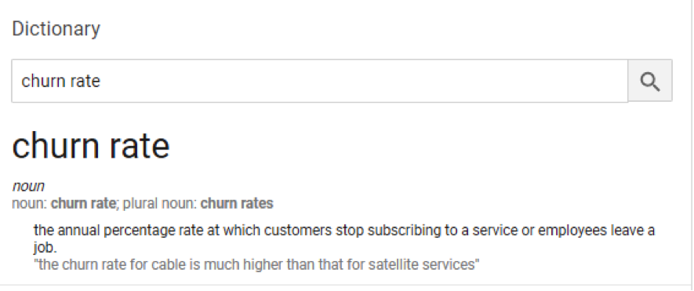
What is Churning?

Slide 3
Possible Churning Factors
Customer experience – dissatisfied customer -> higher churn
Customer expectation – company doesn’t meet public expectation
Competitors – competition offer better service/product

Slide 4
Problem caused by Churning
Loss of reputation
Less consumer
Less income

Slide 5
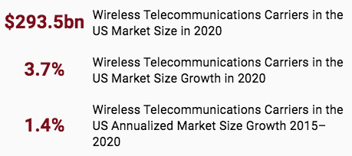
Statistics
https://www.ibisworld.com/industry-statistics/market-size/wireless-telecommunications-carriers-united-states

Slide 6
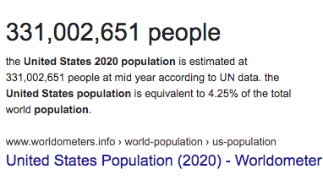
2020 US Population

Slide 7
On average, people spend $887 per year on mobile subscription.
Churning loss $887 per year for 1 consumer.
Imagine if company lost 1000 consumer, that’s $887,000 loss per year!
In theory, cost of finding new customer > cost of retaining

Slide 8
Apps Objectives
View churning related statistics
Predict future churn outcome given customer’s monthly usage
For high churning probability, can do preventative measure -> offer discount/promo

Slide 9
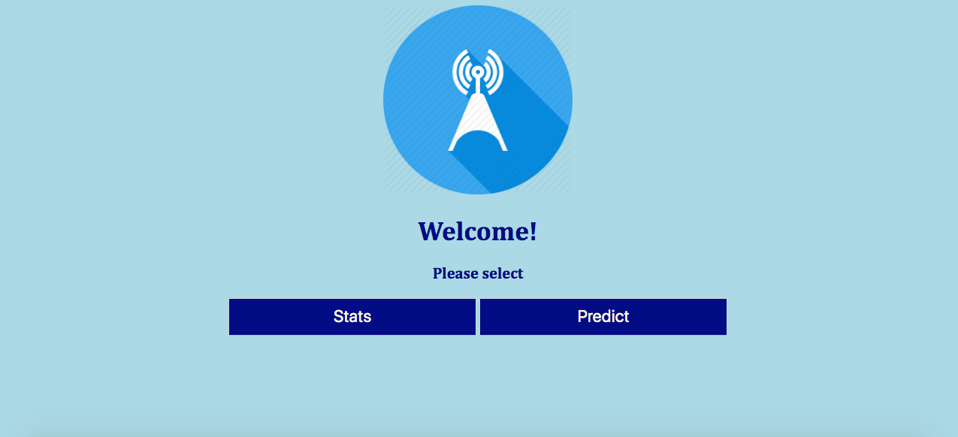
Home Page

Slide 10
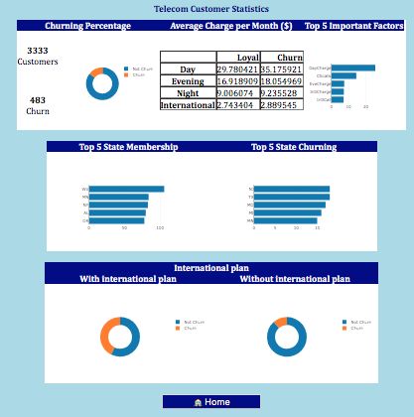
Statistic Page

Slide 11
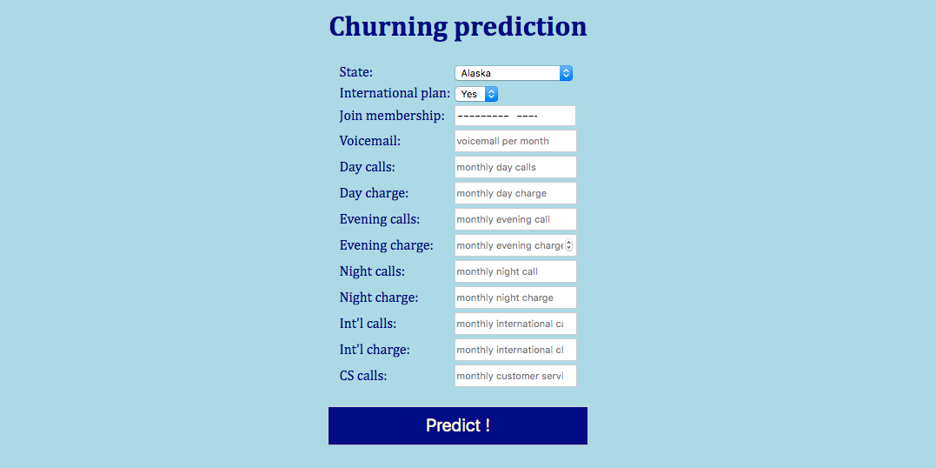
Input Prediction

Slide 12
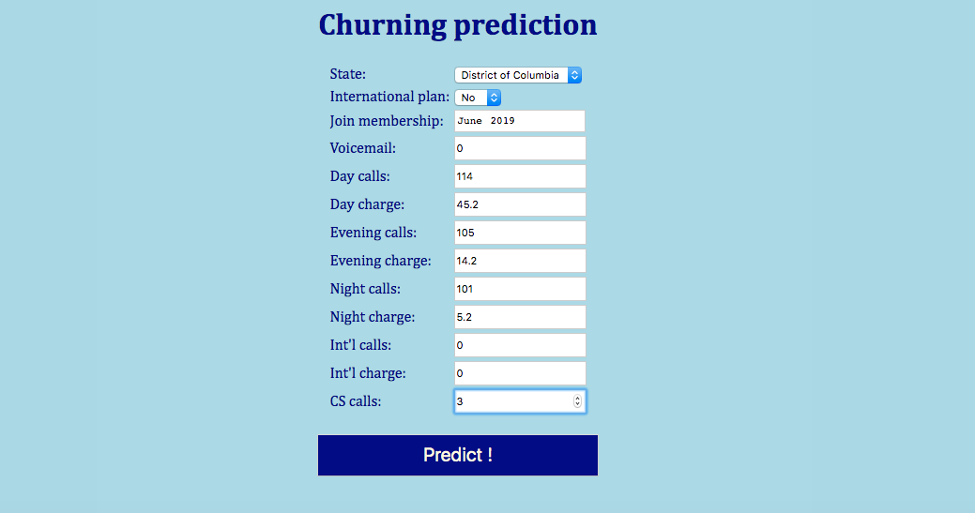

Slide 13
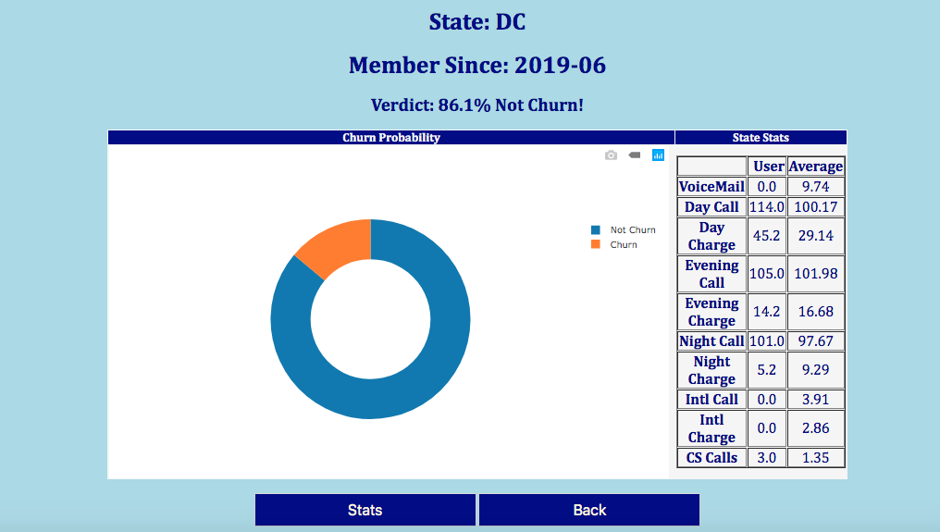
Result Page

