Slide 1
Telco Company Churning
By:
Christian Elbert

Slide 2
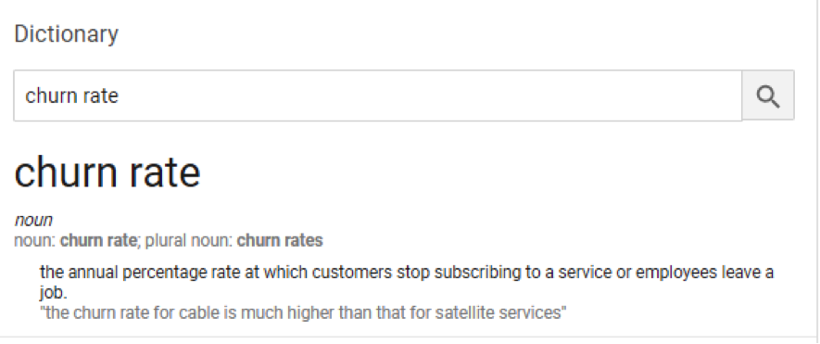
What is Churning?

Slide 3
Possible Churning Factors
Customer experience – dissatisfied customer -> higher churn
Customer expectation – company doesn’t meet public expectation
Competitors – competition offer better service/product

Slide 4
Problem caused by Churning
Loss of reputation
Less consumer
Less income

Slide 5
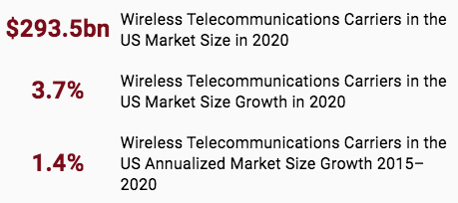
Statistics
https://www.ibisworld.com/industry-statistics/market-size/wireless-telecommunications-carriers-united-states

Slide 6
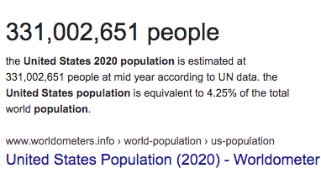
2020 US Population

Slide 7
On average, people spend $887 per year on mobile subscription.
Churning loss $887 per year for 1 consumer.
Imagine if company lost 1000 consumer, that’s $887,000 loss per year!

Slide 8
We provide a solution !!!!

Slide 9
Churning Prediction App

Slide 10
Apps Objectives
View churning related statistics -> help understand pattern
Predict future churn outcome given customer’s monthly usage

Slide 11
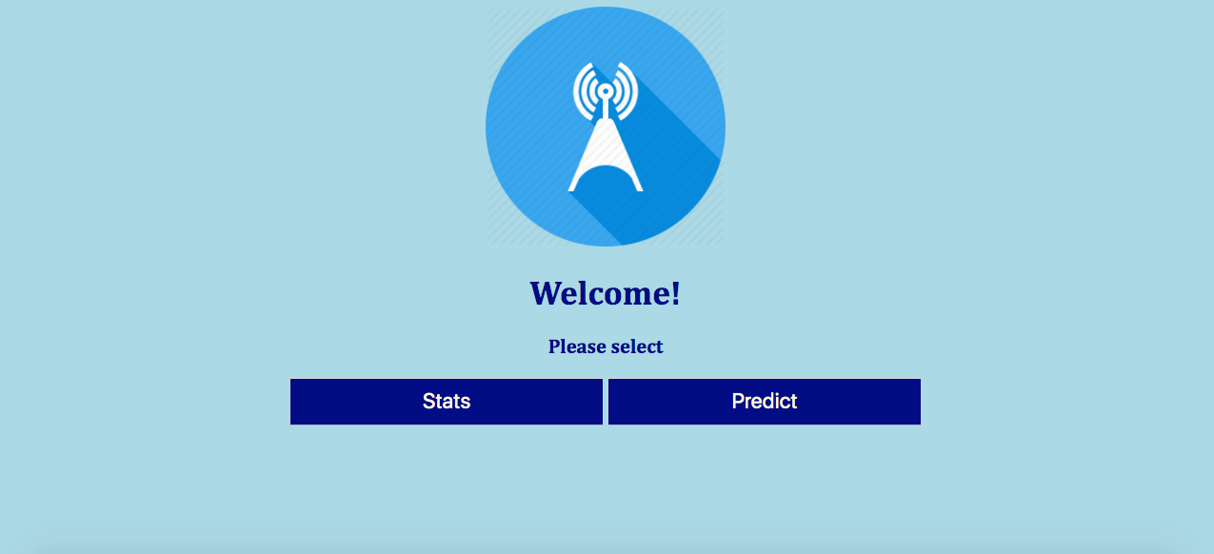
Home Page

Slide 12
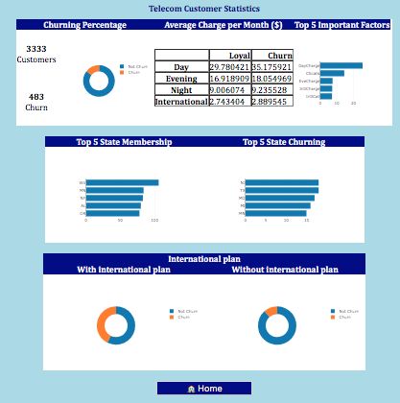
Statistic Page

Slide 13
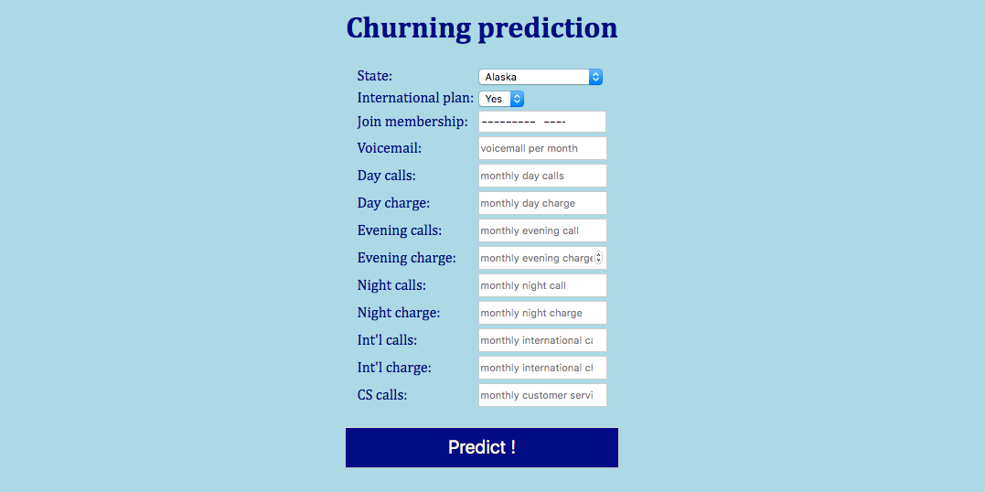
Input Prediction

Slide 14
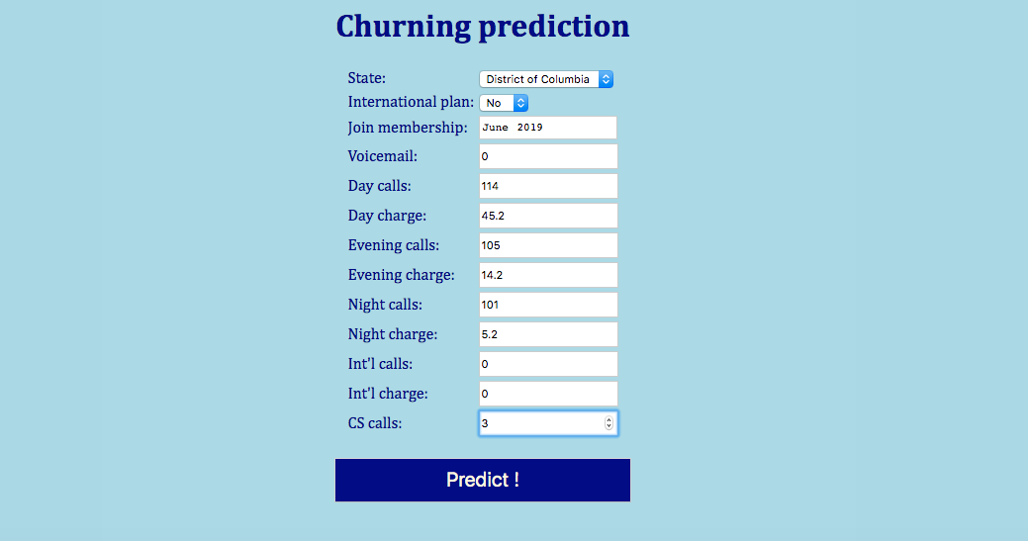

Slide 15
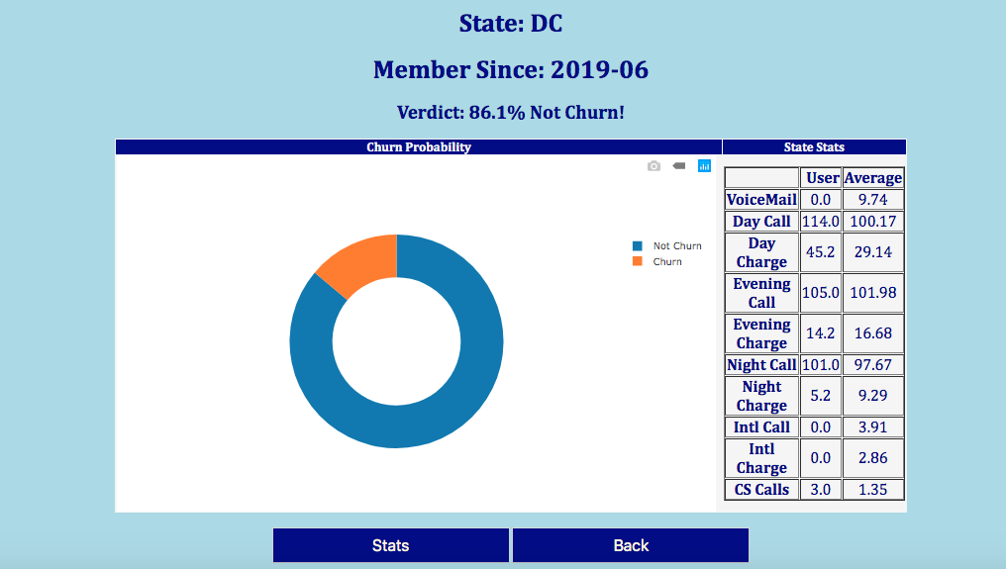
Result Page

Slide 16
Thank you !!

