Slide 1
Telco Company Churning
By:
Christian Elbert

Slide 2
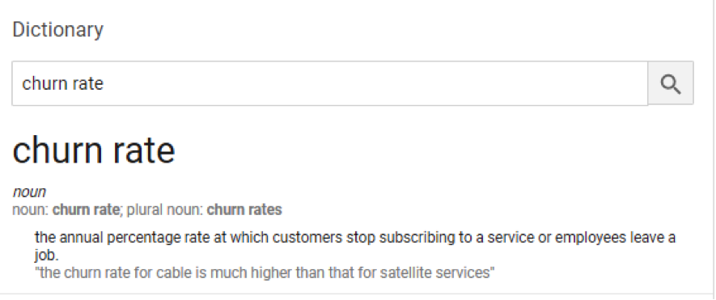
What is Churning?

Slide 3
Possible Churning Factors
Customer experience – dissatisfied customer -> higher churn
Customer expectation – company doesn’t meet public expectation
Competitors – competition offer better service/product

Slide 4
Problem caused by Churning
Loss of reputation
Less consumer
Less income

Slide 5
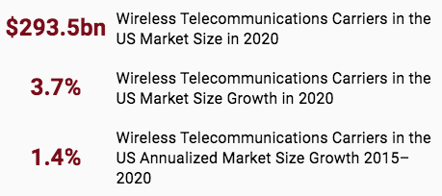
Statistics
https://www.ibisworld.com/industry-statistics/market-size/wireless-telecommunications-carriers-united-states

Slide 6
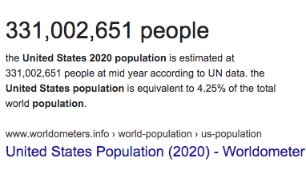
2020 US Population

Slide 7
On average, people spend $887 per year on mobile subscription.
Churning loss $887 per year for 1 consumer.
Imagine if company lost 1000 consumer, that’s $887,000 loss per year!

Slide 8
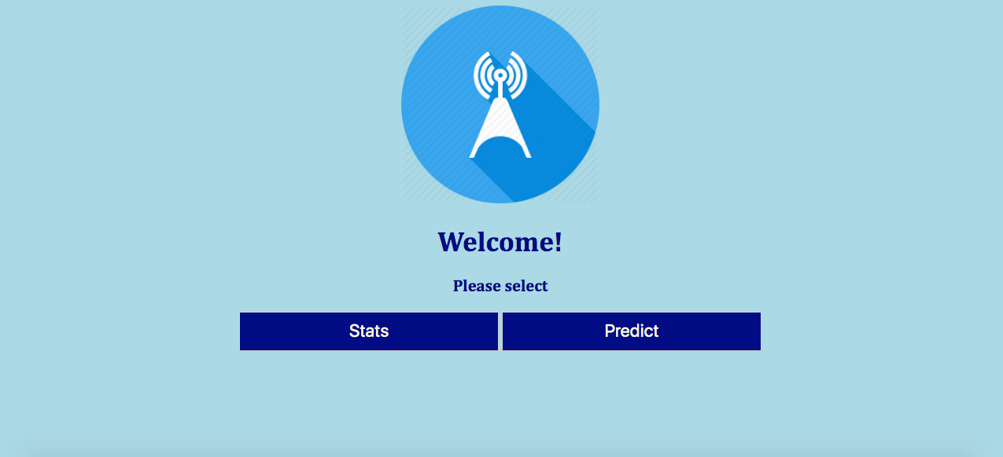
Home Page

Slide 9
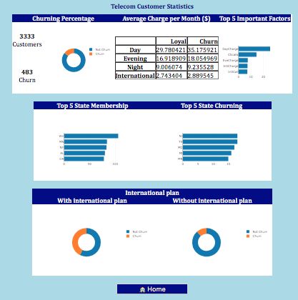
Statistic Page

Slide 10
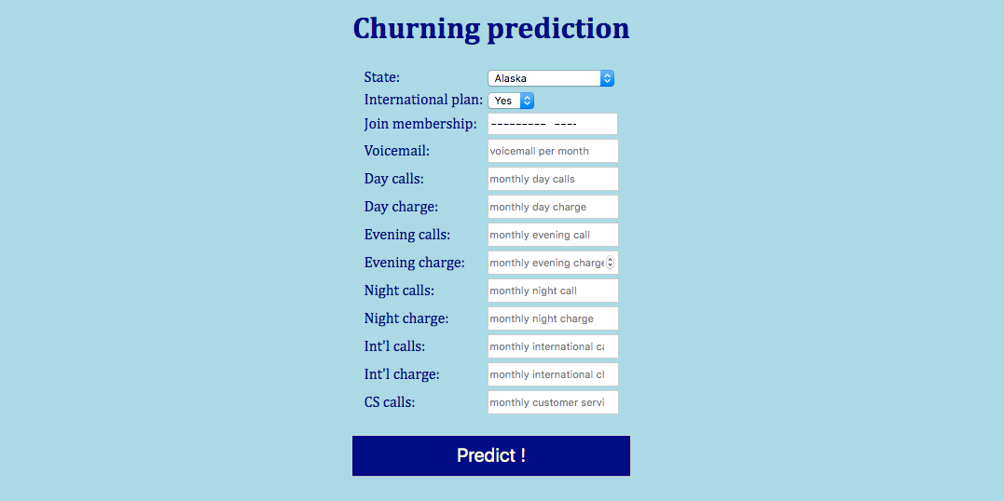
Input Prediction

Slide 11
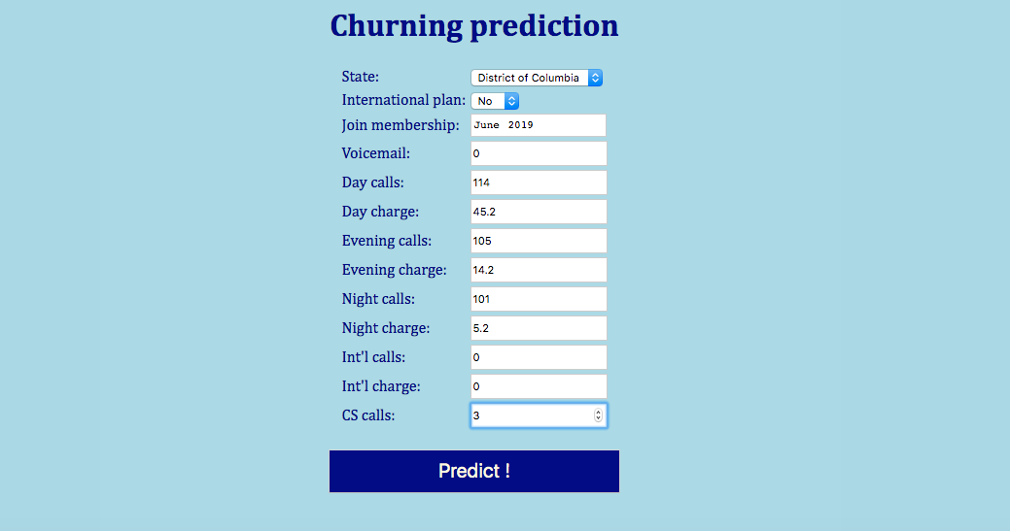

Slide 12
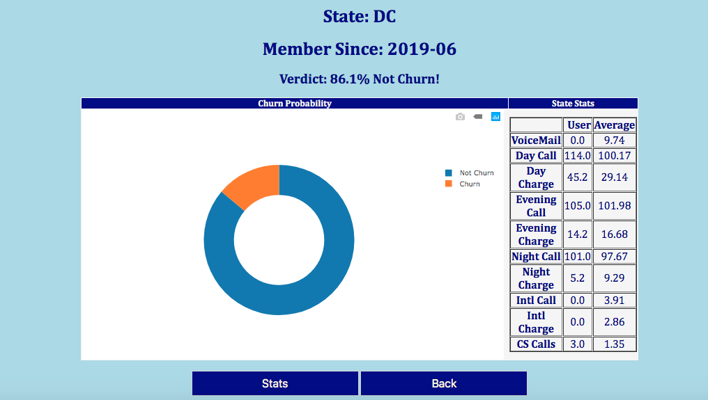
Result Page

Slide 13
Apps Objectives
View churning related statistics
Predict future churn outcome given customer’s monthly usage
Make appropriate recommendation (i.e: for high probability churning, give discount)

