Slide 1



Introduction to Business Technology Platform (BTP) Programming
Ann-Christin Fleischle, Borys Levkovskyi
Technical University Munich (TUM), Germany

Slide 2
Version 1 – 23.11.2022
Internet Browser (Chrome recommended)
SAP Cloud Connector
Eclipse
BTP Access
Basic knowledge in cloud software
Basic understanding of SAP software
Basic knowledge in SAP ABAP, OData, and Fiori development

Slide 3
Understanding SAP BTP capabilities
Understanding the differences between SAP BTP Trial, Free-tier, and Productive versions
Setting up development environment of SAP BTP

Slide 4
Agenda
What is SAP BTP?
BTP Subscription Models
BTP Development Environment

Slide 5
What is SAP BTP?
SAP BTP
Application Development & Automation
Extended Planning & Analysis
Data & Analytics
Artificial Intelligence
Integration
SAP Business Application Studio
SAP AppGyver
SAP Process Automation
SAP Work Zone
Financial Planning
Supply Chain Planning
Workforce Planning
Sales Planning
SAP HANA Cloud
SAP Analytics Cloud
SAP Data Warehouse Cloud
SAP Master Data Governance
SAP AI Core
SAP AI Business Services
SAP AI Launchpad
SAP Conversational AI
SAP Integration Suite
SAP Data Intelligence
Source: https://www.sap.com/products/technology-platform/solutions.html

Slide 6
SAP BTP – Two Use Cases
Extend SAP S/4HANA
Simplify Connectivity
User Story
As a sales executive I want to access real-time business partner data outside of company’s intranet on a mobile device
Solution Steps
Data source – S/4HANA On-premise system
UI – Fiori-based application on SAP BTP communicating with the backend using OData
Required Software
SAP Business Application Studio
SAP Launchpad Service
Access point – any device with internet access
SAP Connectivity Service
User Story
As a retailer I want a unified access point for my customers so that I provide modern customer experience
Solution Steps
Data source – any legacy system, both SAP and non-SAP
Required Software
SAP Integration Suite
Middleware – unified API in SAP Cloud Foundry
Access point – any device with internet connection
SAP Business Application Studio
SAP Launchpad Service
Source: https://discovery-center.cloud.sap/missiondetail/3239/3325/
Source: https://www.sap.com/products/technology-platform/use-cases/open-connectors.html

Slide 7



SAP BTP – Customer Stories
Porsche - SAP Analytics Cloud & SAP Data Warehouse Cloud
Roche – Predictive Planning
NHL – SAP HANA Cloud
Real-time sales data dashboard
Unified data management and analytics
Ensured data security in a governed environment
Drastically reduced financial forecast time
Increased forecast trust
Fully automated forecast process
Instant analysis of the puck and player tracking data – coaches get insights directly during the game
Data stored in a data lake for short-term analytical purposes
Easy data visualization
… and more: https://www.sap.com/products/technology-platform/customer-stories.html

Slide 8
BTP Subscription Models
Trial Account
Free-Tier Account
vs
Available for 365 days in total, renewal after 30 days
Educational purpose only
All users on the same instance
Access to a broad Feature Set B for evaluation purposes: Feature Sets Overview
Existing role collections can be assigned to users for access limit
4 GB of memory for applications, 8 GB of instance memory, 10 total routes and 40 total services available.
Possible to configure 2 on-premise systems with the Cloud connector. However - destination service cannot be used for BAPI/OData calls
Possible to use HDI containers in a shared SAP HANA database
Applications stop automatically on a daily basis
No apps for identity and access management (IAM), communication management, or software component lifecycle
Does not expire
Can be used productively, Pay-As-You-Go model, can be switched to productive model at any time
Your own instance
Limited to free services: Discover Free Services
User management available
Every free service has its own quota
Multiple on-premise systems can be configured with the Cloud connector; destination service can be fully used for BAPI/OData calls

Slide 9
Development Environment on SAP BTP – (1)
Global Account
Subaccount
Cloud Foundry Org
Directory
Subaccount
Multi-tenant subscriptions
Represents your organization
Used to manage subaccounts, members, entitlements and quotas
Organize and manage subaccounts
Can reflect a hierarchy 7 levels deep
Not mandatory but can be used to monitor usage and costs
Contains your instances, such as Cloud Foundry, and subscriptions, such as Business Application Studio
Entitlements are assigned to a subaccount by choosing an appropriate service plan
Region-specific

Slide 10
Development Environment on SAP BTP – (2)
Cloud Foundry Org
Cloud Foundry Space
ABAP Environment
Kyma Runtime
Deployed Applications
Created with a subaccount
Can contain multiple spaces
Developers logon to cloud foundry org from their IDE
Shared location for development
Developers choose a space after logon to cloud foundry org
Repository objects are found in the space
Quotas of the entitlements are assigned to a space
Applications are deployed into a space
Most wide-spread environments are ABAP and Kyma

Slide 11
Entitlements for Development
In BTP free tier administrators need to configure their entitlements themselves
For the development curriculum following entitlements are necessary:
ABAP environment – free service plan
Cloud Foundry Runtime – free service plan
Launchpad Service – free service plan
SAP Business Application Studio – free service plan
SAP HANA Cloud – hana-free, hana-cloud-connection-free, relational-data-lake-free service plans
Web Access for ABAP – free service plan; unlike other entitlements, this one has an unlimited quota
Other entitlements are already available when subaccount is provisioned

Slide 12
Employee vs Business User
Employee
Business User
vs
Tracks personal and contact information of a person
Tracks the period during which that person can access BTP
User is linked to an employee record
Created automatically when a person is assigned to the global account and/or subaccount
ID needs to be maintained for the user to be assigned and get access to development environment
Managed in the “Maintain Employees” app
Tracks roles and access of the person
Defines language and regional settings for person’s UI
1:1 mapping to employees
Needs to be created for the employee if that employee will be developing
SAP_BR_DEVELOPER role is needed for our curriculum; creation of custom roles possible if needed
Managed in the “Maintain Business Users” app

Slide 13
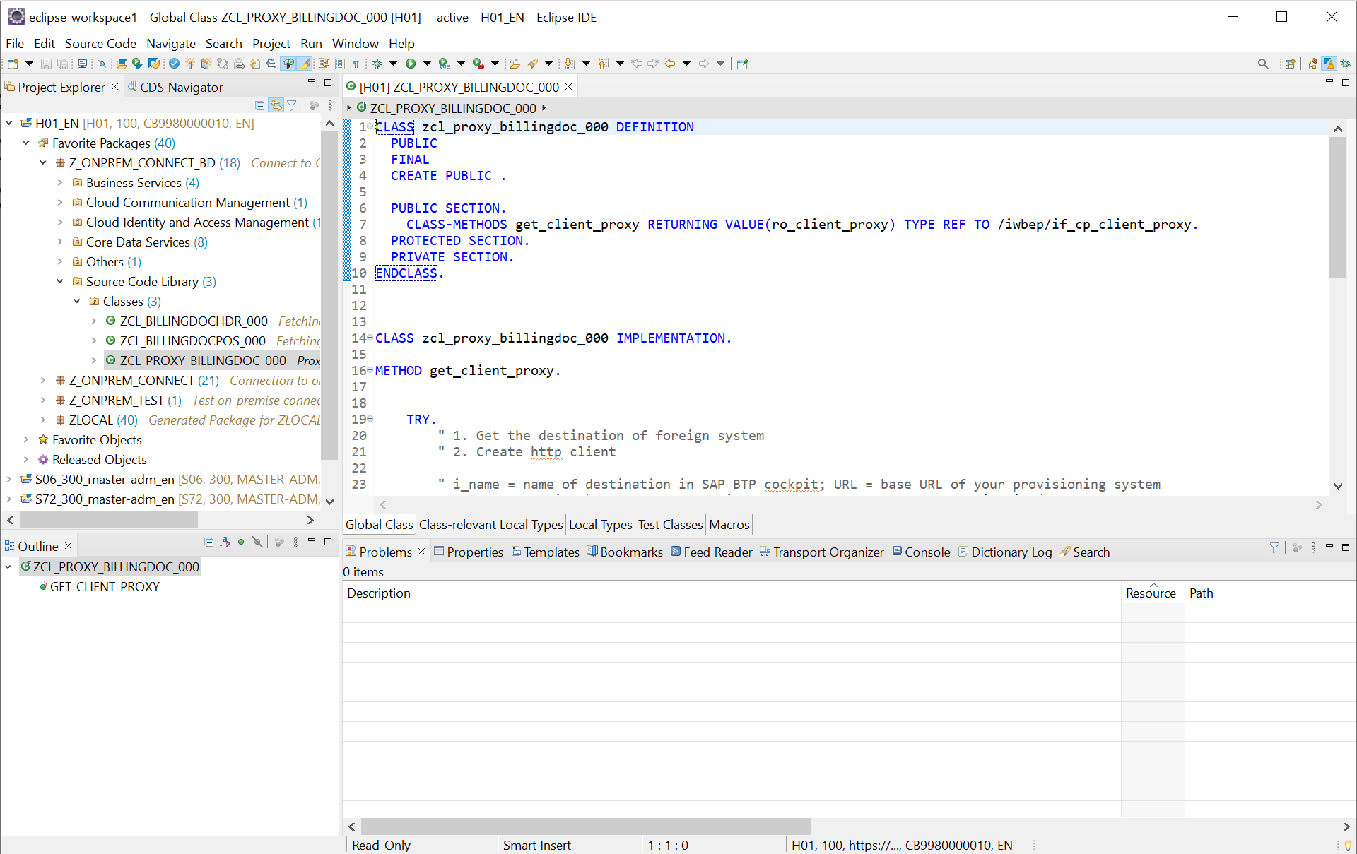
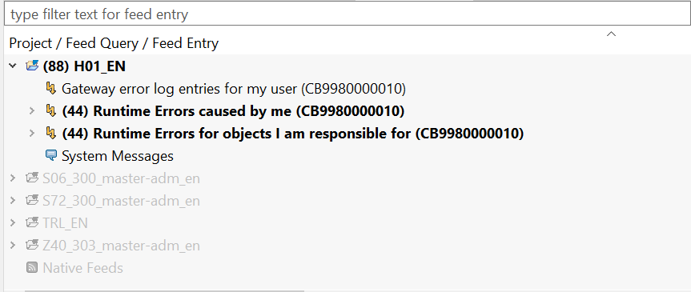
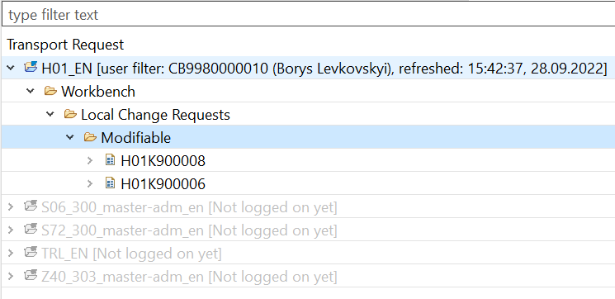
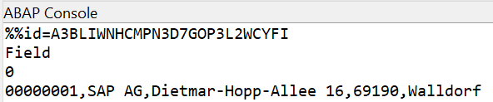
IDE for Backend – Eclipse
Eclipse is an open-source IDE with plugin based architecture
No SAP GUI exists for BTP Development
Full support for ABAP language but also for Core Data Services
Generators and wizards for business service definitions and bindings
Powerful debugger with the same UI as the one for Java, easy switch to new language
Transport management, output console, and error feed in one application, no need to switch between transactions

Slide 14
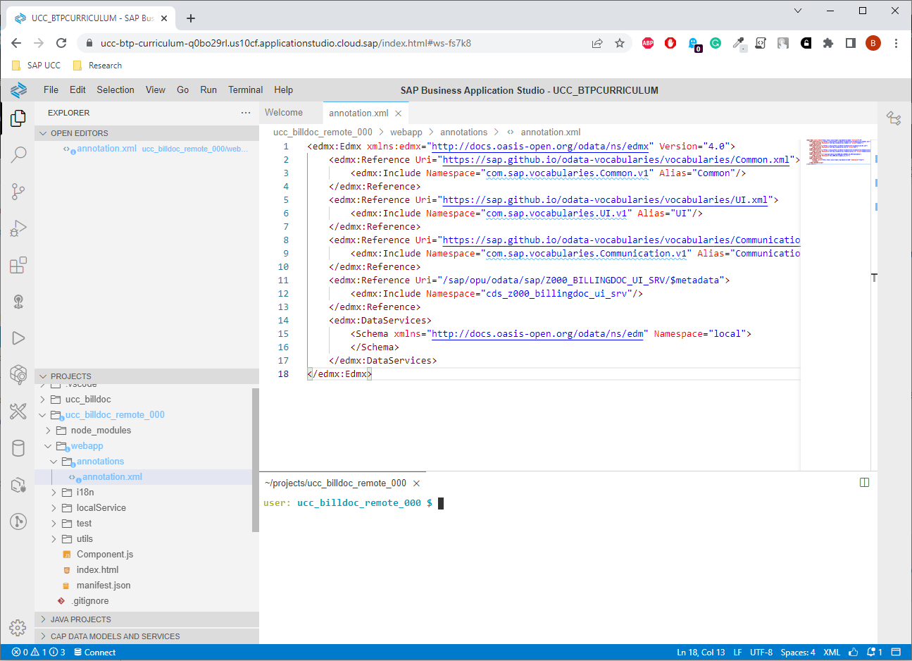
IDE for Frontend – Business Application Studio
Browser-based IDE similar to Visual Studio Code
Plugin-based architecture
Primary IDE for Fiori application components but also fitting for CAP development and UI5 freestyle development
Templates and wizards for most common application types
Main tool for cloud foundry development
Supports deployment into on-premise system
Developments stored in a so-called development space. In free tier 2 spaces of 4 GB per user, one running at a time

Slide 15

Thank you for your attention!

