Slide 1



Getting Ready to Develop on SAP BTP
Technical University Munich (TUM), Germany

Slide 2
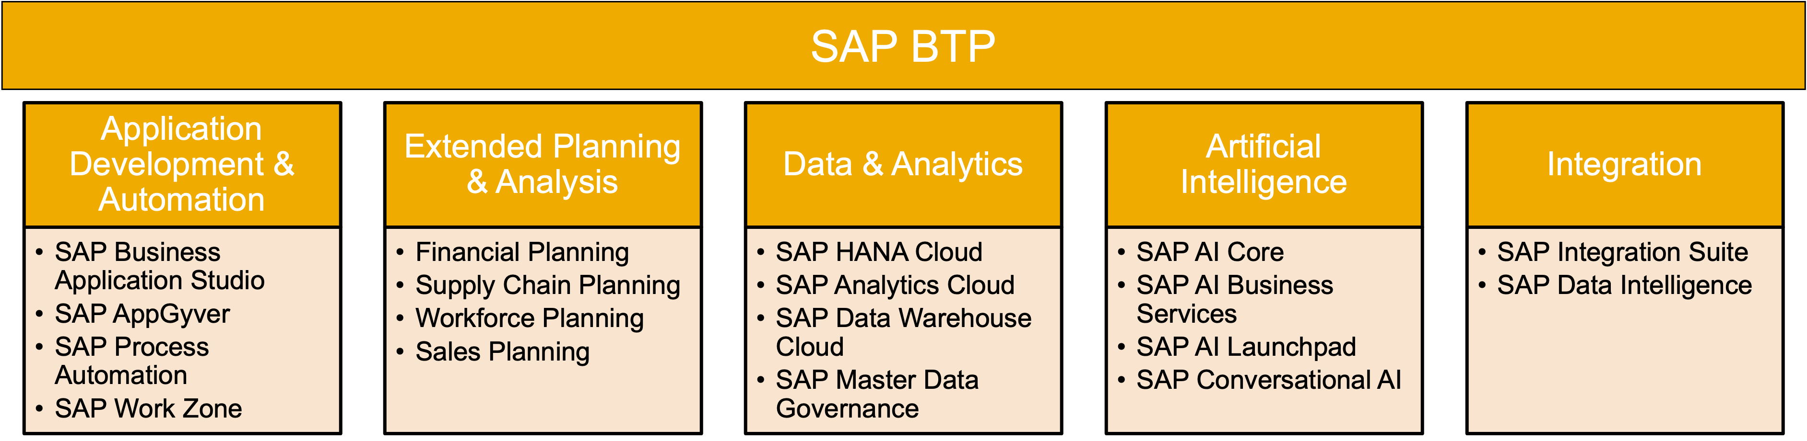
1. What is SAP BTP?
BTP stands for SAP Business Technology Platform
A technology platform that brings together data and analytics, artificial intelligence, application development, automation, and integration in one, unified environment.

Slide 3

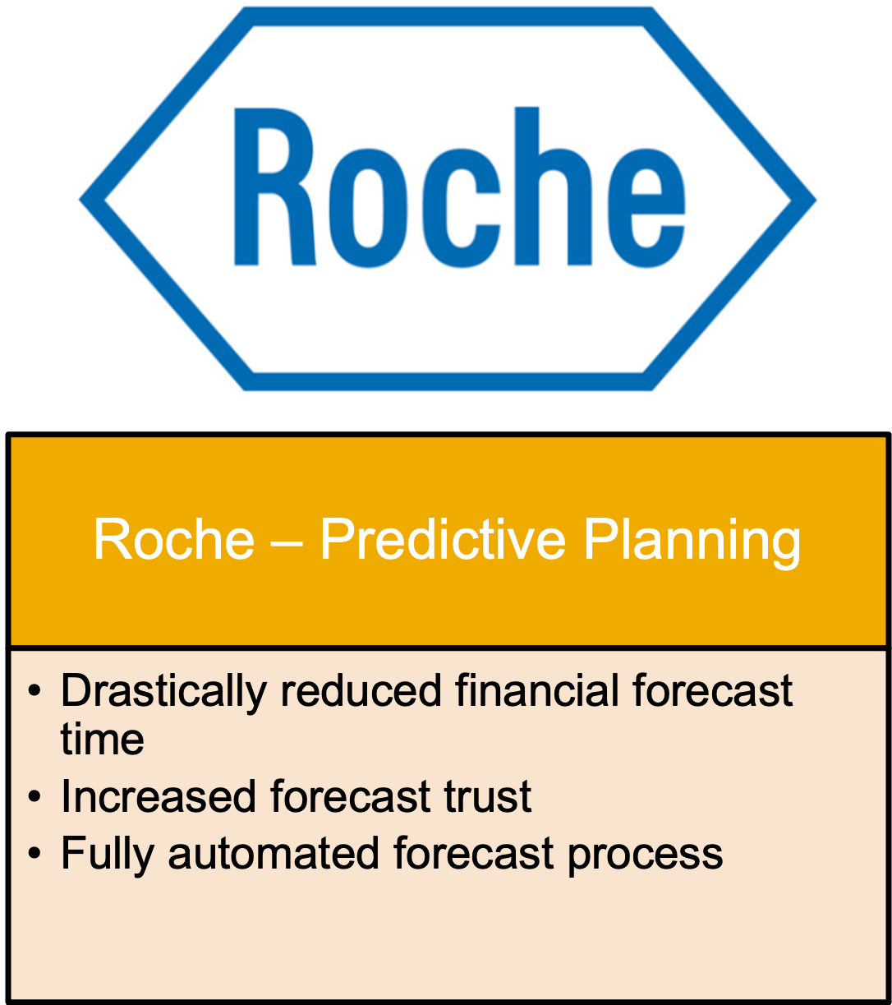

2. SAP BTP – Customer Stories
… and more: sap.com/products/technology platform/customer-stories.html

Slide 4
3. Entitlements for Development
In BTP free tier administrators need to configure their entitlements themselves
For the development curriculum following entitlements are necessary:
Other entitlements are already available when subaccount is provisioned

Slide 5
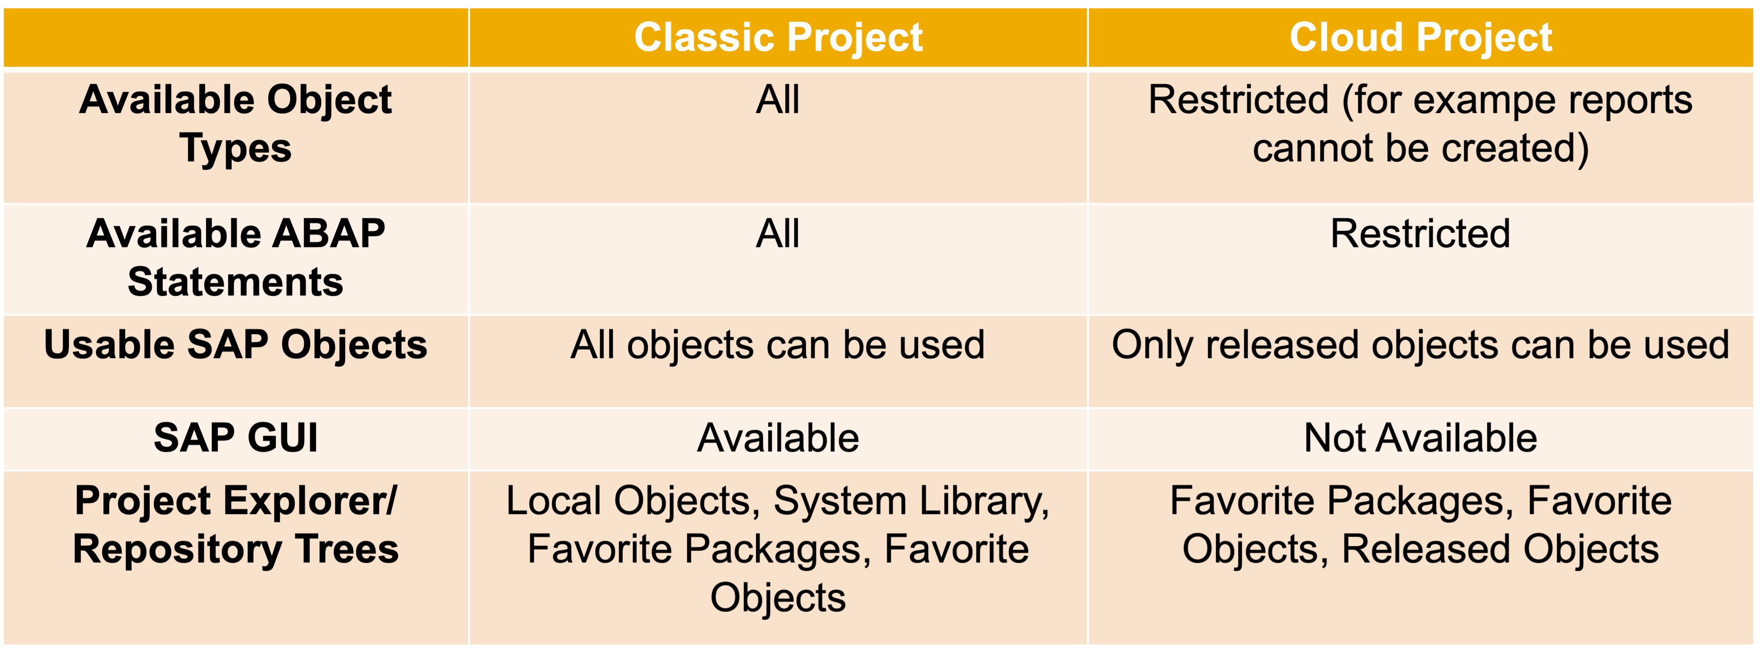
4. ABAP Project vs. ABAP Cloud Project

Slide 6
Conclusion
Thank you for your attention!

