Slide 1


Introduction to ABAP
SAP UCC Technical University of Munich

Slide 2
Agenda
Introduction to SAP
Introduction into ABAP
Transport Concept
Development Prerequisites
Using Help
Development of a first application

Slide 3
SAP SE
I. Introduction to SAP
Market leader in enterprise application software
About >110.000 employees
22.000 partner companies
Source: https://www.sap.com/about/company.html (25.10.2022)
SAP Software Portfolio:
SAP Business Suite
Company Size
SAP Business All-in-One
SAP Business by Design
SAP Business One
Source: Following SAP SE

Slide 4
SAP Netweaver
I. Introduction to SAP
Netweaver = platform to support various SAP applications
Nearly every SAP system is based on the SAP Netweaver Application Server
Different Netweaver runtimes: ABAP, Java, ABAP+Java (Dual Stack)
Examples of SAP applications:
SAP ERP – Enterprise Resource Planning SAP CRM – Customer Relationship Management
SAP SCM – Supply Chain Management
SAP PLM – Product Lifecycle Management

Slide 5
History of ABAP
II. Introduction into ABAP
Introduced 1983 in SAP R/2 as “Allgemeiner Berichts- (und) Aufbereitungs-Prozessor”
Initially only for the creation of reports
Later: ABAP = Advanced Business Application Programming
Since Release 4.3: support for the development of transactions
Machine Code Pascal
SAP UI5
Assembler ABAP ABAP Objects
Cobol HTML5
SAP BTP
Source: Own illustration
1950
1954
1968
1983
1992
2012
2013
2021

Slide 6
II. Introduction into ABAP
What is SGEN?
The SAP Netweaver Application Server can be installed on multiple platforms
Platform = the combination of DBMS, OS and hardware
In newly installed SAP Systems no ABAP is precompiled
Ways to compile ABAP code:
Execute the code for the first time
Call the transaction SGEN to generate the ABAP load
ABAP load gets stored in table REPOLOAD

Slide 7
ABAP repository
II. Introduction into ABAP
Client = technical and organizational independent entity
Client 900
Client dependent Customizing
Client 901
Client dependent Customizing
Application Data
User
Accounts
Application Data
User
Accounts
Data in a SAP system can be either:
Client dependent / specific
Client independent / Cross-
Client
Client independent customizing
Repository
Source: Own illustration

Slide 8



II. Introduction into ABAP
Report / Dialog-Driven Program
Difference between a Report and a Dialog-driven program:
Report:
Follows a relatively simple programming model
Produces a report (interactive list)
Can be executed in the background
Dialog-driven program:
Also known as transaction
Cannot be executed in the background
SAP
SAP
GUI
GUI
SAP System
Dispatcher
Background Work Process
Work Process
There are different kind of work processes – e.g.:
Dialog work processes (for interactive tasks)
Background work processes (for background execution)
Source: Own illustration
The SAP GUI connects to the dispatcher

Slide 9


Why transportation?
III. Transport Concept
Transfer changes made to objects in either Customizing or the Repository to other SAP systems (e.g. developments, corrections, repairs, …)
The SAP transport system uses transport requests
Example (recommendation from SAP):
Development System (DEV)
Quality Assurance System (QAS)
Production System (PROD)
Source: Own illustration

Slide 10








Transport Hierarchy
III. Transport Concept
Defined by Project Owner
Project
Defined by Transport Request Owner / Manager
Transport
Request
Transport
Request
Task 1
Task 2
Task A
Task B
Task C
Developer
Developer
Developer
Developer
Source: Own illustration

Slide 11
Releasing transport requests
III. Transport Concept
The recorded entries of the task are copied into the object list of the transport request
Developers have to release their tasks (in urgent situations a task can be taken over)
Tasks get released to the related transport request
When every task has been released, it is possible to release the transport request
When releasing a transportable transport request, table entries get written on the filesystem.
A released transport request cannot be edited anymore.
Releasing a transport request can be done in the Transport Manager (Transaction: SE09 or SE10)

Slide 12
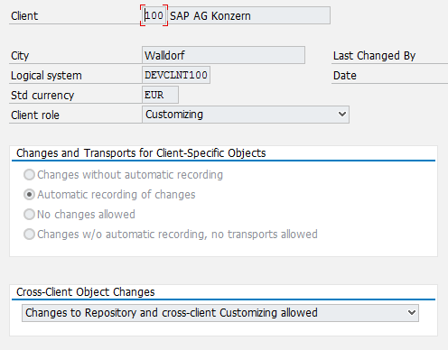
IV. Development Prerequisites
SAP Client configuration
A properly configured client is necessary for development
Access to the repository is needed
Configuration in transaction SCC4
Client Role C (Customizing)
Changes should be allowed

Slide 13
IV. Development Prerequisites
Creation of a package and a transport request
For development an own package and an own transport request are needed
Packages allow you to group your developments
Transport requests enable you to transport new developments to other SAP systems
It is not possible to transport developments when using the local package $TMP

Slide 14
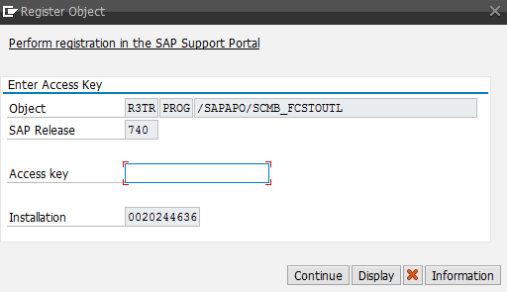
Namespaces
IV. Development Prerequisites
Important: pay attention to namespaces!
SAP uses namespaces from A to X for their own programs and implementations
Companies can register their own namespace
A namespace is unique and can only be assigned to
one company
Developer namespaces begin with Y or Z (e.g. ZZ_*)
When modifying a program outside the development
namespace a modification key has to be entered

Slide 15
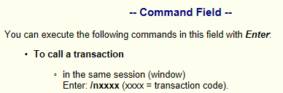
V. Using Help
Using different Help options (separate with screenshots)
F1 Help: press F1 to get help to the currently selected item
F4 Help: press F4 in an input field when the symbol
is shown for a list of all valid values
Links:
SAP Community Network: https://answers.sap.com/
SAP for Me: https://me.sap.com/
ABAP Help:
http://help.sap.com/saphelp_nw74/helpdata/de/4a/24dbfa64550455e10000000a421937/frameset.htm
Books
The Official ABAP Reference, SAP PRESS, ISBN-13: 978-1592290390
ABAP-Objects, SAP PRESS, ISBN-13: 978-1592290796

Slide 16
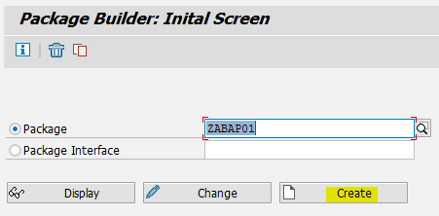
VI. Development of a first application
A Hello World application – Step 1
First an own package has to be created (Transaction SE21 – Package builder)

Slide 17
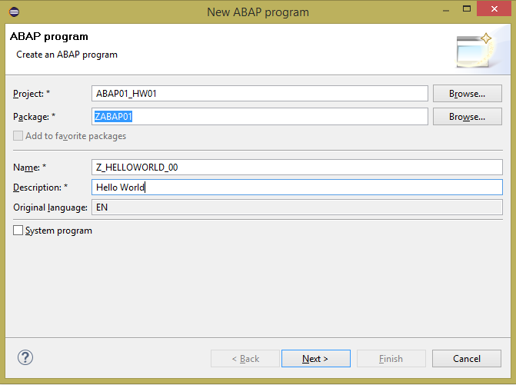
VI. Development of a first application
A Hello World application – Step 2
Create your program

Slide 18

A Hello World application – Step 3
VI. Development of a first application
Now add your code
Code for report
Z_HELLOWORLD_00
Writes “Hello World” on the screen.
Note the closing dot (similar to
semicolon in Java or C#)

Slide 19
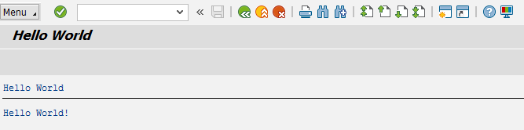
VI. Development of a first application
A Hello World application – Step 4
Finally activate your code and run the application
The SAP system always executes the last activated version of a program
If your program has not been activated after changing the code, the version before the changes were made will be executed

Slide 20
Now you know the very basics of ABAP development.
To consolidate your knowledge, you can do the Introduction exercise.

Slide 21
Check your knowledge

Slide 22
Check your knowledge
An ABAP report can only be executed in the background.
□ True □ False
Which requirements have to be fulfilled in order to release a transport request.
□ Code has been successfully written to the filesystem □ Its Tasks have to be released
□ You have to be owner of the request
Which ABAP reports can be created with only having an access key for developers.
□ SAPLWB_INITIAL_TOOL □ A_CALCULATOR □ Z_CALCULATOR □ BMW_I8
22

Slide 23
Solution

Slide 24
Solution
An ABAP report can only be executed in the background.
□ True ☒ False
Which requirements have to be fulfilled in order to release a transport request.
□ Code has been successfully written to the filesystem ☒ Its Tasks have to be released
□ You have to be owner of the request
Which ABAP reports can be created with only having an access key for developers.
□ SAPLWB_INITIAL_TOOL □ A_CALCULATOR ☒ Z_CALCULATOR □ BMW_I8

Slide 25
Version History
Version 1.0 created by Adrian Streitz, Johannes Rank, Borys Levkovskyi in 2018
Version 2.0 adapted by Adrian Streitz, Johannes Rank, Borys Levkovskyi in 2018
Version 3.0 adapted by Ann-Christin Fleischle, Philipp Landler in 2023
Information on slides adapted to S/4HANA
VS Code as IDE for frontend development
Local testing of SAPUI5 applications

Slide 26
© 2023 SAP SE or an SAP affiliate company. All rights reserved.
No part of this publication may be reproduced or transmitted in any form or for any purpose without the express permission of SAP SE or an SAP affiliate company.
SAP and other SAP products and services mentioned herein as well as their respective logos are trademarks or registered trademarks of SAP SE (or an SAP affiliate company) in Germany and other countries. Please see http://global12.sap.com/corporate-en/legal/copyright/index.epx for additional trademark information and notices.
Some software products marketed by SAP SE and its distributors contain proprietary software components of other software vendors. National product specifications may vary.
These materials are provided by SAP SE or an SAP affiliate company for informational purposes only, without representation or warranty of any kind, and SAP SE or its affiliated companies shall not be liable for errors or omissions with respect to the materials. The only warranties for SAP SE or SAP affiliate company products and services are those that are set forth in the express warranty statements accompanying such products and services, if any. Nothing herein should be construed as constituting an additional warranty.
In particular, SAP SE or its affiliated companies have no obligation to pursue any course of business outlined in this document or any related presentation, or to develop or release any functionality mentioned therein. This document, or any related presentation, and SAP SE’s or its affiliated companies’ strategy and possible future developments, products, and/or platform directions and functionality are all subject to change and may be changed by SAP SE or its affiliated companies at any time
for any reason without notice. The information in this document is not a commitment, promise, or legal obligation to deliver any material, code, or functionality. All forward- looking statements are subject to various risks and uncertainties that could cause actual results to differ materially from expectations. Readers are cautioned not to place undue reliance on these forward-looking statements, which speak only as of their dates, and they should not be relied upon in making purchasing decisions.

