Slide 1
Crisis Response: Ukraine Refugee Support
02268 Process-oriented and Event-driven Software Systems
Final Presentation
Group 2

Slide 2
Agenda
Introduction and Domain Description
Business Model
Processes and Events
Implications and Limitations

Slide 3






Crisis Response: Ukraine Refugee Support 1. Introduction and Domain Description
Idea – Provide Support (Use Case: Ukraine-Russia conflict)
Travel Support Service
Visa Support Service
Job Application Support Service
Mobile Application
Frontend
Backend
External Sources

Slide 4
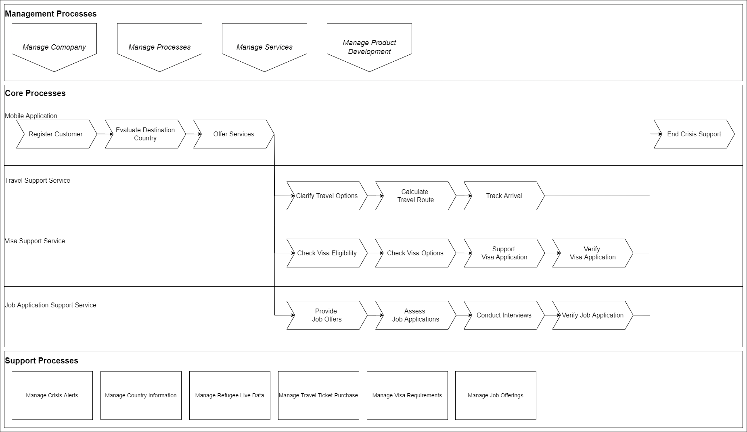
Crisis Response: Ukraine Refugee Support 2. Business Model – Process Landscape

Slide 5
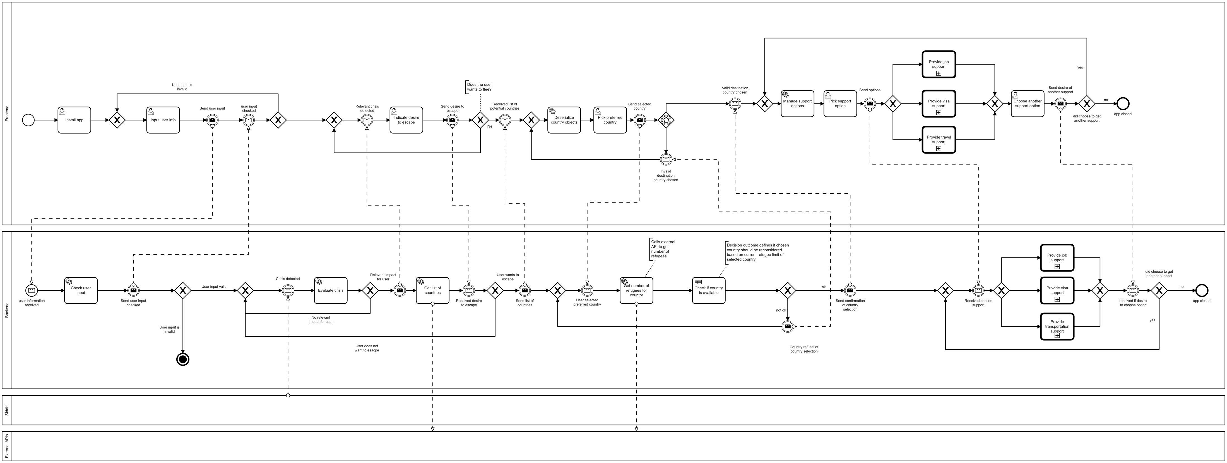
Crisis Response: Ukraine Refugee Support 2. Business Model – Main Process

Slide 6
Crisis Response: Ukraine Refugee Support 2. Business Model – Main Process

Slide 7
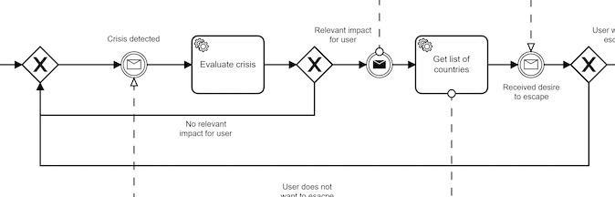
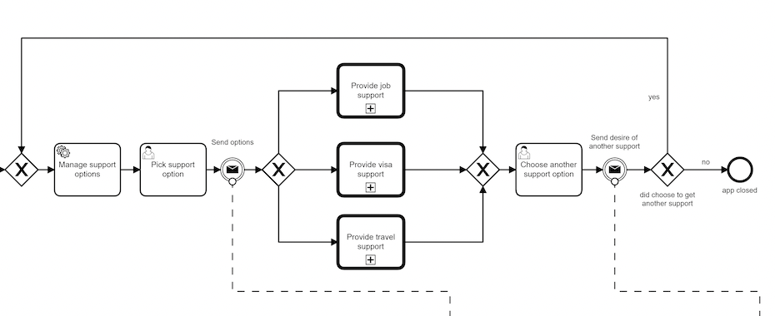
Crisis Response: Ukraine Refugee Support 2. Business Model – Main Process
Crisis Detection
Providing Support

Slide 8
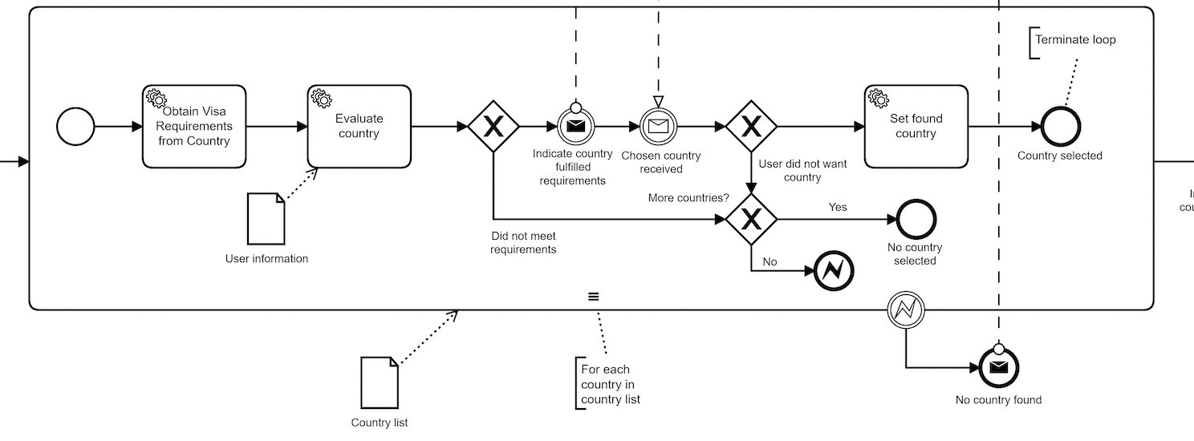
Crisis Response: Ukraine Refugee Support 2. Business Model – Visa Process
Multi Instance

Slide 9
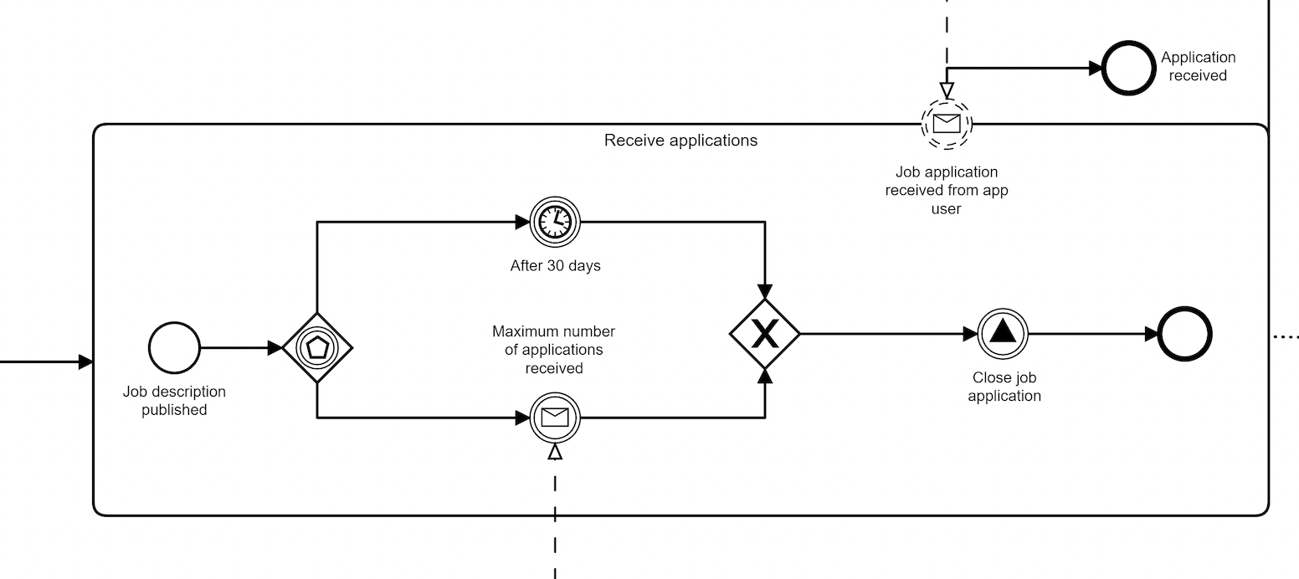
Crisis Response: Ukraine Refugee Support 2. Business Model – Job Process
Simulation of Application Window

Slide 10
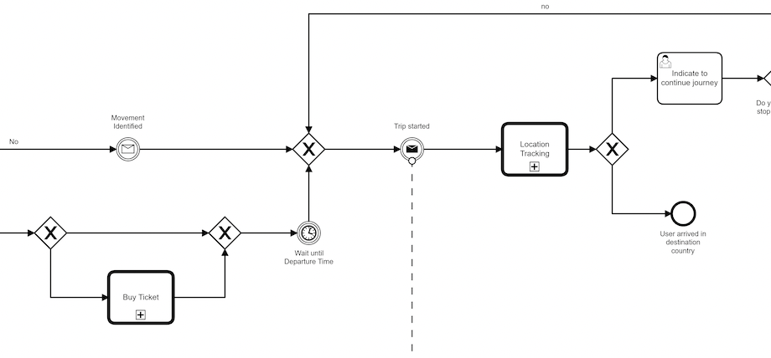
Crisis Response: Ukraine Refugee Support 2. Business Model – Travel Process
Location Tracking

Slide 11
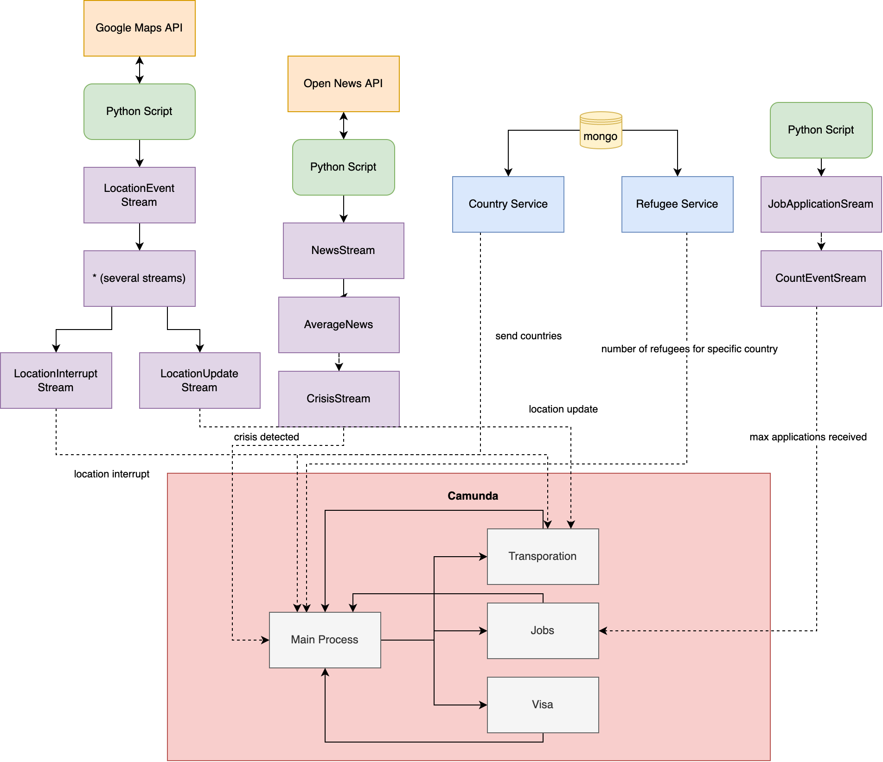
Crisis Response: Ukraine Refugee Support 3. Processes and Events
Architecture

Slide 12
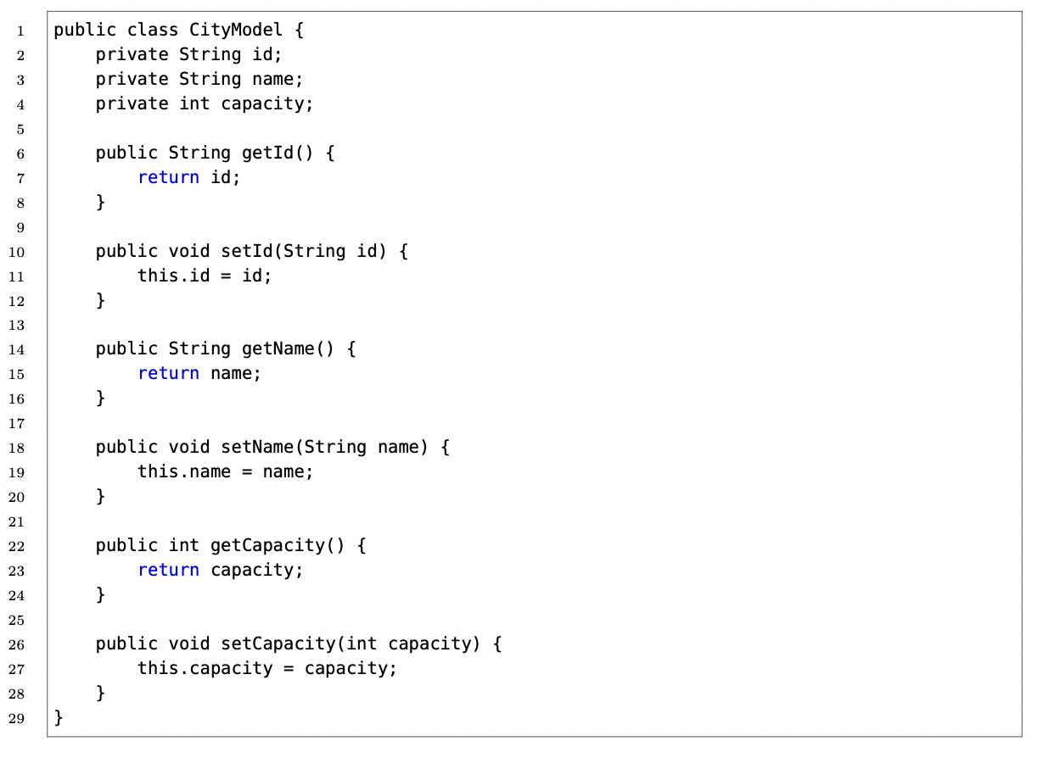
Crisis Response: Ukraine Refugee Support 4. Implications and Limitations
Camunda – Wrapped in Spring Project

Slide 13
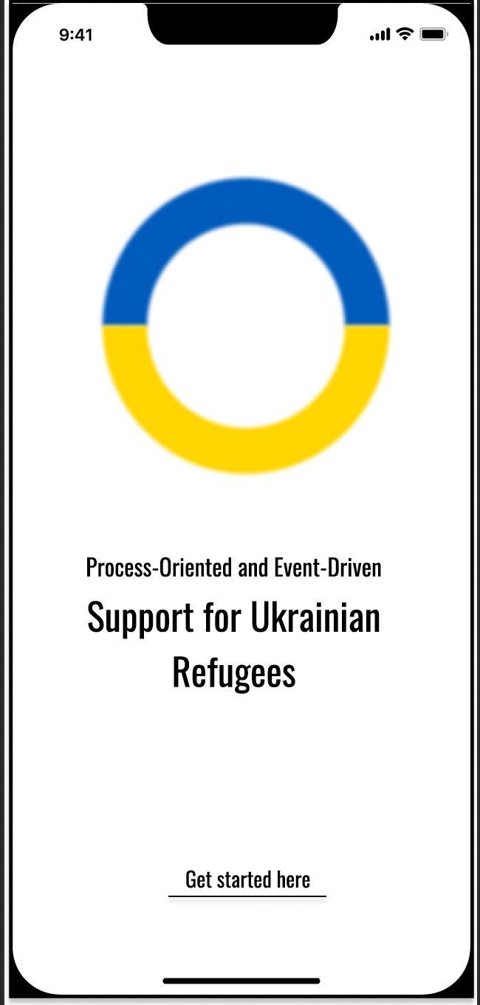
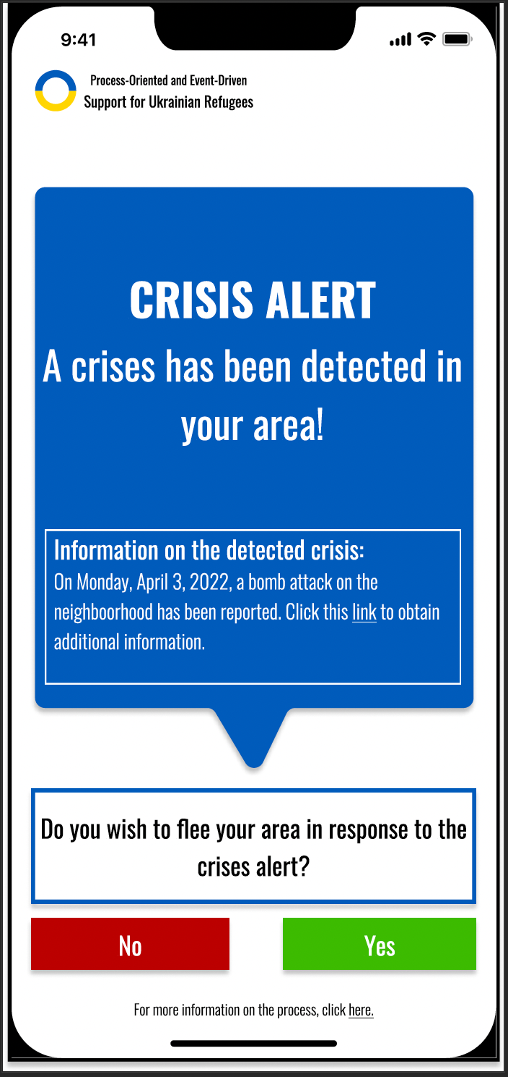
Crisis Response: Ukraine Refugee Support 4. Implications and Limitations
App UI

