Slide 1
Copyright in the Digital Age…
Gray Murky OOZE
IT DEPENDS

Slide 2
Shedding Some Light on COPYRIGHT:
Copyright and Your Dissertation:
What you absolutely, positively need to know now
Graduate School of Biomedical Sciences
Graduate School of Nursing
University of Massachusetts Medical School
October 25, 2012
Barbara Ingrassia, MLS, AHIP, CCM
Head, Copyright and Licensing
Lamar Soutter Library
Barbara.ingrassia@umassmed.edu
508-856-1041
Disclaimer:
I’m not an attorney
The information
presented here should not be construed as legal advice.

Slide 3
GOALS for today’s presentation:
Provide (non-legal) guidance:
What you absolutely positively need to know
…So you can MANAGE the OOZE—to achieve your goals
Some “Basics” about Copyright (non-legal advice)/MYTHS
“Categories” of resources vis a vis Copyright
“Things to think about” when choosing content
“Attribution” vs. “Permission” vs. “Fair Use”
Manage Copyright—Don’t Let it Manage You!

Slide 4
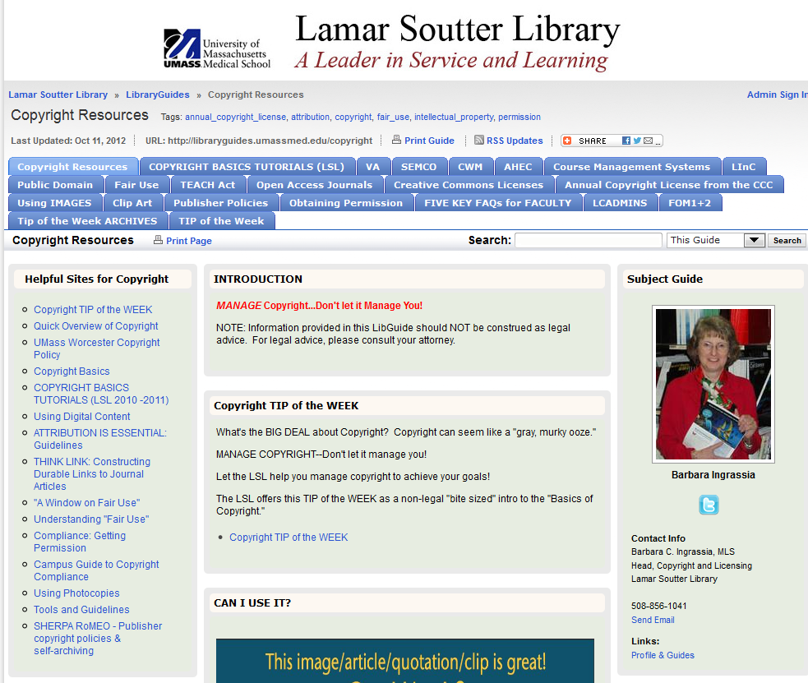
http://libraryguides.umassmed.edu/copyright

Slide 5
Copyright Ownership
Secured automatically when the work is created and fixed in a tangible form
May belong to the:
      Author(s)
      Employer/Funder
Rights can be transferred in whole or in part—
Often, authors transfer all of their ownership rights to a publisher when accepting the offer to be published—BE WARE!! Read the fine print!
Notes:
to Authors and Inventors
As of changes to US Copyright law in the late 1980’s, there are no formalities required in order to be the owner of the exclusive rights afforded a copyright holder. As soon as a work is created, and fixed in a tangible form the author automatically owns the copyright and all rights associated with copyright.
Only the author, or those deriving rights through or from the author, can claim copyright rights.
In the case of works created in the scope of an employment relationship and other works made for hire under the copyright law, the employer is the copyright holder of the works created by its employees. (Such as a staff writer or editor. In an academic setting, the employment contract generally specifies the copyright provisions of works created during employment at the institution.)
For works that are contracted, however, the party performing the contracted work (“freelancer”is considered the author of the work unless the agreement for the contracted work specifies otherwise. And, in the case of joint works, two or more authors can own the copyright to a work. (Such as freelance writers, freelance photographers, illustrators, etc)
Copyright in each separate contribution to a collective work is distinct from copyright in the collective work as a whole, and vests initially in the author of the contribution. In the absence of an express transfer of copyright, the owner of copyright in the collective work is presumed to have acquired only the privilege of reproducing and distributing the contribution as part of that particular collective work, any revision of that collective work, and any later collective work in the same series. Such as a periodical containing articles, and photographs within. The author/artist can own the rights to the individual article or photo, and the publisher can own simultaneously own rights to the entire magazine issue containing those granular works. (The magazine is the “collective work.”) Another example is a chapter contained within an anthology.
Rights can be Transferred by the author or any subsequent rightsholder(s).

Slide 6
AND...just to complicate matters a bit more…
is no longer required…
©
So its ABSENCE is not a reliable indication of the copyright status of the work.
But we do recommend that you continue to use it.
© 2012 University of Massachusetts Medical School
Notes:
We recommend tha you continue to use it as info for the user. We’ll get to that in more detail in a minute.

Slide 7
ASSUME the work you want to use is COPYRIGHTED—
Until you can determine otherwise!
This includes:
*Articles *Chapters *Lectures *E-mail messages
*Blog postings *Webpages *Social media
*Images (photos, charts, graphs, tables, illustrations, microslides)
*Video *Audio *Cartoons *Clipart
Even notes on paper napkins….AND “Happy Birthday”

Slide 8
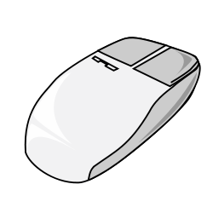

Just because you CAN Right Click…
Doesn’t mean you SHOULD
FYI: Images are from www.OpenClipArt.org
A library of images in the Public Domain
ALWAYS ASSUME it’s COPYRIGHTED…until you can determine otherwise.
Notes:
The technology is there, but you need to think about how you’ll use it.

Slide 9
Publicly ACCESSIBLE
Does NOT necessarily mean
--FREE-To-USE
--Public Domain
ALWAYS check the “terms and conditions of use”

Slide 10
OPTIONS for choosing content:
FREE to use—no restrictions. No permission or fee
required
Use with CONDITIONS—follow the rules set by
the copyright owner
3. MUST obtain PERMISSION
ALWAYS include an attribution/citation

Slide 11
FREE to use—no restrictions. No permission or fee required
PUBLIC DOMAIN
(Works in the PUBLIC DOMAIN are not covered by copyright)
Works first published in the U.S. pre-1923
Expired Copyright
Never Copyrighted--due to:
  oversight
  don’t qualify for copyright protection**
    (original works not fixed in a tangible format, titles/names/slogans, ideas/facts/data, lists of content/ingredients)
US. Government documents—created by federal employees
or contractors
(Not all materials on a U.S. Govt web site .gov are in
the Public Domain—3rd party content may be copyrighted)
** HOWEVER, trademark or patent law may apply

Slide 12
MOST U.S. Government Documents are in the Public Domain—
IF a federal employee or federal contractor created the content as part of their employment.
Some U.S. Government sites include content created by a 3rd party which holds the copyright… OR the Copyright was transferred to the government.
So look closely!!
These .gov sites include content copyrighted by 3rd parties:
e.g.: PubMedCentral
(NIH Public Access Policy. Copyright still applies.)

Slide 13
POSSIBLE SOURCES FOR PUBLIC DOMAIN IMAGES: (U.S. Government)
http://phil.cdc.gov/phil/about.asp
http://www.nih.gov/about/nihphotos.htm
(The NIH Image Bank contains images from the collections of the 27 Institutes and Centers that comprise the National Institutes of Health. Contents include general biomedical and science-related images, clinicians, computers, patient care-related images, microscopy images, and various exterior images)
http://research.archives.gov/search?v:project=opa&query=626166 Photographs Relating to Disasters and Emergency Management Programs, Activities, and Officials. "View all Online Holdings" to access over 8,000 photographs.
www.usa.gov/Topics/Graphics.shtml
U.S. Government journals in the Public Domain:
Addiction Science & Clinical Practice
Emerging Infectious Diseases
Preventing Chronic Disease

Slide 14
NOTE:
STATE government documents may or may not be in the Public Domain.
It often depends on the particular department/agency/publication.

Slide 15
USE with CONDITIONS—
no permission required, but you may have to comply with rules set by the copyright owner
(“terms and conditions”)
Digital content LICENSED by UMMS.
Must review the “permitted uses, “terms and conditions of use.” Generally, the T+C can be found at the bottom of any screen for the content on that site.
HOWEVER: The license UMMS has signed may not allow for “re-publication” or use off campus. (Contact: Barbara.ingrassia@umassmed.edu)
Blanket LICENSE: Copyright Clearance Center Annual License. UMMS has such a license, but, again, it generally does not allow for use outside of UMMS, including re-publication. However, it may be possible to pay for a particular use.

Slide 16
USE with CONDITIONS—no permission required, but you may have to comply with rules set by the copyright owner
(“terms and conditions”)…continued…
3. CREATIVE COMMONS—
These works are copyrighted, but the copyright owner has indicated that certain uses do not require permission.
This is a LICENSE with CONDITIONS—not Public Domain.
SEE: http://search.creativecommons.org

Slide 17
Open Access materials
free, unrestricted, online access
Copyright Holder retains copyright Transmission, reproduction, or reuse of protected material, beyond that allowed by the fair use principles of the copyright laws, requires the written permission of the copyright owners
+
a Creative Commons License
Copyright Holder retains copyright but grants certain permissions to Users without requiring written permission. User must follow certain rules.
SEE: Intro to OPEN ACCESS AND What is CREATIVE COMMONS?

Slide 18
What are Creative Commons licenses?
http://creativecommons.org/licenses/
Copyright Holder retains copyright, but grants certain permissions to Users without requiring the User to seek written permission. User must credit the original AND link to the particular license::
There are 6 basic types:
Attribution (The most accommodating. User may distribute, remix, tweak, build upon—even for commercial purposes)
Attribution—Share Alike (Very similar to #1, but any derivatives must allow the same uses as the original work)
Attribution—NoDerivs (User must pass along the original work in whole and unchanged)
Attribution—NonCommercial (Very similar to # 1, but for non-commercial purposes only)
Attribution—NonCommercial--ShareAlike (Combination of # 2 and # 4)
Attribution—NonCommercial-NoDerivs (The most restrictive. Combination of # 3 and # 4.)

Slide 19
We are most familiar with these Open Access Publishers
They actually use CREATIVE COMMONS licensing (copyrighted with some rights to re-use)
BioMedCentral (BMC)
PLoS
The Lamar Soutter Library is a member of those 2 publishers = UMMS authors receive a discount on author fees to publish
BMC http://www.biomedcentral.com/info/about/supportermembership
PLoS
http://www.plos.org/support/instmembership.php
PubMedCentral also has a very small set of articles that are copyrighted with some rights to re-use
PubMed Central Open Access Subset

Slide 20
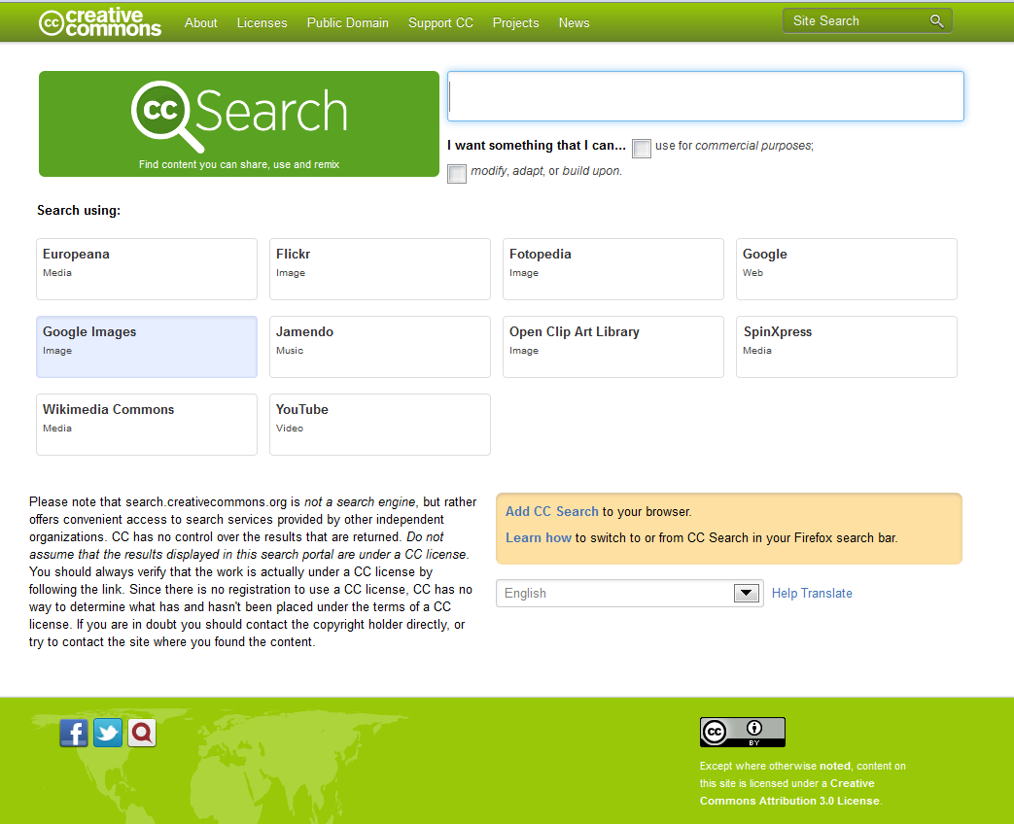
http://search.creativecommons.org/

Slide 21
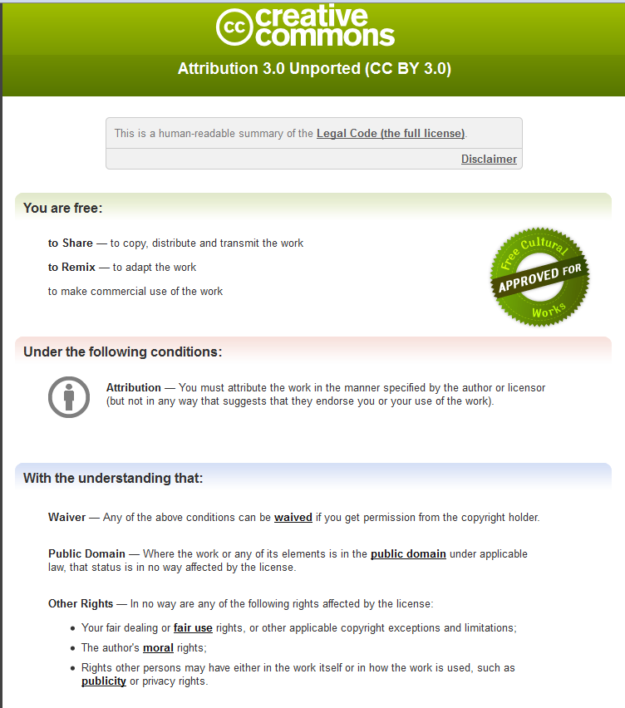
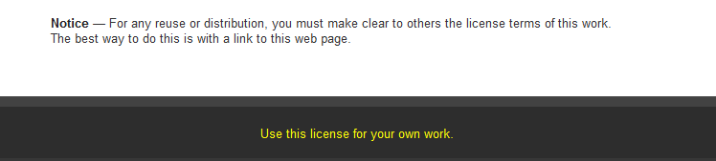

Slide 22
Charts
Diagrams
Figures
Graphs
Illustrations
Photos
Slides
Tables
  SEARCHING
  FOR
  IMAGES:
Specific Resources for UMMS:
Consult this WORD document on the LSL Copyright LibGuide:
http://tinyurl.com/SEARCHING-for-IMAGES

Slide 23
“Fair Use” –
Probably the MOST MISUNDERSTOOD part of the Copyright Law
“Every educational use” is NOT AUTOMATICALLY a Fair Use
There are NO MAGIC numbers, percentages, etc. in the U.S.
Copyright Law
Any “numbers” that you see in articles on this topic may be:
Simply Guidelines—without the force of law
OR
If within a signed license—those are binding.
(“License trumps Law.”)

Slide 24
Whether a proposed use is a FAIR USE is determined by the careful analysis of the 4 FACTORS---for each piece of 3rd party copyrighted content –including each image—that you propose to use
IT DEPENDS… on the SPECIFICS of the situation:
  Purpose and character of the proposed use
  Nature of the copyrighted work
  Amount and substantiality of the portion used
  Effect of the use on the Market for the
  original Work
  This must be done BEFORE you use the work

Slide 25
When you need to obtain permission
This does not have to be:
arduous
or
time – consuming
or
even expensive.
BUT…you must plan ahead
General discussion of the “permissions process” from the: Columbia University Libraries/Information Services
Copyright Advisory Office
Tips for obtaining permission.
Includes sample
Language for requests

Slide 26
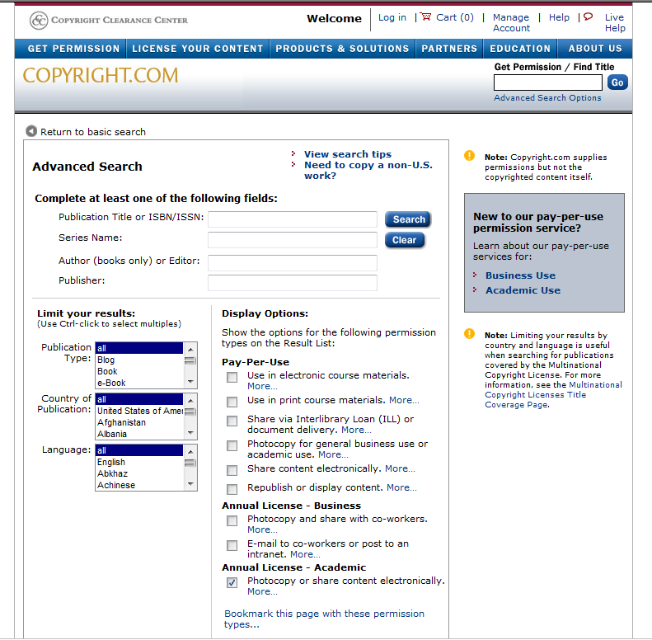
http://www.copyright.com/
The CCC has a PAY-PER-
USE option

Slide 27
Many publishers now post permission procedures on their web page or even next to the article:
RightsLink (another service from the Copyright Clearance Center) (SEE: example from Elsevier)
This is particularly useful for requests to “republish”—that is--use the copyrighted content outside of a UMMS course.
NOTE: Use of images often requires contacting the publisher directly. (Publisher may not own the rights)

Slide 28
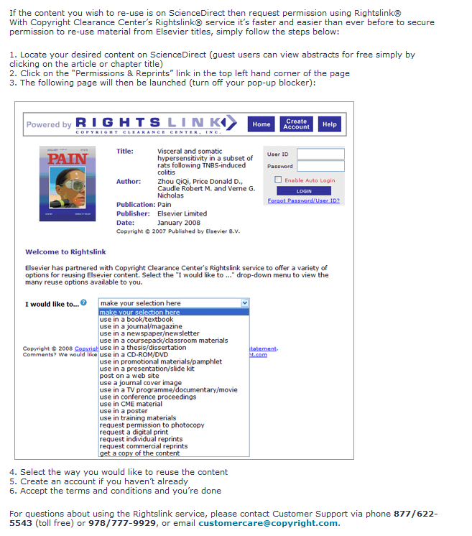
Using Rightslink for permissions
Image © Elsevier.
Used by permission.
IMPT TO INCLUDE!!
http://www.elsevier.com/wps/find/authorsview.authors/permissionsguide

Slide 29
FREE CONDITIONS PERMISSION
Public Domain
All Rights Reserved
CC-BY
CC-BY-SA
CC-BY-ND
CC-BY-NC
CC-BY-NC-SA
CC-BY-NC-ND
FAIR USE
If a CC license doesn’t give you the rights you need, you certainly can contact the copyright owner.

Slide 30
Citing 3rd party images: Best Practices
Figure 1.4 A representation of… Reprinted with permission from Smith and Jones Very Important Journal 2010: 10, 325-349. (License No. 123456789).

Slide 31
Citing 3rd party images: Best Practices
Figure 2.5. Protein immunity… Rest of caption… (Johnson and Clark. 2005. Another Journal. 45:79. Reprinted with permission under the terms of the Creative Commons Attribution License (http://creativecommons.org/licenses/BY/2.0), which permits unrestricted use, distribution, and reproduction in any medium, provided the original work is properly cited.

Slide 32
Publisher Policies:
Thesis Content and Article Publishing
MIT Libraries has created a helpful “table that summarizes publisher policies regarding graduate students’ reuse of their previously published articles in their theses, and policies on accepting submissions that first appeared in an author’s previously released thesis.”
http://libraries.mit.edu/sites/scholarly/publishing/publisher-policies-thesis-content-and-article-publishing/
Publisher
Reuse of author’s previously published article in author’s thesis
Submission of new articles by author that first appeared as part of
author’s thesis
BUT always double check—policies can change.
If YOUR Publisher is not included, please contact the LSL; we’ll find their policies and create a UMMS table.

Slide 33
Some additional points to consider:
REGISTERING your copyrighted work with the U.S. Copyright Office
Not required—but adds strength to your claims.
Easy to do online: http://www.copyright.gov/eco/
Not expensive (presently $35)
BE WARE of “offers to publish” your dissertation.
Investigate carefully.
If it seems “too good to be true,”
…it probably is.
SEE: Dean Carruthers’ email message of 1/5/2012
“IMPORTANT: Info about publishing your doctoral thesis”
(concerning LAMBERT ACADEMIC PUBLISHERS)

Slide 34
Best Practices:
  KEEP COMPLETE RECORDS FOR ANY WORK YOU USE
  ASSUME that a work is copyrighted
  A © copyright statement is no longer required
  Remember that publicly accessible IS NOT automatically Free to Use
  Check “terms and conditions of use”
  Use resources licensed by UMMS, if permitted
  Use resources in the PUBLIC DOMAIN
  Use Creative Commons Resources; attribute to the specific license
  Include complete attribution at the “point of use”
  When seeking “permission,” retain all documentation
  Include the © copyright statement
  Add “Used with permission” as appropriate
  If doing a “Fair Use Analysis,” retain dated documentation.
  On your completed work, include a copyright statement

Slide 35
And Remember:
in any copyright situation...
IT DEPENDS
Each case must be analyzed individually
Thank you!

Slide 36
BUT…
The Lamar Soutter Library is here to help you
MANAGE COPYRIGHT to meet YOUR Goals.
Members of the UMMS/UMMHC community:
If you have any questions about copyright, please contact me at:
Barbara.ingrassia@umassmed.edu
508-856-1041
While I cannot give legal advice, I may be able to serve as a resource.

Slide 37
COPYRIGHT
IS THE
AUTHOR’S
RIGHT
BEFORE
you transfer those rights…
Read the “fine print”
Consider your future plans for using
the work
Explore the Options
Consult your Mentors
Make your Decision for
this particular situation

Slide 38
RESOURCES:
Lamar Soutter Library Copyright LibGuide
http://libraryguides.umassmed.edu/copyright
U.S. Government PUBLIC DOMAIN Resources (especially images)
http://phil.cdc.gov/about.asp
http://www.nih.gov/about/nihphotos.htm
http://research.archives.gov/search?v:project=opa&query=626166
www.usa.gov/Topics/Graphics.shtml
Creative Commons
http://creativecommons.org/about
http://creativecommons.org/licenses
http://search.creativecommons.org
http://wiki.creativecommons.org/FAQ#How_do_I_properly_attribute_a_Creative_Commons_licensed_work.3F
http://www.biomedcentral.com/info/about/supportermembership
http://www.plos.org/support/instmembership.php
http://www.ncbi.nlm.nih.gov/pmc/tools/openftlist/ (PMC-OA)

Slide 39
RESOURCES cont:
LSL Copyright LibGuide--Images
http://tinyurl.com/SEARCHING-for-IMAGES
LSL Copyright LibGuide—FAIR USE
http://libraryguides.umassmed.edu/content.php?pid=154236&sid=1329810
LSL Copyright LibGuide—Permission
http://libraryguides.umassmed.edu/content.php?pid=154236&sid=1329857
http://www.copyright.com
Publisher Policies—Reuse/Submission (MIT)
http://libraries.mit.edu/sites/publishing/publisher-policies-thesis-content-and-article-publishing/
Registering a copyright with the U.S. Copyright Office
http://www.copyright.gov/eco
http://www.copyright.gov
Barbara.ingrassia@umassmed.edu

