Slide 1
The Password Tool

Slide 2
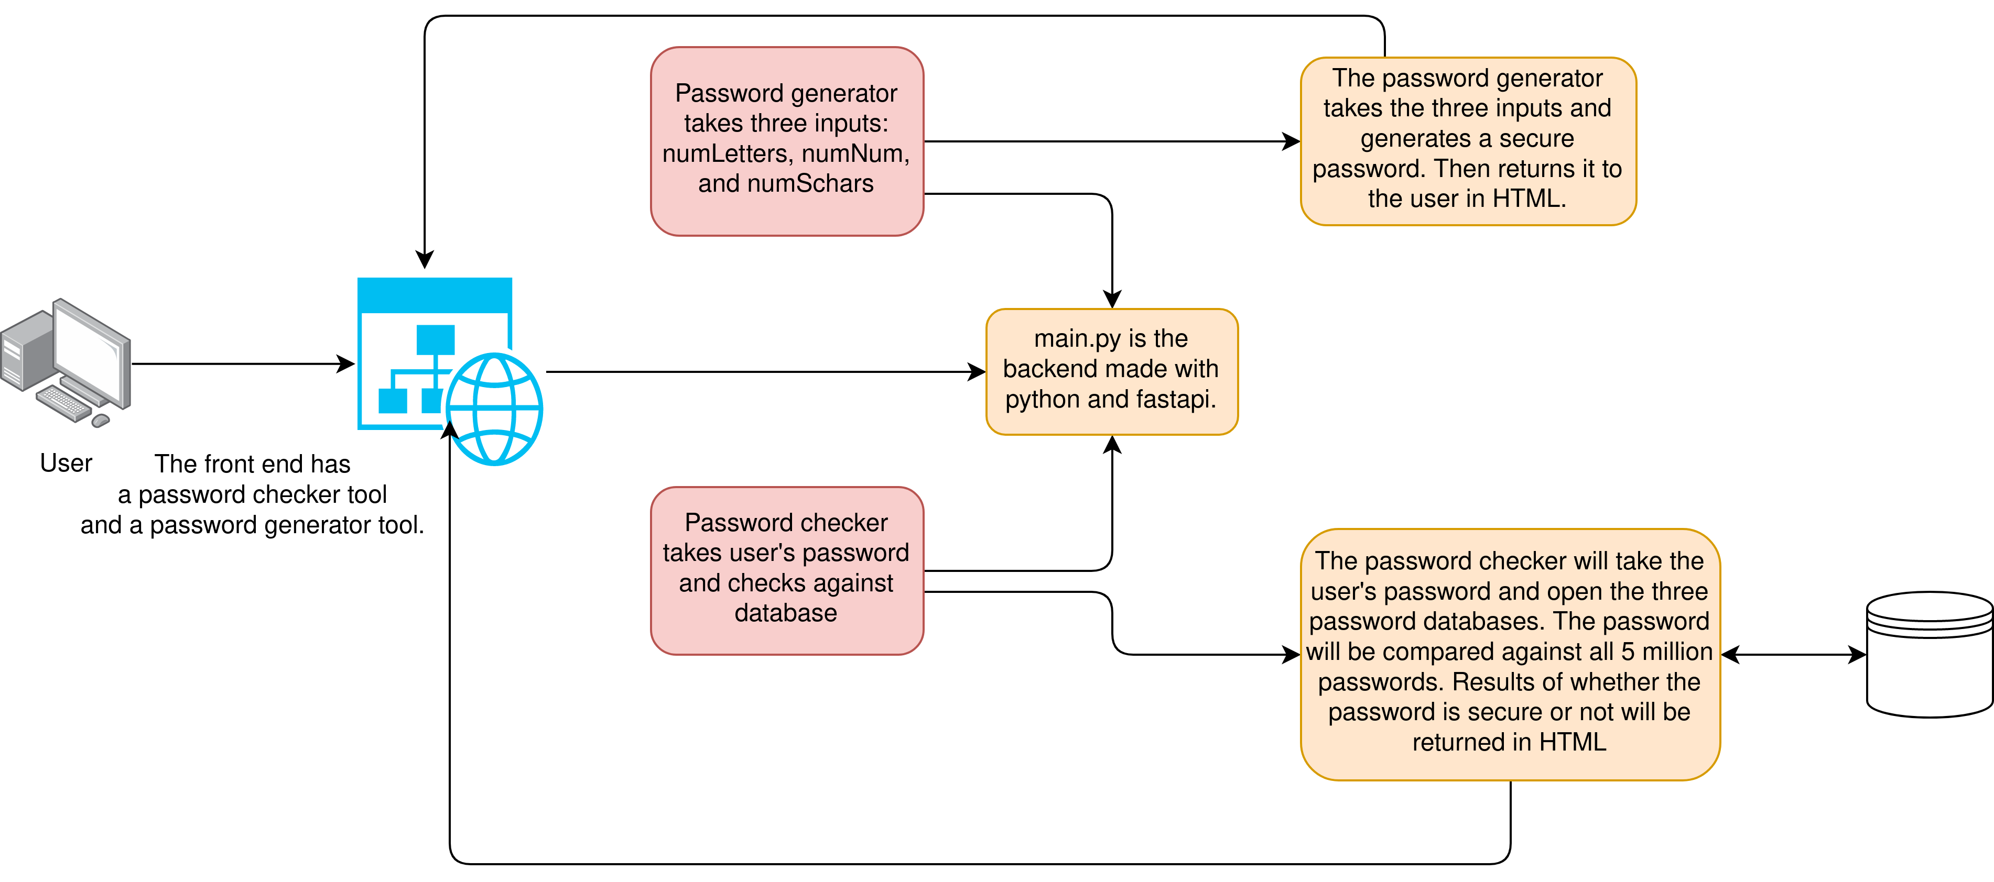
Road Map/ Diagram

Slide 3
Technology Used
I used multiple types of technology to create my project.
HTML and CSS for the front-end.
Python w/ FastApi framework for the back-end.
DigitalOcean (Cloud VPS service) for deployment.
GitHub for source code management.

Slide 4
Demonstration Time!

Slide 5
Documentation

Slide 6
Project Reflection

