Slide 1

MobileNet DPU Accelerated Inference System
EE382N-4 Advanced Embedded Systems Spring 2024
Christian Lancaster, Reva Vaidya, William Avery

Slide 2
Problem Statement
Accelerating deep neural networks for pose estimation using the Zynq Deep Learning Processing Unit (DPU)
Optimizing for the split between CPU and DPU utilization

Slide 3
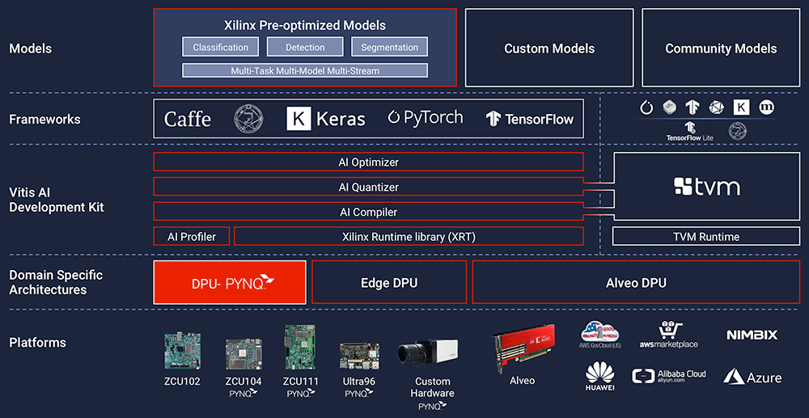
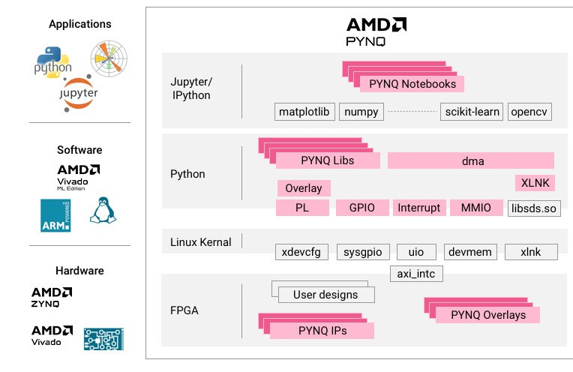
Technologies Used: Vitis AI & AMD Pynq
Vitis AI
PYNQ
https://www.xilinx.com/applications/medical/healthcare-ai.html
Notes:
Vitis AI is a development environment to accelerate AI inference on AMD hardware platforms. The framework includes optimized IP cores, tools, libraries, models and reference designs. Supports mainstream networks, like Pytorch and Tensorflow.
Vitis AI has a zoo of pre optimized models you can run. You may also want to bring your own model, as we have done with mobilenet
AI Optimizer: Prunes the model to reduce complexity with minimal loss of accuracy.
AI Quantizer: converts from floating point to fixed point formats, optimizing for reduced memory bandwidth, faster processing, and power efficiency
AI Compiler: Maps the AI model to the DPU instruction set and dataflow model. Additional optimizations specific to the AMD hardware
Vitis AI library and runtime: apis for submission and collection of jobs from the accelerator, multithreading and multiprocess execution
So basically we are bringing our own custom model to be accelerated on the Ultra96. We run it through the Vitis AI framework in order to produce a binary output which can then be run on any DPU enabled system. Next we need a system to run it on.
Pynq is a hardware/software framework for Zynq SoCs that enables running ml apps on programmable hardware. It is distributed as a board image file and contains a bitfile to instantiate a system containing the Pynq-DPU IP, as well as a suite of python tools that simplify the use of the Vitis AI APIs in order to run our model on the Ultra96

Slide 4
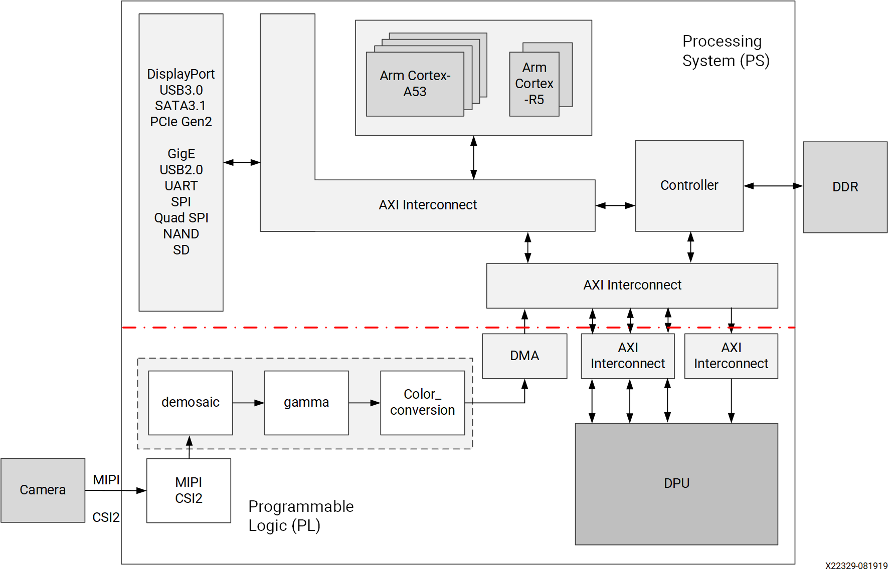
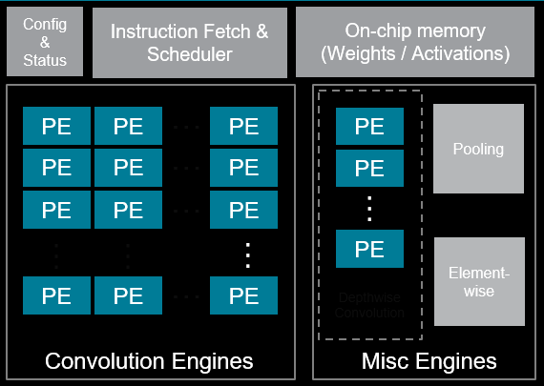
Deep Learning Processing Unit
https://docs.amd.com/r/en-US/pg338-dpu/MPSoC-Integration-Example
https://xilinx.github.io/Vitis-AI/3.0/html/docs/workflow-system-integration.html
Notes:
Christian -
DPU is a general purpose AI inference accelerator. One DPU can run multiple neural nets simultaneously. Multiple DPU instances can be instantiated per device. DPU can be scaled in size
The dpu is a matrix of heterogenous processing engines. It’s similar to a systolic array. The DPU is a microcoded processor with its own ISA.
Xmodel executable is the output of the vitis ai compiler. The vitis ai runtime handles scheduling tasks, with support for running multiple networks or multiple dpu instances simultaneously.
There is no need to reload the bitfile when running a new network, the DPU enabled system serves as a general purpose inference engine for running any Xmodel.
DPU IP is distributed via download as a reference implementation, which can then be integrated into existing designs or further modified and tuned for a developers application. We obtained the DPU as part of the Pynq board image which is a prepackaged implementation suitable for running most models.
DPU support is available for Vivado, though it is not found in the standard repository, as shown in the diagram on the right, and interfaces with the PS and RAM via standard AXI interfaces.

Slide 5
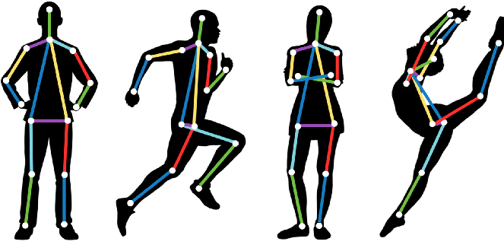
Mobile Pose Inference
MobileNetV2 backbone with dense upsampling convolutions
Downstream pose estimation with dense upsampling convolutions and differentiable spatial to numerical transformations
Trained using the MobilePose library and the MPII human pose dataset on a single A100 GPU
https://www.analyticsvidhya.com/blog/2021/10/human-pose-estimation-using-machine-learning-in-python/
Notes:
William

Slide 6
Key Results
Hardware | Static INT8 Quantization | Euclidean Loss (Pixels) | Jenson-Shannon Divergence | Framerate (FPS)
DPU (Vitis-AI) + CPU (ONNX) | Y+Y | 0.093 | 0.26 | 3.1383
DPU (Vitis-AI) + CPU (ONNX) | Y+N | 0.093 | 0.26 | 7.4450
CPU (ONNX) | Y | 0.092 | 0.25 | 9.7242
CPU (ONNX) | N | 0.090 | 0.25 | 11.6259
Euclidean Loss: distance between predicted pose and true pose
Jenson-Shannond Divergence: similarity between heatmaps
Notes:
William

Slide 7
What went well
Remote training and inference system
We were able to work effectively over the internet using own resources
Support of Xilinx PYNQ framework
Documentation
Jupyter Notebook programming interface
Built in DPU-PYNQ support for Ultra96V2
Camera interfacing fully supported by PYNQ

Slide 8
What did not go well
Xilinx documentation was limited and varies between Vitis AI major versions
Many operations not supported by the DPU
Sparse documentation on extending compiler and DPU to support custom IP
Validating the quantized model
This just took a long time due to discrepancies between Vitis AI documentation and what actually happens

Slide 9
What would we do differently
Pivoted several times due to limitations of the Vitis AI ecosystem
Board support, custom op support, model support
We only found PYNQ at a late stage in the project
Accelerate a proprietary model with cutting edge operations optimized for mobile architecture
Knowing what we have learned now, we could likely achieve this
Possibly explore the design of a custom system using Vivado

Slide 10
References
[1] Vitis AI: https://www.xilinx.com/products/design-tools/vitis/vitis-ai.html
[2] AMD PYNQ: https://www.pynq.io/
[3] DPU-PYNQ: https://github.com/Xilinx/DPU-PYNQ
[4] MPII Human Pose Database: http://human-pose.mpi-inf.mpg.de/
[5] MobilePose: https://github.com/YuliangXiu/MobilePose
[6] MobileNetV2: https://arxiv.org/abs/1801.04381

