Slide 1
E-Ballot
Electronic Voting System Using Blockchain

Slide 2
What is Blockchain?
Blockchain is a chain of blocks that are connected together and are continuously growing by storing transactions on the blocks.
BlockChain uses a decentralized approach that allows the information to be distributed and that each piece of distributed information or commonly known as data have shared ownership.
Blockchains holds batches of transactions that are hashed thus providing them security and they are managed by peer-to-peer networks.

Slide 3
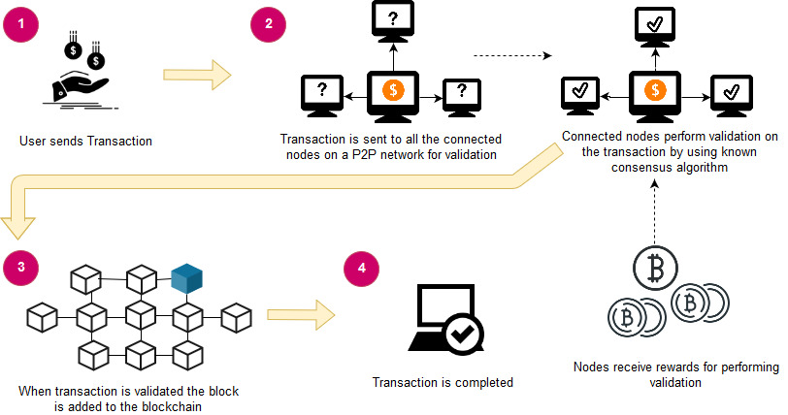
An overview of Blockchain architecture

Slide 4
Problem Statement
By adopting blockchain in the distribution of databases on e-voting systems can reduce one of the cheating sources of database manipulation.
Blockchain technology is one of solutions, because it embraces a distributed system and the entire database are owned by many users.
Blockchain itself has been used in the Bitcoin, Ethereum, Ripple, Litecoin.

Slide 5
Aim
Aims to building an voting system that satisfies the legal requirements of legislators has been a challenge for a long time.
Distributed ledger technologies is an exciting technology world.
Also aims to evaluate the application of blockchain as service to implement distributed electronic voting systems.

Slide 6
Objective
The election system must be openly verifiable and transparent.
The election system must ensure that the vote cast by the voter has been recorded.
Only eligible voters must be allowed to vote.
The election system should be tamper-proof.

Slide 7
Metamask
MetaMask is a cryptocurrency wallet that enables users to store Ether and other ERC-20 tokens.
The wallet can also be used to interact with decentralized applications or dapps

Slide 8
Ganache
Ganache is a private Ethereum blockchain environment that allows to you emulate Ethereum blockchain so that you can interact with smart contract in your own private blockchain.
Ganache is a personal blockchain for rapid Ethereum and corda distributed application development.

Slide 9
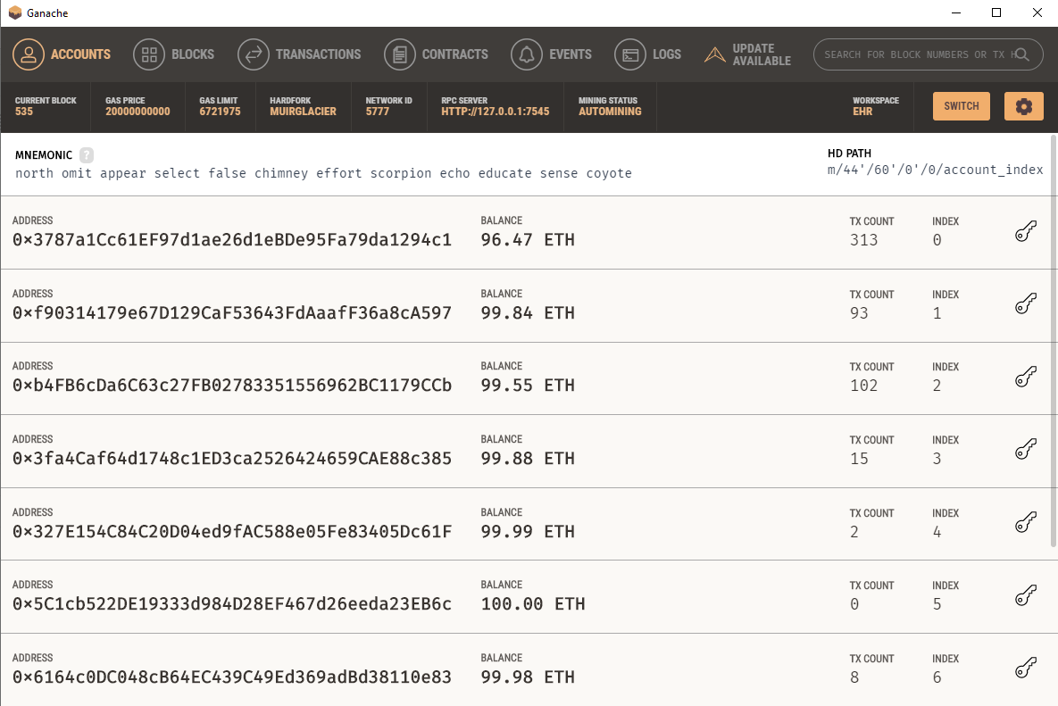

Slide 10
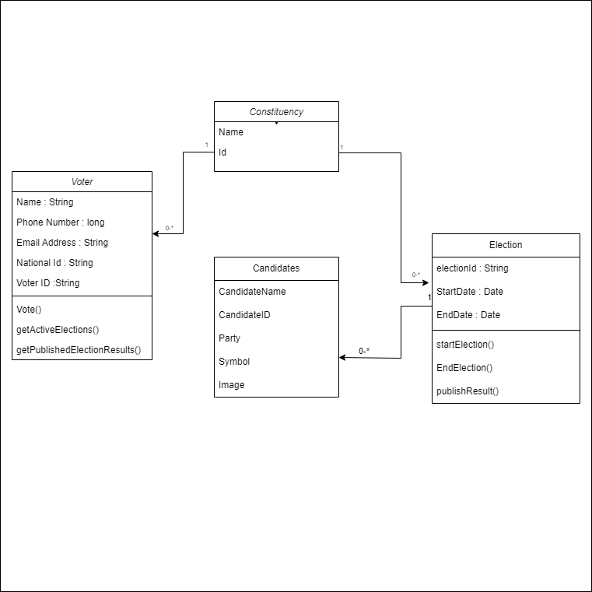
Class Diagram

Slide 11
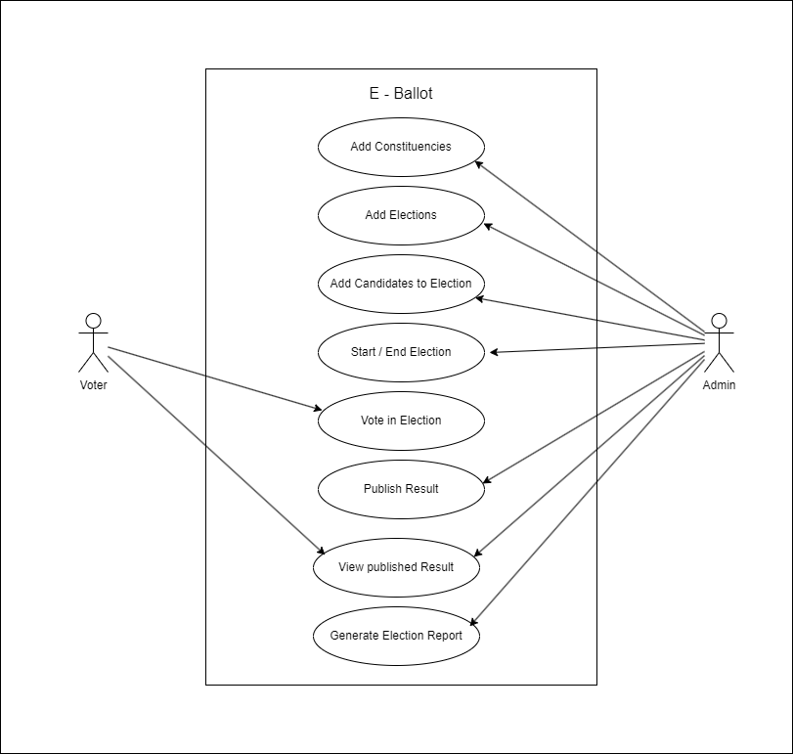
Use Case Diagram

Slide 12
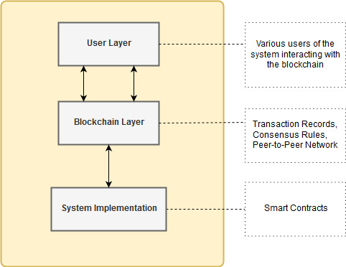
System Design & Architecture

Slide 13
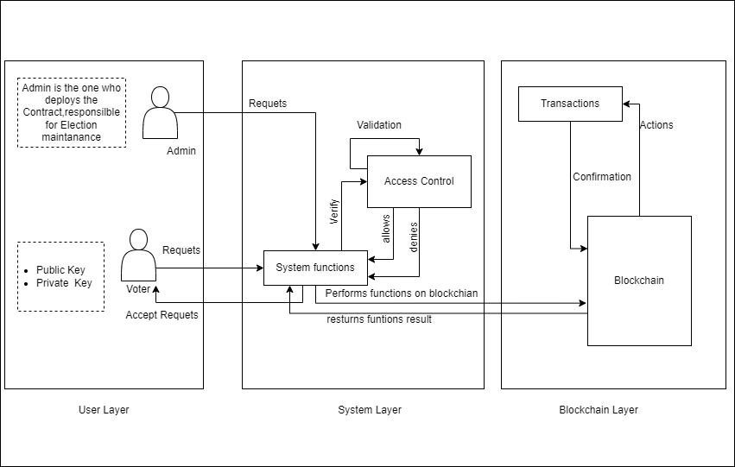
System Design & Architecture

Slide 14
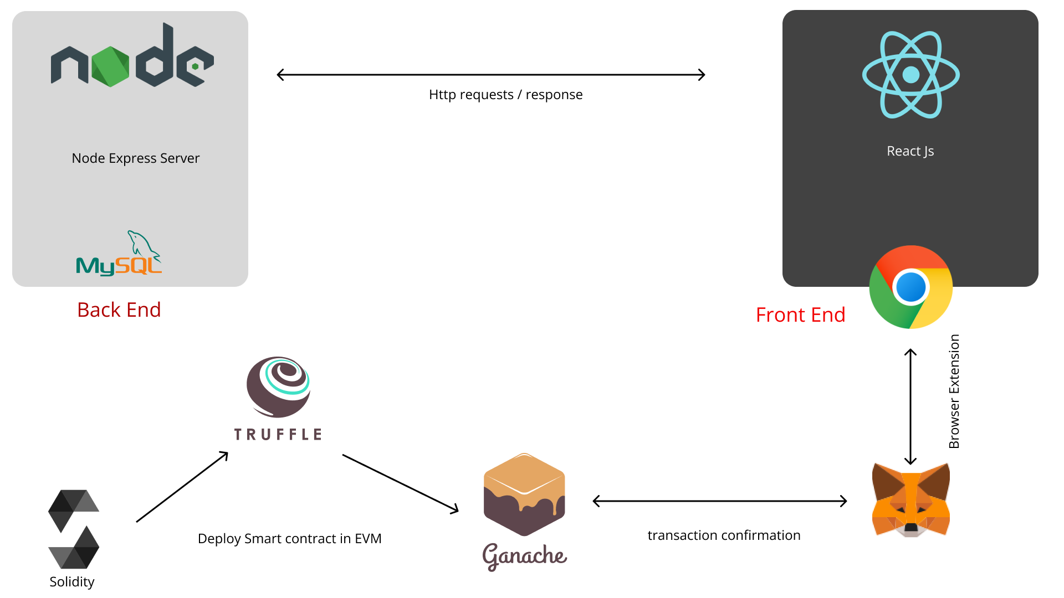
D-App Flow

Slide 15
Algorithm
Add Election :
function add Election (electionId, startDate, endDate)
require(msg.sender == admin)
add Election Data
end function
Add Voter:
function add Election (nationalId, password)
require(msg.sender != admin)
require(msg.sender != voter)
add Voter
end function

Slide 16
Algorithm Contd.
Add Candidate :
function add Candidate (candidateId, name, electionId)
require(msg.sender == admin)
add Candidate Data
add Candidate to Election with
electionId == electionId
end function

Slide 17
Algorithm Contd.
Vote:
function Vote(candidateId, electionId)
require(msg.sender == voter)
check if voter already voted
append vote count for candidate with candidateId
append total voteCount for election with electionId
set voter voted is true
end function

Slide 18
Modules
Admin
Add Election
Add Candidates
Add Constituencies
View Election
Publish Results
Start/End Election
Generate report

Slide 19
Modules Contd.
Voter
Vote in Elections
View Published Election Results

Slide 20
Development Environment
Front End
React JS, CSS3
Back End
Node JS, MySQL
Blockchain
Ganache Truffle, Solidity
IDE
WebStorm

Slide 21
THANKS

