Slide 1
June 20, 2022

Slide 2
Source
RRL
Uni Heid.
SIO/LLNL
INSTAAR
ANSTO
DePol Holz
Chris Turney
Records for intercomp:
Baring Head Record (Flask and NaOH)
CGO Record
(NaOH) NWT3/NWT4
(Standard Materials)
NWT3/NWT4
(Standard Materials)
See Turnbull 2015
ANSTO (Tree Rings)
Monte Tarn (Tree Rings)
Lonliest Tree (Tree Rings)
Source
RRL
Uni Heid.
SIO/LLNL
INSTAAR
ANSTO
DePol Holz
Chris Turney
Δ¹⁴CO₂ with latitude:
Harmonized Background Baring Head Record
CGO Record
SOAR Tree Rings
Neumayer Record
Macquarie Island Record
Palmer Station
American Samoa
South Pole*
DRAKE PASSAGE! (sensitive because it is a PhD thesis and not published)
Data from the rest of Chile (the rest of his data which isn’t from Monte Tarn)
???
???
X
C_CapeGrim_Cleanup.py B_CHO_BHD_harmonization.py harmonizes the background dataset for latitudinal studies
Our reference record.
X
C_SOAR_Tree_Ring_Cleanup.py
Cleans up the tree ring data for lat. analysis
X
C_Neumayer_Cleanup.py
X
A_heidelberg_intercomparison.py (Compares CGO data with BHD data over time)
X
C_Maquarie_Cleanup.py
X
A_SIO&LLNL_RRL_intercomparison (Compares NWT3 and NWT4 stds from these two labs)
X
Graven_cleanup_offsetcalc.py
X
Don’t have own data from LLNL, see Turnbull 2015 for offset.
X
A_ANSTO_intercomparison (Compares tree rings from both groups)

Slide 3
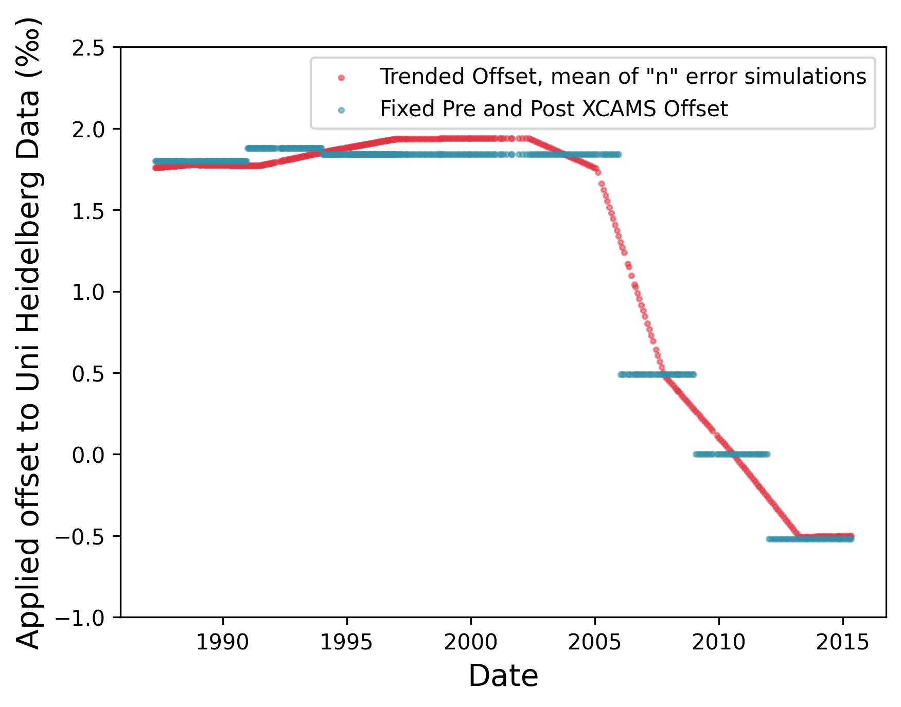
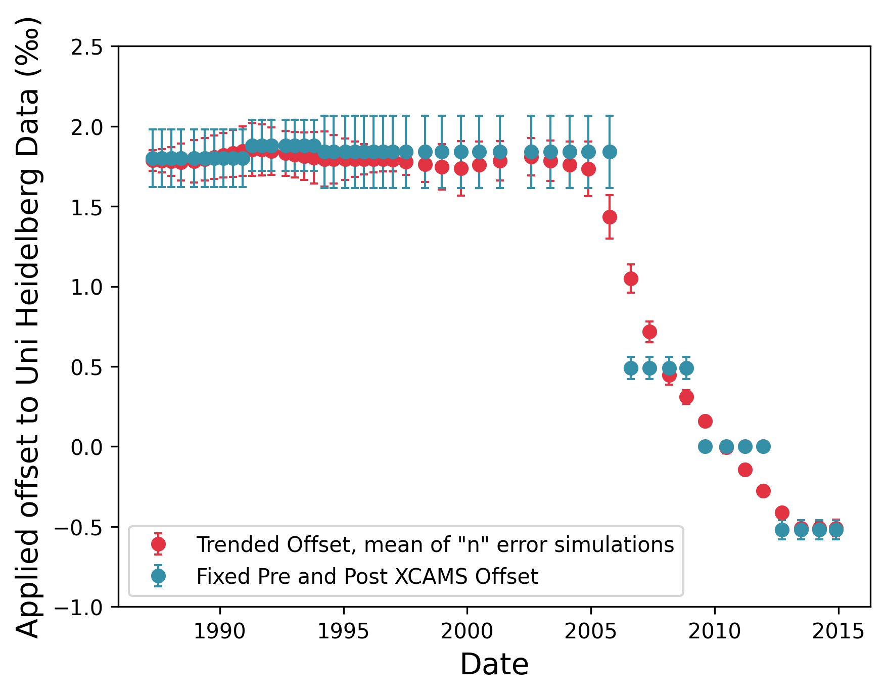
How should we apply the offsets to Uni Heidelberg Data? Fixed or smoothed?

Slide 4
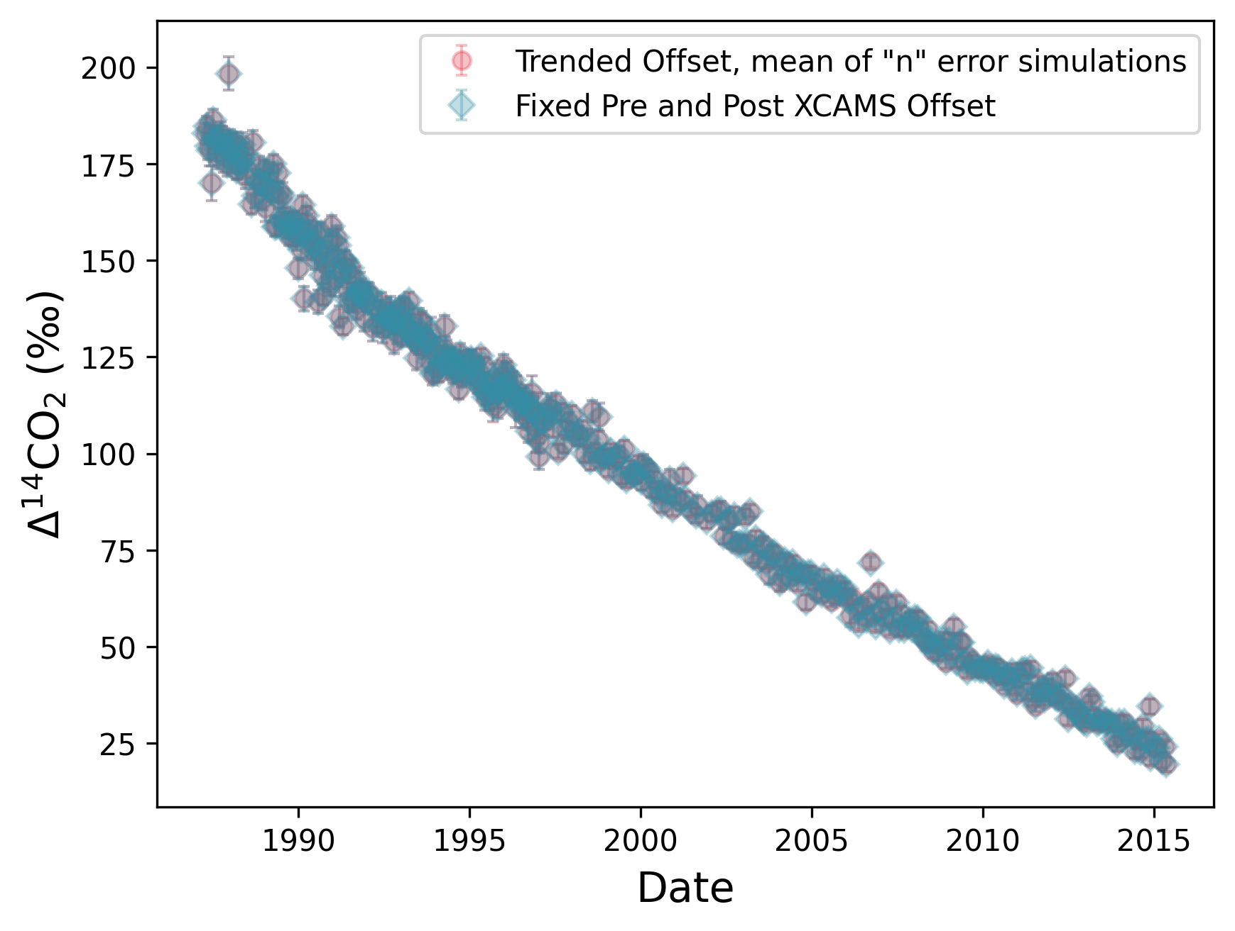
How should we apply the offsets to Uni Heidelberg Data? Fixed or smoothed?
D14C values corrected using either offset are not significantly different.
Running the smoothed-offset correction at
n = 1000, I get the following results:
CGO
Ttest_relResult(statistic=-1.18030493552624, pvalue=0.23846844292582228)
NEU
Ttest_relResult(statistic=1.4899604180943744, pvalue=0.13810966150677695)
MCQ
Ttest_relResult(statistic=2.178696555445278, pvalue=0.029708904516783867)
Need to brush up on how these p-values are actually calculated because when I t-test a dataset against itself with only one value changed, see offset_analysis.py, the p-value is only
pvalue=0.3174961750101793)

Slide 5
Source
RRL
Uni Heid.
SIO/LLNL
ANSTO
DePol Holz
Chris Turney
Instaar
Records for intercomp:
Baring Head Record
CGO Record
NWT3/NWT4
ANSTO Tree Rings
Monte Tarn
Lonliest Tree
NWT3 and 4
Δ¹⁴CO₂ with latitude:
Harmonized Background Baring Head Record
CGO Record
SOAR Tree Rings
Neumayer Record
Macquarie Island Record
Palmer Station
American Samoa
South Pole*
???
???
???
Data Intercomparison
Determine offset between Cape Grim and Baring Head
Offset-correct Cape Grim Data
Offset-correct Neumayer
Offset-correct MCQ
Combine offset corrected Heidelberg data for clarify
Harmonize CGO and BHD as background reference
Determine offset between SIO/LLNL
Apply offset to Palmer Station
Apply offset to American Samoa
Apply offset to South Pole
A_heidelberg_intercomparison.py
C_CapeGrim_cleanup.py
C_Neumayer_Cleanup.py
Offset_analysis.py (allows analysis of the offset calculations without running the long monte Carlo every time – uses stored data)
C_Maquarie_Cleanup.py
C_Maquarie_Cleanup.py
B_CGO_BHD_harmonization.py
A_SIO&LLNL_RRL_intercomparison.py

