Slide 1

SAP RETAIL SIGNAL / PLUS ONE BRAINCELL
PROBLEM STATEMENT
Demand shifts before retailers can respond
SAP Retail Signal
Closing the gap between a demand shift and a business response
One product connects early customer intent with a decision the business can carry out.
Plus One Braincell · Team 463980 · Product+ 2026 · Competition concept
RETAIL SIGNAL
Introduction
Product
Analysis
Implementation
Conclusion
01
Notes:
- 20 seconds. Open with the case: how can SAP close the gap between a demand shift and a business response?
- Focus on apparel merchandise planners. Sales record completed purchases; missed interest can disappear before the next planning cycle.
- Our answer is one product, SAP Retail Signal, with three connected parts.
- Sources: Product+ 2026 Case Package, pp. 3–5; Launchpad report, pp. 2–4.
Layout inspiration: Elevate 2026 A T&T, PROSPER 2025, PepsiCo and Poppi, W Consulting BCG 2024, and LBSW Consulting Group Finals BSC Case Competition. Their unrelated client facts and logos are not part of this proposal.
Retail and persona images are generated illustrations. App images are captures of the working seeded prototype.

Slide 2
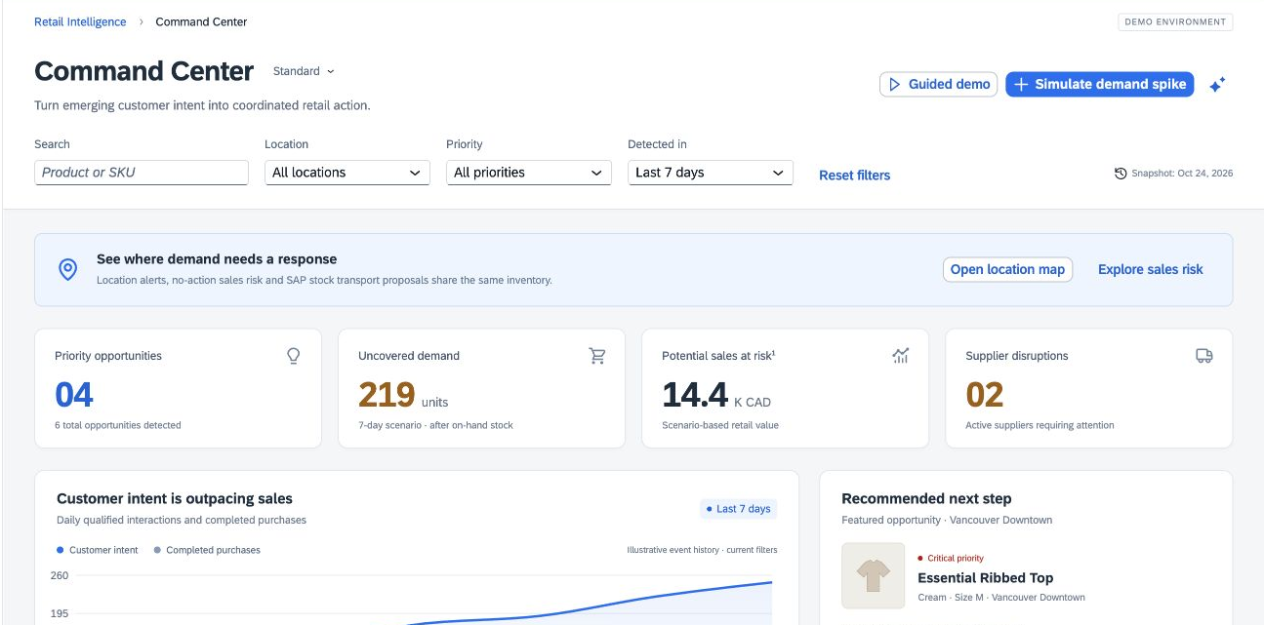
SAP RETAIL SIGNAL / PLUS ONE BRAINCELL
COMPANY OVERVIEW
SAP already supports the retailer’s core business
440,000+
180
14,000+
enterprise customers
countries
retail customers
Case-package baseline
Case-package baseline
SAP Future of Retail
Retail Signal would extend existing transaction, commerce and planning systems with early demand evidence and a shared response workflow.
Customer counts describe SAP’s broader footprint, not the addressable apparel market.
RETAIL SIGNAL
Introduction
Product
Analysis
Implementation
Conclusion
02
Notes:
- 12 seconds. SAP spans finance, procurement, supply chain and customer experience. Existing customers offer an initial route to market.
- These counts are different scopes; they cannot be added together.
- Sources: supplied case, p. 3; https://www.sap.com/engage/future-of-retail.html (accessed 25 Oct 2026).
Layout inspiration: Elevate 2026 A T&T, PROSPER 2025, PepsiCo and Poppi, W Consulting BCG 2024, and LBSW Consulting Group Finals BSC Case Competition. Their unrelated client facts and logos are not part of this proposal.
Retail and persona images are generated illustrations. App images are captures of the working seeded prototype.

Slide 3
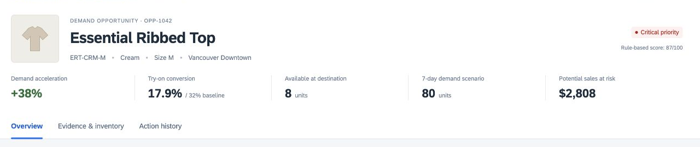
SAP RETAIL SIGNAL / PLUS ONE BRAINCELL
KEY ISSUES
Three gaps delay the same decision
01
Interest is invisible
02
Unmet online demand disappears
03
Supply risk arrives without context
Store teams see what sold, but not which sizes were tried and left behind.
Searching an unavailable size can end without a sale or a restock request.
A price or delivery change needs to be traced to affected products, stores and margins.
Case-based problem hypothesis. Validate the frequency and cost through planner interviews and a pilot.
RETAIL SIGNAL
Introduction
Product
Analysis
Implementation
Conclusion
03
Notes:
- 20 seconds. Today’s workflow can involve sales reports, separate website analytics and supplier emails before a planner reconciles stock.
- The case establishes fragmented data and time pressure; it does not quantify the delay. We will measure that baseline.
- Sources: case, p. 4; Launchpad, recommendations 1–3.
Layout inspiration: Elevate 2026 A T&T, PROSPER 2025, PepsiCo and Poppi, W Consulting BCG 2024, and LBSW Consulting Group Finals BSC Case Competition. Their unrelated client facts and logos are not part of this proposal.
Retail and persona images are generated illustrations. App images are captures of the working seeded prototype.
01: Interest is invisible: Store teams see what sold, but not which sizes were tried and left behind.
02: Unmet online demand disappears: Searching an unavailable size can end without a sale or a restock request.
03: Supply risk arrives without context: A price or delivery change needs to be traced to affected products, stores and margins.

Slide 4

SAP RETAIL SIGNAL / PLUS ONE BRAINCELL
PART 1 · CUSTOMER STORY
Meet Bob, before Retail Signal
9:00 Sales look ordinary
The cream medium top has only 8 units left in Vancouver.
10:30 The signals live elsewhere
240 try-ons, 43 purchases and 162 out-of-stock sessions are not in his sales report.
Bob, regional planner
Later The replenishment misses the window
Fictional 100-store apparel retailer
The primary supplier needs 21 days; Bob still has to locate transferable stock.
Bob is a fictional persona. Product, supplier and location figures are seeded demo records.
RETAIL SIGNAL
Introduction
Product
Analysis
Implementation
Conclusion
04
Notes:
- 25 seconds. Bob is accountable for availability, but he must reconstruct the situation across teams.
- This is a persona scenario, not a customer interview or measured time study.
- The 80-unit seven-day demand scenario leaves a 72-unit gap after 8 on hand. Low conversion does not establish a fit problem.
- Sources: current Retail Signal prototype; Launchpad report, pp. 3–4.
Layout inspiration: Elevate 2026 A T&T, PROSPER 2025, PepsiCo and Poppi, W Consulting BCG 2024, and LBSW Consulting Group Finals BSC Case Competition. Their unrelated client facts and logos are not part of this proposal.
Retail and persona images are generated illustrations. App images are captures of the working seeded prototype.
9:00: Sales look ordinary: The cream medium top has only 8 units left in Vancouver.
10:30: The signals live elsewhere: 240 try-ons, 43 purchases and 162 out-of-stock sessions are not in his sales report.
Later: The replenishment misses the window: The primary supplier needs 21 days; Bob still has to locate transferable stock.

Slide 5
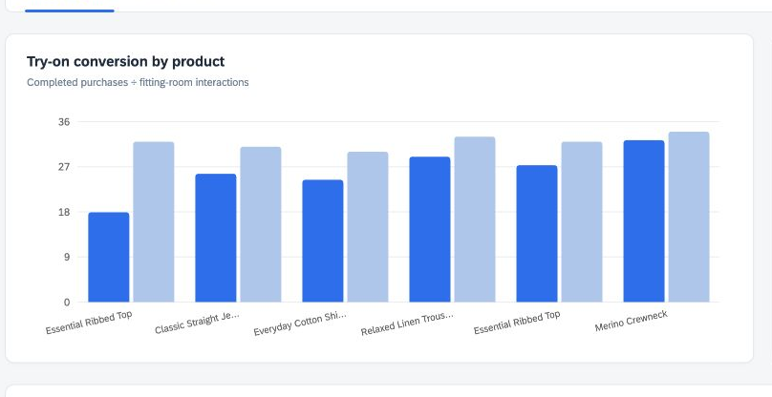
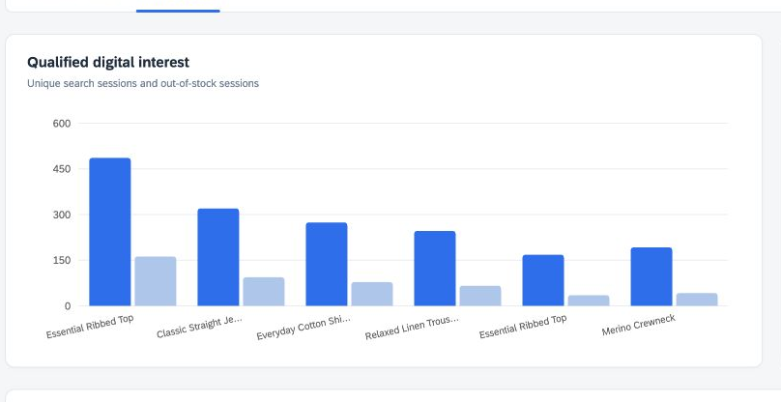
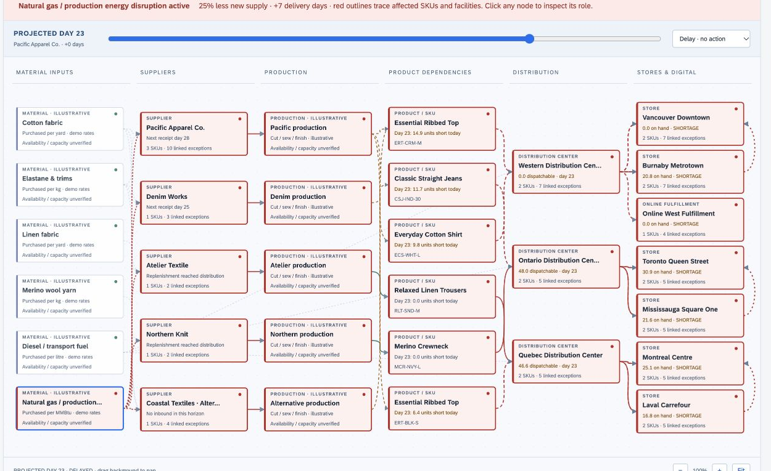
SAP RETAIL SIGNAL / PLUS ONE BRAINCELL
RECOMMENDATION DEMO · 90 SECONDS
One product, three connected parts
PART 1
PART 2
PART 3
Fitting-room demand
Out-of-stock demand
Supply risk and response
Reveal interest before purchase.
Qualify demand for unavailable sizes.
Explain exposure and compare a response.
240 try-ons / 43 purchases
162 qualified sessions / 24 scenario units
Gas shortage / cost and margin impact
90-second demo: Joule explains the evidence and options. A planner approves the response.
Working website with seeded records. Joule-inspired explanations and SAP execution are simulated.
RETAIL SIGNAL
Introduction
Product
Analysis
Implementation
Conclusion
05
Notes:
- 90 seconds. Play the recommendation walkthrough on this slide, or open the supplied MP4.
- The video demonstrates all three parts of one product. It uses real captures of our working website.
- Part 1: compare 240 try-ons with 43 purchases, then investigate availability, fit or price instead of guessing the cause.
- Part 2: 162 qualified out-of-stock sessions × assumed 15% conversion, rounded down, gives 24 scenario units for Online West. These are not confirmed orders.
- Part 3: inspect material rates, apply a gas shortage and ask the assistant to explain added costs and margin effects. Then compare immediate stock transfer with later supplier replenishment.
- No live RFID, retailer analytics, SAP tenant or SAP Joule service is connected.
Layout inspiration: Elevate 2026 A T&T, PROSPER 2025, PepsiCo and Poppi, W Consulting BCG 2024, and LBSW Consulting Group Finals BSC Case Competition. Their unrelated client facts and logos are not part of this proposal.
Retail and persona images are generated illustrations. App images are captures of the working seeded prototype.
1: Smart Fitting-Room Demand Signals: Reveal interest before purchase.
2: Out-of-Stock Demand Tracker: Qualify demand for unavailable sizes.
3: Supply-Chain Risk and Response View: Explain exposure and compare a response.

Slide 6
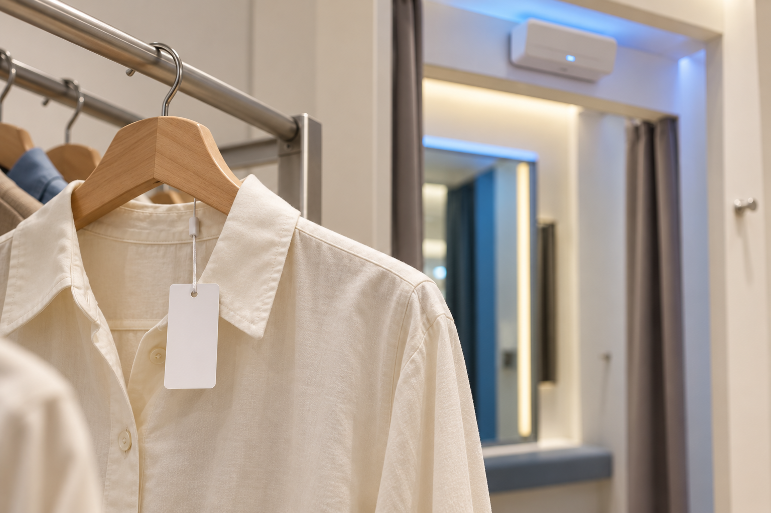
SAP RETAIL SIGNAL / PLUS ONE BRAINCELL
PART 1 · PROPOSED PARTNER MODEL
Hardware partners and regional delivery
Region | Proposed distribution lead | Deployment
North America | Ingram Micro | Local RFID integrators
Latin America | Ingram Micro | Country-qualified integrators
Europe | TD SYNNEX | Local RFID integrators
Asia Pacific / Japan | TD SYNNEX | Local RFID integrators
India / Middle East / Africa | Redington | Local RFID integrators
Proposed hardware partners
Zebra
Fixed readers and antennas
Avery Dennison
Garment tags and inlays
Proposed partners, not signed agreements. Availability, product authorization and RF certification require country-level checks.
RETAIL SIGNAL
Introduction
Product
Analysis
Implementation
Conclusion
06
Notes:
- 20 seconds. Recommendation 1 needs specialist hardware rather than SAP manufacturing its own readers. Use Zebra readers, Avery Dennison tags and regional distribution.
- Radio-frequency identification, or RFID, identifies tagged garments using radio waves. Room-zone calibration is essential to avoid counting adjacent racks.
- Start with already tagged assortments; tag economics for new assortments are excluded from the base quote and must be priced.
- Capability sources: https://www.zebra.com/us/en/products/rfid/rfid-readers.html ; https://rfid.averydennison.com/en/home/industry-segments/retail/apparel-and-fashion.html ; https://careers.ingrammicro.com/en/locations/ ; https://www.tdsynnex.com/us/en/where-we-are.html ; https://redingtongroup.com/about-us/global-presence/ . All accessed 25 Oct 2026.
Layout inspiration: Elevate 2026 A T&T, PROSPER 2025, PepsiCo and Poppi, W Consulting BCG 2024, and LBSW Consulting Group Finals BSC Case Competition. Their unrelated client facts and logos are not part of this proposal.
Retail and persona images are generated illustrations. App images are captures of the working seeded prototype.

Slide 7
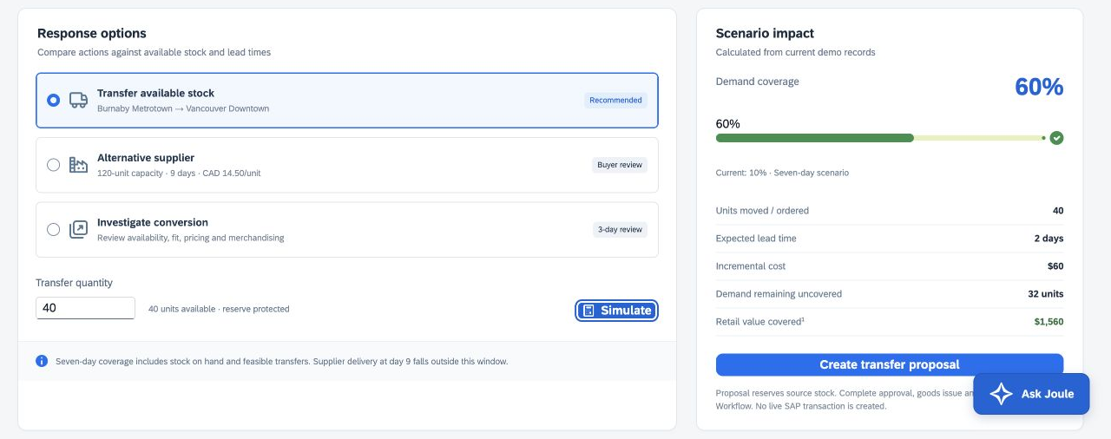
SAP RETAIL SIGNAL / PLUS ONE BRAINCELL
PART 2 · CUSTOMER STORY
Meet Bob, with a response he can explain
Bob’s decision
10% to 60%
Seven-day coverage in the transfer scenario
40 units
CAD 60 transfer cost / 2-day assumed transit
32 units remain uncovered
Compare options, approve a transfer, and confirm receipt
Simulation: 8 current units + 40 transfer units = 48 of 80 scenario units covered. Sales recovery is unproven.
RETAIL SIGNAL
Introduction
Product
Analysis
Implementation
Conclusion
07
Notes:
- 20 seconds. Bob can evaluate a 40-unit transfer at a modeled cost of 60 dollars.
- Coverage rises from 8 of 80 to 48 of 80. Thirty-two units remain uncovered: the tool makes the residual problem visible.
- Approval does not create inventory. Goods issue moves stock into transit; goods receipt adds destination sellable stock.
- Source: prototype seeded transfer scenario, ERT-CRM-M.
Layout inspiration: Elevate 2026 A T&T, PROSPER 2025, PepsiCo and Poppi, W Consulting BCG 2024, and LBSW Consulting Group Finals BSC Case Competition. Their unrelated client facts and logos are not part of this proposal.
Retail and persona images are generated illustrations. App images are captures of the working seeded prototype.
See: One evidence trail: Try-ons, online interest, available inventory and supplier lead time share product and location context.
Decide: Compare 40 units at CAD 60 transfer cost: Protect Burnaby’s 36-unit reserve; the nine-day alternative is too late for this seven-day window.
Act: Approve, dispatch and confirm receipt: Only goods receipt makes the 40 transferred units sellable in Vancouver.

Slide 8

SAP RETAIL SIGNAL / PLUS ONE BRAINCELL
MARKET RESEARCH
The first buyers are SAP-connected apparel chains
Primary users: merchandise and inventory planners
Economic buyer: COO / merchandising leader, with CFO approval
First segment: 50–250 stores, online sales and reliable SKU-level stock
Illustrative TAM
Illustrative SAM
Year-3 ending ARR target
CAD 1.40B
CAD 175M
CAD 52.5M
4,000 eligible chains × CAD 350k/year
500 initial serviceable chains × CAD 350k/year
150 customers × CAD 350k/year
Account counts and contract values are planning assumptions, not verified market counts. 150 customers is 30% of the modeled SAM.
RETAIL SIGNAL
Introduction
Product
Analysis
Implementation
Conclusion
08
Notes:
- 20 seconds. Total addressable market, TAM, is modeled annual software spend. SAM narrows that to chains we could initially serve. SOM is the share we aim to win; 150 accounts is an ambitious scenario, not a forecast.
- We use a 100-store reference contract. A real account list and willingness-to-pay interviews are needed before funding scale.
- Context: the Launchpad cites US$957B fashion e-commerce in 2026; Shopify corroborates a US$957.31B Statista projection. Consumer sales are not software TAM.
- Source: https://www.shopify.com/uk/enterprise/blog/ecommerce-fashion-industry ; SAP retail footprint source on slide 2.
Layout inspiration: Elevate 2026 A T&T, PROSPER 2025, PepsiCo and Poppi, W Consulting BCG 2024, and LBSW Consulting Group Finals BSC Case Competition. Their unrelated client facts and logos are not part of this proposal.
Retail and persona images are generated illustrations. App images are captures of the working seeded prototype.

Slide 9
SAP RETAIL SIGNAL / PLUS ONE BRAINCELL
COMPETITOR ANALYSIS
Competitors validate the need; integration decides the fit
Alternative | Established strength | Retail Signal’s proposed fit
Sensormatic TrueVUE | RFID inventory and fitting-room insight | Use equivalent event inputs in a wider decision workflow.
Oracle Retail | Connected merchandising, inventory and AI planning | Focus on retailers whose execution already runs on SAP.
Blue Yonder | Retail planning, scenarios and network intelligence | Bring early intent to a concise SAP approval workflow.
Existing SAP IBP / CAR | Demand planning and retail transaction context | Extend these products; reuse their planning and data services.
Qualitative positioning from public vendor descriptions. Competitors are commercial offerings; Retail Signal is a prototype.
RETAIL SIGNAL
Introduction
Product
Analysis
Implementation
Conclusion
09
Notes:
- 20 seconds. RFID fitting-room insight and AI inventory planning already exist. We are not claiming to invent these categories or to have features competitors lack.
- The case for Retail Signal is a focused experience joining early intent with SAP operational decisions. If an existing SAP deployment already solves the workflow, extend it instead of selling duplicate software.
- Sources: https://www.sensormatic.com/de_de/TrueVUE-Inventory-Intel/TrueVUE-Fitting-Room ; https://www.oracle.com/retail/ ; https://blueyonder.com/solutions/retail-planning ; https://www.sap.com/products/scm/integrated-business-planning.html ; https://www.sap.com/products/crm/customer-activity-repository.html .
Layout inspiration: Elevate 2026 A T&T, PROSPER 2025, PepsiCo and Poppi, W Consulting BCG 2024, and LBSW Consulting Group Finals BSC Case Competition. Their unrelated client facts and logos are not part of this proposal.
Retail and persona images are generated illustrations. App images are captures of the working seeded prototype.

Slide 10
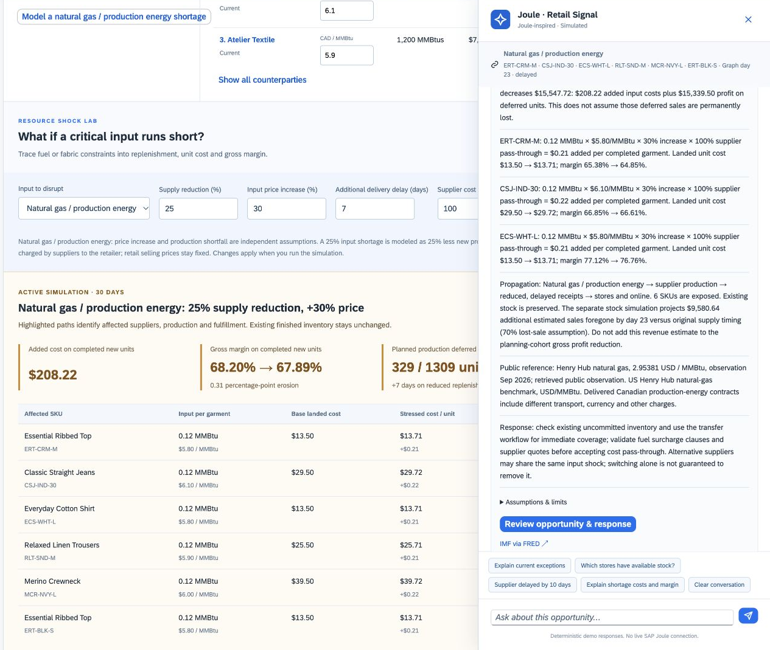
SAP RETAIL SIGNAL / PLUS ONE BRAINCELL
COMPETITIVE ADVANTAGE
SAP’s ecosystem can shorten the path to action
Connected execution
S/4HANA holds stock movements and purchasing. Commerce Cloud contributes online context. IBP supports planning.
Consistent business context
Authorized product, location, cost and supplier data can make recommendations more relevant to the retailer.
Learning with permission
SAP’s large client base creates a potential learning advantage, subject to contracts, consent and evaluation. More data alone does not prove better accuracy.
Proposed architecture. No live SAP integration or cross-customer training is present in this demo.
RETAIL SIGNAL
Introduction
Product
Analysis
Implementation
Conclusion
10
Notes:
- 20 seconds. Like an ecosystem of compatible devices, SAP’s appeal is that another tool can work with systems the retailer already uses. This still requires integration work and licensing.
- Our data advantage is business context, not unrestricted access to every customer’s records. Customer data use for AI improvement is governed by service agreements; new development can require additional consent. External model providers do not receive training rights by default.
- Sources: SAP Integration Suite https://www.sap.com/products/technology-platform/integration-suite.html ; SAP responsible AI https://www.sap.com/products/artificial-intelligence/ai-ethics.html ; https://learning.sap.com/courses/building-confidence-in-ai-with-sap/does-ai-train-on-my-data .
Layout inspiration: Elevate 2026 A T&T, PROSPER 2025, PepsiCo and Poppi, W Consulting BCG 2024, and LBSW Consulting Group Finals BSC Case Competition. Their unrelated client facts and logos are not part of this proposal.
Retail and persona images are generated illustrations. App images are captures of the working seeded prototype.
Connected execution: S/4HANA holds stock movements and purchasing. Commerce Cloud contributes online context. IBP supports planning.
Consistent business context: Authorized product, location, cost and supplier data can make recommendations more relevant to the retailer.
Learning with permission: SAP’s large client base creates a potential learning advantage, subject to contracts, consent and evaluation. More data alone does not prove better accuracy.

Slide 11
SAP RETAIL SIGNAL / PLUS ONE BRAINCELL
SWOT ANALYSIS
SWOT: a credible extension with execution risk
STRENGTHS
WEAKNESSES
S
Existing SAP workflows
One evidence-to-action experience
W
Prototype, not production
Hardware and data-quality dependence
OPPORTUNITIES
THREATS
O
Sell into SAP retail relationships
Prove value on unavailable sizes
T
Strong planning and RFID vendors
Budget pressure and long sales cycles
Strategic assessment by Plus One Braincell; pilot evidence is needed to validate the opportunity.
RETAIL SIGNAL
Introduction
Product
Analysis
Implementation
Conclusion
11
Notes:
- 12 seconds. Our strongest asset is the fit with SAP execution; our weakest point is that commercial value and integrations remain unproven.
- Competition, integration effort and adoption should shape the pilot, not be hidden behind an AI claim.
Layout inspiration: Elevate 2026 A T&T, PROSPER 2025, PepsiCo and Poppi, W Consulting BCG 2024, and LBSW Consulting Group Finals BSC Case Competition. Their unrelated client facts and logos are not part of this proposal.
Retail and persona images are generated illustrations. App images are captures of the working seeded prototype.

Slide 12
SAP RETAIL SIGNAL / PLUS ONE BRAINCELL
DEPENDENCIES
Dependencies come before automation
Dependency | Required before pilot actions | Owner
Reliable shared records | Match SKU / size / location; reconcile stock and timestamps | Retail IT + data lead
Safe SAP integration | Tenant sandbox, supported interfaces, roles and audit trail | SAP / retailer integration team
Qualified demand events | RFID zone tests; session deduplication; bot filtering | Hardware + commerce teams
Commercial and privacy terms | Partner quotes, data agreement and retention policy | Procurement + privacy lead
Proposed SAP roles: CAR = transaction context; S/4HANA = execution; Commerce = online channel; IBP = planning.
RETAIL SIGNAL
Introduction
Product
Analysis
Implementation
Conclusion
12
Notes:
- 15 seconds. The most important dependency is a common product and location identifier. Without it, the tool may recommend stock the business cannot actually move.
- BTP means Business Technology Platform; Integration Suite connects systems through controlled interfaces, or APIs. A production service needs authentication, monitoring, retry safety and tenant-specific field mapping.
- Sources: SAP Integration Suite, CAR and IBP official product documentation, cited in appendix.
Layout inspiration: Elevate 2026 A T&T, PROSPER 2025, PepsiCo and Poppi, W Consulting BCG 2024, and LBSW Consulting Group Finals BSC Case Competition. Their unrelated client facts and logos are not part of this proposal.
Retail and persona images are generated illustrations. App images are captures of the working seeded prototype.

Slide 13
SAP RETAIL SIGNAL / PLUS ONE BRAINCELL
RISKS AND MITIGATIONS
Three risks could stop the pilot
Risk | Mitigation | Stop / review trigger
Wrong demand or stale stock | Confidence thresholds; fresh-stock check; planner approval; reconcile receipts | Stock mismatch >2% or repeated bad transfers
Fitting-room privacy and trust | Garment events only; no cameras or identities; aggregate; short retention | Unresolved privacy concern or missing approval
Low adoption or weak economics | Planner co-design; top exceptions only; matched comparison; capped pilot | No response-time improvement or no path to positive value
Risk owners: retail operations, privacy lead and CFO respectively. Thresholds are proposed pilot gates.
RETAIL SIGNAL
Introduction
Product
Analysis
Implementation
Conclusion
13
Notes:
- 20 seconds. These are the three biggest risks: bad decisions from weak data, loss of shopper trust, and a product that does not repay its cost.
- Human approval and transaction reconciliation prevent an explanation from becoming an unverified stock movement.
- Privacy controls require a local legal review; proposed retention is seven days for raw garment events and 90 days for aggregates, subject to that review.
Layout inspiration: Elevate 2026 A T&T, PROSPER 2025, PepsiCo and Poppi, W Consulting BCG 2024, and LBSW Consulting Group Finals BSC Case Competition. Their unrelated client facts and logos are not part of this proposal.
Retail and persona images are generated illustrations. App images are captures of the working seeded prototype.

Slide 14
SAP RETAIL SIGNAL / PLUS ONE BRAINCELL
STAKEHOLDER ALIGNMENT
Decision rights resolve competing stakeholder needs
Stakeholder | What they need | Decision / concession
Bob + store managers | Fast action without draining another store | Planner proposes; source manager protects reserve.
CFO / COO | Value, margin and spending control | CFO owns pilot gate and spending limits.
Retail IT + SAP product team | Secure integration and a clear product boundary | Reuse IBP / CAR; IT can block stale or invalid data.
Privacy + shoppers | No personal surveillance | Privacy lead approves collection and retention.
Hardware / service partners | Commercial incentive and support clarity | Partners earn hardware and deployment revenue.
Escalation: margin or reserve conflict → retail operations leader; data/privacy failure → pause affected actions.
RETAIL SIGNAL
Introduction
Product
Analysis
Implementation
Conclusion
14
Notes:
- 20 seconds. Adoption requires an explicit bargain. Bob gets speed, while the source store keeps a reserve and the CFO keeps spending authority.
- Marketing can promote availability improvements only after results are measured. Procurement validates supplier alternatives; Joule cannot approve a new vendor.
- SAP owns the software roadmap; partners own installation and first-line device support.
Layout inspiration: Elevate 2026 A T&T, PROSPER 2025, PepsiCo and Poppi, W Consulting BCG 2024, and LBSW Consulting Group Finals BSC Case Competition. Their unrelated client facts and logos are not part of this proposal.
Retail and persona images are generated illustrations. App images are captures of the working seeded prototype.

Slide 15
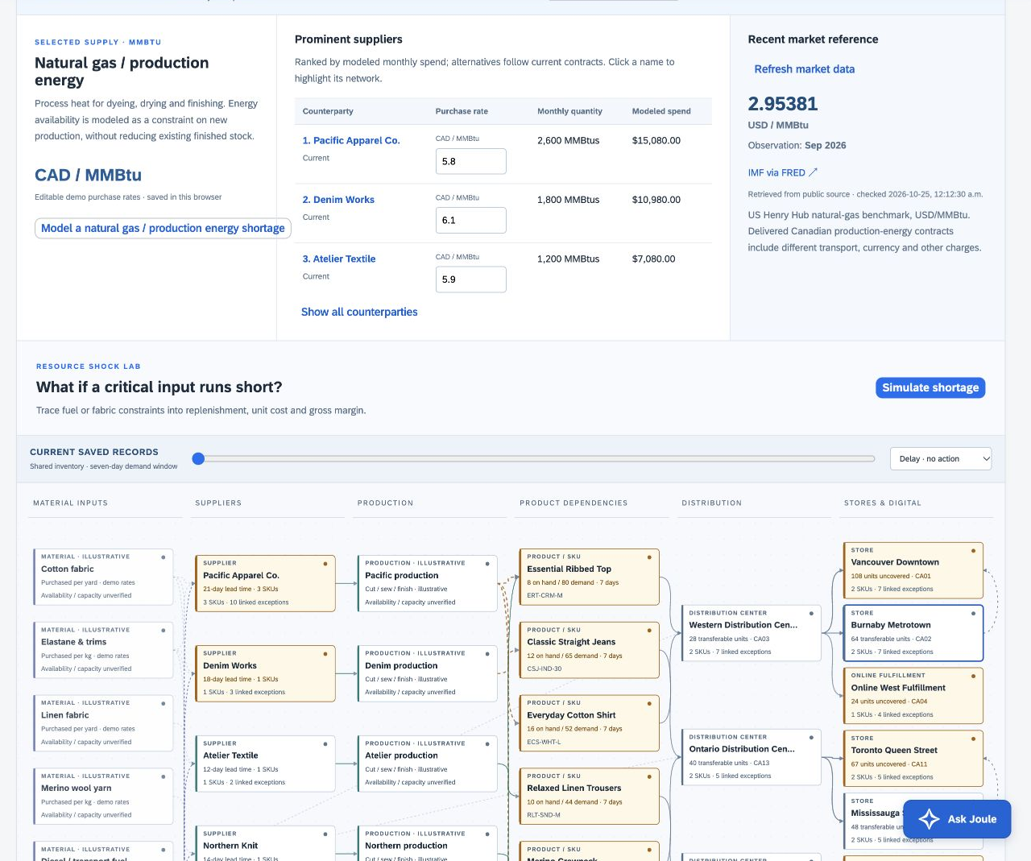
SAP RETAIL SIGNAL / PLUS ONE BRAINCELL
TRADE-OFFS AND LIMITATIONS
Trade-offs are deliberate
Human approval
Slower than full automation; safer while evidence is uncertain.
Apparel and existing SAP users first
Narrower reach; lower initial workflow and data complexity.
RFID in selected stores
Less coverage; avoids outfitting every store before value is proven.
Evidence before prediction
The demo explains scenarios; live news prediction and autonomous procurement remain future work.
Try-ons and searches indicate interest, not guaranteed purchases or the cause of non-purchase.
RETAIL SIGNAL
Introduction
Product
Analysis
Implementation
Conclusion
15
Notes:
- 15 seconds. We prioritize online demand and shared stock first because they avoid hardware lead time. Then validate RFID in selected stores and introduce supply-cost scenarios.
- Baseline demo rates and material-consumption assumptions are illustrative. Public commodity benchmarks are not the retailer’s contract prices.
- Existing stock does not vanish when new production is constrained.
Layout inspiration: Elevate 2026 A T&T, PROSPER 2025, PepsiCo and Poppi, W Consulting BCG 2024, and LBSW Consulting Group Finals BSC Case Competition. Their unrelated client facts and logos are not part of this proposal.
Retail and persona images are generated illustrations. App images are captures of the working seeded prototype.
Human approval: Slower than full automation; safer while evidence is uncertain.
Apparel and existing SAP users first: Narrower reach; lower initial workflow and data complexity.
RFID in selected stores: Less coverage; avoids outfitting every store before value is proven.
Evidence before prediction: The demo explains scenarios; live news prediction and autonomous procurement remain future work.

Slide 16
SAP RETAIL SIGNAL / PLUS ONE BRAINCELL
IMPLEMENTATION TIMELINE
A 12-week pilot earns the right to scale
Pilot workstream
Weeks
1
2
3
4
5
6
7
8
9
10
11
12
Establish trust
Baseline
weeks 1–2
Connect demand
Shadow mode
weeks 3–5
Approve limited actions
Approve and receive
weeks 6–8
Measure and decide
Evaluate economics
weeks 9–12
Release gates: data feasible / reliable shadow results / safe actions / scale or stop
Resources: SAP product lead, 2 integration engineers, full-stack engineer, analyst, UX/change lead; retail and partner counterparts.
RETAIL SIGNAL
Introduction
Product
Analysis
Implementation
Conclusion
16
Notes:
- 20 seconds. Start with interviews and a two-week baseline, then shadow mode: calculate recommendations without executing them.
- Hardware qualification can proceed alongside digital integration. If devices are delayed, digital and supply workflows continue; RFID claims wait.
- Scale to a 100-store customer only after week 12. Wider commercial rollout takes additional quarters, separate from pilot completion.
Layout inspiration: Elevate 2026 A T&T, PROSPER 2025, PepsiCo and Poppi, W Consulting BCG 2024, and LBSW Consulting Group Finals BSC Case Competition. Their unrelated client facts and logos are not part of this proposal.
Retail and persona images are generated illustrations. App images are captures of the working seeded prototype.
WEEKS 1–2: Establish trust: 5 planner interviews; baseline workflow; privacy and stock mapping.
WEEKS 3–5: Connect demand: Online signals and stock read-only; shadow recommendations; hardware zone tests.
WEEKS 6–8: Approve limited actions: 10 stores; controlled transfers; RFID evidence; reconcile all receipts.
WEEKS 9–12: Measure and decide: Matched-store evaluation; cost scenarios; CFO / COO scale or stop gate.

Slide 17
SAP RETAIL SIGNAL / PLUS ONE BRAINCELL
PILOT KPIs
Success means a faster, verified response
median response time
inventory reconciliation
weekly planner use
−50%
≥98%
≥70%
Qualified signal → approved action
Physical / recorded stock agreement
Eligible pilot planners
Business gate: positive incremental contribution after transfer costs and returns, with a credible cash payback within 24 months at the negotiated price.
Targets, not achieved results. Compare pilot with matched stores and pre-pilot baseline; report uncertainty.
RETAIL SIGNAL
Introduction
Product
Analysis
Implementation
Conclusion
17
Notes:
- 18 seconds. Measure both median and 90th-percentile response time so an average cannot hide slow exceptions.
- Track signal freshness, recommendation acceptance with reasons, stockout sessions, realized contribution and shopper complaints.
- CFO owns financial verification; analyst owns matched-store measurement; operations owns stock accuracy. If the pilot is underpowered, extend measurement rather than claim causal uplift.
Layout inspiration: Elevate 2026 A T&T, PROSPER 2025, PepsiCo and Poppi, W Consulting BCG 2024, and LBSW Consulting Group Finals BSC Case Competition. Their unrelated client facts and logos are not part of this proposal.
Retail and persona images are generated illustrations. App images are captures of the working seeded prototype.

Slide 18
SAP RETAIL SIGNAL / PLUS ONE BRAINCELL
FINANCIALS · PRICING AND REVENUE SPLIT
One subscription; partners earn the hardware work
CAD 350k / year
Reference customer: 100 stores
CAD 50k platform + CAD 3k per store
Illustrative charge | Recipient / split
CAD 8k per equipped store | OEM / tag supplier 62.5% · distributor 12.5% · installer 25%
CAD 75k customer onboarding | Delivery partner 80% · SAP coordination fee 20%
Annual product subscription | SAP 100%; partner hardware invoiced separately
Proposed commercial model; quotes and accounting treatment unconfirmed. Existing tagged merchandise assumed; taxes and new tag programs excluded.
RETAIL SIGNAL
Introduction
Product
Analysis
Implementation
Conclusion
18
Notes:
- 20 seconds. The reference price covers the one product with all three parts. RFID is activated only at equipped stores.
- Of each 8,000-dollar hardware and installation invoice, 5,000 goes to equipment/tag suppliers, 1,000 to distribution and 2,000 to deployment. SAP earns no hardware margin in this model.
- Of 75,000 onboarding, SAP retains 15,000 and the delivery partner receives 60,000. All are assumptions, not negotiated terms.
Layout inspiration: Elevate 2026 A T&T, PROSPER 2025, PepsiCo and Poppi, W Consulting BCG 2024, and LBSW Consulting Group Finals BSC Case Competition. Their unrelated client facts and logos are not part of this proposal.
Retail and persona images are generated illustrations. App images are captures of the working seeded prototype.

Slide 19
SAP RETAIL SIGNAL / PLUS ONE BRAINCELL
FINANCIALS · REFERENCE CUSTOMER
Retailer value must clear the cash-only test
Annual value / cost | CAD | Basis
Recovered-sales contribution | 450,000 | 1% of CAD 100M sales × 45% contribution margin
Planner / store capacity freed | 364,000 | 2 h/store/week × 100 × 52 × CAD 35
Subscription | (350,000) | 100-store reference price
Upfront deployment | 235,000 | 20 RFID stores × CAD 8k + CAD 75k onboarding
economic payback
6.1 months
Includes value of time freed
cash-only payback
28.2 months
Excludes time unless cash is saved
Illustrative steady-state annual benefits; not measured. Base cash-only payback misses the 24-month scale gate.
RETAIL SIGNAL
Introduction
Product
Analysis
Implementation
Conclusion
19
Notes:
- 25 seconds. Separate productive capacity from cash savings. One percent incremental sales at a 45 percent contribution margin yields 450,000 dollars; time freed is worth 364,000 only if productively redeployed.
- Economic net annual value is 464,000, but cash-only net is 100,000. Upfront 235,000 means 6.1-month economic payback versus 28.2 months cash-only.
- The base model fails our 24-month cash gate. We must prove at least 1.04% uplift, lower price/cost, or documented cash savings before scale. This is why the pilot is needed.
Layout inspiration: Elevate 2026 A T&T, PROSPER 2025, PepsiCo and Poppi, W Consulting BCG 2024, and LBSW Consulting Group Finals BSC Case Competition. Their unrelated client facts and logos are not part of this proposal.
Retail and persona images are generated illustrations. App images are captures of the working seeded prototype.

Slide 20
SAP RETAIL SIGNAL / PLUS ONE BRAINCELL
FINANCIALS · SAP PRODUCT SCENARIO
SAP’s base scenario reaches CAD 38.1M in year 3
CAD millions, unless noted | Year 1 | Year 2 | Year 3
Ending customers | 20 | 60 | 150
Average active customers | 10 | 40 | 105
Subscription revenue | 3.50 | 14.00 | 36.75
Net onboarding fee | 0.30 | 0.60 | 1.35
Total modeled SAP revenue | 3.80 | 14.60 | 38.10
Hosting / support | (0.88) | (3.50) | (9.19)
Product / sales / operations | (5.00) | (6.00) | (8.00)
Operating contribution | (2.08) | 5.10 | 20.91
Illustrative, not SAP guidance. Midyear customer wins, no churn, CAD 350k/customer/year; hardware pass-through excluded.
RETAIL SIGNAL
Introduction
Product
Analysis
Implementation
Conclusion
20
Notes:
- 25 seconds. Annual recurring revenue at the end of year 3 is 52.5 million; recognized year-3 revenue is 38.1 million because new customers arrive throughout the year.
- This is a product contribution model before tax, financing, corporate allocations and working capital. Costs include customer acquisition and the proposed pilot in year-one spending.
- Zero churn and 150 wins are optimistic assumptions. Renewal-only break-even is approximately 23 full-year customers at the year-two fixed cost. Sensitivities are in the appendix.
Layout inspiration: Elevate 2026 A T&T, PROSPER 2025, PepsiCo and Poppi, W Consulting BCG 2024, and LBSW Consulting Group Finals BSC Case Competition. Their unrelated client facts and logos are not part of this proposal.
Retail and persona images are generated illustrations. App images are captures of the working seeded prototype.

Slide 21
SAP RETAIL SIGNAL / PLUS ONE BRAINCELL
VALUE PROPOSITION
Earlier evidence is useful only when teams can act
One product connects the demand signal to a response the business can verify
01 Fitting-room demand
02 Out-of-stock demand
03 Supply risk and response
Reveal customer interest before checkout.
Qualify demand for unavailable sizes.
Trace exposure and compare a response.
For Bob
For the retailer
For shoppers
For SAP
A prioritized decision with evidence, alternatives and a visible owner.
Better availability and margin discipline, measured against the cost of responding.
A better chance of finding the right size, without personal fitting-room surveillance.
A focused extension of existing retail workflows and recurring software revenue.
One SAP Retail Signal subscription. Shared evidence, shared inventory context and a traceable response.
RETAIL SIGNAL
Introduction
Product
Analysis
Implementation
Conclusion
21
Notes:
- 12 seconds. The value is the shorter gap between a qualified signal and a verified business response.
- Better business context can make Joule more useful, while people retain accountability for consequential actions.
Layout inspiration: Elevate 2026 A T&T, PROSPER 2025, PepsiCo and Poppi, W Consulting BCG 2024, and LBSW Consulting Group Finals BSC Case Competition. Their unrelated client facts and logos are not part of this proposal.
Retail and persona images are generated illustrations. App images are captures of the working seeded prototype.
For Bob: A prioritized decision with evidence, alternatives and a visible owner.
For the retailer: Better availability and margin discipline, measured against the cost of responding.
For shoppers: A better chance of finding the right size, without personal fitting-room surveillance.
For SAP: A focused extension of existing retail workflows and recurring software revenue.

Slide 22

SAP RETAIL SIGNAL / PLUS ONE BRAINCELL
CALL TO ACTION
A pilot decision, with a clear scale gate
CAD 250k
SAP-funded pilot proposal
12 weeks · 10 stores · one apparel design partner
Approve a capped pilot, name the retail sponsor and agree access to a sandbox.
Scale when response time improves, stock reconciles and cash payback meets the 24-month gate.
Pilot budget included in year-one operating spend. Funding, customer participation and partners remain proposed.
RETAIL SIGNAL
Introduction
Product
Analysis
Implementation
Conclusion
22
Notes:
- 18 seconds. Our ask is a capped 250,000-dollar pilot, a named retailer sponsor and sandbox access.
- The budget covers 80,000 hardware, 80,000 integration, 50,000 product analytics, 20,000 training and 20,000 contingency.
- End with the decision: prove the response workflow and retailer economics before scaling. SAP Retail Signal makes an early signal useful by connecting it to action.
- Total planned main-deck time: 480 seconds including the 90-second video.
Layout inspiration: Elevate 2026 A T&T, PROSPER 2025, PepsiCo and Poppi, W Consulting BCG 2024, and LBSW Consulting Group Finals BSC Case Competition. Their unrelated client facts and logos are not part of this proposal.
Retail and persona images are generated illustrations. App images are captures of the working seeded prototype.

Slide 23
SAP RETAIL SIGNAL / PLUS ONE BRAINCELL
APPENDIX · 01
Financial assumptions and boundaries
Input | Base assumption | Validation required
Currency / reference customer | CAD; 100 stores; CAD 100M annual sales | Retailer finance data
Product price | CAD 50k platform + CAD 3k/store/year | Willingness-to-pay and procurement
RFID footprint | 20 of 100 stores; CAD 8k/store | Vendor quote; already tagged inventory
Onboarding | CAD 75k total; CAD 15k retained by SAP | Partner scope and signed contract
Retailer uplift / contribution | 1.0% sales; 45% incremental contribution | Matched-store test; net of returns and variable costs
Freed time | 2 hours/store/week; CAD 35/hour | Time study and redeployment plan
SAP Retail Signal · Supporting detail for Q&A · All financial forecasts are illustrative.
RETAIL SIGNAL
APPENDIX / Supporting evidence and calculations
23
Notes:
- All values on this slide are modeling assumptions created for the pitch, not data supplied as actual customer results.
- Prices exclude sales taxes, new item-tag programs and financing. Existing retailer SAP licenses are assumed. Incremental SAP infrastructure and usage costs must be confirmed; if not included in the negotiated subscription they worsen ROI.
Layout inspiration: Elevate 2026 A T&T, PROSPER 2025, PepsiCo and Poppi, W Consulting BCG 2024, and LBSW Consulting Group Finals BSC Case Competition. Their unrelated client facts and logos are not part of this proposal.
Retail and persona images are generated illustrations. App images are captures of the working seeded prototype.

Slide 24
SAP RETAIL SIGNAL / PLUS ONE BRAINCELL
APPENDIX · 02
Retailer calculations: value and payback
Calculation | Formula | CAD / result
Recovered sales | 100,000,000 × 1.0% | 1,000,000
Incremental contribution | 1,000,000 × 45% | 450,000
Capacity value | 100 × 2 × 52 × 35 | 364,000
Annual economic value net of fee | 450,000 + 364,000 − 350,000 | 464,000
Annual cash-only value net of fee | 450,000 − 350,000 | 100,000
Upfront | 20 × 8,000 + 75,000 | 235,000
Payback | 235,000 ÷ annual net × 12 | 6.1 months economic / 28.2 cash
Simple payback assumes steady-state benefits from day 1; ramp-up lengthens realized payback.
RETAIL SIGNAL
APPENDIX / Supporting evidence and calculations
24
Notes:
- First-year economic benefit 814,000; cost 585,000; economic surplus 229,000; first-year ROI = 229,000 / 585,000 = 39.1%.
- Cash-only first-year surplus = 450,000 − 585,000 = −135,000. At the base assumptions, scale should not be approved on economic value alone.
- No discounting, depreciation, tax, inflation or working-capital benefit included.
Layout inspiration: Elevate 2026 A T&T, PROSPER 2025, PepsiCo and Poppi, W Consulting BCG 2024, and LBSW Consulting Group Finals BSC Case Competition. Their unrelated client facts and logos are not part of this proposal.
Retail and persona images are generated illustrations. App images are captures of the working seeded prototype.

Slide 25
SAP RETAIL SIGNAL / PLUS ONE BRAINCELL
APPENDIX · 03
Retailer sensitivity and break-even
Recovered sales uplift | Annual cash net after fee | Cash-only payback | Economic payback
0.5% | −CAD 125k | No payback | 11.8 months
1.0% · base | CAD 100k | 28.2 months | 6.1 months
1.5% | CAD 325k | 8.7 months | 4.1 months
2.0% | CAD 550k | 5.1 months | 3.1 months
Renewal cash break-even: 0.778% sales uplift.
24-month cash payback gate: 1.039% uplift.
First-year cash break-even: 1.300% uplift.
SAP Retail Signal · Supporting detail for Q&A · All financial forecasts are illustrative.
RETAIL SIGNAL
APPENDIX / Supporting evidence and calculations
25
Notes:
- Formulas: cash net = sales × uplift × 45% − 350,000. Economic net adds 364,000 capacity value. Upfront is 235,000.
- Cash renewal break-even = 350,000 / (100,000,000 × .45).
- 24-month gate = (350,000 + 235,000/2) / 45,000,000 = 1.0389%.
- Year-one break-even = (350,000 + 235,000) / 45,000,000 = 1.3%.
- At 0.5% uplift, economic payback = 235,000 / 239,000 × 12 = 11.8 months, illustrating why cash and capacity must be separated.
Layout inspiration: Elevate 2026 A T&T, PROSPER 2025, PepsiCo and Poppi, W Consulting BCG 2024, and LBSW Consulting Group Finals BSC Case Competition. Their unrelated client facts and logos are not part of this proposal.
Retail and persona images are generated illustrations. App images are captures of the working seeded prototype.

Slide 26
SAP RETAIL SIGNAL / PLUS ONE BRAINCELL
APPENDIX · 04
Recommendation 1: proposed money flow
Customer charge | Recipient | CAD | Share
One store hardware + install: CAD 8k | OEM / tag-equipment supplier | 5,000 | 62.5%
Same invoice | Regional distributor | 1,000 | 12.5%
Same invoice | Installation / device-support partner | 2,000 | 25.0%
Customer onboarding: CAD 75k | Delivery / integration partner | 60,000 | 80.0%
Same onboarding scope | SAP coordination fee | 15,000 | 20.0%
Reference subscription: CAD 350k/year | SAP | 350,000 | 100%
Illustrative allocations, not manufacturer prices or signed commercial terms. No hardware revenue booked by SAP.
RETAIL SIGNAL
APPENDIX / Supporting evidence and calculations
26
Notes:
- Hardware and installation are customer-funded and separately invoiced by partners in a full rollout.
- The illustrative 12-week pilot is SAP-funded, so the hardware part of that pilot is a SAP program cost instead.
- A new garment tagging program, replacements, local duties, service levels and any channel referral fees require separate pricing. Do not present this allocation as a quote from Zebra or Avery Dennison.
Layout inspiration: Elevate 2026 A T&T, PROSPER 2025, PepsiCo and Poppi, W Consulting BCG 2024, and LBSW Consulting Group Finals BSC Case Competition. Their unrelated client facts and logos are not part of this proposal.
Retail and persona images are generated illustrations. App images are captures of the working seeded prototype.

Slide 27
SAP RETAIL SIGNAL / PLUS ONE BRAINCELL
APPENDIX · 05
SAP revenue and cost formulas
Metric | Year 1 | Year 2 | Year 3
Beginning / new / ending accounts | 0 / 20 / 20 | 20 / 40 / 60 | 60 / 90 / 150
Average accounts: begin + ½ new | 10 | 40 | 105
SaaS: average × CAD 350k | 3.500M | 14.000M | 36.750M
Net service: new × CAD 15k | 0.300M | 0.600M | 1.350M
Variable cost: SaaS × 25% | 0.875M | 3.500M | 9.1875M
Fixed product / sales / operations | 5.000M | 6.000M | 8.000M
Contribution | −2.075M | 5.100M | 20.9125M
Cumulative contribution | −2.075M | 3.025M | 23.9375M
SAP Retail Signal · Supporting detail for Q&A · All financial forecasts are illustrative.
RETAIL SIGNAL
APPENDIX / Supporting evidence and calculations
27
Notes:
- Revenue assumes recurring software delivered throughout the year, all wins at a midyear average, and no churn or expansion. Services use net coordination fees, not gross pass-through.
- Commercial principal-versus-agent treatment must be reviewed by finance. This is a simplified product model, not an IFRS revenue-recognition conclusion.
- Fixed costs include staffing, sales, acquisition, operations and the CAD 250k pilot. Hardware margins, tax, corporate allocations and financing are excluded.
Layout inspiration: Elevate 2026 A T&T, PROSPER 2025, PepsiCo and Poppi, W Consulting BCG 2024, and LBSW Consulting Group Finals BSC Case Competition. Their unrelated client facts and logos are not part of this proposal.
Retail and persona images are generated illustrations. App images are captures of the working seeded prototype.

Slide 28
SAP RETAIL SIGNAL / PLUS ONE BRAINCELL
APPENDIX · 06
SAP downside and concentration risk
Scenario | Year-3 ending accounts | Year-3 contribution | 3-year cumulative
Base: 20 / 60 / 150 | 150 | CAD 20.91M | CAD 23.94M
Slower wins: 10 / 40 / 80 | 80 | CAD 8.35M | CAD 5.83M
Price CAD 300k; variable cost 35% | 150 | CAD 13.83M | CAD 13.48M
Stalled after 20 customers | 20 | −CAD 2.75M | −CAD 5.58M
Renewal-only break-even at CAD 6M fixed spend:
CAD 6M ÷ (CAD 350k × 75%) = 22.9 full-year accounts.
Scenario analysis, not forecasts. Zero churn is optimistic; renewal, sales cycles and cloud usage require validation.
RETAIL SIGNAL
APPENDIX / Supporting evidence and calculations
28
Notes:
- Slower wins uses average customers 5, 25, 60 and new accounts 10, 30, 40 with the same 5M / 6M / 8M fixed costs.
- Price-pressure case keeps base adoption but price falls to 300k and COGS rises to 35%.
- Stalled case: ending accounts 20,20,20, average 10,20,20; new20,0,0; contributions −2.075M,−0.75M,−2.75M. Cumulative −5.575M.
- Losses are plausible if sales stall; scale spending should follow evidence.
Layout inspiration: Elevate 2026 A T&T, PROSPER 2025, PepsiCo and Poppi, W Consulting BCG 2024, and LBSW Consulting Group Finals BSC Case Competition. Their unrelated client facts and logos are not part of this proposal.
Retail and persona images are generated illustrations. App images are captures of the working seeded prototype.

Slide 29
SAP RETAIL SIGNAL / PLUS ONE BRAINCELL
APPENDIX · 07
Pilot funding and release gates
Use of funds | CAD | Release condition
10-store hardware trial | 80,000 | Zone accuracy and partner quote
Integration engineering | 80,000 | Sandbox, fields and access approved
Product + measurement | 50,000 | Baseline and matched-store design agreed
Training + adoption | 20,000 | Named planners and store champions
Contingency | 20,000 | Sponsor approval for actual need
Total pilot proposal | 250,000 | Capped; included in Year-1 fixed spending
SAP Retail Signal · Supporting detail for Q&A · All financial forecasts are illustrative.
RETAIL SIGNAL
APPENDIX / Supporting evidence and calculations
29
Notes:
- The hardware line is a trial budget, not a committed ten-store purchase. Timing depends on device availability and local approvals.
- Customer staff time and existing SAP licenses are contributions assumed outside this SAP program budget. Confirm their costs with the design partner.
- Week-two gate: data and privacy feasibility. Week-five gate: reliable shadow recommendations. Week-eight gate: safe actions. Week-twelve gate: adoption, response time and economics.
Layout inspiration: Elevate 2026 A T&T, PROSPER 2025, PepsiCo and Poppi, W Consulting BCG 2024, and LBSW Consulting Group Finals BSC Case Competition. Their unrelated client facts and logos are not part of this proposal.
Retail and persona images are generated illustrations. App images are captures of the working seeded prototype.

Slide 30
SAP RETAIL SIGNAL / PLUS ONE BRAINCELL
APPENDIX · 08
What is implemented today
Capability | Working prototype | Needed for production
Demand evidence | Seeded try-ons, purchases and qualified digital aggregates | Live RFID and commerce collection
Supply and cost | Selectable network, editable demo rates, public benchmarks, shortage simulation | Validated supplier / material / logistics feeds
Assistant | Deterministic explanations and calculations | Authorized SAP Joule orchestration and evaluation
Execution | Local proposal → approve → issue → receipt lifecycle | Authenticated SAP tenant APIs, permissions and reconciliation
Storage / security | Browser-local demo state; no business database | Tenant database, identity, access controls and audit storage
React + TypeScript + UI5 interface. SAP-like styling does not itself establish SAP integration.
RETAIL SIGNAL
APPENDIX / Supporting evidence and calculations
30
Notes:
- The prototype uses React for the interface, TypeScript for typed code, Vite for development/building, and UI5 web components for SAP-style controls.
- localStorage is browser storage; it is useful for a demo but not a secure multi-user system of record.
- The public market endpoint retrieves a fixed set of benchmark series and caches observations. Dates and currencies remain visible. It is not a live supplier quote feed or a news prediction engine.
Layout inspiration: Elevate 2026 A T&T, PROSPER 2025, PepsiCo and Poppi, W Consulting BCG 2024, and LBSW Consulting Group Finals BSC Case Competition. Their unrelated client facts and logos are not part of this proposal.
Retail and persona images are generated illustrations. App images are captures of the working seeded prototype.

Slide 31
SAP RETAIL SIGNAL / PLUS ONE BRAINCELL
APPENDIX · 09
Proposed SAP integration responsibilities
SAP application / service | Role in the proposed product | Current status
SAP CAR | Shared sales and retail inventory context | Seeded inputs
SAP S/4HANA | Purchasing, stock transport, issue and receipt | Local workflow simulation
SAP Commerce Cloud | Online events and sellable availability | Seeded events / shared demo stock
SAP IBP | Planning scenarios and approved planning handoff | Export / mapping concept
BTP / Integration Suite | Secure interfaces, event routing and monitoring | Production design
SAP Joule / Business AI | Explain evidence and call approved business actions | Joule-inspired deterministic demo
Required products and licenses depend on the retailer’s landscape. Reuse existing planning instead of replacing it.
RETAIL SIGNAL
APPENDIX / Supporting evidence and calculations
31
Notes:
- CAR is Customer Activity Repository, a place to harmonize retail transaction data. S/4HANA is enterprise resource planning software, or ERP, holding business records and operations.
- IBP means Integrated Business Planning. Commerce Cloud runs digital commerce. BTP is the platform for extensions; Integration Suite connects systems.
- Sources: https://www.sap.com/products/crm/customer-activity-repository.html ; https://learning.sap.com/products/s4hana-cloud ; https://www.sap.com/products/crm/commerce-cloud.html ; https://www.sap.com/products/scm/integrated-business-planning.html ; https://www.sap.com/products/technology-platform/integration-suite.html .
Layout inspiration: Elevate 2026 A T&T, PROSPER 2025, PepsiCo and Poppi, W Consulting BCG 2024, and LBSW Consulting Group Finals BSC Case Competition. Their unrelated client facts and logos are not part of this proposal.
Retail and persona images are generated illustrations. App images are captures of the working seeded prototype.

Slide 32
SAP RETAIL SIGNAL / PLUS ONE BRAINCELL
APPENDIX · 10
The transfer demo: conservation of inventory
Step | Burnaby physical | In transit | Vancouver sellable
Before proposal | 76 | 0 | 8
40-unit proposal / approval | 76 | 0 | 8
Goods issue | 36 | 40 | 8
Goods receipt | 36 | 0 | 48
The proposal reserves 40 available units and preserves Burnaby’s 36-unit reserve.
The scenario covers 48 / 80 = 60%; 32 units remain uncovered.
CAD 60 transfer cost = 40 × CAD 1.50/unit. Two-day transit is an assumption; the 9-day alternative misses the 7-day window.
RETAIL SIGNAL
APPENDIX / Supporting evidence and calculations
32
Notes:
- Proposal and approval reserve available stock but do not physically move it. Goods issue records dispatch; goods receipt records arrival.
- Baseline exposure: (80 − 8) × 39 = CAD 2,808 retail value. After feasible receipt: (80 − 48) × 39 = CAD 1,248. This is not realized revenue.
- A 70% lost-sale assumption gives CAD 1,965.60 versus 873.60 estimated foregone sales. Do not present the CAD 1,092 difference as profit or observed sales.
Layout inspiration: Elevate 2026 A T&T, PROSPER 2025, PepsiCo and Poppi, W Consulting BCG 2024, and LBSW Consulting Group Finals BSC Case Competition. Their unrelated client facts and logos are not part of this proposal.
Retail and persona images are generated illustrations. App images are captures of the working seeded prototype.

Slide 33
SAP RETAIL SIGNAL / PLUS ONE BRAINCELL
APPENDIX · 11
Demand calculations and inference limits
Signal | Calculation | What it can establish
Try-on conversion | 43 ÷ 240 = 17.9%; 32% baseline | Conversion is lower; cause still needs investigation.
Online shortage scenario | floor(162 sessions × 15%) = 24 units | A quantity to test, not 24 confirmed orders.
Gross online exposure | 24 × CAD 39 = CAD 936 | Illustrative retail value before uncertainty.
Estimated foregone online sales | CAD 936 × 70% = CAD 655.20 | Depends on the explicit lost-sale assumption.
Qualify session + SKU pairs; exclude bots and repeated events.
Do not add store and online signals into a unique customer total.
SAP Retail Signal · Supporting detail for Q&A · All financial forecasts are illustrative.
RETAIL SIGNAL
APPENDIX / Supporting evidence and calculations
33
Notes:
- Fitting-room counts are aggregated item interactions, not identified customers. POS means point of sale, the checkout system.
- Conversion is purchases divided by interactions. A low ratio may reflect availability, fit, price, merchandising or measurement errors.
- Digital inference should use historical conversion where possible, a range rather than false precision, and bot/agent classification rather than silently treating all machine traffic as worthless.
Layout inspiration: Elevate 2026 A T&T, PROSPER 2025, PepsiCo and Poppi, W Consulting BCG 2024, and LBSW Consulting Group Finals BSC Case Competition. Their unrelated client facts and logos are not part of this proposal.
Retail and persona images are generated illustrations. App images are captures of the working seeded prototype.

Slide 34
SAP RETAIL SIGNAL / PLUS ONE BRAINCELL
APPENDIX · 12
Gas-shortage demo: unit cost and cohort impact
Input / result | Illustrative scenario
Shock assumptions | 25% less input supply; +30% input price; +7 days; 30-day horizon
Cream top energy uplift | 0.12 MMBtu × CAD 5.80/MMBtu × 30% × 100% pass-through = CAD 0.2088
Cream top landed cost / margin | CAD 13.50 → 13.71; 65.38% → 64.85% at CAD 39 retail
Completed new-production cohort | Added cost CAD 208.22; weighted margin 68.20% → 67.89%
Deferred production | 329 of 1,309 planned new units; not assumed permanently lost
Planning-cohort profit reduction | CAD 15,339.50 on deferred units + CAD 208.22 added cost = CAD 15,547.72
MMBtu = million British thermal units, an energy measure. Production reduction and price increase are independent assumptions.
RETAIL SIGNAL
APPENDIX / Supporting evidence and calculations
34
Notes:
- Base cost already includes existing energy; only the uplift is added. Supplier pass-through is how much added supplier cost reaches the retailer, not a retail price increase.
- Weighted margin is calculated from revenue and costs across completed units; do not average SKU percentages unweighted.
- The separate timeline estimates foregone sales using current stock and hypothetical receipts. Do not add that sales estimate to the cohort gross-profit reduction.
- Public benchmark: https://fred.stlouisfed.org/series/PNGASUSUSDM ; benchmark currency/market differs from the illustrative Canadian purchase rate.
Layout inspiration: Elevate 2026 A T&T, PROSPER 2025, PepsiCo and Poppi, W Consulting BCG 2024, and LBSW Consulting Group Finals BSC Case Competition. Their unrelated client facts and logos are not part of this proposal.
Retail and persona images are generated illustrations. App images are captures of the working seeded prototype.

Slide 35
SAP RETAIL SIGNAL / PLUS ONE BRAINCELL
APPENDIX · 13
Sources: case, market and SAP context
Reference | Source and scope
S1 · Product+ case package | Supplied PDF, pp. 3–5. Challenge, user roles, SAP customer/country baseline.
S2 · Plus One Braincell Launchpad | Supplied PDF, recommendations 1–3 and source bibliography. Team 463980.
S3 · SAP Future of Retail | https://www.sap.com/engage/future-of-retail.html 14,000+ retail customers; broader footprint, not eligible apparel accounts.
S4 · Shopify fashion industry | https://www.shopify.com/uk/enterprise/blog/ecommerce-fashion-industry 2026 fashion e-commerce projection, citing Statista; different scope from apparel sales.
S5 · McKinsey agentic commerce | https://www.mckinsey.com/capabilities/quantumblack/our-insights/the-agentic-commerce-opportunity-how-ai-agents-are-ushering-in-a-new-era-for-consumers-and-merchants US$3–5T goods commerce by 2030 is context, not software TAM.
Accessed 25 Oct 2026. The Launchpad’s valuation and H1 revenue figures are omitted because they are unnecessary to the investment case.
RETAIL SIGNAL
APPENDIX / Supporting evidence and calculations
35
Notes:
- Statista’s apparel page was not retrievable in this review. The Launchpad’s US$1.92T apparel estimate is therefore not used as a verified slide claim.
- US$957B online fashion and US$1.92T all-channel apparel have different category definitions; dividing them would be misleading.
- Market account counts, pricing, benefits, adoption and all forecast costs are team assumptions.
Layout inspiration: Elevate 2026 A T&T, PROSPER 2025, PepsiCo and Poppi, W Consulting BCG 2024, and LBSW Consulting Group Finals BSC Case Competition. Their unrelated client facts and logos are not part of this proposal.
Retail and persona images are generated illustrations. App images are captures of the working seeded prototype.

Slide 36
SAP RETAIL SIGNAL / PLUS ONE BRAINCELL
APPENDIX · 14
Sources: SAP applications and AI governance
Reference | Source and scope
S6 · Customer Activity Repository | https://www.sap.com/products/crm/customer-activity-repository.html Transaction, demand and inventory context.
S7 · Commerce / planning / execution | https://www.sap.com/products/crm/commerce-cloud.html https://www.sap.com/products/scm/integrated-business-planning.html https://learning.sap.com/products/s4hana-cloud
S8 · Integration Suite | https://www.sap.com/products/technology-platform/integration-suite.html Controlled SAP and third-party integration; actual tenant mapping still required.
S9 · AI data handling | https://www.sap.com/products/artificial-intelligence/ai-ethics.html https://learning.sap.com/courses/building-confidence-in-ai-with-sap/does-ai-train-on-my-data Use depends on agreements and service settings; external model training is restricted.
Accessed 25 Oct 2026. Product capabilities are vendor descriptions; proposed integrations are not completed integrations.
RETAIL SIGNAL
APPENDIX / Supporting evidence and calculations
36
Notes:
- This presentation makes no claim of unrestricted cross-customer data pooling or demonstrated model superiority.
- Grounding means supplying authorized relevant business evidence to an AI response. Training means changing the AI model based on examples. The two are different.
Layout inspiration: Elevate 2026 A T&T, PROSPER 2025, PepsiCo and Poppi, W Consulting BCG 2024, and LBSW Consulting Group Finals BSC Case Competition. Their unrelated client facts and logos are not part of this proposal.
Retail and persona images are generated illustrations. App images are captures of the working seeded prototype.

Slide 37
SAP RETAIL SIGNAL / PLUS ONE BRAINCELL
APPENDIX · 15
Sources: hardware, distribution and competition
Reference | Source and scope
S10 · Hardware capability | https://www.zebra.com/us/en/products/rfid/rfid-readers.html https://rfid.averydennison.com/en/home/industry-segments/retail/apparel-and-fashion.html
S11 · Regional presence | Ingram Micro: global locations TD SYNNEX: regional coverage Redington: global presence Full links in speaker notes
S12 · Competitors | https://www.sensormatic.com/de_de/TrueVUE-Inventory-Intel/TrueVUE-Fitting-Room https://www.oracle.com/retail/ https://blueyonder.com/solutions/retail-planning
S13 · Prototype and public reference | Current local Retail Signal website, captured 25 Oct 2026. https://fred.stlouisfed.org/series/PNGASUSUSDM Public commodity observations are not supplier quotes.
Sources establish capabilities and geographic presence, not a signed Retail Signal partnership or a completed feature audit.
RETAIL SIGNAL
APPENDIX / Supporting evidence and calculations
37
Notes:
- A distributor’s presence in a country does not establish authorization for a specific Zebra SKU, stock availability, local installation capacity or commercial terms.
- Procurement must validate those separately before any rollout commitments.
Layout inspiration: Elevate 2026 A T&T, PROSPER 2025, PepsiCo and Poppi, W Consulting BCG 2024, and LBSW Consulting Group Finals BSC Case Competition. Their unrelated client facts and logos are not part of this proposal.
Retail and persona images are generated illustrations. App images are captures of the working seeded prototype.
https://careers.ingrammicro.com/en/locations/
https://www.tdsynnex.com/us/en/where-we-are.html
https://redingtongroup.com/about-us/global-presence/

Slide 38
SAP RETAIL SIGNAL / PLUS ONE BRAINCELL
APPENDIX · 16
Evaluation coverage and Q&A
Evaluation criterion | Weight | Where addressed
Problem definition | 20% | Specific planner, current workflow, Bob before; pilot baseline
Product solution | 20% | Three parts, feature priorities, competitors and retailer economics
Prototype | 20% | Working website walkthrough; evidence → simulate → approve → receive
Implementation | 10% | 12-week plan, resources, dependencies, risks and KPI gates
Stakeholder alignment | 20% | Decision rights, privacy, CFO cash gate, partner incentives and limits
Presentation / Q&A | 10% | 480-second main flow; financial formulas and sources in appendix
SAP Retail Signal · Supporting detail for Q&A · All financial forecasts are illustrative.
RETAIL SIGNAL
APPENDIX / Supporting evidence and calculations
38
Notes:
- Why not just use IBP? Reuse IBP; test whether early intent plus a simpler operational workflow adds incremental value.
- Is the demo AI? The assistant is deterministic; production SAP Joule access and model evaluation remain future work.
- Are these customer results? No. Demo figures are seeded; benefits are modeling assumptions.
- Is the cash ROI good enough? Not yet in the base case. The pilot must prove 1.039% sales uplift or equivalent cost/price improvement to meet 24-month cash payback.
- What about customer data? Authorized within-tenant grounding first; training only within agreed terms and controls.
Layout inspiration: Elevate 2026 A T&T, PROSPER 2025, PepsiCo and Poppi, W Consulting BCG 2024, and LBSW Consulting Group Finals BSC Case Competition. Their unrelated client facts and logos are not part of this proposal.
Retail and persona images are generated illustrations. App images are captures of the working seeded prototype.

