Slide 1
ADVANCED VEHICLE BLACKBOX
Jose Garza, Prisha Srivastava, Lide Su, Christian Loth

Slide 2
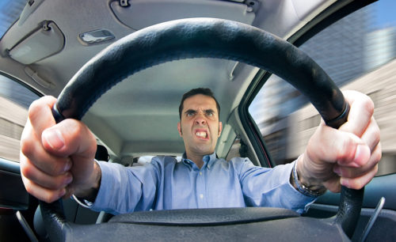
Problem Background
Chances of collision increase as drivers perform unsafe maneuvers.
Drivers are unaware of their driving behaviours.
Insurance companies charge for insurance based on assumptions of age and car model. Creates unfair system.
Accidents are preventable.

Slide 3



Needs Statement
Drivers need to recognize their bad driving habits in order to determine areas of improvement and awareness of their consequences.
Drivers need a device that constantly monitors their driving behavior.
Drivers need a customized user interface that develops a holistic driving profile for them.

Slide 4
Goal and Objectives
The goal of this project is to encourage healthy and responsible driving practices through automatic, real-time monitoring systems. Incorporating a user-specific interface creates an accurate profile such that it increases self-awareness. We hope that by creating a time sensitive profile algorithm, we are able to realistically grasp a driver’s current driving behavior and through consistent monitoring, reduce their chances of collisions or accidents.

Slide 5
Literature Review
Military Vehicle Blackbox - Ahmad Asi, Benjimin Chang, Mehdi Dadfarnia, Serge Kamta, and Ifzalul Khan
Prevent Data Loss: high-speed SSD, pressure sensor, GPS, data rotator software.
Funded by US Military
IoT-based Blackbox - Karthika M*, Anitha A
Data sent to IoT via ESP8266 chip
Alcohol sensor, gyroscopes, light and ultrasonic sensor
Output displayed in LCD Screen, saved on cloud
IoT-based Blackbox - IEEE
Similar to the above project
Sends text messages for data retrieval
Contacts medical assistance during collisions
Focus on protecting victims of car crashes.
DVR Dashcams
Contain Event Data Recorder
Cost-efficient

Slide 6
Design Constraints and feasibility
Technical
We will be relying on a combination of wired and wireless sensor implementation (i.e OBD) to reduce wiring issues.
Proper Wiring is main focus here
Physical
We are designing our prototype with compactness in mind, in order to make our product accessible for various vehicles.
Our outside “hull” for our microcomputer will be 3-D printed such that it contains ports for outside connections and a space to fit the raspberry pi inside.
Economical
Provided $600 Budget: Purchase of materials for embedded system
Remaining budget for unexpected purchases
Time
End of April
Create bi-weekly sprints + burn up charts.

Slide 7
Evaluation of alternative solutions
Dash Cams
Standard dash cams lack the implementation of GPS, IMU and OBD
They are only helpful in the case of collision, as they keep videographic proof of lanes leading upto the collision.
Therefore, it cannot identify the driver's behavior because anyone can get into a bad accident, whether they are good or bad drivers.
Front+Rear Camera
Image recognition is expensive and difficult, making it a tough starting point for our project.
Does not guarantee accuracy and often requires training models several times on lane detection to get it to work well.
limits insightful data on a user’s holistic driving behavior.
Standard IMU
IMU lacks insight from road conditions (i.e bumpy, traffic giving inconsistent speed reading) needed for an advanced driving detection system.
GPU based Web Platform
Location tracking and speed detection through GPS may lack context in situations where driving above or below the speed limit is realistic.
Speed Alert System
Creating an alarm system that sounds an alarm each time a user goes above speed limit can result in distracted drivers, causing them to be frustrated and reduce their focus from responsible driving.

Slide 8
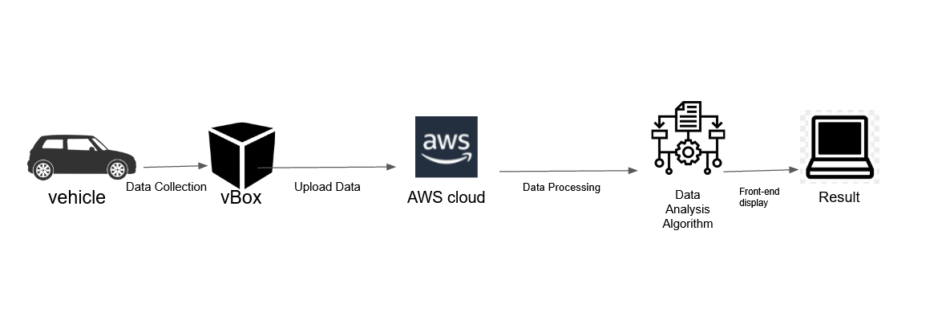
Proposed Design
High Level Block Design

Slide 9
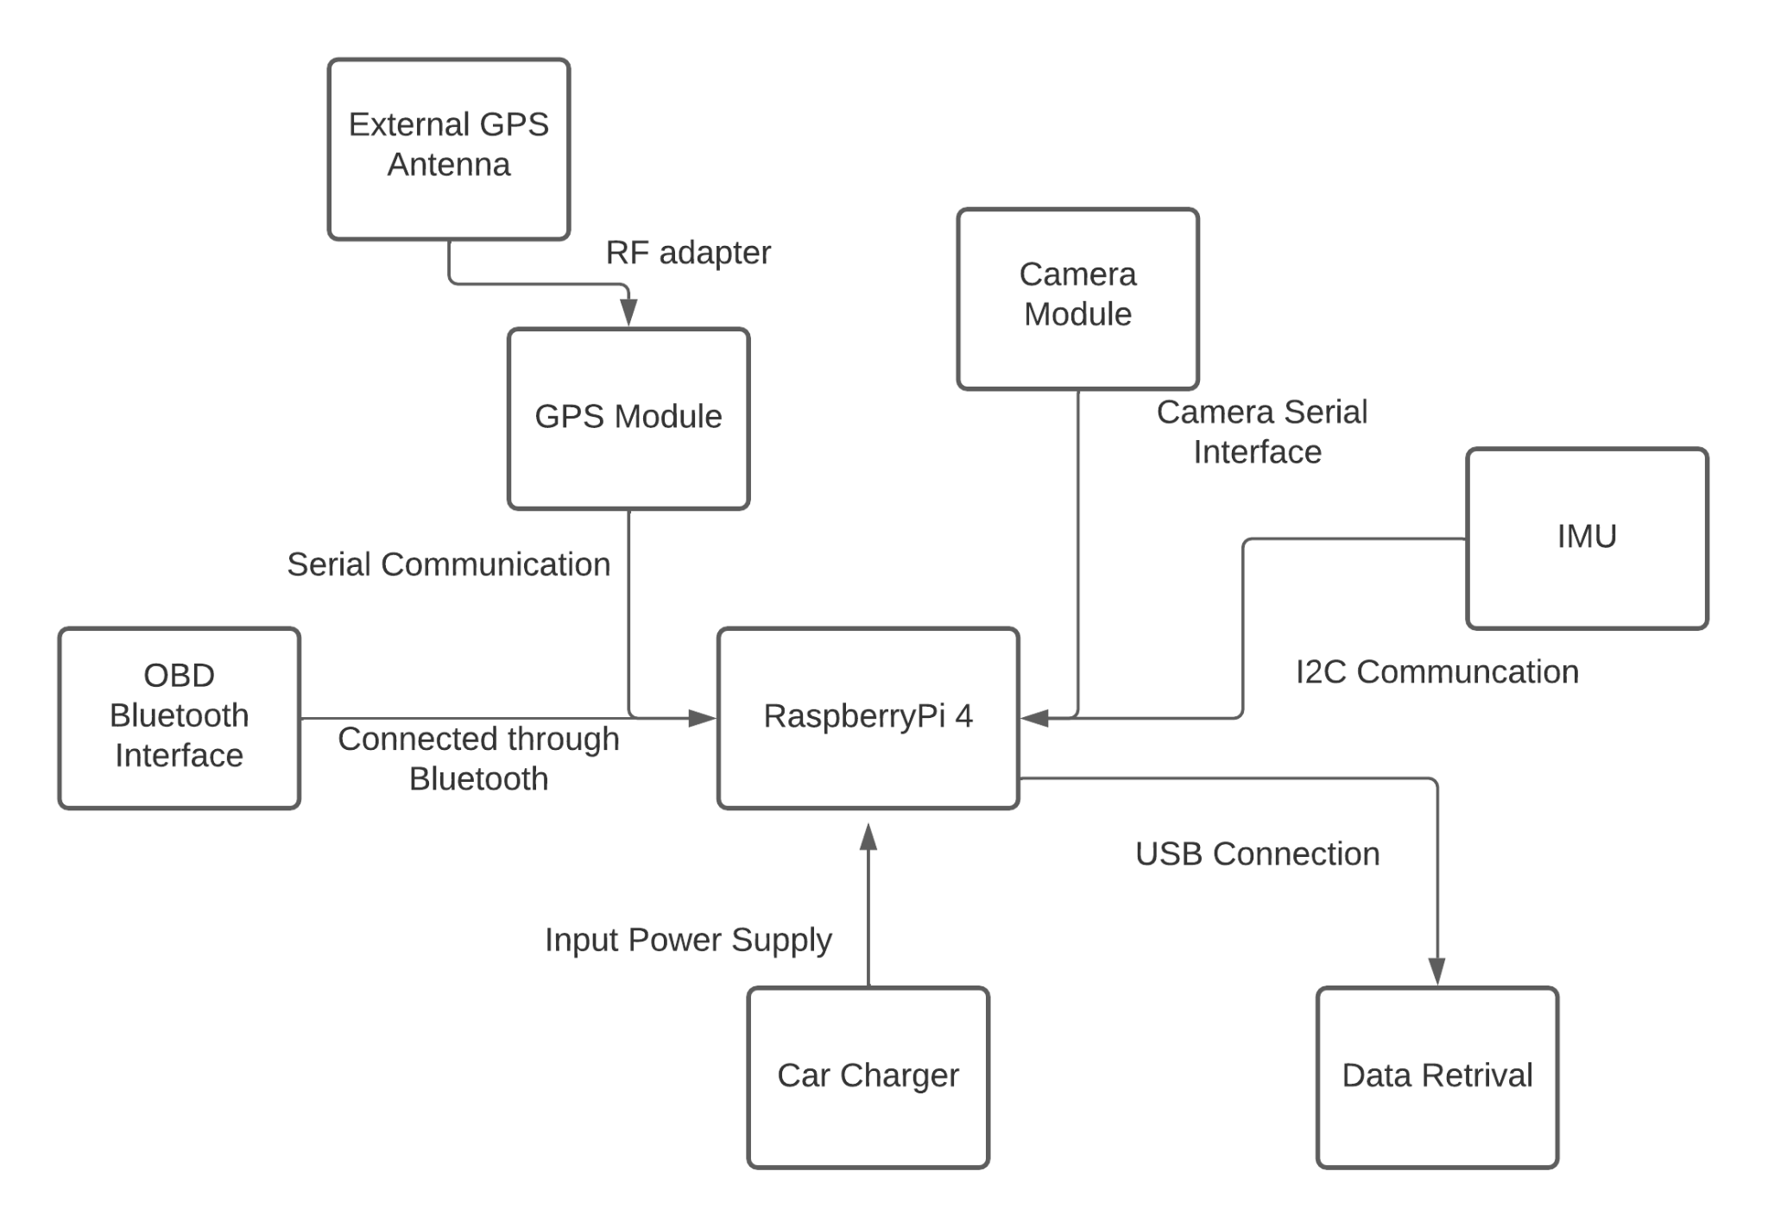
Proposed Design
Sensor & Data Retrieval Flowchart

Slide 10
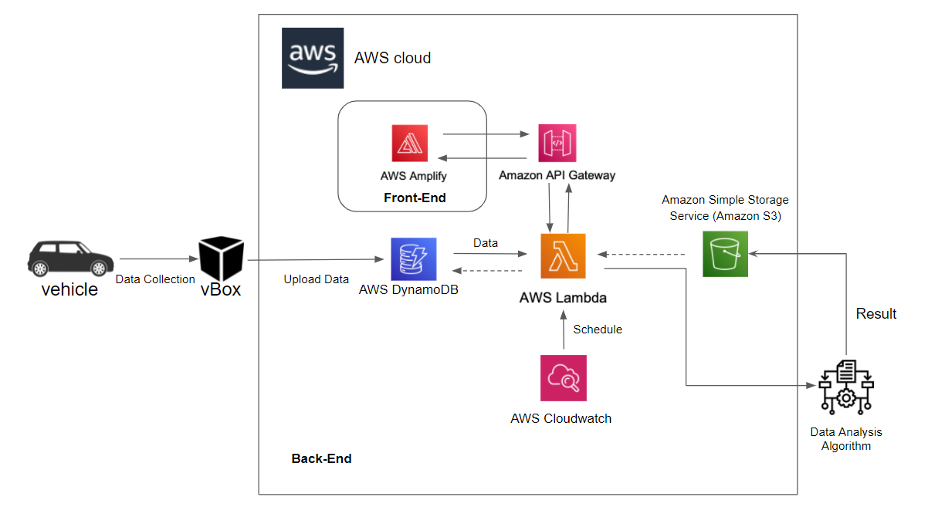
Proposed Design
Embedded System Design Flowchart

Slide 11
Approach for design validation
Our design is intended to transition from prototype to final deployment through a series of layered testing that allows us to thoroughly examine the functionality of hardware and software aspects of our project.
Hardware
Run simple python commands on Raspi terminal to check each sensor status.
Use multimeter to check soldering connection
Software
Viewing ‘Transaction Logs’ in SQL Server to check if new data entry has been made for a given timestamp
Usage Scenario
Slow-speed Area
Fast-lane roads
High Traffic Area
Rough Terrain Area

Slide 12
Economic analysis and budget
Total = $345.50
Economical viability: Volume Production $250.
Sustainability: Parts are ordinary common parts that can easily be found from more than one vendor
Manufacturability: Highly modularized and flexible since data is handled on the cloud side
Description | Price | Quantity
Raspberry Pi 4 Camera | $24.59 | 1
Adafruit GPS Hat | $29.95 | 1
External GPS antenna | $19.95 | 1
IMU (Accelerometer & Gyro) | $14.95 | 1
Standoffs for Pi HATs | $0.75 | 1
RF Adapter cable | $3.95 | 1
Bluetooth interface OBD port | $13.99 | 1
Raspberry Pi 4 | $167.95 | 1
SD card with 512 GB | $29.99 | 1
Car charger for Raspberry Pi 4 | $14.44 | 1
Suction Cup Mount | $24.99 | 1
3D Printed Enclosure | $25.00 | 1

Slide 13
Schedule of tasks
Task # | Task Description | Start Date | End Date
1 | Web Application starter code | 02/17/2022 | 02/22/2022
2 | Dashboard Design | 02/22/2022 | 02/24/2022
3 | Assemble and install Camera, IMU, GPS | 02/24/2022 | 02/28/2022
4 | Connect Raspberry Pi to Server | 02/24/2022 | 02/28/2022
5 | Connect OBD port interface | 02/24/2022 | 02/28/2022
6 | Setup AWS Database | 02/24/2022 | 03/10/2022
7 | Setup AWS Lambda & API | 02/24/2022 | 03/10/2022
8 | Obtain raw data from modules | 02/28/2022 | 03/03/2022
9 | Integrate OBD python library | 02/28/2022 | 03/07/2022
10 | Concurrently obtain data from GPS and OBD | 03/08/2022 | 03/15/2022
11 | Format data file | 03/10/2022 | 03/24/2022
12 | Record Camera video and store as needed | 03/10/2022 | 03/20/2022
13 | Retrieve data and make error handlings | 03/15/2022 | 03/29/2022
14 | WebApp Google API integration | 03/10/2022 | 03/17/2022
15 | WebApp: Login View | 03/10/2022 | 03/17/2022
16 | WebApp: Report View | 03/10/2022 | 03/22/2022
17 | Implement uploading data to server | 03/17/2022 | 03/24/2022
18 | Develop analyzing algorithm | 03/22/2022 | 04/05/2022
19 | Testing-WebApp displaying retrieved data | 03/24/2022 | 04/07/202
20 | Determine metrics for reckless behavior | 04/05/2022 | 04/12/2022
21 | Final testing | 04/05/2022 | 04/19/2022
22 | Correct/Perform minor improvements | 04/14/2022 | 04/21/2022
Major Tasks Schedule Breakdown:
Assemble and install necessary packages of the modules by the 02/28/2022
Software: Setup necessary AWS API functions, tables in database, among other AWS configurations by 03/10/2022
Hardware: Working on concurrently obtaining and storing data of all the modules by 03/17/2022
Web Application Development with basic data and APIs functionality: 03/24/2022
Develop Analyzing Algorithm by 04/05/2022
Metrics testing and final testing by April 19, 2022

Slide 14
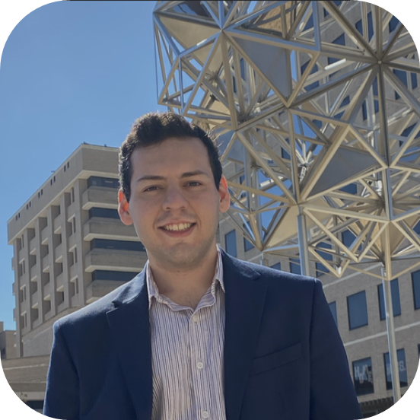



Project Management and teamwork
Due to the project encompassing hardware and software at a similar level. The team will split into two groups:
Hardware
Software

Slide 15
Societal, safety and environmental analysis
Societal
Society benefits directly from reduced poor driving practices -- more saved lives.
Safety
Blackbox will be manufactured in a compact design such that driver's ability to drive is not impacted by the device
Environmental
Reducing carbon footprint through use of car’s battery outlet instead of external source of power.
Reusing data during training purposes to reduce gas emissions caused from project

Slide 16
We appreciate your attention
Questions?

