Slide 1
Team EIGENNEXUS
Picking the Right Molecule to Build
Why the popular computational shortcut sometimes picks the wrong candidate — and how a quantum-accurate check catches it first.
Candidate A CrO
vs
Candidate B NiO
GIC 2026 · Phase 3 · Advanced Materials (Mitsubishi Chemical & AIST)

Slide 2
You can only afford to build one
Advancing one molecule to synthesis and lab testing costs months and real money. Computers screen candidates first to pick the best one — usually with a method called DFT.
1.9 eV how much the DFT answer swings
depending on the 'flavor' chosen
The catch
The most popular 'flavor' of DFT (called B3LYP) can get the answer backwards on these tricky molecules. If it does, the whole ranking flips — and you'd build the wrong one.

Slide 3
The test: which is the stronger magnet?
Candidate A — CrO
Candidate B — NiO
Real-world answer: strong high-spin (a good magnet).
This is the correct pick.
Real-world answer: weaker high-spin than CrO.
The runner-up.
How we decide
Rank the two by how strongly they prefer the high-spin state, using six DFT flavors AND a quantum-accurate method. We wrote the rule down before computing the quantum answer — no moving the goalposts.

Slide 4
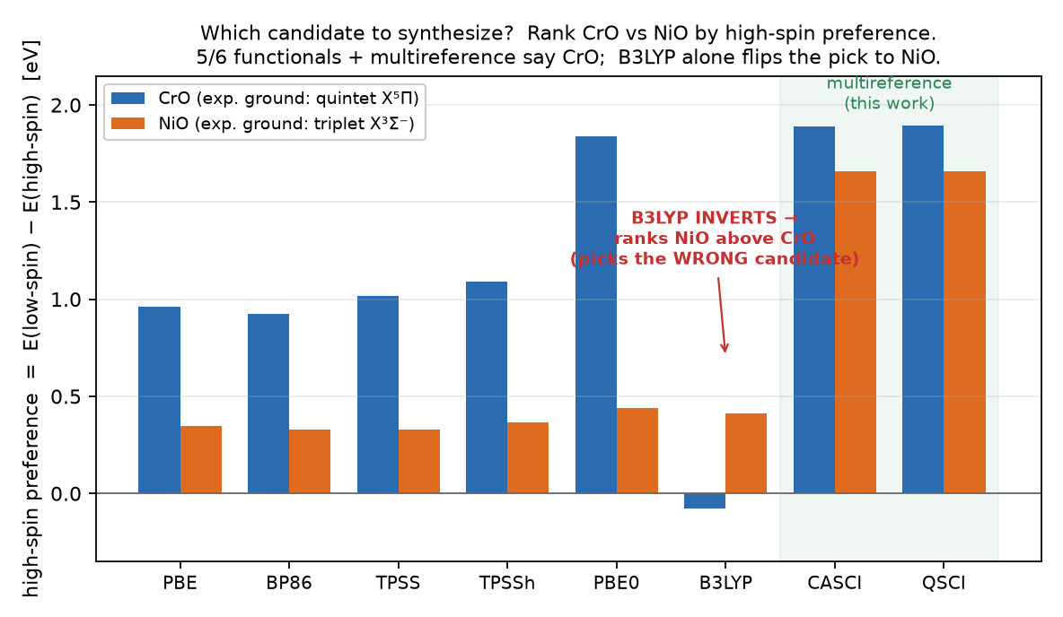
The quantum-accurate check picks the right one
Synthesize CrO The quantum-accurate method — and 5 of 6 DFT flavors — agree.
B3LYP → NiO The popular flavor picks the wrong molecule.

Slide 5
Why it matters
AI suggests molecules
→
DFT quick-screens
→
Quantum check on the tricky ones
→
Build the winner
The quantum-accurate check sits right where DFT is unreliable — catching a wrong pick before the months-long build.
The rough cost of picking wrong
Waste ≈ N · fmr · p · C
N candidates screened × how many are 'tricky' × how often the shortcut mis-picks × cost per wrong build. Every number is yours to fill in — the point is the mechanism is real and measured.

Slide 6
Honest, and you can check it yourself
✓
Real result
A popular method picks the wrong molecule; the quantum-accurate one picks the right one — matching experiment.
✓
Small print, stated
One small test, a simplified model — the pattern is real, not the exact dollar figure.
✓
Re-runnable
Anyone can reproduce it: one script, committed data, no special access.

