Slide 1
Team EIGENNEXUS
When DFT Picks the Wrong Molecule
A quantum-accurate candidate decision that inverts a widely-used DFT ranking — and matches the experiment.
Candidate A CrO
vs
Candidate B NiO
GIC 2026 · Phase 3 · Advanced Materials (Mitsubishi Chemical & AIST)

Slide 2
Which candidate do you synthesize?
DFT is the standard pre-synthesis filter. But its functional choice can flip the answer exactly where it matters most — strongly-correlated (multireference) metal-oxide chemistry, the heart of EUV resists.
1.9 eV spread across six DFT functionals
on one molecule's spin-state gap
Why it bites here
On CrO, one of the six functionals — B3LYP, the single most-used functional — assigns the wrong ground state (spin-gap −0.08 eV vs the true +1.89 eV). A screen built on it inherits that error and mis-ranks the candidate.

Slide 3
A frozen, testable decision
Candidate A — CrO
Candidate B — NiO
Experimental ground state: X⁵Π (quintet, S = 2).
A robust high-spin center.
Experimental ground state: X³Σ⁻ (triplet, S = 1).
A weaker high-spin preference than CrO.
The rule (pre-registered)
Rank both candidates by high-spin preference (spin-gap = E(low-spin) − E(high-spin)), computed by six DFT functionals and by a fixed CAS(10,10) CASCI/QSCI treatment. The decision rule was committed before the multireference numbers were computed.

Slide 4
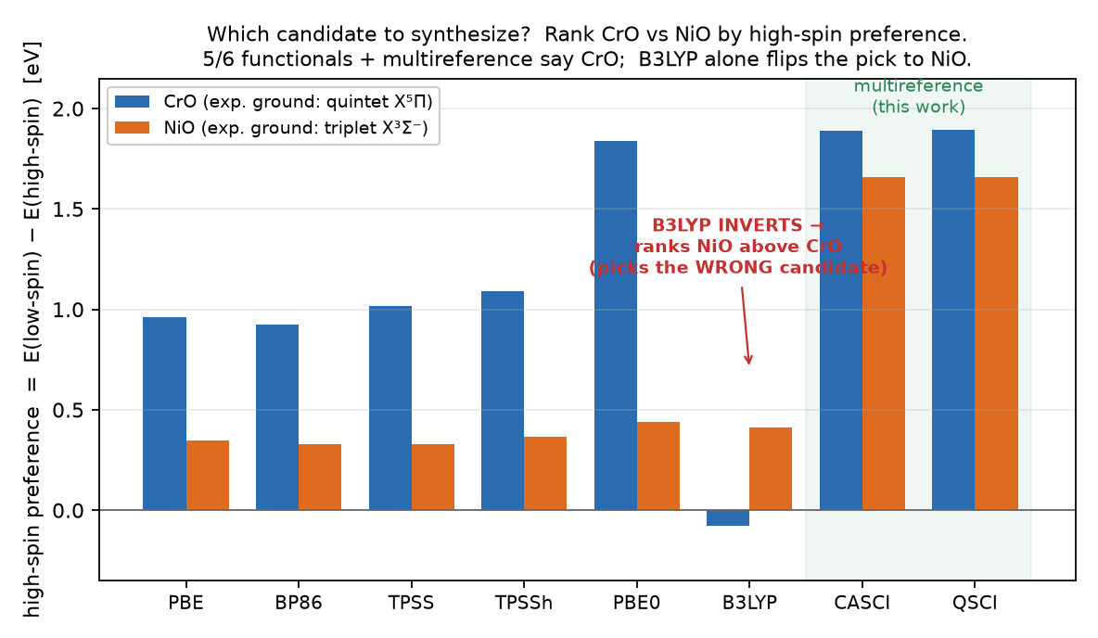
The multireference selector is right — B3LYP inverts it
Synthesize CrO 5 of 6 functionals + CASCI/QSCI agree; matches CrO's experimental X⁵Π.
B3LYP → NiO The most-used functional inverts the ranking — advances the wrong candidate.

Slide 5
Where a quantum-accurate check pays off
AI proposes
→
DFT filters
→
QSCI-accurate check on multireference candidates
→
Bayesian selects → synthesize
The interception point: catch the flipped ranking before the months-long synthesis commit.
Avoidable waste (illustrative framework — plug your own numbers)
Waste ≈ N · fmr · p · C
N screened × f_mr (multireference fraction) × p (mis-rank rate) × C (cost per false lead). Dollar inputs are placeholders; the measured facts are the 1.9 eV spread, the B3LYP sign-error, and the ranking inversion. Multi-fidelity screening shows up to 3× cost reduction (Fare 2022).

Slide 6
Decision-robust. Verifiable. Honest.
✓
Decision-robust
5/6 functionals + CASCI/QSCI pick CrO; B3LYP alone inverts. The multireference selector doesn't flip.
✓
Honest scope
Fixed modest CAS(10,10)/def2-SVP; the claim is the ranking/sign (which candidate), not a benchmark gap magnitude.
✓
Verifiable
python src/candidate_decision.py → results/candidate_decision_evidence.json. Frozen rule, committed evidence.

