Slide 1
Team EIGENNEXUS · GIC 2026 Phase 3 · Advanced Materials (Mitsubishi Chemical & AIST)
MATGEN-Q
A bluff-detector for the expensive chemistry decisions.
Generative AI designs the quantum circuits. A quantum-selected solver returns an answer that is always honest about its own error — so a wrong prediction never reaches the lab.
40q
26/26
p<0.0001
executed, pre-reg PASS
re-runnable checks
AI transfer to 56q

Slide 2
THE BUSINESS PROBLEM
Building one candidate is a months-long bet
Advancing a single photoresist candidate from computer to synthesis and lithographic test costs months of lab time and real money. So the decision of what to build is made by a computer prediction — before anyone touches a flask.
$800B+
semiconductor industry riding on photoresist chemistry — where a wrong candidate is paid for in months, not minutes.
The catch: the chemistry that matters most for EUV photoresists — strongly-correlated Sn / Hf / Zr metal-oxides — is exactly the chemistry where the standard prediction is least trustworthy.
The question this deck answers: what is it worth to know when your computer prediction is wrong — before you build?

Slide 3
THE MECHANISM · MEASURED, NOT ASSUMED
The gold standard doesn't just err — it bluffs
On strongly-correlated bonds, CCSD(T) collapses non-variationally: it returns an energy BELOW the true answer, confidently, with no internal signal that anything is wrong.
217 mHa
~144 mHa
40× error growth
below the exact energy
and non-convergent
0.14 → 5.49 mHa
H₁₀ stretched to dissociation — an unphysical, confidently-wrong number.
A real Cr–O bond stretch, identical active space as the exact reference. Non-convergent points scatter on re-runs (to ~162) — that scatter IS the failure.
The real Sn₂O₂ EUV motif under bridge cleavage — QSCI stays ≤0.48 mHa.
strong_correlation.py
cro_dissociation.py
sn2o2_dissociation.py
A screen built on a method that fails silently inherits every one of those failures — and pays for them in the lab.
All three measured in this work and re-runnable via reproduce.py; CCSD(T) uses the identical embedded Hamiltonian as the exact reference (apples-to-apples).

Slide 4
THE ANSWER
Our method cannot bluff — by construction
Variational. QSCI can only ever return an upper bound to the true energy. It cannot sit below the right answer the way CCSD(T) does — the failure mode simply does not exist for it.
Self-certifying. An Epstein–Nesbet PT2 bracket tells you how converged you are. So the answer is either certified-converged, or it tells you it isn't. It never looks confident while being wrong.
Where CCSD(T) fails
Where QSCI stands
Confidently wrong. Sits 217 mHa below the exact answer with no error signal at all — you cannot tell a good prediction from a bad one.
A rigorous bound, with its own error certificate — and on the real oxides it stays within chemical accuracy throughout (≤2.8 mHa on CrO, ≤0.48 mHa on Sn₂O₂).
EN-PT2 certificate: encoder/selci_pt2.py — extrapolation hits FCI to ~4 mHa at equilibrium, ~54 mHa stretched (disclosed); the bracket is rigorous either way.

Slide 5
WHAT WE CONTRIBUTED
AI · Quantum · Business
AI
QUANTUM
BUSINESS
Generative circuit design that transfers
Executed at scale — and on real devices
A pre-synthesis trust gate
A classical GPT-style transformer writes the quantum circuits — it is not a quantum model.
Trained on 8q+12q only, deployed zero-shot to 56 qubits: 43/48 paired wins, p<0.0001 (8 seeds).
Trained on energy alone, it recovers the MP2 amplitude hierarchy it was never shown (ρ=0.31).
40 qubits, chemically accurate vs its frozen reference (+1.226 mHa, pre-registered pass).
20q / 28q on NVIDIA GPU; trapped-ion QPU silicon decoded and driving the same solver.
Two 38q runs that CORRECT their classical DMRG reference — verified at three bond dimensions.
Catch the confidently-wrong classical number before the months-long synthesis commit.
Applies to the strongly-correlated subset — exactly the EUV Sn/Hf/Zr oxide chemistry.
Cost is auditable, not asserted: cost_audit.py re-derives program spend from published pricing.
GQE (Nakaji et al. 2024) and QSCI (Kanno et al. 2023) are prior art we build on and cite; the pairing at scale, the transfer generator and the executed results are ours.

Slide 6
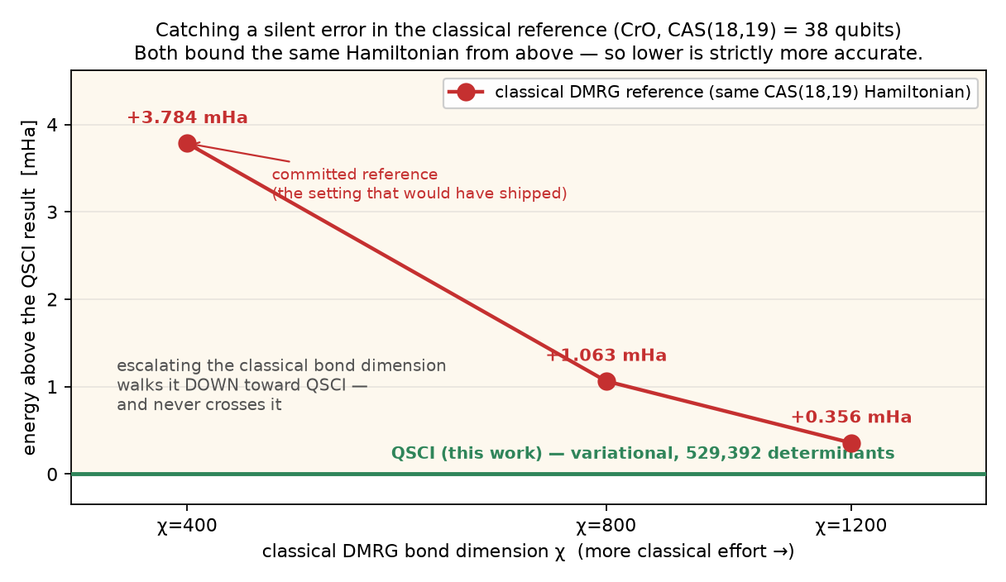
THE RESULT WE ALMOST FILED AS A FAILURE
We caught a silent error in the reference
At 38 qubits our answer came in BELOW the trusted classical reference — on two independent systems. Both are variational upper bounds on the identical Hamiltonian, so the lower energy is strictly more accurate.
−3.784 / −0.399 mHa
Two independent corrections
CrO and the real Sn₂O₂ EUV motif — both below their committed same-CAS DMRG(χ=400) reference.
Honest limits: this is the METHOD, not the hardware — at 38q the determinant selection ran classically (the disclosed proxy; device-sampled selection is validated at 20q/28q). Not cheaper (19.1 h vs ~15 min to escalate χ classically) — the value is the trigger, not the compute. n = 2: a pattern, not a measured rate. Reported as the pre-registered P4 criterion failing as-measured.
χ=400 → 800 → 1200
The mechanism, proven
Escalating the classical bond dimension walks DMRG down toward our energy (+3.78 → +1.06 → +0.36 mHa) and never crosses it.
Why it matters: DMRG gives you no signal that your bond dimension is big enough — you stop when it looks converged. An independent variational method coming in lower is proof you hadn't. Useful today, with no quantum-advantage claim.

Slide 7
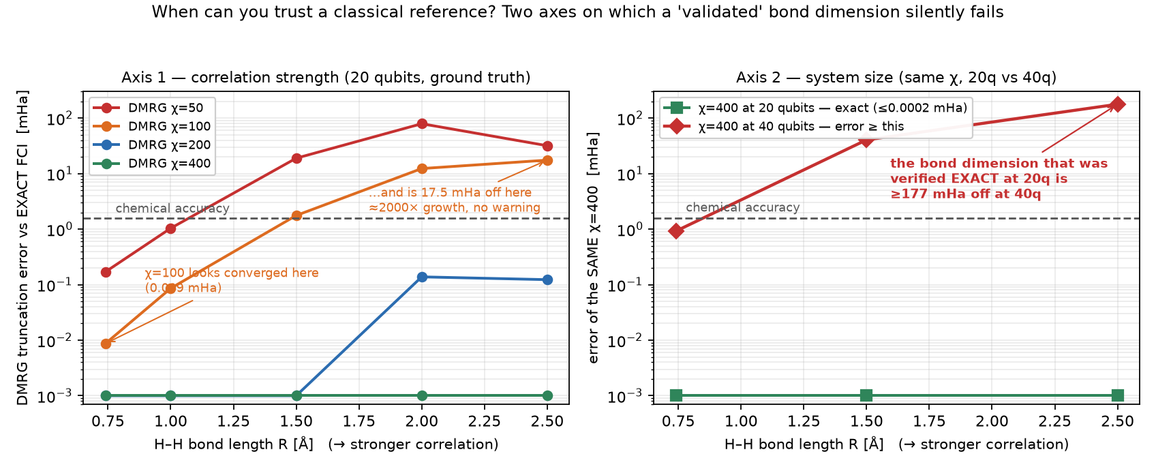
THE PREDICTIVE RULE · MEASURED AGAINST EXACT FCI
When can you trust a classical reference?
Two axes silently break a bond dimension you already validated — one measured against exact FCI.
The rule: a bond dimension validated on a smaller or easier system tells you nothing about its error on a larger or harder one — and DMRG gives no internal signal either way. That is where an independent check earns its keep.

Slide 8
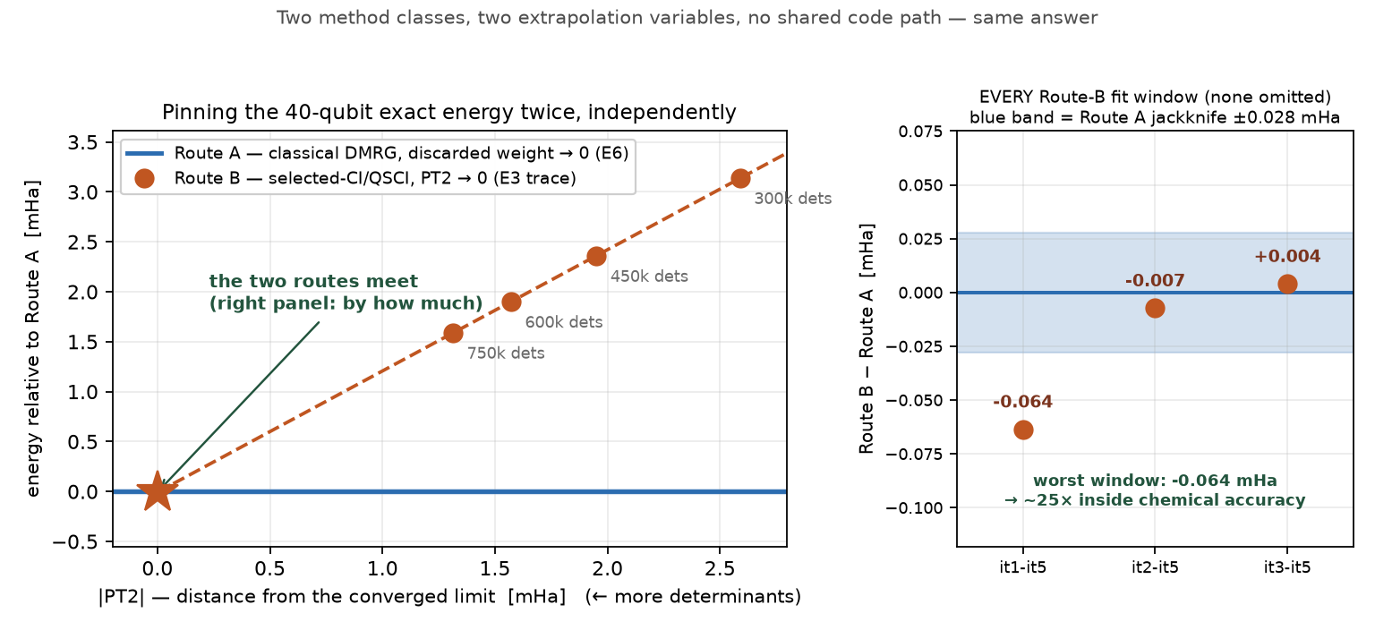
THE STRONGEST SCIENTIFIC RESULT
The 40-qubit exact energy — pinned twice
Full CI at 40 qubits is intractable (~3.4×10¹⁰ determinants), so any “exact” value is an extrapolation you must take on trust. We pin it by two independent routes.
Route A
classical tensor network
−10.293599 Ha
block2 DMRG χ=400→2400, extrapolated on discarded weight → 0
Route B
determinant selection
−10.293621 Ha
A cross-validated benchmark other groups can cite:
selected-CI/QSCI on 750,257 dets, extrapolated on PT2 → 0
FCI(H₂₀, 40q, STO-6G) ≈ −10.29361 Ha
Both routes are extrapolations, not exact FCI; we quote the WORST fit window, not the best. No new computation — analysis of already-committed evidence.
They agree to 0.064 mHa in the WORST fit window (0.004 best). With Route A’s own jackknife spread folded in: ~0.10 mHa, ~15× inside chemical accuracy — sharing no solver, no extrapolation variable, no code path.

Slide 9
THE SCIENTIFIC VALUE
Built so a skeptic can check every number
Pre-registered
Every judged claim's threshold was git-timestamped BEFORE the run. Outcomes reported as measured — passes, a resource-DNF, a non-convergence.
Re-runnable
One command re-executes 17 headline scripts and audits 9 GPU/QPU artifacts: 26/26 PASS, no modification needed.
Self-corrected
Two claims we tested and WITHDREW: an active-space-fragile ranking, and a DFT sign-flip that proved an SCF artifact. In E9, two of four pre-registered predictions FAILED — published as refuted.
Reference-correcting
At 38q our solver drops BELOW the classical DMRG reference — and χ=800/1200 confirm it is the reference that was truncated, not us.
We publish the negatives. That is why the positives should be believed.

Slide 10
EXECUTED — EVERY NUMBER TRACES TO A COMMITTED FILE
What actually ran
+1.226 mHa
+1.59 mHa
−3.784 / −0.399
40q flagship, executed
40q absolute anchor
38q reference corrections
Chemically accurate vs its frozen DMRG(χ=400) reference at 450,257 determinants — pre-registered criterion met. Determinant-space QSCI on the qBraid H100 host; device circuit sampling is the 20q/28q result.
Independent DMRG extrapolation to the near-exact limit; robust to ±0.05 mHa under a leave-one-out jackknife.
CrO and the real Sn₂O₂ EUV motif land below their same-CAS DMRG references — mechanism confirmed at three χ.
0.038 / 0.197 mHa
real QPU
16 TB → 195 MB
Open-shell oxides (20q)
Trapped-ion silicon
The memory wall removed
CrO ⁵Π and NiO ³Σ⁻ to chemical accuracy against exact diagonalization.
AQT ibex-q1 decoded; device-sampled determinants seed a QSCI growth that recovers exact FCI.
Tensor-network representation at the measured bond dimension — what makes 40 qubits fit on one GPU.
Full traceability: docs/claims_ledger.md maps every number → script → evidence file → status.

Slide 11
HONEST LIMITS — NON-NEGOTIABLE
What we do not claim
⚑
No quantum ADVANTAGE anywhere in this work. Classical FCI/DMRG solve every instance here, including the 40q flagship — our own DMRG anchor pins it independently. The value is trust and correctness, not speed. Where an advantage regime begins is a question we do not answer.
⚑
The value case is a framework, not a Mitsubishi ROI. The mechanism is measured here; the dollar inputs are placeholders for your pipeline's own numbers.
⚑
Large-ladder results beyond 20q use a determinant-space proxy for the measurement step — validated against real circuit-sampled shots at 12 / 16 / 20 qubits.
⚑
The 40q absolute result sits AT the chemical-accuracy threshold, not comfortably inside it.
⚑
The 40q tensor-network backend RAN (2.65 h, 12.06 GB) but yielded only 108 determinants where ~450,000 were needed. E9 measured why: like-for-like at 20q, 400k shots at 3× depth give 564 determinants against a 2,401 requirement — 4.3× short — and yield is flat in system size. The MP2-seeded classical growth was a NECESSARY architecture. What is owed is a sampling strategy, not GPU hours.
⚑
Two decision claims were tested and withdrawn rather than defended. The value story above depends on neither.

Slide 12
BOTTOM LINE
Where MATGEN-Q sits in the pipeline
AI proposes
→
Classical screens
→
MATGEN-Q trust gate
→
Synthesize
Applied only to the strongly-correlated candidates — the subset where the classical screen is unreliable.
You stop paying for confidently-wrong predictions.
The classical gold standard can be confidently wrong on exactly the chemistry that matters, with no warning. MATGEN-Q is variational and self-certifying — it never blindsides you, and it is systematically improvable to the exact answer. Executed to 40 qubits on real hardware, and re-runnable end-to-end in one command.
Team EIGENNEXUS · MATGEN-Q · GIC 2026 Phase 3

