Slide 1
MA Christian

Slide 2
Topics
Pipeline
Timeline
FOOOF pitfalls
Final “Schlachtplan”

Slide 3
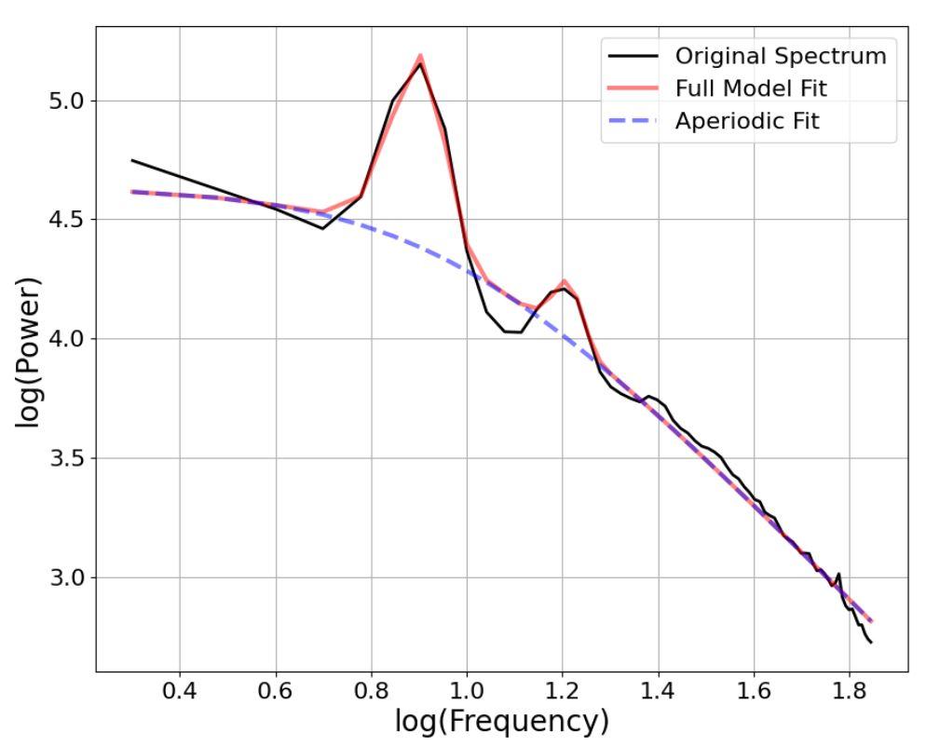
Pipeline (s01)
Load data
Resample 512 Hz
Artefact detection
Normalize
Get variance per quarter (source?)
Low variance or short trials are replaced by NaNs
Filter
.5 Hz HP & 45 Hz LP
Demean
Padding (‘nextpow2’)?
TFR
Foi = [2:.05:35]
Toi = [0:.01: 5]
Hanning taper
FOOOF in standard mode
Peak lims = [1.5 12]
Peak thresh = 2 std
Freq range = 1:35
https://github.com/christianneumannCAU/Master-CAU

Slide 4
Pipeline (s02)
New spectrum = fooofed_spec – ap_fit
Power (trapz)
Alpha
Beta
Regression table
ID
Side
Depth
Channel
AP exponent
ALPHA pow
BETA pow

Slide 5
FOOOF pitfalls
Marius Krösche, HHU

Slide 6
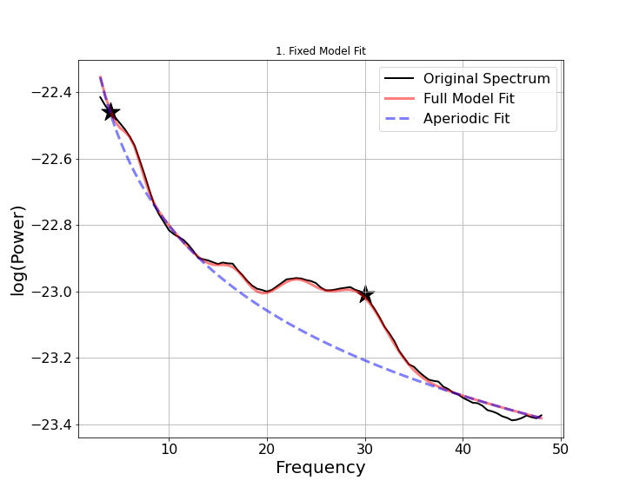
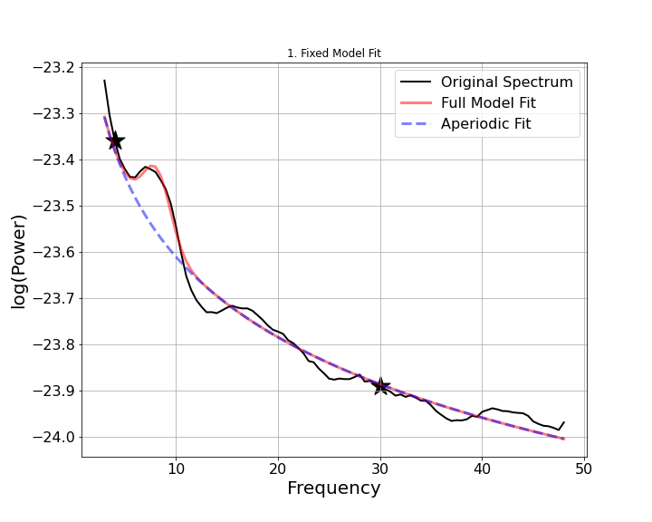
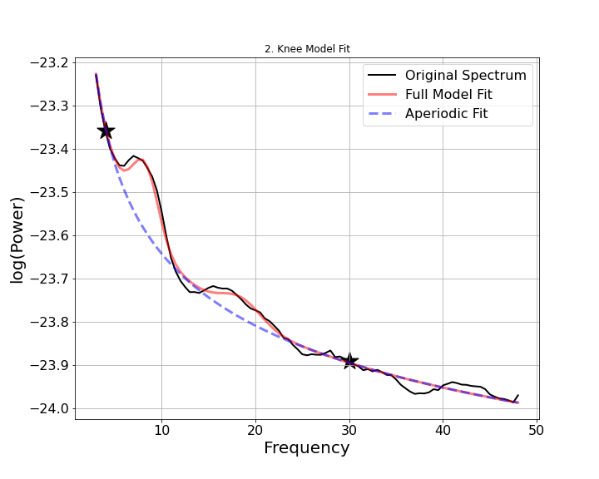
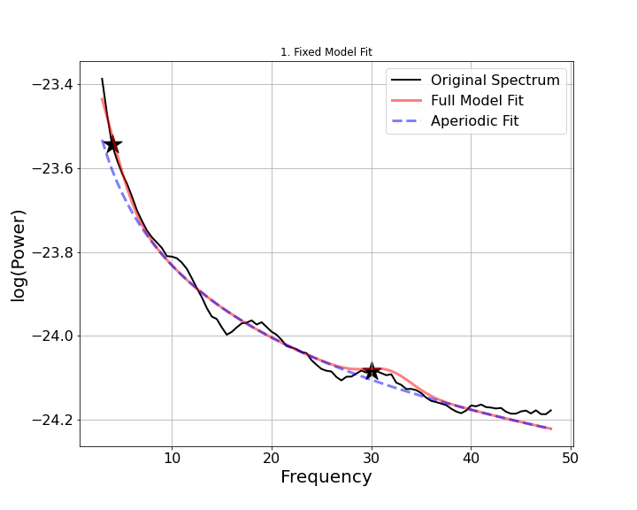
Fooof: ‘Fixed’ Examples
Good fit
Fail to capture
low beta oscillation
Fail to capture any oscillation, but instead add wrong low frequency oscillation

Slide 7
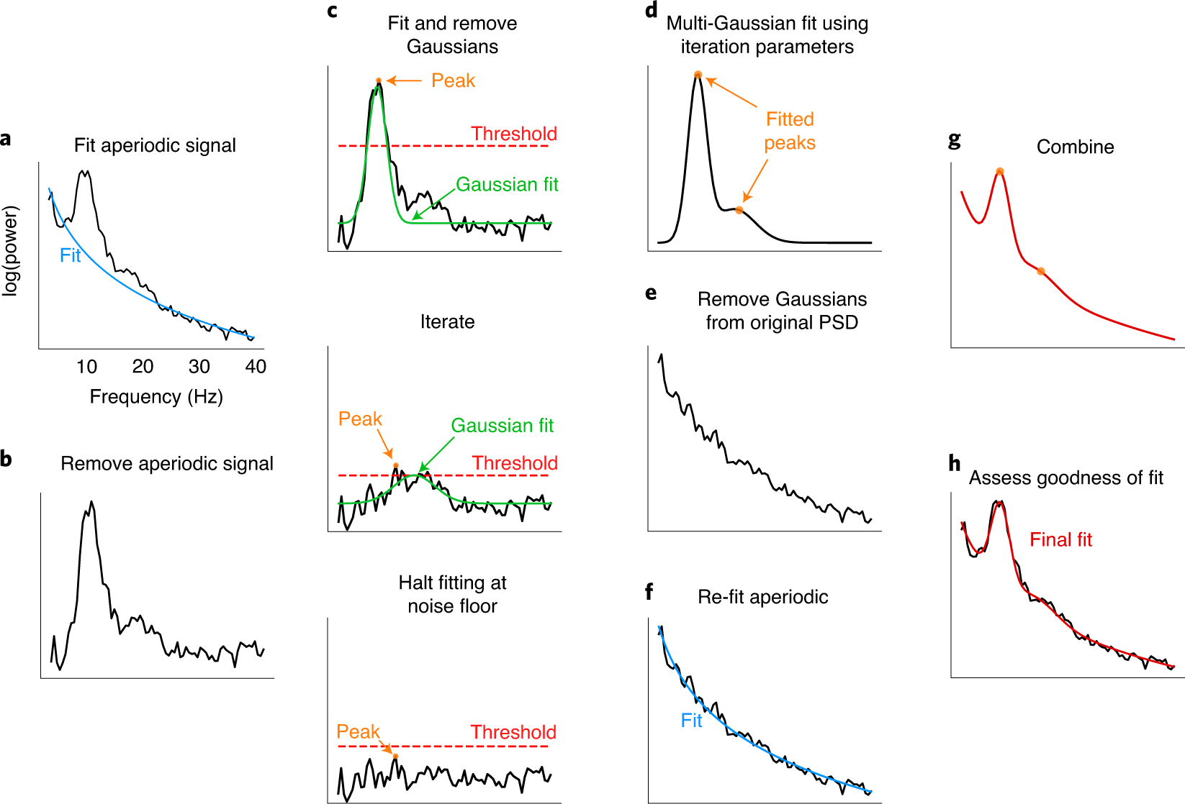
FOOOF

Slide 8
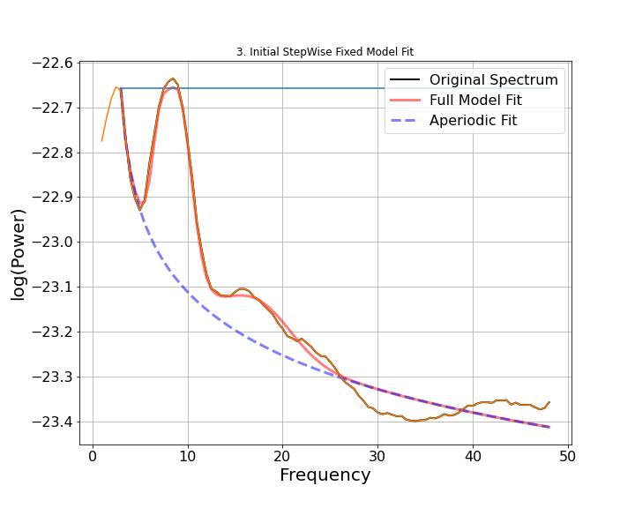
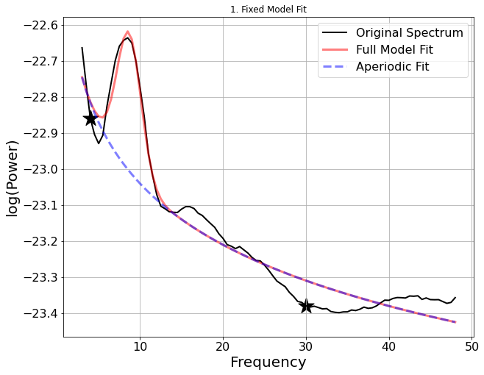
Fooof: ‘Unconvenient’ Examples
Notes:
Initial is another ‘invented’ fitting mode where I shift the offset for the exponential fit towards the set value in ‘initial’.

Slide 9
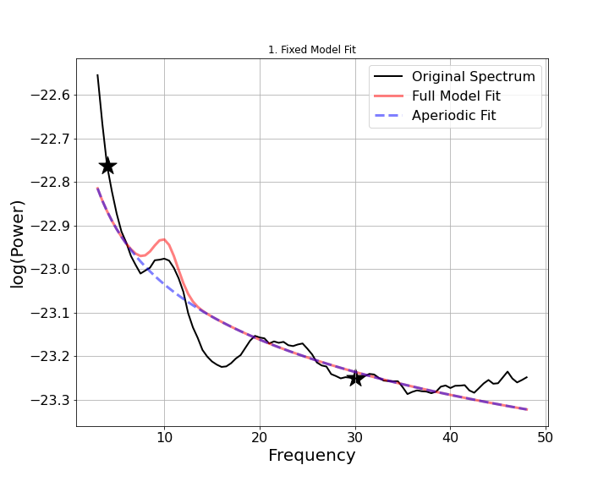
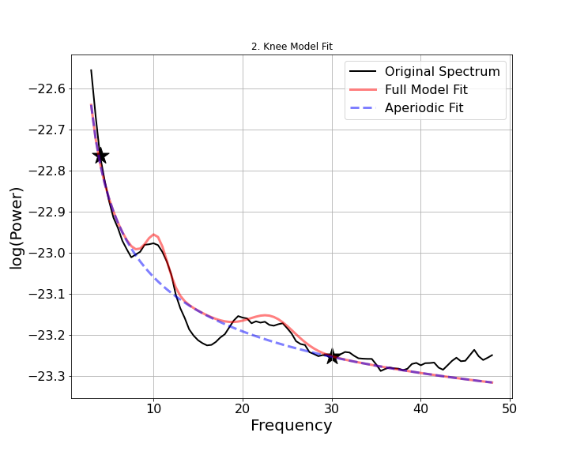
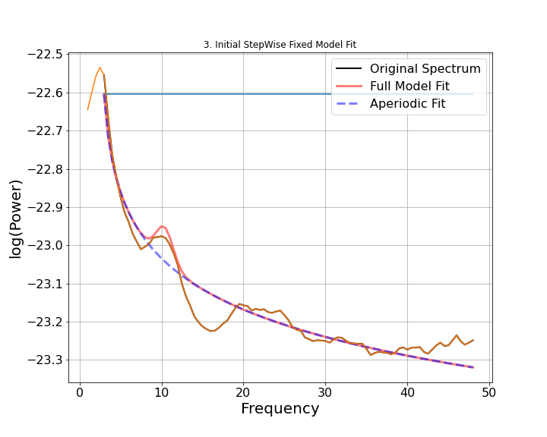
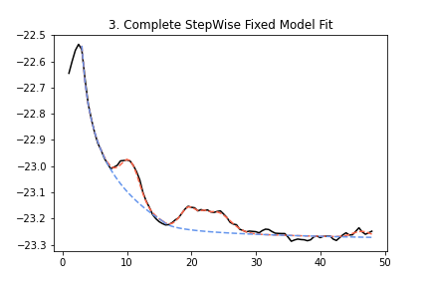
Fooof: ‘Unconvenient’ Examples
Notes:
The final ‘escalation’ in the cascade is stepwise fitting. Here if nothing works in parameter settings from fixed, knee, initial -> Try StepWise fitting.
Here from 4 -> 13 and 13 -> 48.
Visual confirmation is key I think, as fooof can go REALLY wrong. Aim for the best possible result.

Slide 10
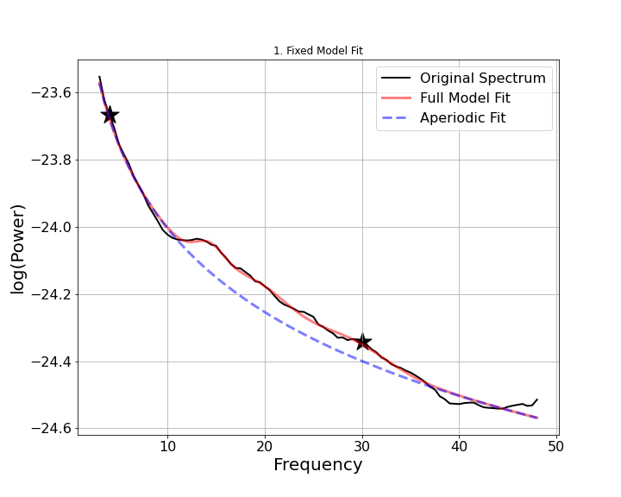
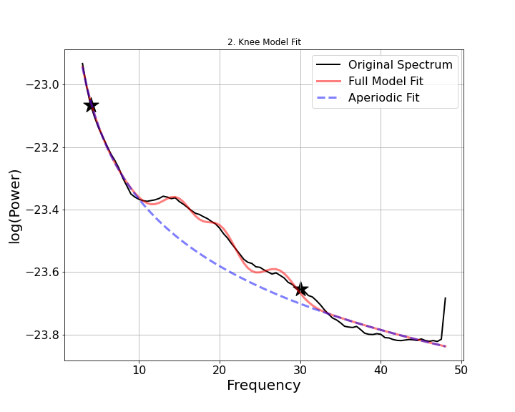
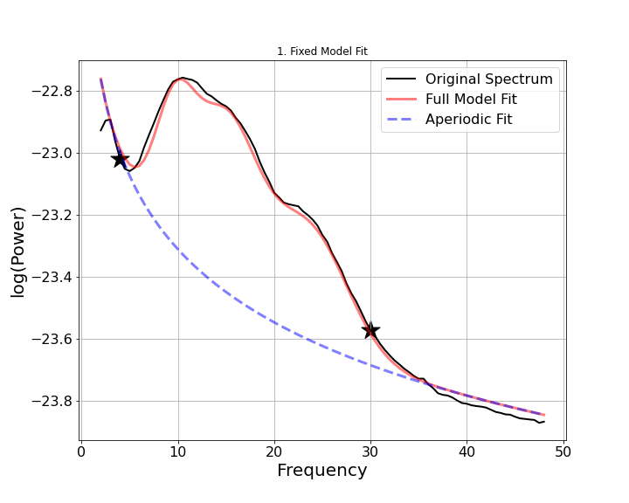
Problems: ‘Jitter’ and ‘smearing’
Smearing: Multiple oscillations overlap and smear together vs. a single large oscillation
Possibilities in Analysis Pipeline:
Major oscillation ( aka largest amplitude oscillation )
Median Oscillation
Compute Center of Energy

Slide 11
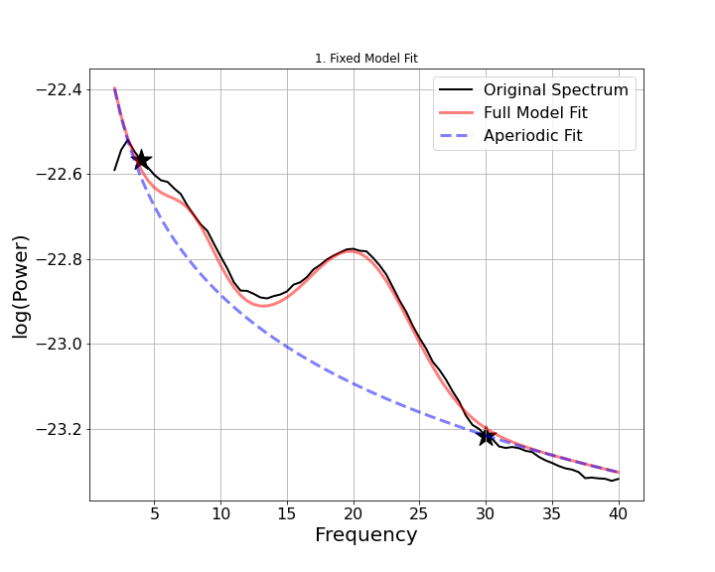
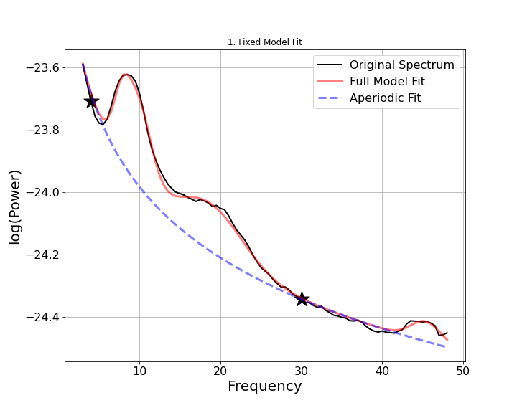
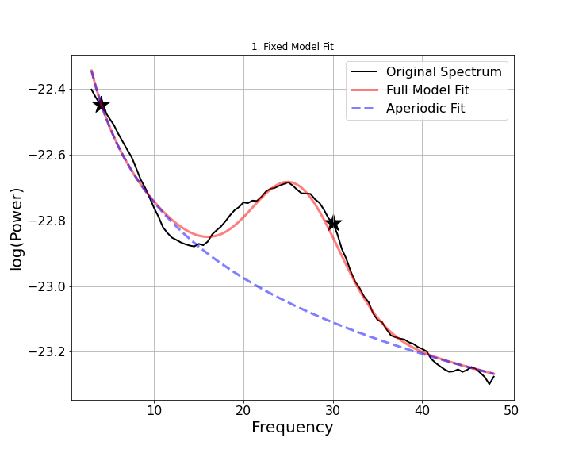
Problems: ‘Jitter’ and ‘smearing’
Jitter: Shift of oscillatory center frequency that cannot be visually confirmed
Possibilities in Analysis Pipeline:
Major oscillation ( aka largest amplitude oscillation )
Median Oscillation
Compute Center of Energy

Slide 12
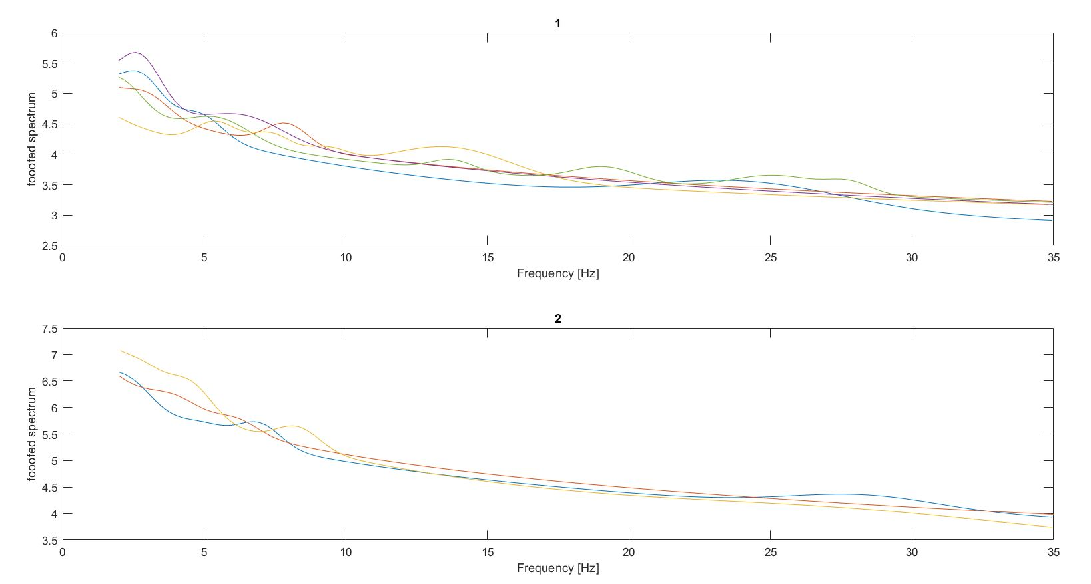
Final Schlachtplan
Implement better FOOOF fit
Check output with exponent
Extract power using fieldtrip
θ (4-7)
α (8-12)
β (13-30)

Slide 13
Timeline
Aktivität | Beginn | Dauer (Tage) | Ende | Version
 |  |  |  | 26.05.2021
erstes Literaturstudium | 08.03.2021 | 23 | 30.03.2021
Fragestellung überlegen | 22.03.2021 | 9 | 30.03.2021
Betrachtung der Daten | 31.03.2021 | 12 | 13.04.2021
Skript zum Einlesen der Daten + Vorbereitung/ weitere Recherche | 13.04.2021 | 48 | 31.05.2021
Skript für die Verarbeitung der Daten | 31.05.2021 | 31 | 01.07.2021
Skript für FOOOF | 01.07.2021 | 62 | 01.09.2021
Auswertung | 01.09.2021 | 122 | 01.01.2022
Text schreiben | 01.01.2022 | 84 | 25.03.2022
Abgabe | 26.03.2022 | 5 | 30.03.2022

