Slide 1
Deep Learning for Multi-Level ESL Pronunciation Assessment and Feedback
Midterm progress: Sprints 1 to 5 of 10
Notes:
Title slide. Introduce yourself and the project in one sentence, then move to the idea.

Slide 2
Scoring English pronunciation at three levels
Sentence
Word
Phoneme
Overall accuracy, fluency and prosody scores
Which words were mispronounced
The smallest units of sound. Each error is classified as a substitution, deletion or addition
Three research questions
1
2
3
Do pretrained speech models beat handcrafted features?
Does multi-task learning help?
Does it generalize to speakers it has never heard?
Notes:
My project is a deep learning system that scores English pronunciation for ESL learners at three levels: whole sentences, words, and phonemes, the smallest units of sound. It also classifies phoneme errors as substitutions, deletions, or additions. I'm asking three questions: do pretrained speech models beat handcrafted features? Does multi-task learning help? And does it generalize to speakers it has never heard?

Slide 3
Two datasets, two kinds of labels
SpeechOcean762
L2-ARCTIC
5,000
250
24
6
recorded sentences
Mandarin-speaking learners of English
learners
language backgrounds
Half children, half adults
Expert scores for sentences, words and phonemes
Arabic, Hindi, Korean, Mandarin, Spanish, Vietnamese
Annotated pronunciation errors: substitution, deletion, addition
Notes:
I use two datasets. SpeechOcean762 has 5,000 recorded sentences from 250 Mandarin-speaking learners of English, half children and half adults, scored by experts. L2-ARCTIC has 24 learners from six language backgrounds, with annotated pronunciation errors.

Slide 4
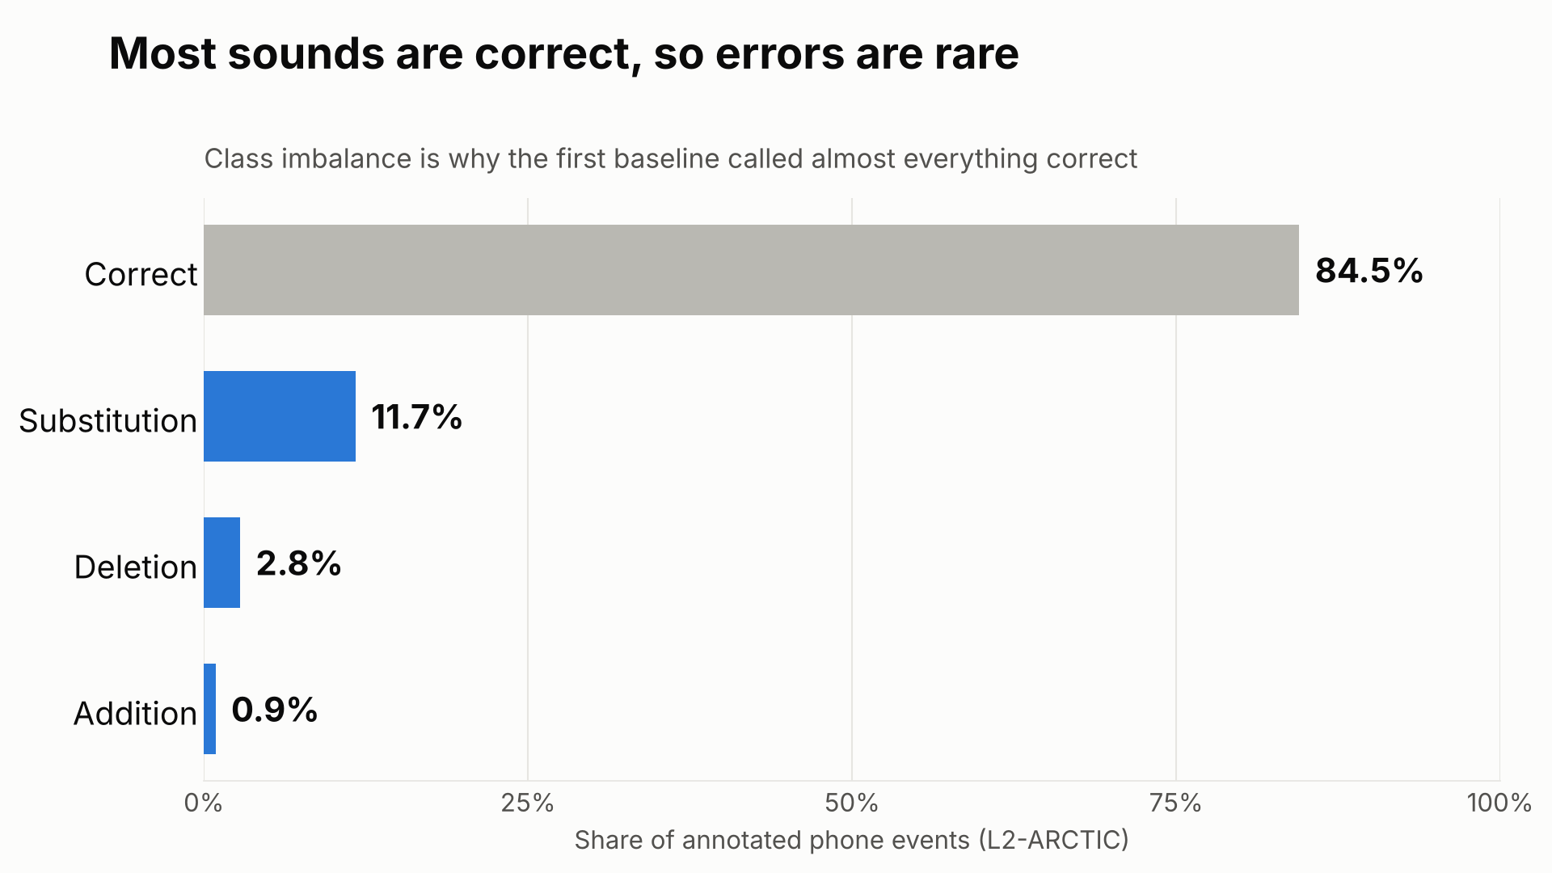
Notes:
About 15% of the sounds in L2-ARCTIC are errors, so errors are rare, and that shapes everything that follows. Because this is a benchmark project, I was also asked to find each model's weaknesses and fix them.

Slide 5
Three stages, same speakers, same test set
1
2
3
Traditional baseline
Frozen WavLM
Fine-tuned WavLM
Classic audio features called MFCCs, with standard machine learning
A speech model pretrained on tens of thousands of hours of audio, with small prediction layers on top
The whole model is trained further for pronunciation scoring
Benchmark project: at every stage, find the model's weaknesses, then fix them
Notes:
I compared three stages on the same speakers and the same test set. First, a traditional baseline: classic audio features called MFCCs with standard machine learning. Second, WavLM, a speech model pretrained on tens of thousands of hours of audio, kept frozen with small prediction layers on top. Third, fine-tuning the whole WavLM model for this task.

Slide 6
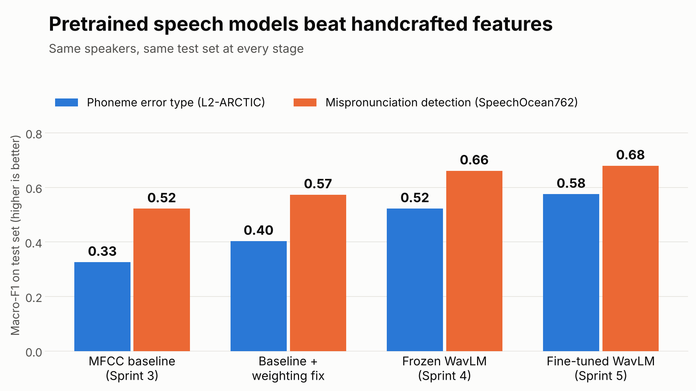
Notes:
On phoneme error type, scored with macro-F1 where 1.0 is perfect, the baseline got 0.33, frozen WavLM 0.52, and fine-tuned 0.58. So pretrained speech models clearly beat handcrafted features.

Slide 7
Every stage: find a weakness, then fix it
Sprint
Weakness
Fix
Result
The baseline called almost every sound correct
Weight rare errors more, and tune the decision threshold
Macro-F1 rose from 0.33 to 0.40
3
wav2vec2 looked weak because it was reading the wrong internal layer
Switch to a better layer
Macro-F1 gained 0.11 on phoneme error type
4
The model memorized its training examples
A lower learning rate (six fix variants tested)
Overconfident predictions fixed (+0.02 macro-F1). Sentence scores did not improve on new speakers
5
Notes:
Since this is a benchmark, at each stage I looked for weaknesses and fixed them. The baseline called almost every sound correct, since most are. Weighting the rare errors and tuning the decision threshold raised the score to 0.40. In stage two, wav2vec2 looked weak only because I was reading the wrong internal layer; switching layers gained 0.11. In stage three, the model was memorizing training examples. A lower learning rate fixed its overconfident predictions. But for sentence scores, closing the memorization gap did not help on new speakers, so that wasn't the real limit.

Slide 8
What's next
1
Multi-task learning (Sprint 6)
2
First, a known weakness
One shared model with a head for each task. Test for negative transfer, and fix it if it appears
The model predicts the worst sounds as almost fine. A loss that re-weights low scores is the planned fix
3
Unseen speakers (Sprint 8)
4
Web app (Sprint 9)
Evaluate on speakers the model has never heard, broken down by language background, with ablations
A React app with color-coded feedback on each word and sound
Feedback preview (mockup):
She
sells
seashells
green = good, amber = close, red = needs work
Notes:
Next is multi-task learning: one shared model with a head for each task. I'll test whether learning the tasks together helps or causes negative transfer, and fix it if it does. One known weakness to tackle first is that the model predicts the worst sounds as almost fine. Then I'll evaluate on unseen speakers with ablations and build a React web app with color-coded feedback on each word and sound.

