Slide 1
Employee Attrition Prediction: A Data Analysis Approach
DS 6306
Christian Orji

Slide 2
Project Objective
To develop a predictive model for employee attrition using a given dataset of employee demographics, job role, job satisfaction, and other related factors.

Slide 3
Dataset Description
The dataset contains 870 records of employee data, with 36 variables including:
Age
Department
Monthly Income
Job Role
Job Satisfaction
Attrition (target variable)

Slide 4
Data Preprocessing
Checked for missing values and removed records with missing values
Checked for duplicate records and removed them
Explored the dataset using descriptive statistics and visualizations
Encoded categorical variables using one-hot encoding

Slide 5
Exploratory Data Analysis (EDA)
Examined the distribution of the target variable
Explored the relationship between the target variable and other variables
Visualized the correlation between variables using a correlation matrix
Identified potential outliers and removed them

Slide 6
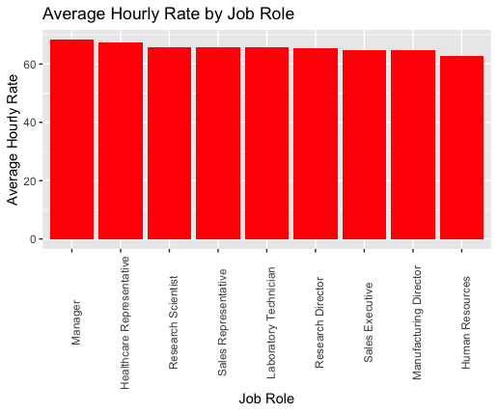
Highest average hourly rate vs job role
Managers have the highest hourly rates

Slide 7
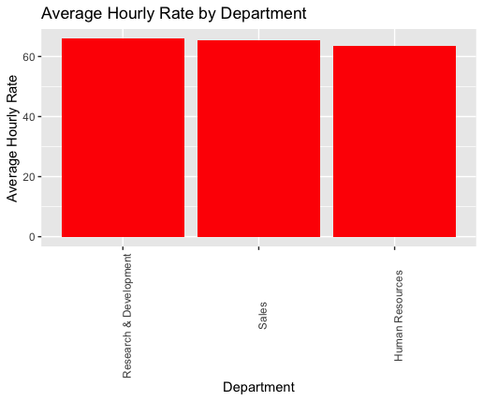
Average hourly rate by Department
Research and Development have the highest hourly rates

Slide 8
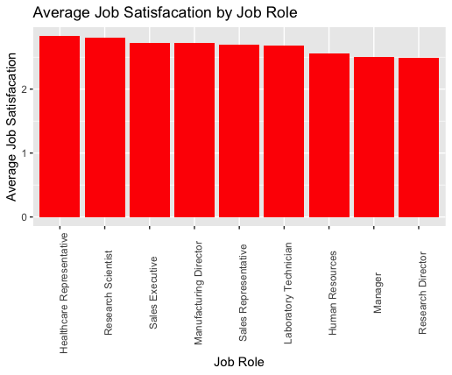
Average Job satisfaction by Job Role
Health Care Representatives have the highest job satisfaction

Slide 9
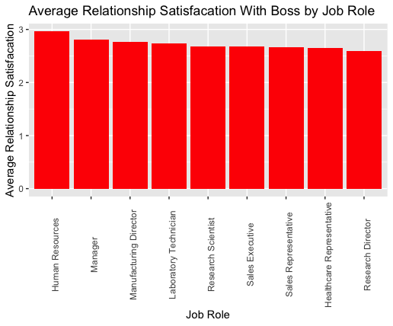
Average Relationship Satisfaction with Boss by Job Role
Human Resources have the the highest average relationship satisfaction with their boss.

Slide 10
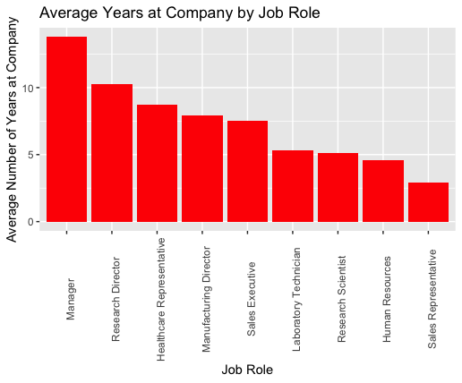
Average Number of years at the Company
Managers have the highest average number of years at the company

Slide 11
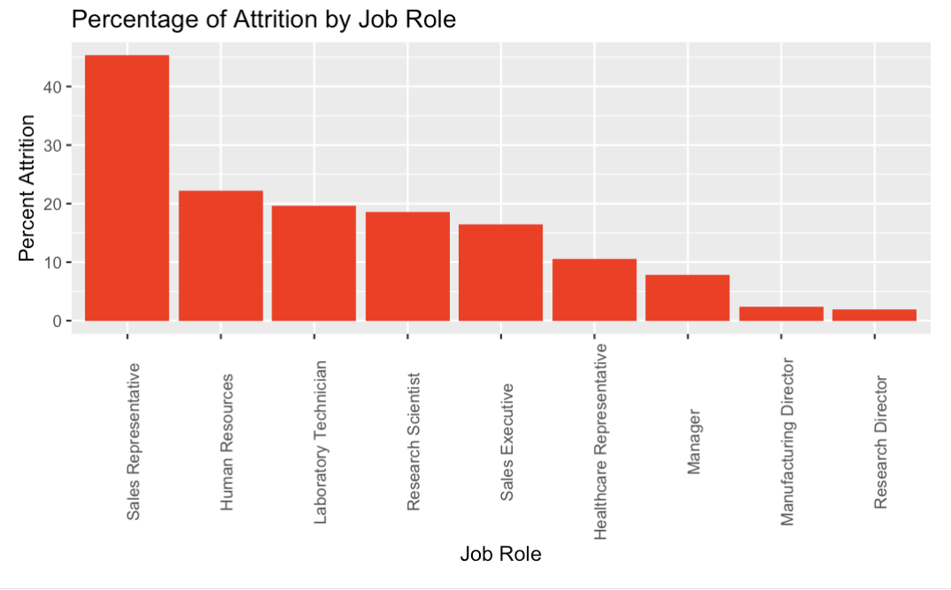
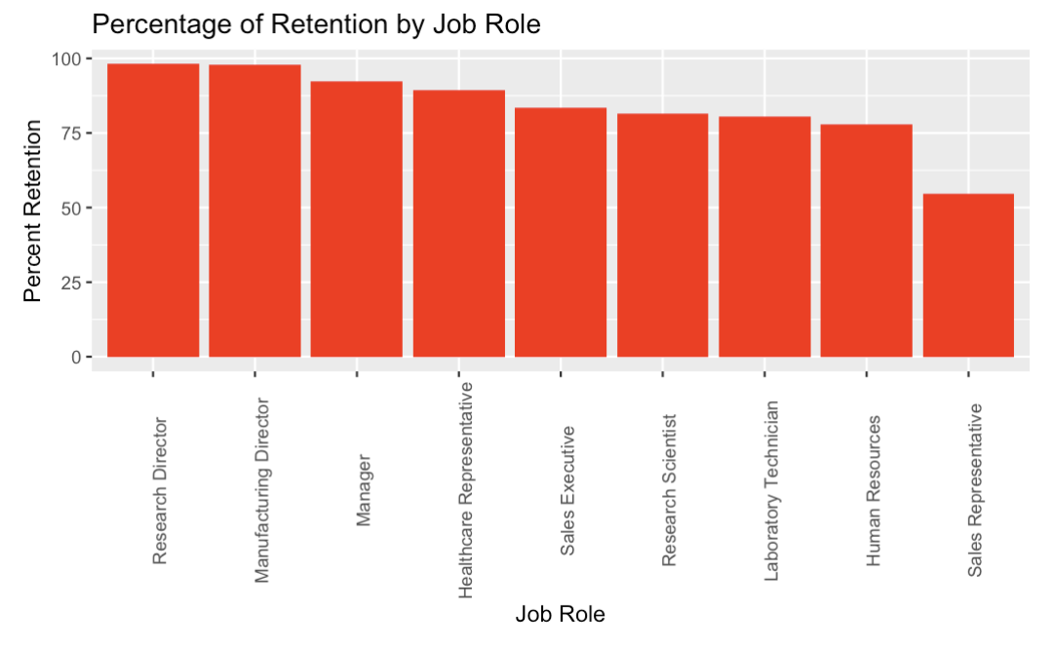
Percentage Attrition by Job Role
Percentage Retention by Job Role
Sales Representative has the highest percentage of Attrition by job Role
Research Director and Manufacturing Director both have the highest percentage of Retention by job Role

Slide 12
Model Building
Split the dataset into training and testing sets
Built a logistic regression model using the training set
Adjusted the sensitivity using up-sampling
Evaluated model performance using a confusion matrix and ROC analysis
Built a LASSO regression model to identify important features

Slide 13
Using up-sampling
The imbalance in the Attrition class was addressed by up-sampling the minority class.
A logistic regression model was created with the up-sampled data.
The model achieved an accuracy of 0.6781 and a kappa of 0.3562.
Sensitivity was 0.6027 and specificity was 0.7534.
The positive predictive value was 0.7097 and the negative predictive value was 0.6548.

Slide 14
Predict the attrition status of employees
We used the the Created Naïve Bayes model to predict the attrition status of employees in the test dataset. We added the results of the predictions to a new dataframe called “attritionprediction” which contains the ID of the employees and the predicted attrition status (0 for No and 1 for yes).

Slide 15
To Predict Monthly Income
Conducted 100 iterations of linear regression model evaluation using mean squared prediction error (MSPE) metric
Two models were evaluated, with and without the variable "YearsWithCurrManager"
Results:
Mean MSPE of Model 1 (without "YearsWithCurrManager") = 1497524.6
Mean MSPE of Model 2 (with "YearsWithCurrManager") = 1493481.5
Root mean squared error (RMSE) of Model 1 = 1355.1
RMSE of Model 2 = 1355.1
Model 2 was chosen and used to predict Monthly Income for employees with missing data
Results were saved to a dataframe with employee ID and predicted Monthly Income

Slide 16
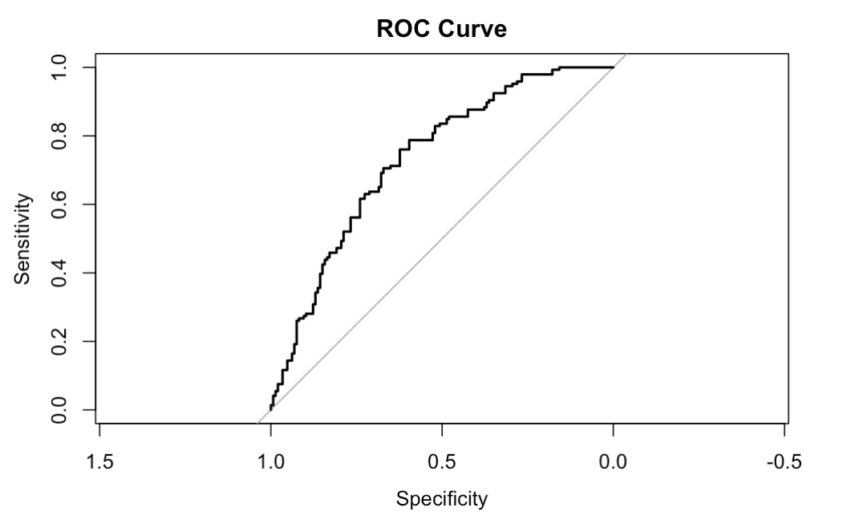
ROC ANALYSIS
Encoded categorical variables using one-hot encoding.
Split the dataset into training and testing sets (80/20).
Created a logistic regression model using the training set.
Made predictions on the testing set and evaluated model performance using confusion matrix and AUC.
Achieved an AUC of 0.73, indicating good model performance.
Plotted the ROC curve to visualize model performance.

Slide 17
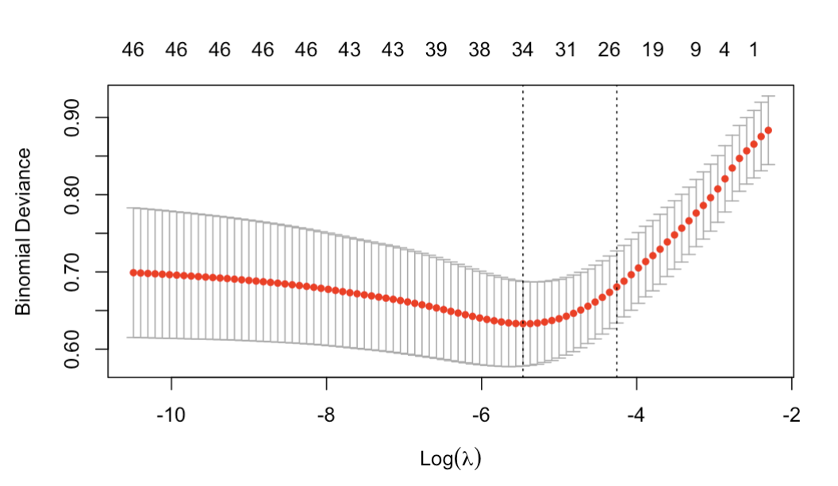
LASSO ANALYSIS
Based on the LASSO model, the most important features for predicting attrition were identified.
We extracted the coefficients at lambda.min and found the non-zero coefficients (excluding intercept).
Finally, we displayed the important features and their coefficients.

Slide 18
Model Evaluation
The Logistic Regression Model Achieved an Accuracy of 67.81% and sensitivity of 60.27%
The ROC analysis showed that the regression model had a moderate predictive ability with AUC of 0.73
The LASSO regression model identified important features for predicting employee attrition

Slide 19
Conclusion and Future Work
The logistic regression model performed moderately well in predicting employee attrition, but there is room for improvement
Up-sampling improved the sensitivity of the model, but more sophisticated sampling techniques could be explored
The LASSO regression model identified important features for predicting employee attrition, which can be used to inform decision-making processes related to employee retention strategies
Future work could explore the use of other machine learning algorithms or feature engineering techniques to improve model performance

Slide 20
Thank you
Questions?
Email: corji@smu.edu

Slide 21
YOUTUBE LINK:
https://youtu.be/8vRqXWJPlgM
R-SHINY APP:
https://christianorji.shinyapps.io/CS2ShinyApp/

