Slide 1

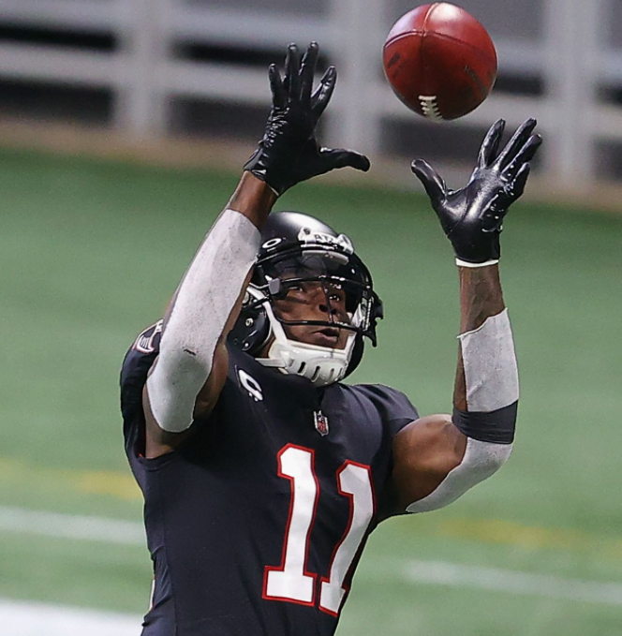
Can “BREAKOUT” Wide Receivers in the NFL be predicted with Accuracy?
DATA698 – Capstone Research Project
Christian Thieme
11/26/2021
Notes:
Hello, my name is Christian Thieme and this is my presentation for my capstone research project titled “Can breakout wide receivers in the NFL be predicted with accuracy”

Slide 2

The Project
Fantasy football leagues have become more and more popular each year
Not only are they fun, but they can be very lucrative with prizes exceeding $1M
Dynasty leagues allow you to keep players year after year
This means that selecting the right rookies is one of the best ways to strengthen your team
Rookie wide receivers have the potential to make big impacts on their teams
The Research Question
Is possible to build a predictive model using a wide receiver’s collegiate and NFL combine statistics to accurately predict 80% of the wide receivers that will average 10 fantasy points per game (“breakout” wide receivers)?
Notes:
To give you a little background on this project, this project revolves around fantasy football.
There’s a specific type of fantasy league called a dynasty leagues

Slide 3
THE Dataset
Historically, the NFL has been one of the slowest sports leagues in collecting and releasing data to the public – this has slowed growth of analytics within the industry, but they’re catching up
Dave Wright a well-known author at DynastyLeagueFootball.com maintains a player database with key metrics for every player for seasons 2018-2022
Dataset is unique in that it is broken down by position (i.e., running back, wide receiver, etc.)
The dataset has 836 rows (players) and 602 columns with both numeric and categorical data
Descriptive columns for each player contain information such as:
Player Name, College attended, Conference, DOB, Draft Round Picked, Draft Pick, Draft Age, and how many season they played in the NCAA
Numeric columns include:
Yearly statistics from the 2018-2022 seasons, aggregated metrics from these seasons such as average receptions per game or total career touch downs, and metrics from the NFL combine such as height, weight, 40 time, hand size, etc.
In total, there are 100 different metrics.
~11% of the players within the dataset are “breakout” wide receivers (class imbalance)
Notes:
Now let’s talk a little bit about this dataset

Slide 4
Challenges
Missing data
Almost every row of data has at least one missing value.
Reasons for this vary, but common reasons include, the player was injured and missed a season, the player retired and stopped playing during the period of time this dataset contains, etc.
For most of these cases, the missing values can be filled with 0’s because the player truly didn’t have a metric
However, for combine metrics I decided to use k-means clustering as combine performance is heavily utilized in draft selections
Dimensionality of the dataset
602 columns is a lot to wade through and can make modeling difficult and time intensive
Principal Component Analysis was explored to reduce the dimensionality, but overall decreased the accuracy of the model significantly, so was not used in the final models

Slide 5
Modeling
Modeling was done using the tidymodels library in R
This is an incredible framework that brings a multitude of modeling techniques under one roof and uses the same syntax
The variable of interest is a variable called “Breakout” that indicates whether a player averages 10 fantasy football points a game or not. The field is a binary Yes/No field
Algorithms chosen to model with:
Random Forest
XGBoost
K-Nearest Neighbor (KNN)
Support Vector Machines (SVM)
The dataset was broken into a training and test dataset
All tuning and validation was done on the training dataset
Test dataset was used as holdout dataset for final predictions and results

Slide 6
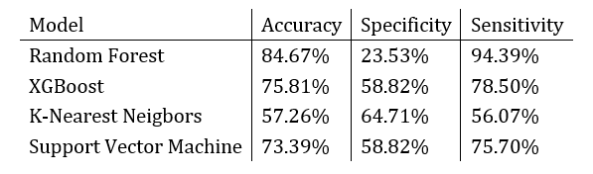
RESULTS
Because of class imbalance, accuracy isn’t the only important metric
Specificity tells us how well the model predicted the breakouts in our dataset
For example, if there were 17 total breakout wide receivers and the model selected 13 of them correctly, the specificity would be ~76%.
No model meets the threshold set for this research of correctly identifying 80% of the “breakout” wide receivers

Slide 7
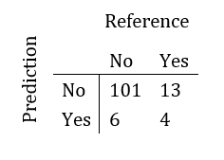
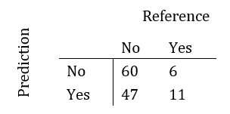
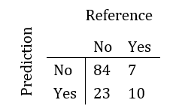
RESULTS CONT’D
Random Forest
KNN
XGBoost
Accuracy: 84.67%
Specificity: 23.53%
Sensitivity: 94.39%
Accuracy: 57.26%
Specificity: 64.71%
Sensitivity: 56.07%
Accuracy: 75.81%
Specificity: 58.82%
Sensitivity: 78.50%
Because of the class imbalance, this automatically makes the model more accurate just by guessing ‘No’ a majority of the time
This model is far less conservative with its allocation to “breakout” and inaccurately classifies 47 non-breakout receivers as “breakouts”
XGBoost model seems to be the most balanced, and if needed, this would be the model chosen to productionalize

Slide 8
Why Didn’t this work?
This is an extremely difficult problem to model
There are important metrics that are not always captured in the data, for example:
Some players may have amazing metrics because they were a star player at a smaller college with less competition and were part of a less competitive conference and vice versa
NFL is composed of players competing at the highest level, some athletes will adjust to this better than others
Some players with great statistics are drafted onto a team with little “opportunity”, meaning there is already a star player on the team and so can’t “breakout” because they play less
The research performed in this study is quite possibly the first of its kind. Being a pioneer in a research field can often be difficult as there are no examples or sources to look to or learn from, however, the research performed provides a good starting point for further research in the area and will open the doors for future researchers to investigate similar questions

Slide 9
Next Steps
In reviewing the results, it appeared that each model was finding different patterns within the data
This seems to suggest that an ensemble model may be able to provide a more accurate model above that of an individual algorithm
An attempt at building an ensemble model was made, however, because of compute power restraints and the length of time the model was taking to run, the attempt was abandoned
As a next step in this research, building an ensemble model using GPU’s or cloud computing power would be an area of focus.

Slide 10
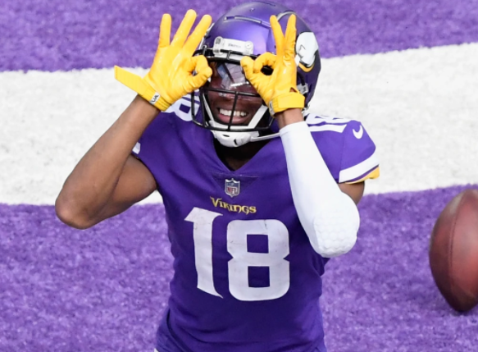
Thank You!
Christianthieme@u.boisestate.edu
Notes:
That concludes my presentation for my research capstone project. If you have any questions, please reach out to me at my personal email address shown on the slide above. Thank you!

