Slide 1
Movie data exploratory analysis
By: Christian Tsui

Slide 2
Background
Microsoft plans to create a movie studio and needs an effective business strategy to make decisions regarding what type of movies to create

Slide 3
Focus Points
Competitive Landscape
Successful Movie Genres
Aspects of Successful Movie Genres

Slide 4
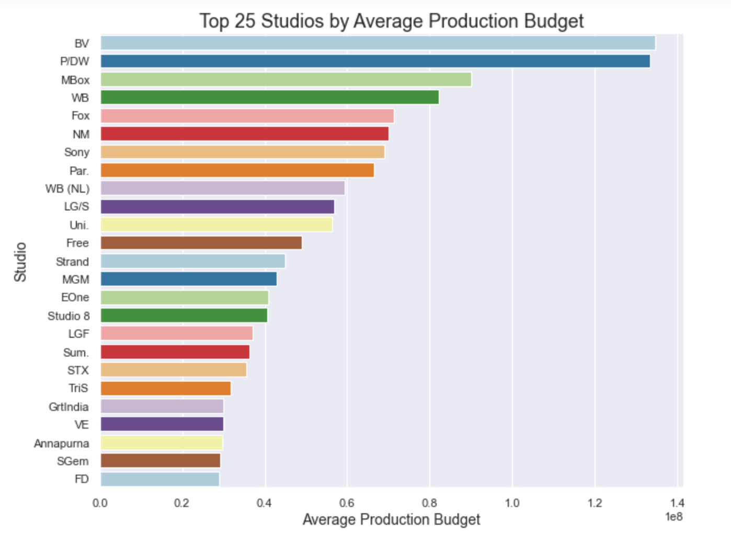
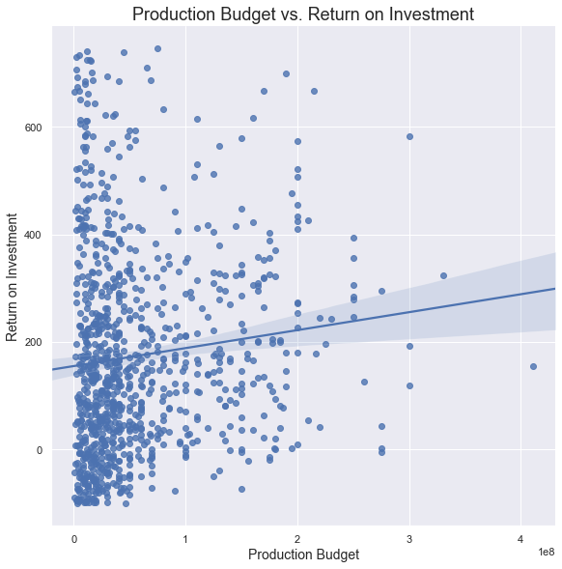
Studios & Production Budget of Successful Movies

Slide 5
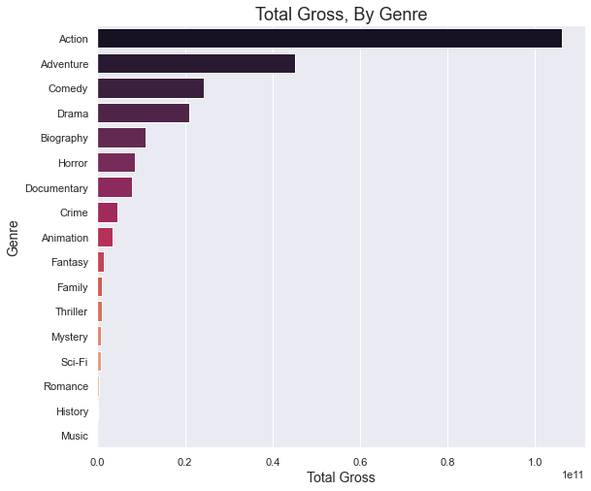
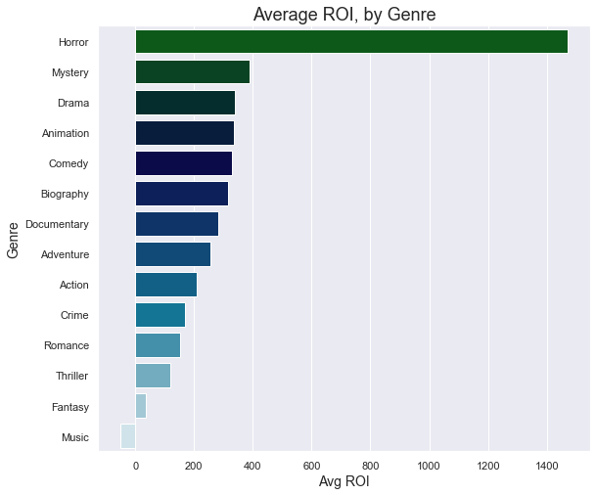
Which Movie Genres are Most Successful?

Slide 6
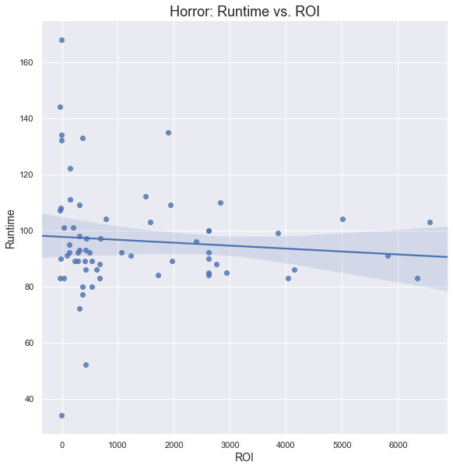
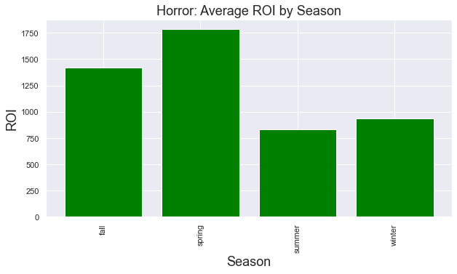
Attributes of Successful Movie Genres

Slide 7
Conclusion & Next Steps
Get an idea of the competitive landscape and production budget
Focus on movies with a higher ROI, as the initial entry into the movie production space
Produce Horror movies with historically successful metrics of runtime and seasonality

