Slide 1



Redefining Olympic Success
Machine Learning Final Project (CSCI 425)
The Environment
The Context
We set out to look beyond raw numbers and redefine athletic success through the lens of "Olympic Efficiency"—evaluating performance relative to economic and demographic constraints.
Traditional Olympic medal counts heavily favor wealthy and highly populated nations. Our team noticed this inherent bias in global rankings.

Slide 2


Data Challenges & Objectives
My Specific Challenge: Build the foundation for our analysis by acquiring and preparing a noise-free, unified dataset.
•
Data Acquisition: Source historical sports data and merge it with global economic metrics.
•
Handling Missing Data: Resolve historical gaps in global GDP records (1896-2024).
•
Feature Engineering: Create variables that models can actually learn from, controlling for extreme outliers.

Slide 3






The Engineering Pipeline
To solve the data challenge, I implemented a three-step preprocessing pipeline:
1. Merging
2. Cleaning
3. Normalization
Downloaded 120 years of Athlete Events from Kaggle and merged it with World Bank GDP/Population time-series data.
Handled missing historical values using regional back-filling to maintain temporal consistency across epochs.
Applied Log-Scale transformations to GDP/Population to handle outliers (USA, China) and built binary indicators for Host Nation Advantage.

Slide 4

A Unified, Normalized Dataset
Dataset Specs
Scope: 200+ Nations
As a result, we successfully engineered a robust foundation. By scaling disparate data types correctly, we removed the noise that would have otherwise confused our predictive models.
Timeline: 1896 - 2024
Missing Values: Reduced to 0%
Output Target: Total Medal Count

Slide 5

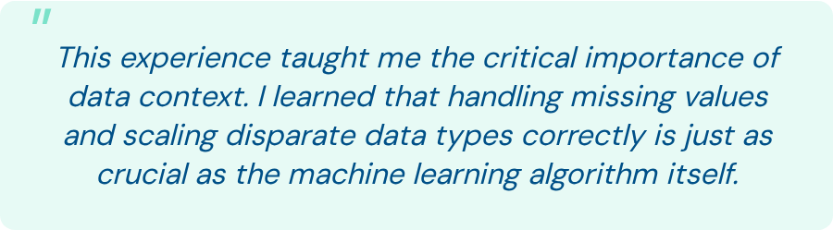
"

Slide 6
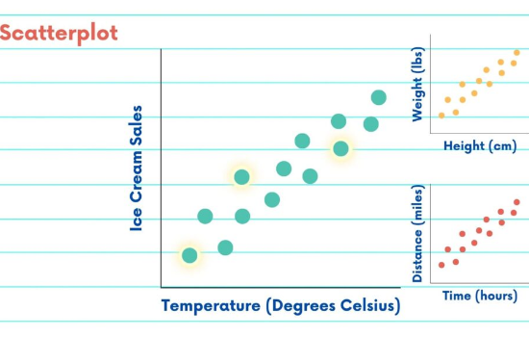
The Wealth-Success Correlation
With a clean dataset in place, we were in an environment where we could clearly see the strong baseline correlation between a nation's wealth and its athletic success.
Wealthier nations heavily skew the absolute medal counts, making it impossible to evaluate true athletic "efficiency" with traditional leaderboards.

Slide 7
Defining the Efficiency Metric
My Challenge: Design, train, and evaluate an ML pipeline to predict expected medals based on resources. Then, isolate the outliers to calculate our custom Efficiency Score.

Slide 8
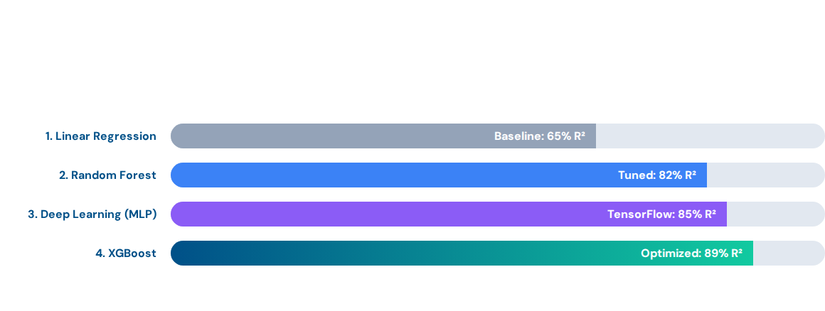
Model Selection & Exploration
I started with a baseline model and progressed to advanced techniques, including Deep Learning, to capture hidden patterns in cultural sports specialization.

Slide 9
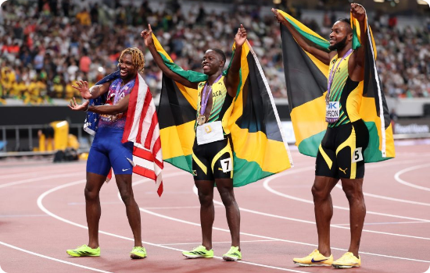
The New Olympic Leaderboard
The measurable outcome: Using our XGBoost predictions, we isolated countries that vastly over-perform relative to their resources.
Jamaica: The most efficient nation globally (Track & Field specialization).
Kenya: Massive outperformance in Long-Distance running.
USA/China: High absolute medals, but average efficiency when adjusted for GDP.

Slide 10
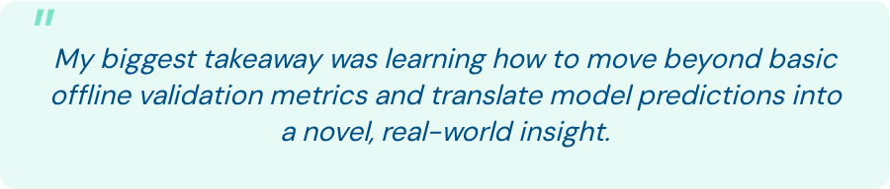
"
Thank You!
Opening the floor for 2-minute Q&A

Slide 11



Image Sources
https://www.visualcapitalist.com/wp-content/uploads/2025/12/Top50EconomiesNC.webp
Source: www.visualcapitalist.com
https://nebigdatahub.org/wp-content/uploads/2023/11/6-Scatterplots-2-1024x576.jpg
Source: nebigdatahub.org
https://www.panamsports.org/wp-content/uploads/2025/09/GettyImages-2235368725-scaled-e1757862130843.jpg
Source: www.panamsports.org

