Slide 1


Whitefish Resort Data Report 2020

Slide 2
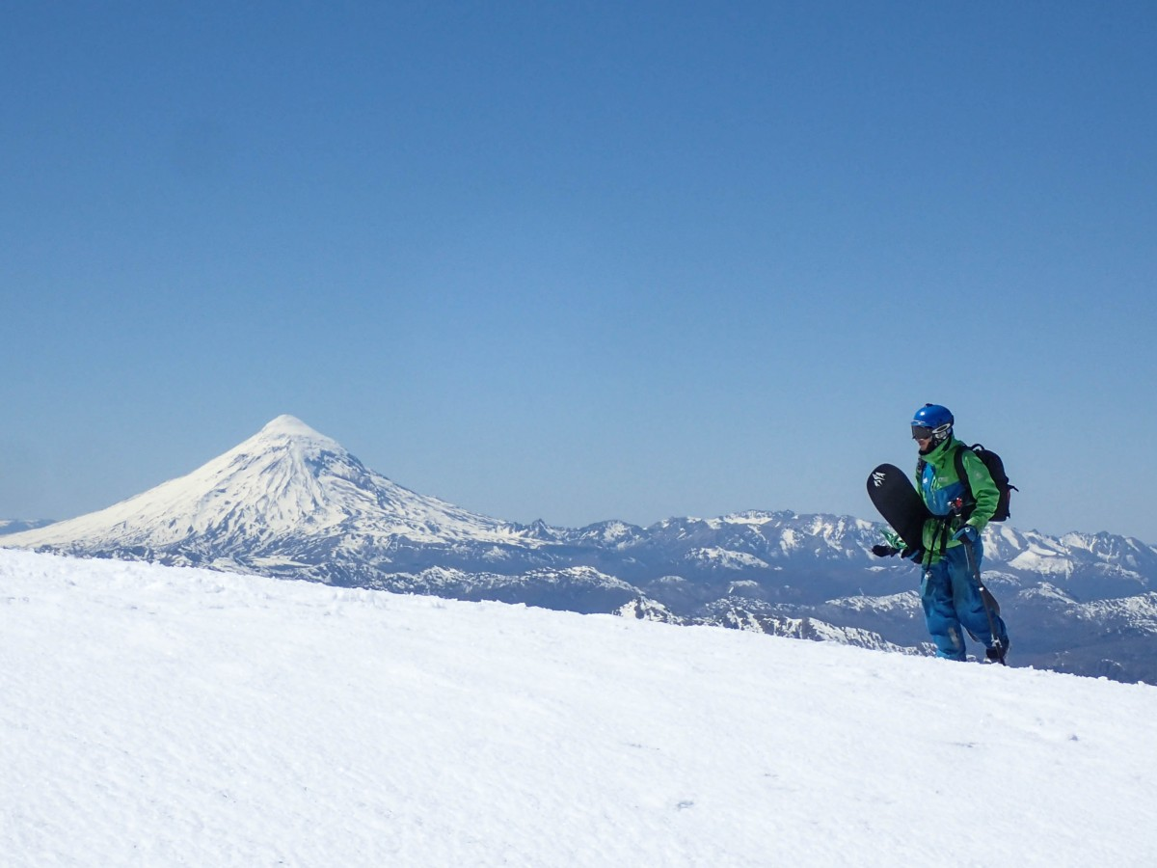
Problem Identification
What opportunities exist for Whitefish Resort to offset the increased operating cost this season due to the new chair lift system?

Slide 3
$1,540,000
350,000
9.8 %
Key Numbers
Cost of New Chair Lift System
Average Visitors per Season
Maintain Current Profit Margin

Slide 4
Recommendation
Market Data supported by Data Modeling
Increase Adult Weekend/Weekday Price
$81 to $90 (11.25% change)
Top End Market Price
Market data from over 300 US ski resorts.

Slide 5
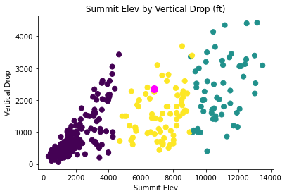
Elevation Ranking
Looking at how Whitefish Resort compares to other resorts in terms of vertical drop and summit elevation, we are considered above average. (magenta dot)

Slide 6
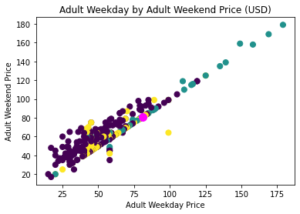
Price Ranking
In terms of pricing, Whitefish Resort is right on par with the adult weekday and adult weekend price correlation. Whitefish is considered higher than most other resorts @ $81 for an Adult weekend price.

Slide 7
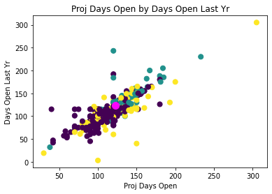
Days Open Ranking
Whitefish is showing a projected days open consistent with last year’s days open. We can plan on a similar season from last year for upcoming revenue calculations.

Slide 8
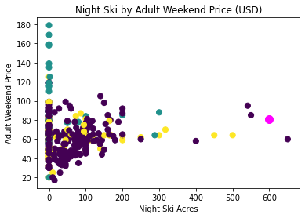
Days Open Ranking
It has been observed that Whitefish ranks as one of the top night ski resorts in the country in terms of available acres. Comparing that feature to the adult weekend price, this would help justify an increased price.

Slide 9
$1,575,000
Conclusion
Additional revenue
175k Adult Visitors (50% of total visitors)
$9 Increase per Adult Weekend/Weekday Ticket
123 Days Open (season average)

