Slide 2
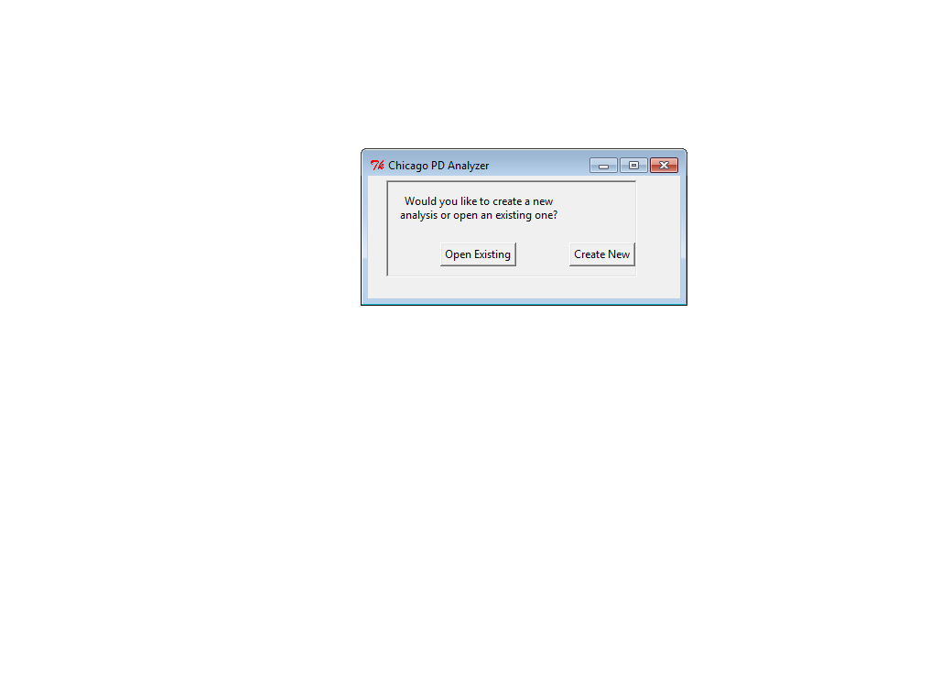

Slide 3
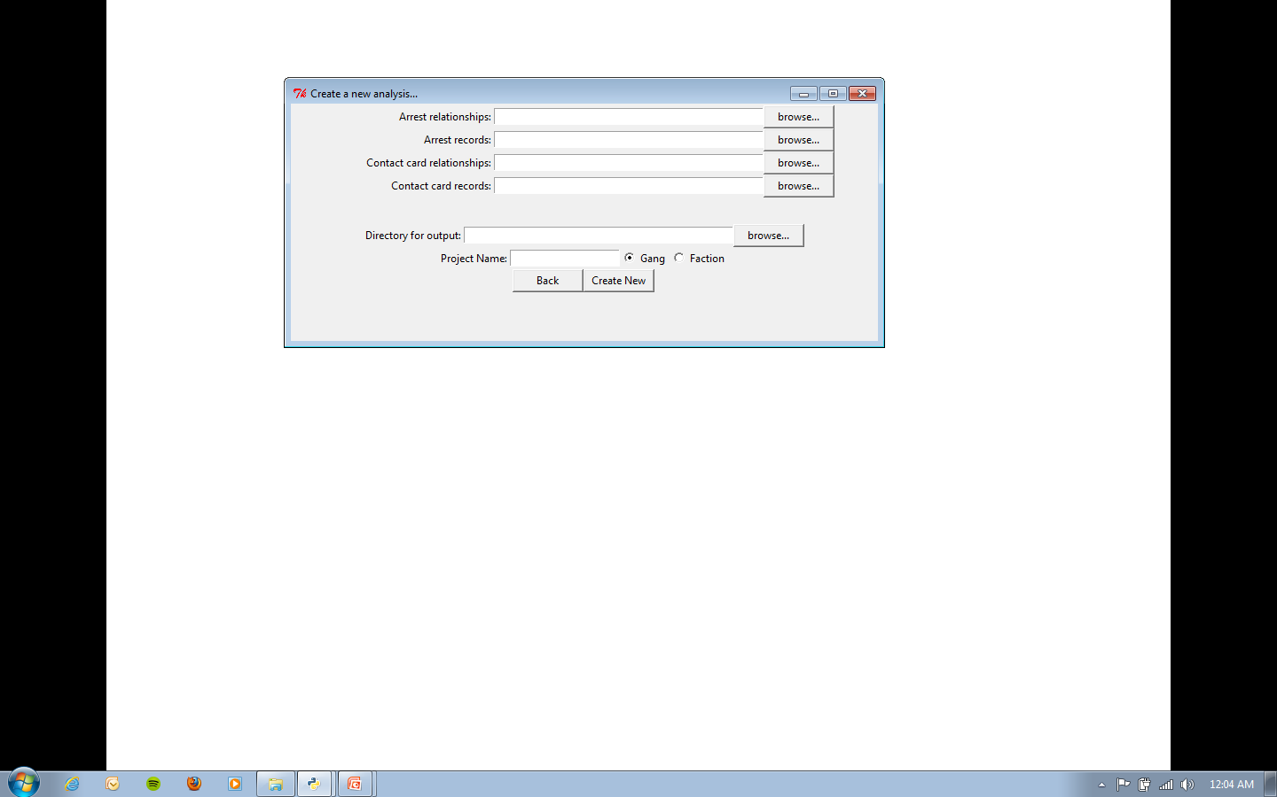
Create New Analysis
The program analyzes connections between arrests and (optionally) contact cards.

Slide 4
Click “browse…” or type in the path to the arrest records.

Slide 5
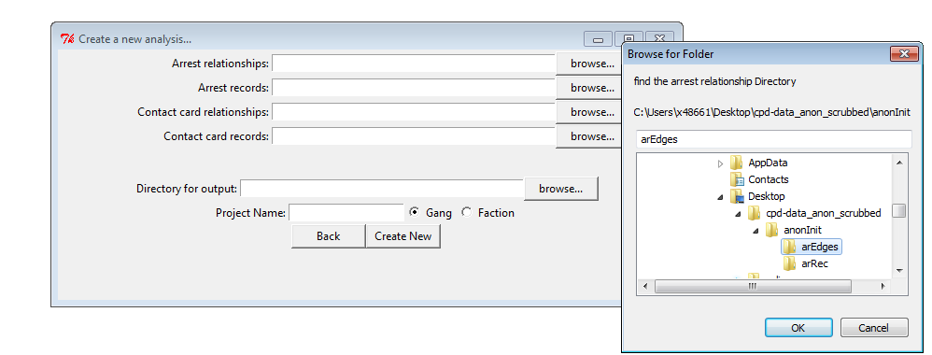
Click ok and repeat for Arrest records

Slide 6
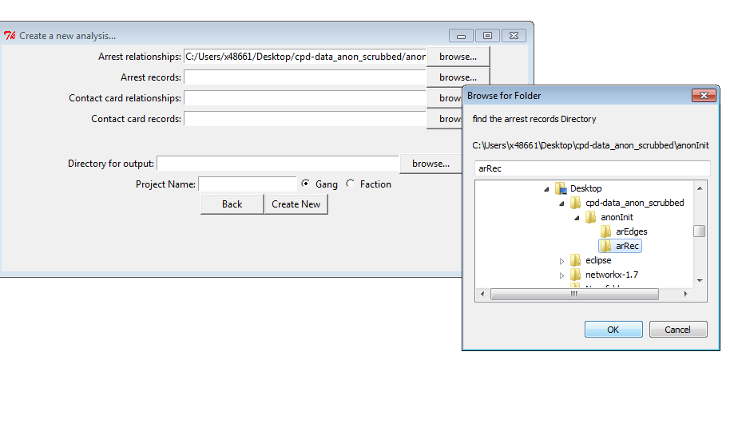
Click Ok

Slide 7
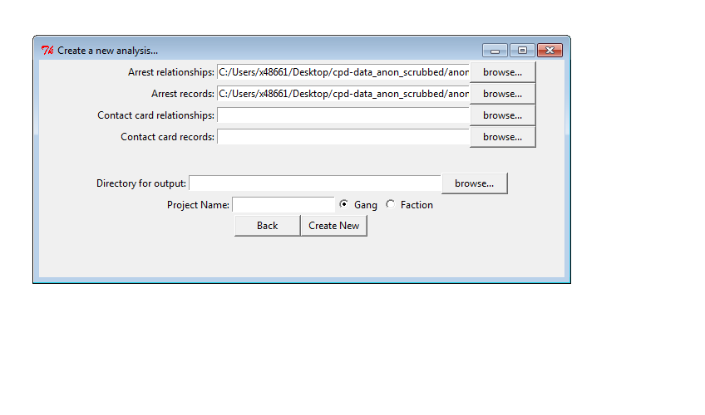
Contact Cards can be left blank or filled in like previous slides

Slide 8
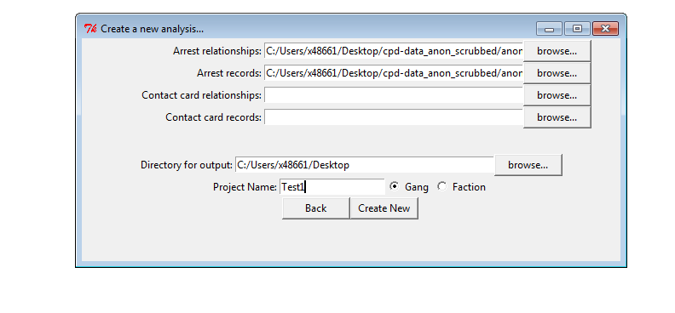
-Select an output directory and name your analysis (a good name might be date eg “03JUL13analysis”).
-Select whether you would like to analyze the records as gangs or factions (negligible difference currently)
-Click create New

Slide 9
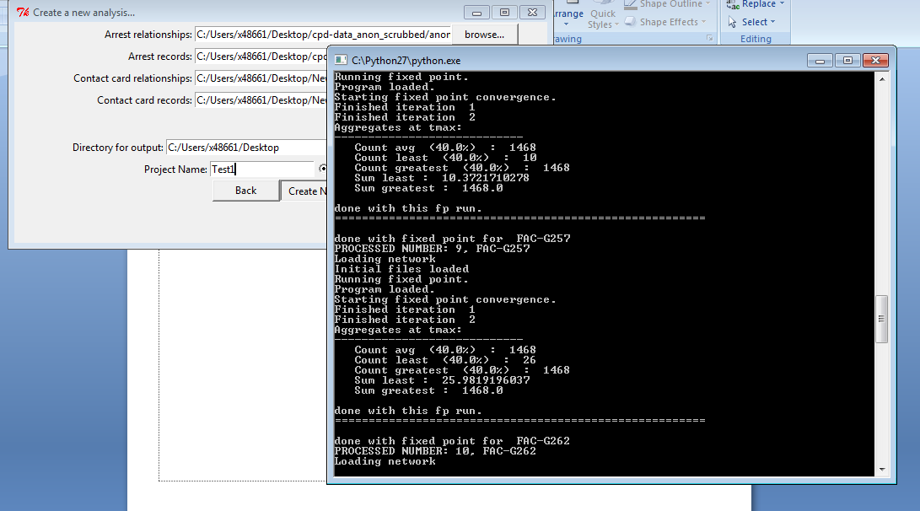
Let it run… (<2 minutes) You should see something like this scrolling quickly

Slide 10
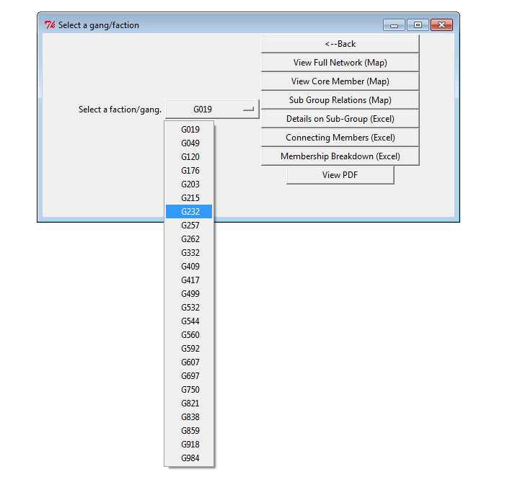
When done, it will bring you to…

Slide 11
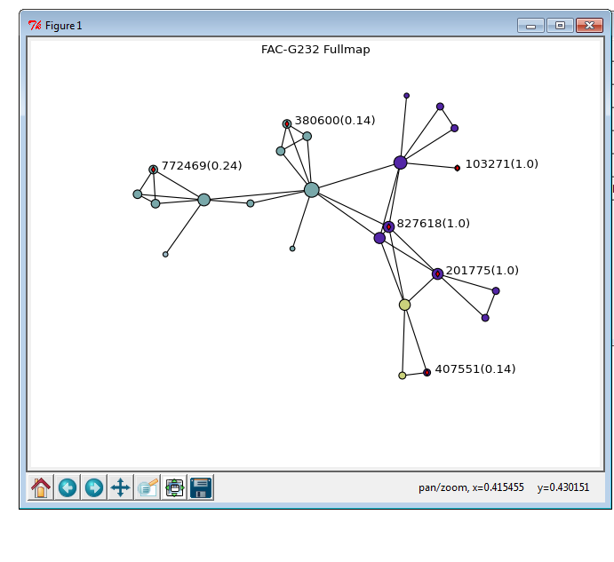
“View Full Network” (1st Button)

Slide 12
Viewing the plots
The circles represent people and the lines represent an arrest together between people
Larger circles = more arrest relationships
Color coded by subgang as determined by analysis
Circles can be clicked for IR number and probability of membership in gang(ie .62 = 62%)
The visual can be zoomed or moved to view certain aspects
A user can zoom to a specific part, select a few nodes, and save modified visual like a normal picture
The core member plot is a similar visual with only the core members, as determined by the analysis

Slide 13
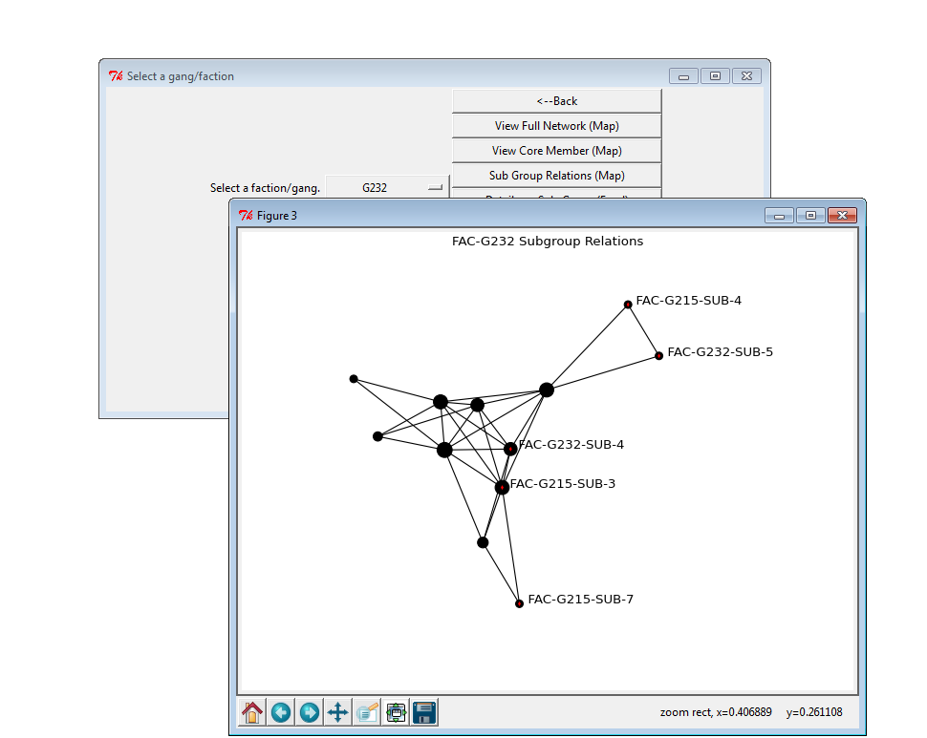
View Subgroup Relations (3rd Button)
Each circle is a sub-gang, not an individual, to show interactions between sub-gangs

Slide 14
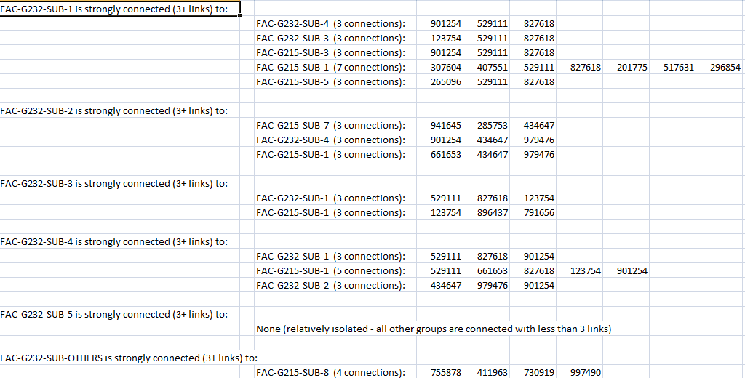
DETAILS ON SUB-GROUP (EXCEL)
Will Open up Excel to show connections between subgroups

Slide 15
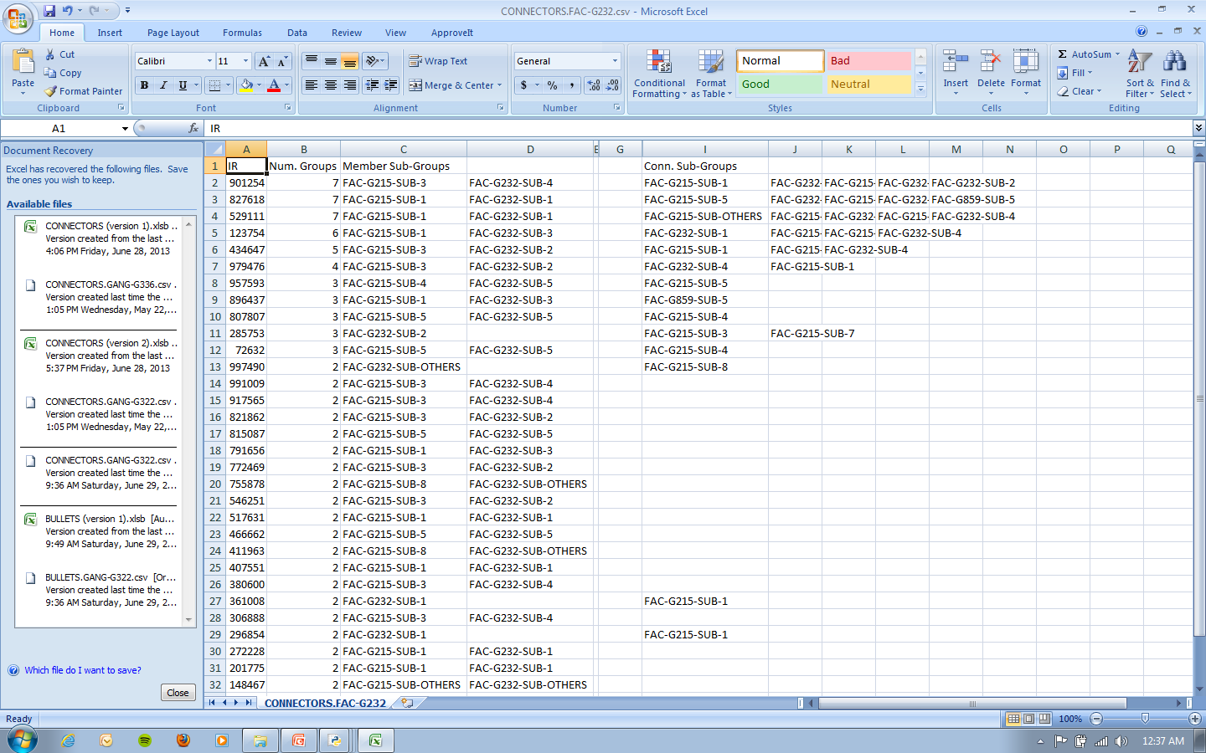
Connecting Members(Excel)
By IR Number, what subgroups a person is a member of, and which ones they connect to

Slide 16
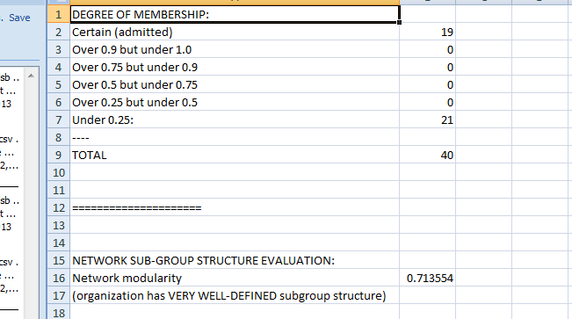
Membership Breakdown(Excel)
Breaks down numbers by probability of membership where 1.0 is self-admitted. Probabilities are determined by arrest relationships

Slide 17
View PDF
If first time button is clicked, will generate a .pdf that summarizes the information (takes about 5 minutes)
Any other time button is clicked will simply open the .pdf

Slide 18
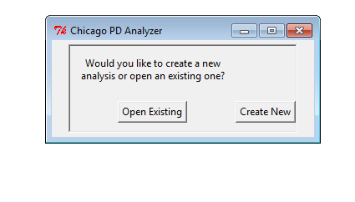
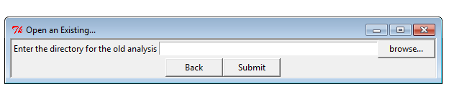
To open an existing analysis…
Click Browse…

Slide 19
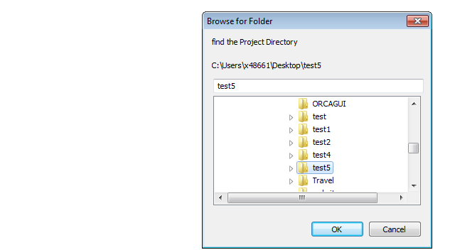
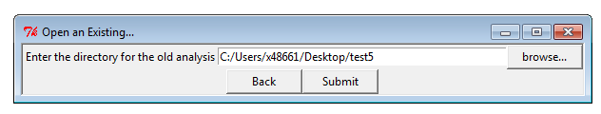
Select the name of the analysis (eg “test5”) and click ok
Click Submit

Slide 20
You’ll be brought back to this menu…

