Slide 1

myTaxiService
AA. 2015-2016 Software Engineering 2 Project - RASD
Requirement Analysis and Specification Document
CHRISTIAN ZICHICHI (840565)
LUIGI MARROCCO (854884)
(48 hours of Work)
Prof. Raffaela Mirandola
POLITECNICO DI MILANO

Slide 2

PROBLEM DESCRIPTION AND GOALS
BIG_CITY TAXI SERVICE - SYSTEM FUNCTIONALITIES:
Fair management of the queues of AVAILABLE taxis:
- ZONES ⬄ QUEUES
- AVAILABILITY UPDATES AND CALL CONFIRMATIONS
- RIDE REJECTION => TAXI MOVED TO LAST POSITION
Create and manage taxi ride requests
- WEB/MOBILE APPLICATION
- TAXI SEARCH
Create and manage taxi ride reservation
- FORM FILLING
- TAXI SEARCH 10 MINUTES BEFORE THE RIDE
Scalability to additional services
- APPLICATION PROGRAMMING INTERFACES (APIs)
AA. 2015-2016 Software Engineering 2 Project - RASD
POLITECNICO DI MILANO

Slide 3
MAIN ASSUMPTIONS
Taxi drivers are enough and pre-registered by the Government
Each Taxi is identified by a unique code and it has Android Auto OS embedded
Big_City is divided in fixed dimension zones
Taxi available ⬄ Taxi does not move from/to a zone
GPS information are always correct
Honesty of Passengers (no malicious users)
The maximum waiting time for each ride is 10 minutes
Origin and destination of rides are always within Big_City
The maximum number of people for a ride is 4
AA. 2015-2016 Software Engineering 2 Project - RASD
POLITECNICO DI MILANO

Slide 4
PROPOSED SYSTEM AND ACTORS
The System is composed of these parts, managed by a back-end centralized server application:
Mobile application (for Users): Android, iOS, hybrid development
Web application (for Users): Front-end similar to the User Interface of Mobile application
Mobile application (for Taxi Drivers): designed for Android Auto
The Actors of the System are:
Guest: not registered, signs up filling a form
User: registered with email and password, has access to the service
Taxi Driver: employed and pre-registered into the service by the government
AA. 2015-2016 Software Engineering 2 Project - RASD
POLITECNICO DI MILANO

Slide 5
FUNCTIONAL REQUIREMENTS
GUEST:
- Sign up in the web application or mobile application by filling up a form with username and password
USER:
- Log in into the web application or mobile application with username and password
- Create a ride request
- Create a ride reservation
- Check the list of booked taxis
- Cancel a ride reservation
TAXI DRIVER:
- Confirm a ride(reservation or request)
- Reject a ride(reservation or request)
- Update their availability
SYSTEM:
- Propose a ride to a taxi
- Confirm request or reservation to the user with related information
- Insert, remove or move a taxi from a queue
- Update availability of taxis
AA. 2015-2016 Software Engineering 2 Project - RASD
POLITECNICO DI MILANO

Slide 6
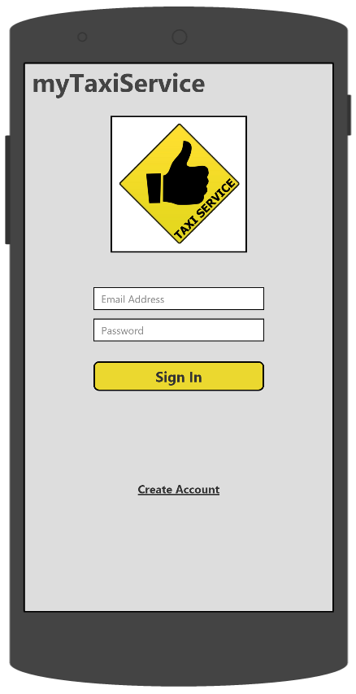
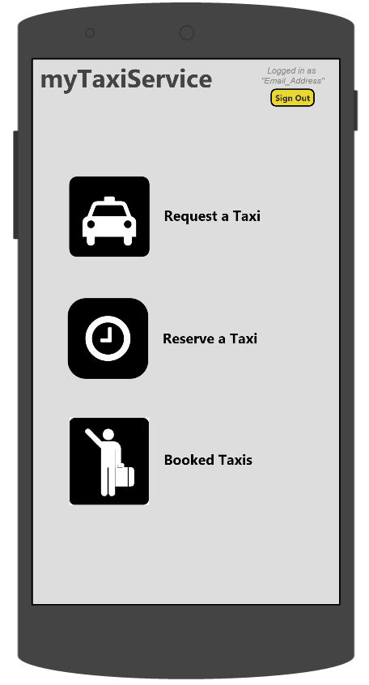
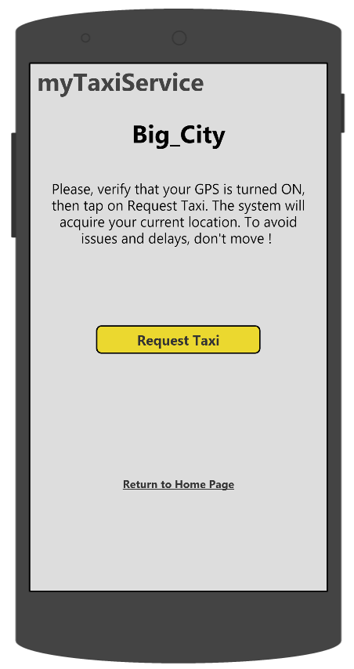
NON FUNCTIONAL REQUIREMENTS (1)
USER MOBILE APPLICATION INTERFACES:
AA. 2015-2016 Software Engineering 2 Project - RASD
POLITECNICO DI MILANO

Slide 7
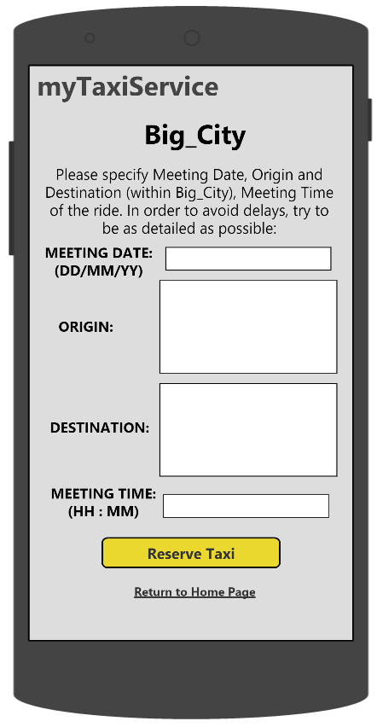
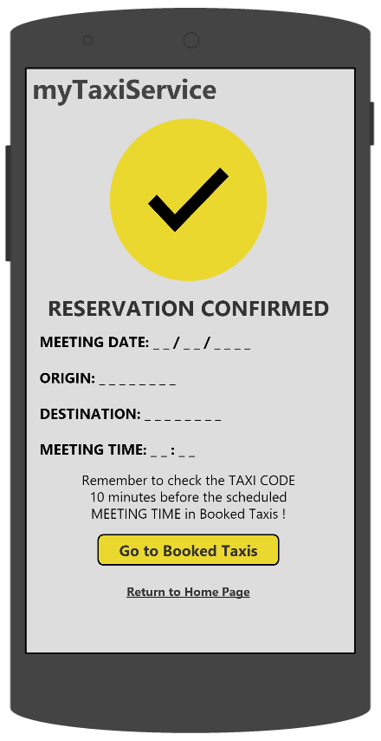
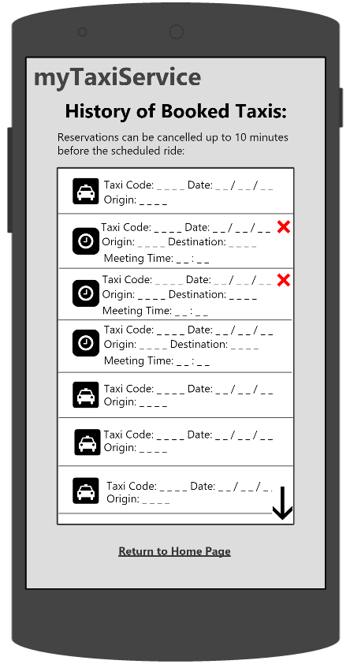
NON FUNCTIONAL REQUIREMENTS (2)
AA. 2015-2016 Software Engineering 2 Project - RASD
POLITECNICO DI MILANO

Slide 8
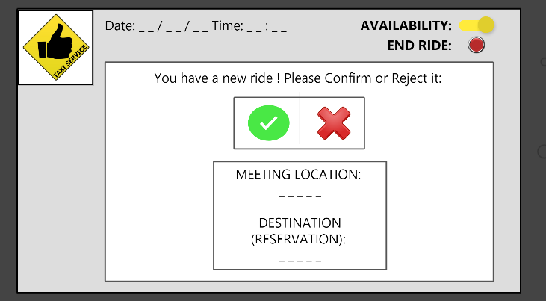
NON FUNCTIONAL REQUIREMENTS (3)
SOFTWARE SYSTEM ATTRIBUTES:
AVAILABILITY: system online 24/7
SECURITY: SSL encryption. Password hashing and salting
RELIABILITY: 99.99 %. 52.56 minutes of downtime per year
......
AA. 2015-2016 Software Engineering 2 Project - RASD
POLITECNICO DI MILANO

Slide 9
SPECIFICATIONS (1)
REGISTRATION OF A GUEST:
- Email address used only once
USER LOGIN:
- Correct information must be inserted
TAXI DRIVER LOGIN:
- Correct information must be inserted
MANAGEMENT OF TAXI QUEUES:
- A FIFO queue for each zone
- Taxi available ⬄ taxi inserted in the queue
- Taxi not available ⬄ taxi removed from the queue
- Ride rejection => taxi moved to the last position of the queue
TAXI RIDE REQUEST:
- Web application => meeting location is required (form)
- Mobile application => meeting location provided by in-built GPS
- No taxi found for a ride in a zone => searching in the nearest zone’s queue
- Taxi code and waiting time assignment
- A request is active => no other requests can be made
AA. 2015-2016 Software Engineering 2 Project - RASD
POLITECNICO DI MILANO

Slide 10
SPECIFICATIONS (2)
TAXI RIDE RESERVATION:
- Form filling (Origin, Destination, Meeting Date and Time)
- Confirmed only if Meeting time is at least 2 hours before
- 10 minutes before the Meeting Time, Reservation = Request
- Up to 10 minutes before the Meeting Time, Cancellation is permitted
CONFIRMATION/REJECTION OF A RIDE:
- Taxi drivers have 10 seconds to answer
- At the end of a ride, End Ride button pressed
UPDATE TAXI DRIVER AVAILABILITY:
- Confirmation of a ride => Availability OFF
LIST OF BOOKED TAXIS:
- History of concluded/pending requests/reservations
SCALABILITY TO ADDITIONAL SERVICES:
- APIs to add functions (i.e., fake requests tracking, taxi sharing service)
AA. 2015-2016 Software Engineering 2 Project - RASD
POLITECNICO DI MILANO

Slide 11
SCENARIO (1)
MIKE’S HAPPY HOUR:
Mike went to a happy hour with his friends and now he wants to go back home. He takes his LG Nexus 5X, opens the application “myTaxiService”, that he has already used many times, and signs in into the system. He selects “Request a Taxi” and the system acquires his location through the in-built GPS. Then, when he confirms, the system informs him that it is searching for an available Taxi. Chester, that has just begun his shift and switched his availability on, sees on the display of its Android Auto device that there is a ride request ready for him. Chester accepts the ride and goes taking the passenger. Mike sees a confirmation page with the taxi code and a waiting time of 8 minutes. After a couple of minutes, Mike forgets the taxi code and goes to the “Booked Taxis” section of the application to see it. Chester takes Mike in and asks him the desired destination. Mike arrives in front of his house, pays Chester and gets off the car. Right after, Chester decides to remain in the same zone and switches on again his availability, waiting for the system to assign him another ride
AA. 2015-2016 Software Engineering 2 Project - RASD
POLITECNICO DI MILANO

Slide 12
SCENARIO (2)
AURORA’S HOLIDAY:
Aurora is on holiday in Big_City and she has planned to go back home the DD/MM at HH:MM by train. The day before that date, she decides to make a taxi reservation since she will need a lift to the station. Therefore, she takes her laptop, opens the browser and goes to “www.mytaxyservice.com” website, and reserves a taxi for the following day. She immediately visualizes the confirmation page with all the specified details. Unfortunately, half an hour before the meeting time, Aurora is informed that the train will arrive with a delay of two hours. Consequently, she decides to cancel the taxi reservation from the “Booked Taxis” section of the mobile application installed in her Samsung Galaxy S6, since she has already switched off the laptop. An hour after, she decides to make a taxi request and go to the station in advance, waiting for the train on the platform. Since it is the rush hour, a taxi with a waiting time of 10 minutes has been assigned to her. In the end, she managed to arrive at the station and after a while, the train arrived.
AA. 2015-2016 Software Engineering 2 Project - RASD
POLITECNICO DI MILANO

Slide 13
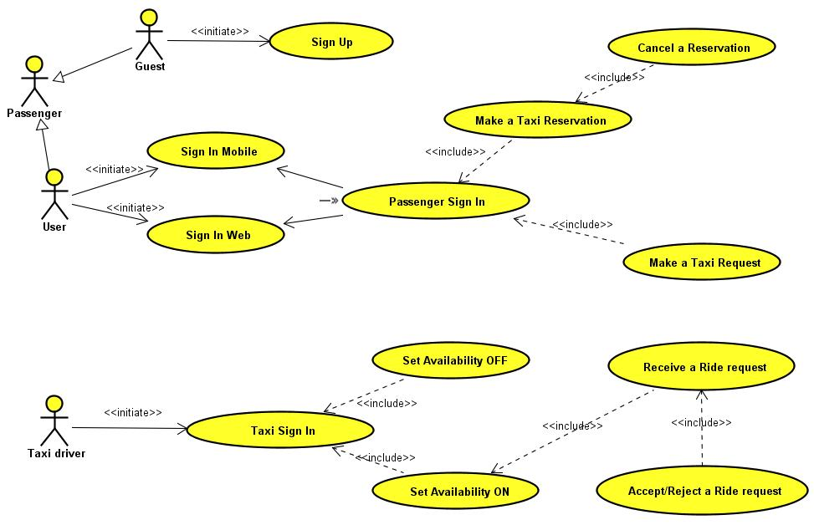
USE CASE DIAGRAM
AA. 2015-2016 Software Engineering 2 Project - RASD
POLITECNICO DI MILANO

Slide 14
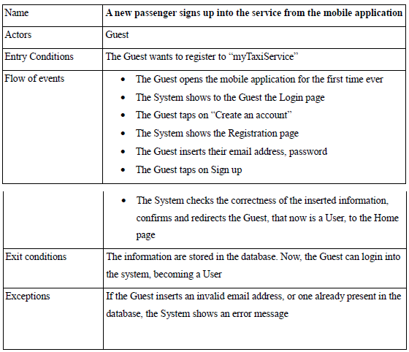
USE CASE DESCRIPTION (1)
AA. 2015-2016 Software Engineering 2 Project - RASD
POLITECNICO DI MILANO

Slide 15
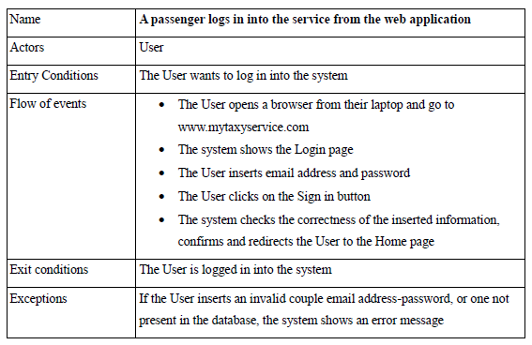
USE CASE DESCRIPTION (2)
AA. 2015-2016 Software Engineering 2 Project - RASD
POLITECNICO DI MILANO

Slide 16
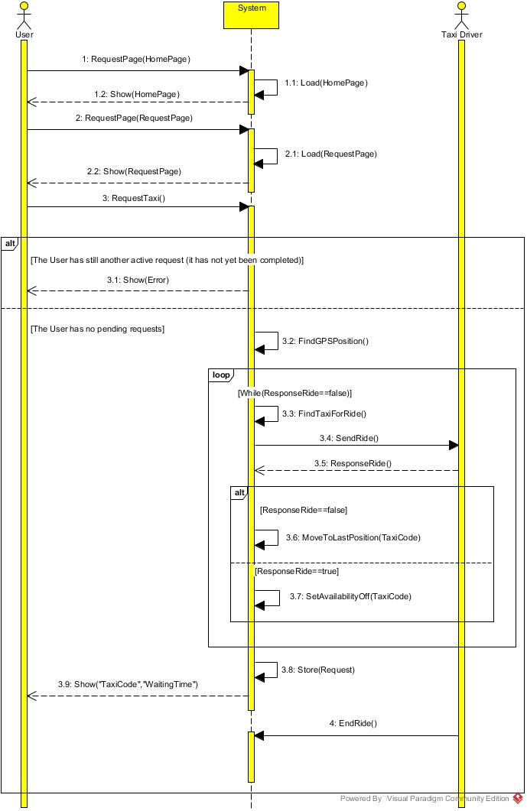
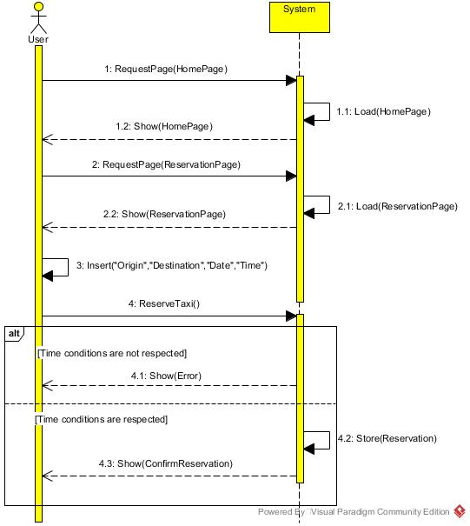
SEQUENCE DIAGRAMS (1)
USER MAKES A RIDE REQUEST AND A TAXI RECEIVES A RIDE:
USER MAKES A TAXI RIDE RESERVATION:
AA. 2015-2016 Software Engineering 2 Project - RASD
POLITECNICO DI MILANO

Slide 17
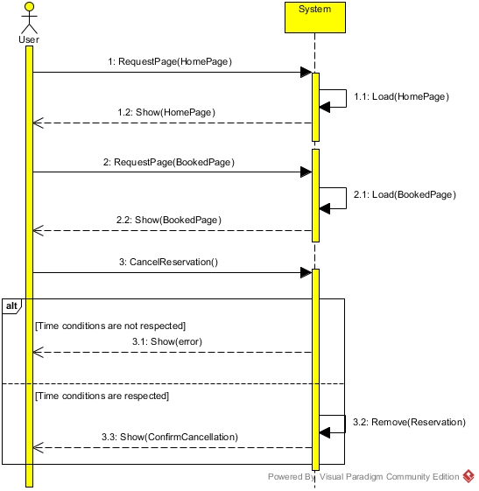
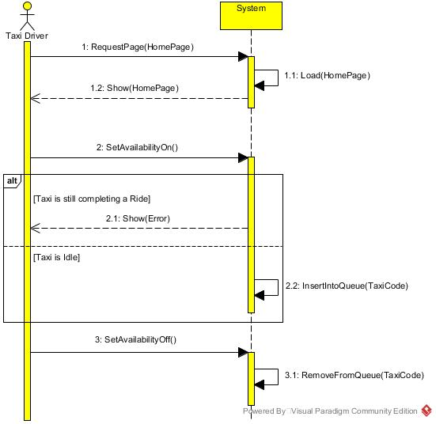
SEQUENCE DIAGRAMS (2)
TAXI DRIVER UPDATES THEIR AVAILABILITY (ON-OFF):
USER VIEWS LIST OF BOOKED TAXIS AND CANCEL A RESERVATION:
AA. 2015-2016 Software Engineering 2 Project - RASD
POLITECNICO DI MILANO

Slide 18
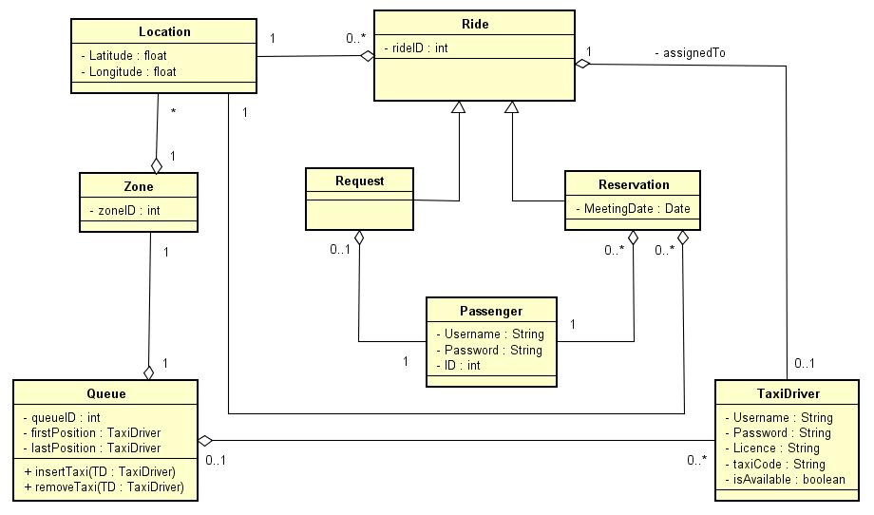
CLASS DIAGRAM
AA. 2015-2016 Software Engineering 2 Project - RASD
POLITECNICO DI MILANO

Slide 19
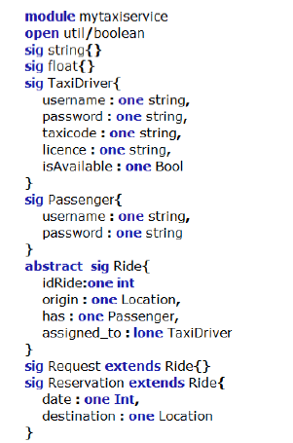
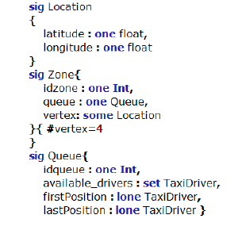
ALLOY (1)
AA. 2015-2016 Software Engineering 2 Project - RASD
POLITECNICO DI MILANO

Slide 20
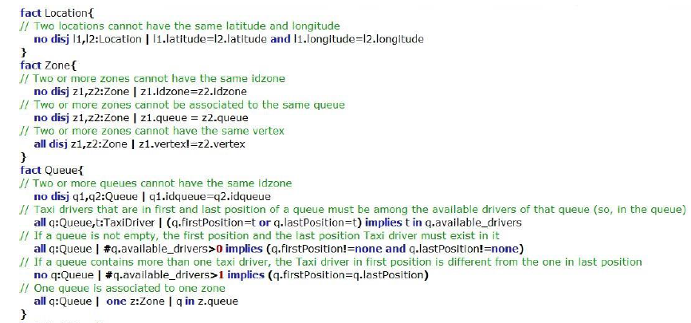
ALLOY (2)
AA. 2015-2016 Software Engineering 2 Project - RASD
POLITECNICO DI MILANO

Slide 21
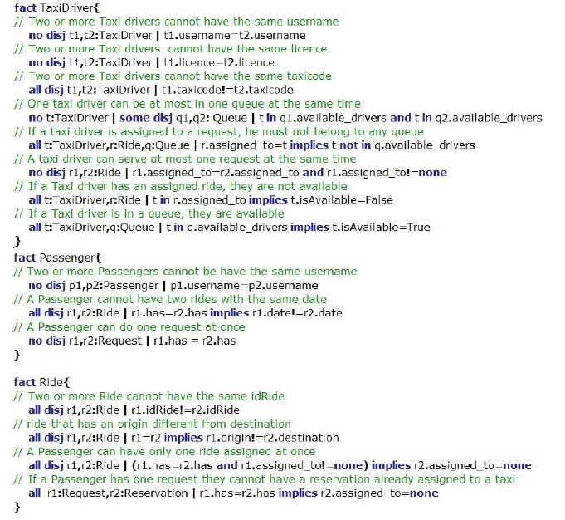
ALLOY (3)
AA. 2015-2016 Software Engineering 2 Project - RASD
POLITECNICO DI MILANO

Slide 22
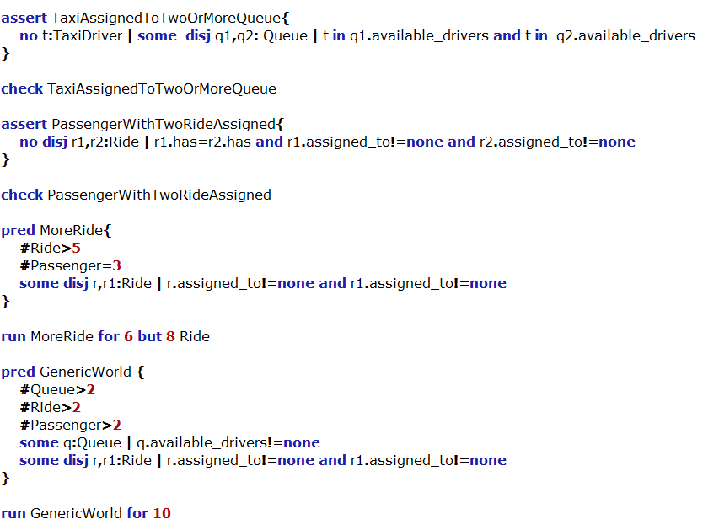
ALLOY (4)
AA. 2015-2016 Software Engineering 2 Project - RASD
POLITECNICO DI MILANO

Slide 23
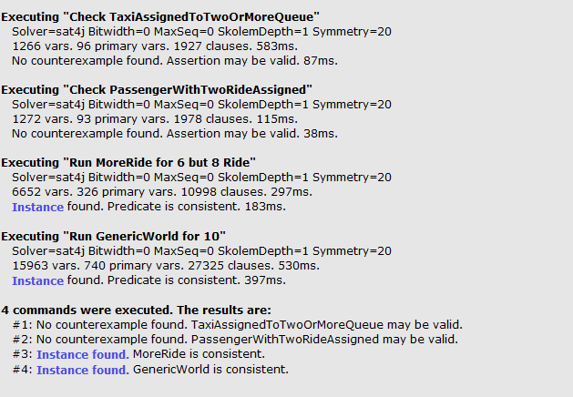
ALLOY (5)
AA. 2015-2016 Software Engineering 2 Project - RASD
POLITECNICO DI MILANO

Slide 24
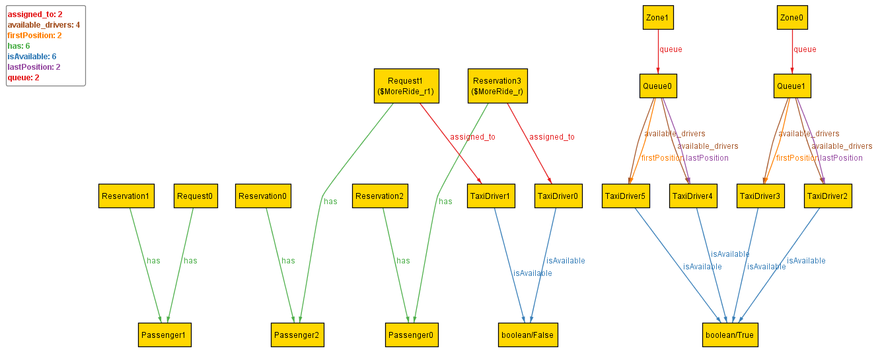
ALLOY (6)
AA. 2015-2016 Software Engineering 2 Project - RASD
POLITECNICO DI MILANO

Slide 25
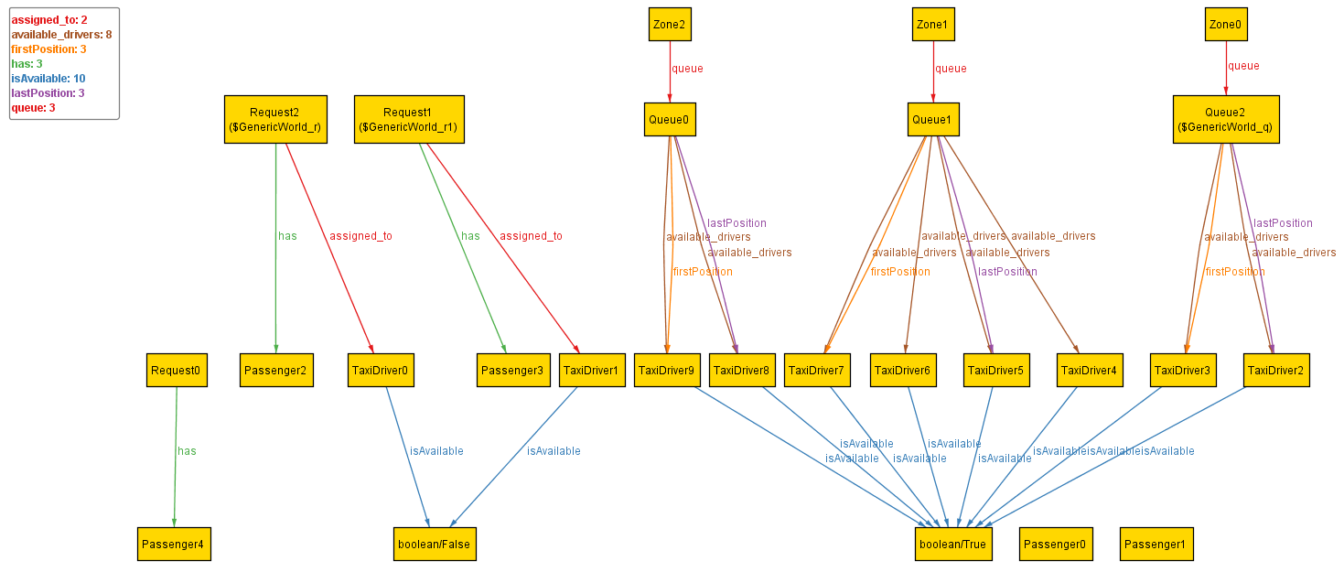
ALLOY (7)
AA. 2015-2016 Software Engineering 2 Project - RASD
POLITECNICO DI MILANO

