Slide 1
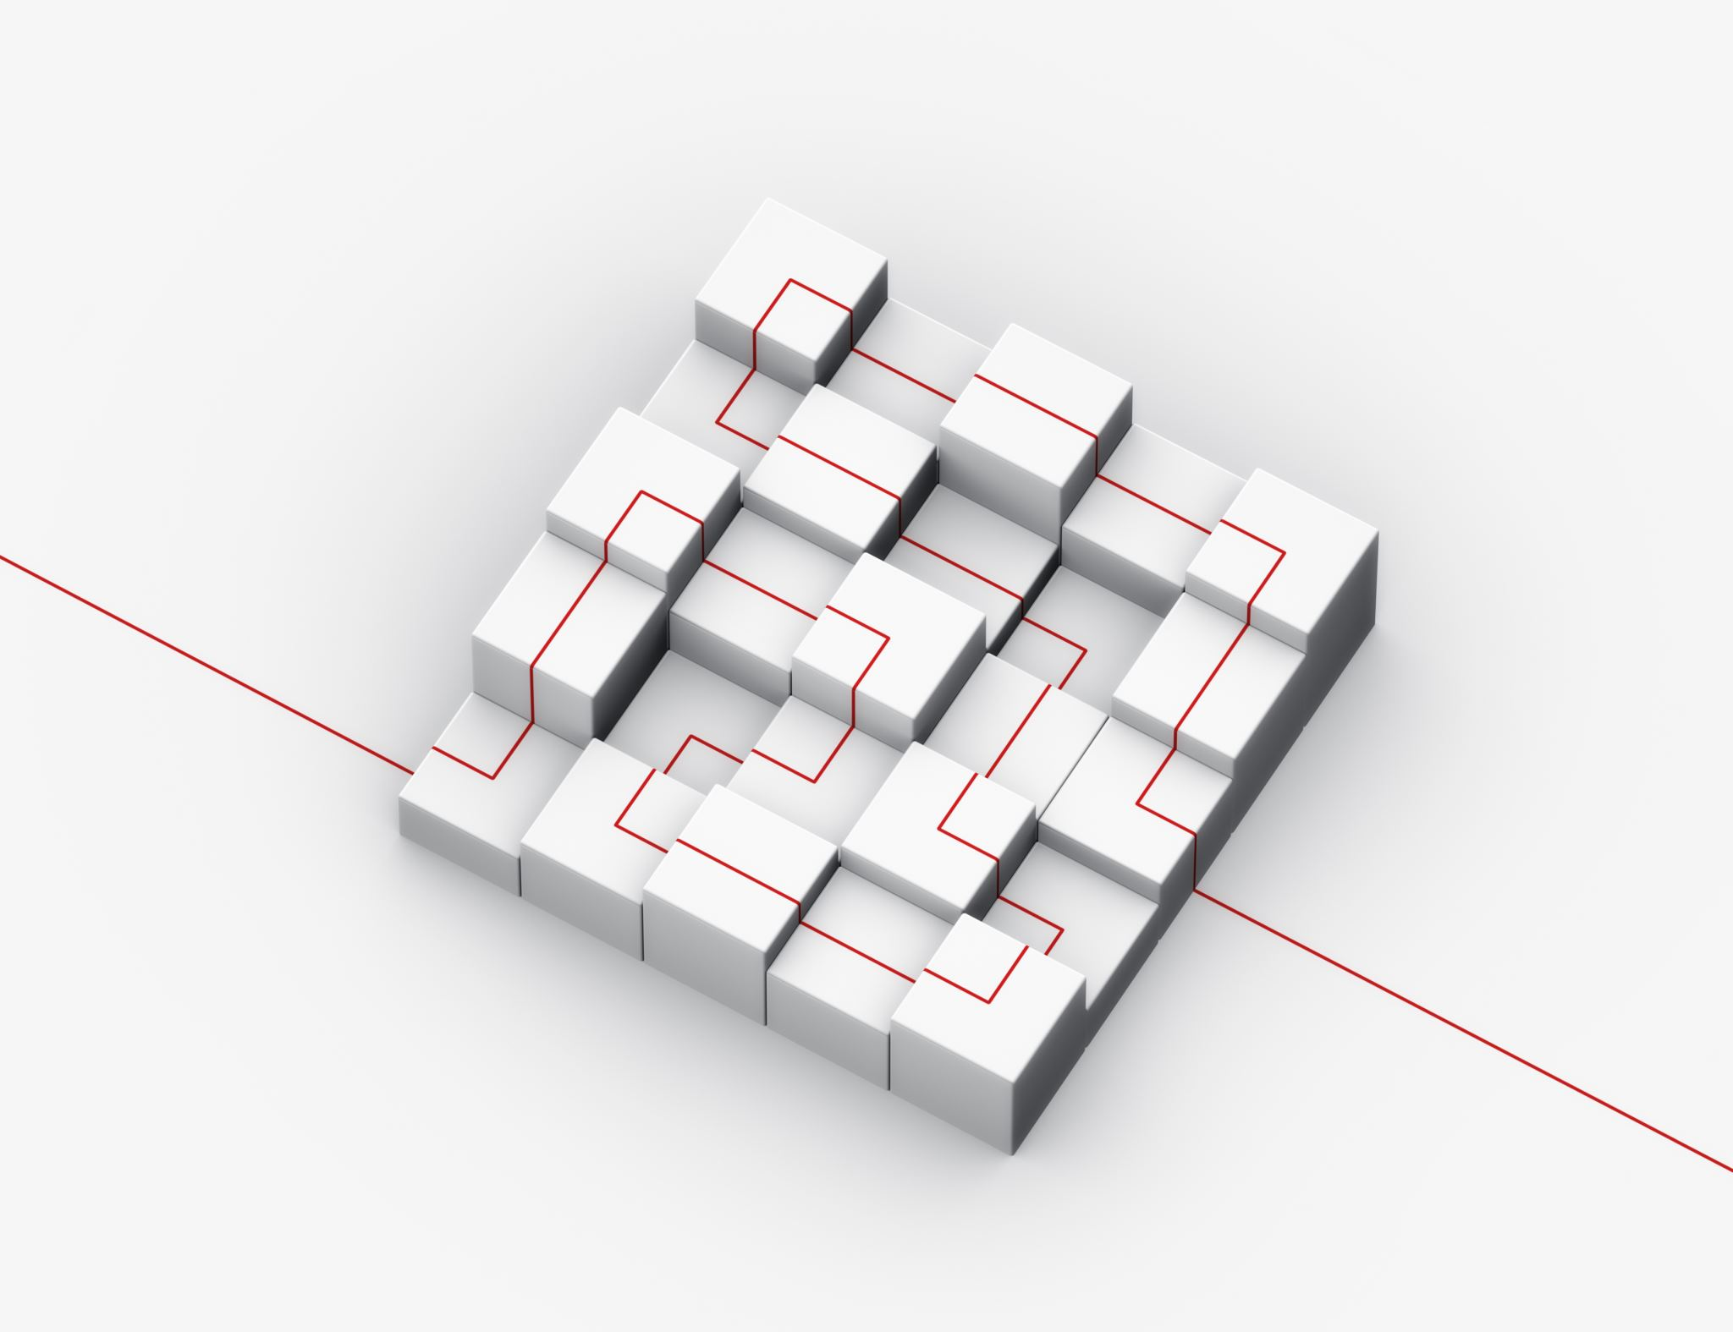
Foundations of DCM in R
Christie Barron

Slide 2
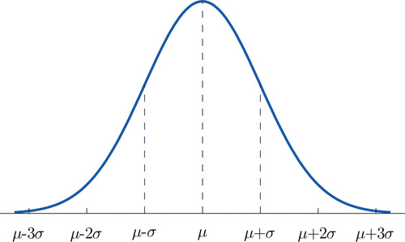

Tennis Ability with a continuous latent variable
Christie
Liam
Eunice
Serena Williams

Slide 3
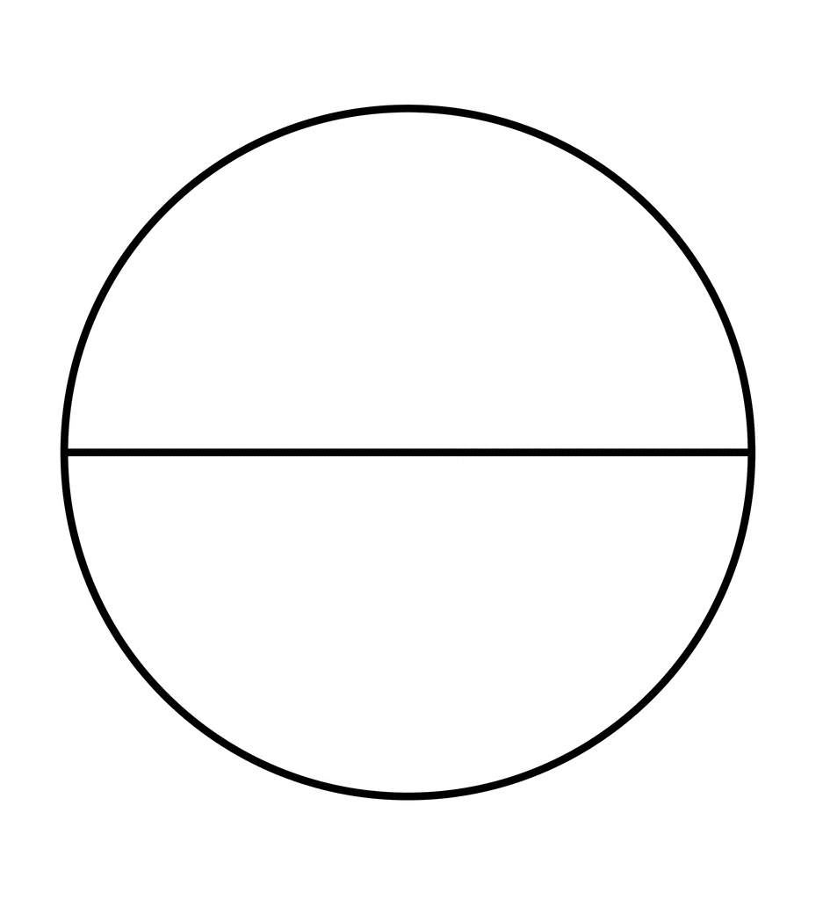
Categorical (Fine-Grained) Tennis Skills
Technique
Endurance
Agility
Strategy
Proficiency
Proficiency
Proficiency
Proficiency
Non-Proficiency
Non-Proficiency
Non-Proficiency
Non-Proficiency

Slide 4
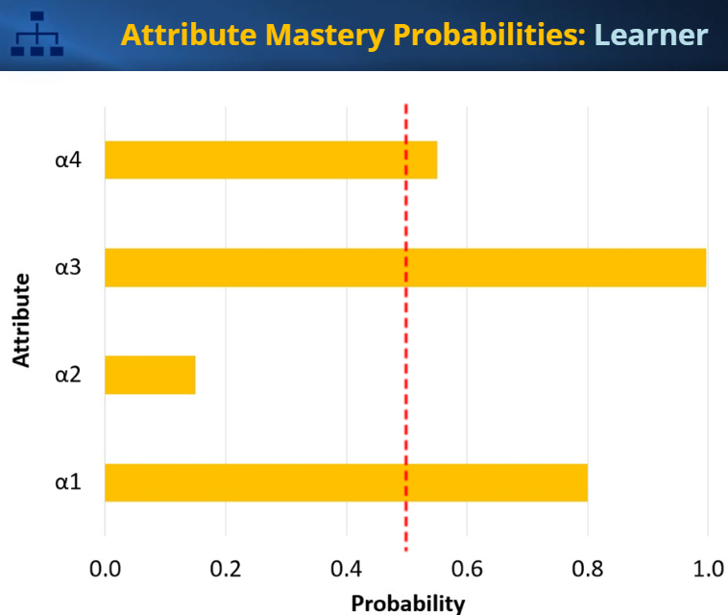
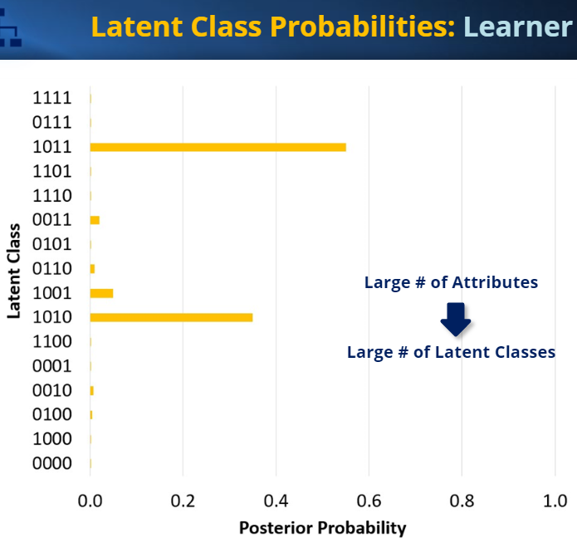
Individual-Level Person Statistic (reprinted)

Slide 5
G-DINA Model
Dina
Dino
A-CDM
LLM/C-RUM
R-RUM
Deterministic Inputs Noisy “and” Gate
Deterministic Inputs Noisy “or” Gate
Additive Cognitive Diagnostic Model
Linear Logistic Model / Compensatory
Reparameterized Unified Model
Reduced Reparameterized Unified Model

Slide 6
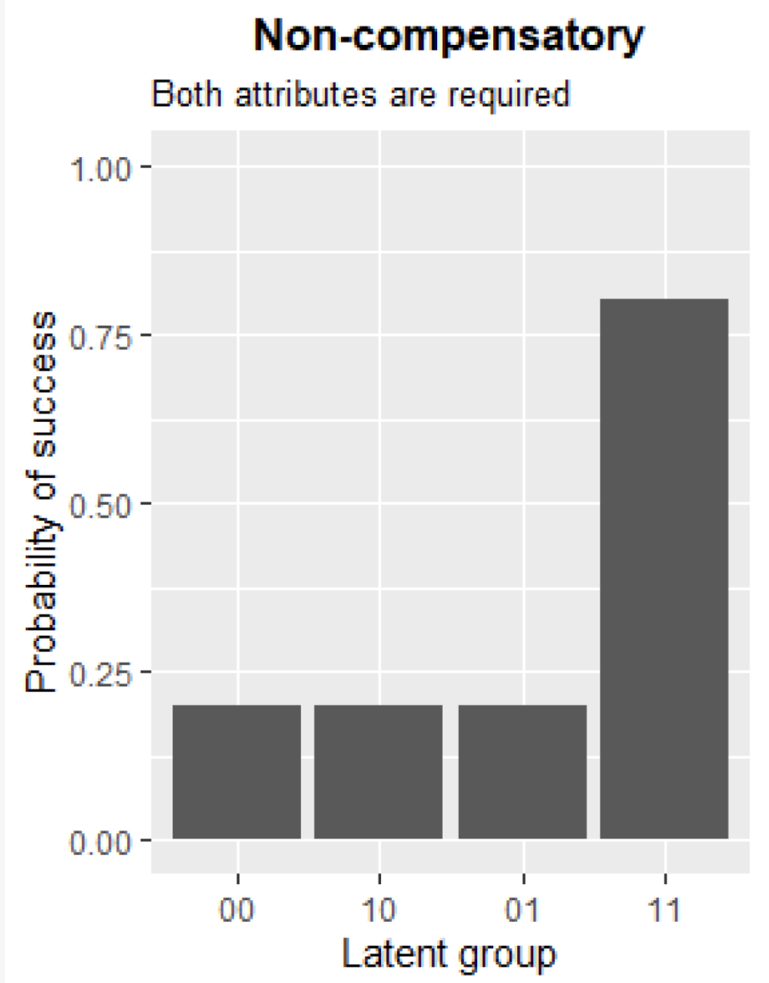
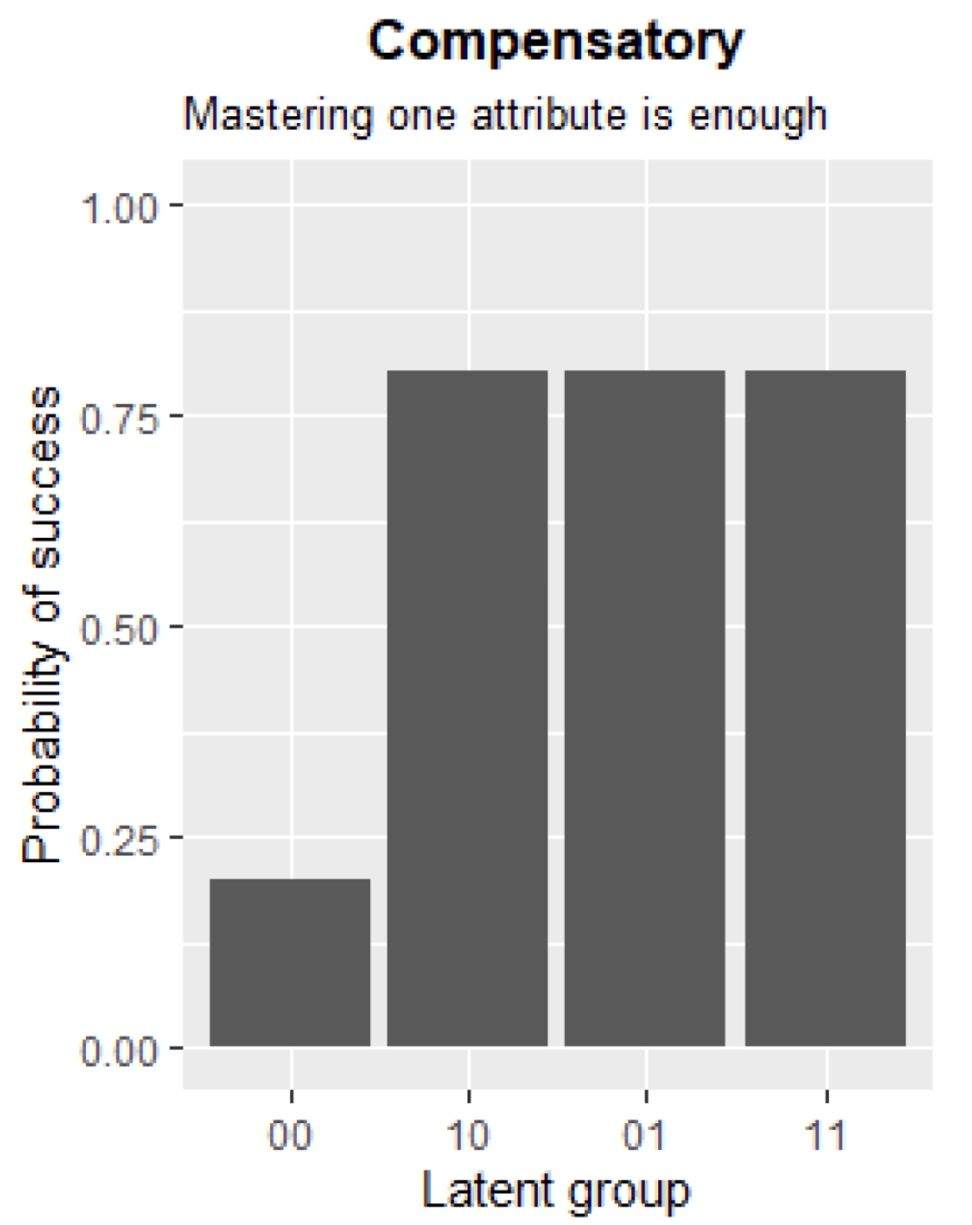
DINA
DINO

Slide 7
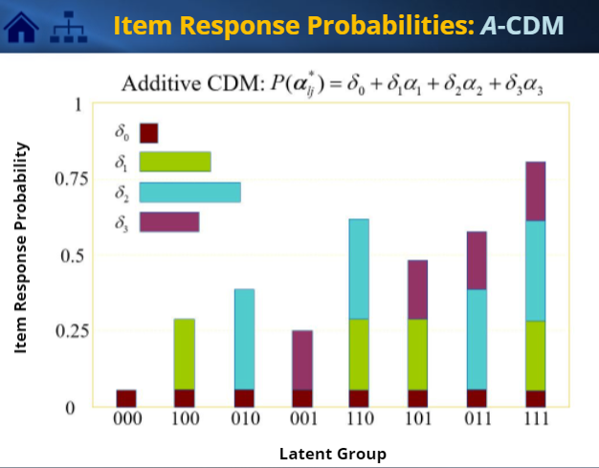
A-CDM Item response probabilities
Delta0: baseline
Delta1: if first required attribute is mastered, probability inc by this much
Etc.

Slide 13
