Slide 1

Textual Detectives: Project 1
Maisam, Gayan, Paramdeep, Vareesha, & Christie
Github: https://github.com/christiebarron/aiTextDetector/

Slide 2
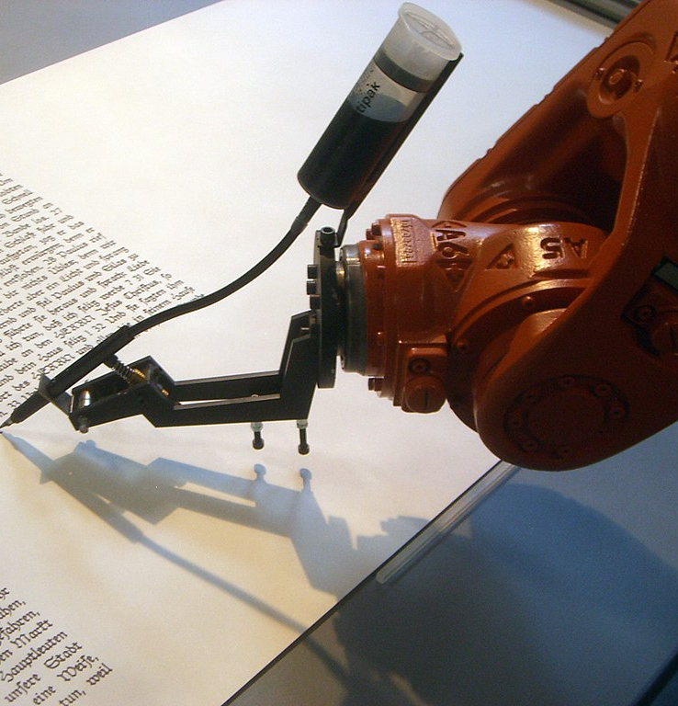
Draft* Executive summary:
The project aims to compare the readability, sentiment, and grammatical features of AI-generated essays with human-written essays.
The industry selected for this project is education, particularly academic writing and automated essay scoring.
The project goals were to analyze the essays and compare the features between the two groups.
The project aims to answer the following questions:
How do AI-generated essays compare to human-written essays in terms of readability and other linguistic features?
Can the insights into the writing style and quality of AI-generated and human-written essays be useful for tasks such as academic integrity, misinformation detection, and content authentication.
This Photo by Unknown author is licensed under CC BY-SA.

Slide 3
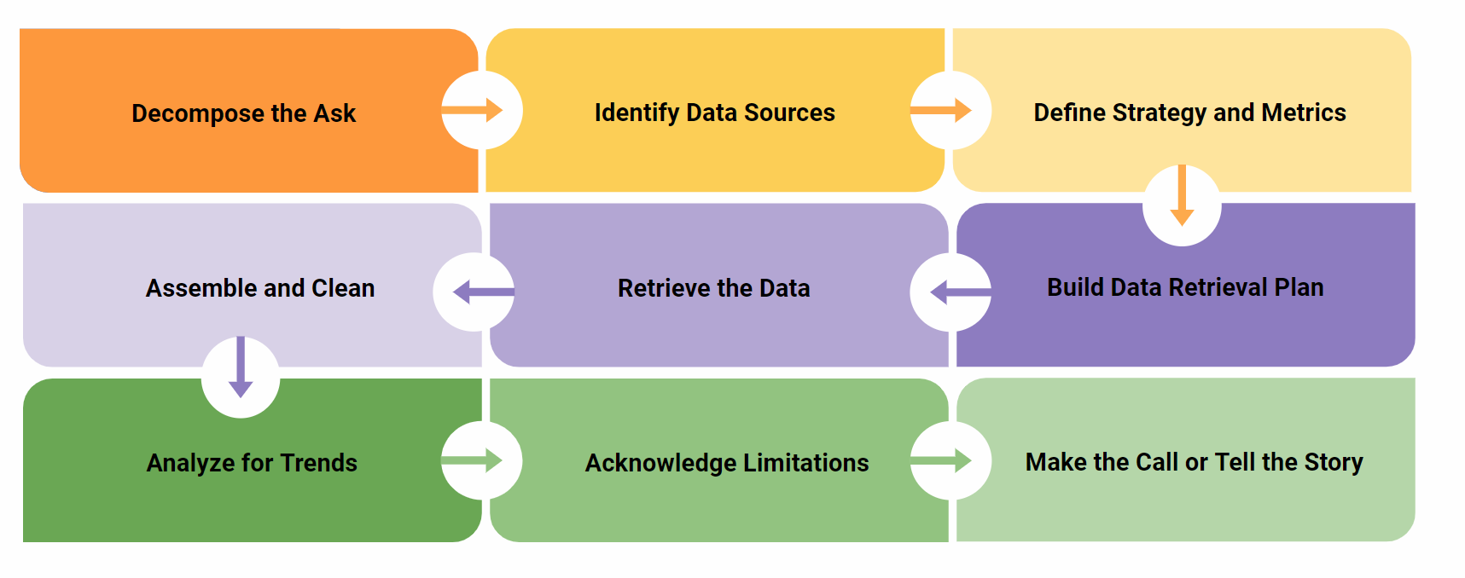
Approach

Slide 4
Datasets
Acquired 21,000 human-written essays from high-school students
Used OpenAI's API to generate 2,600 AI-generated essays on same topics
 | Human-Written Essays | AI-Generated Essays
Source | Kaggle ASAP Data | OpenAI's API
Description | Grade 7-10 students' writing | LLM: GPT-3.5 text-davinci-003
Justification | Gold-standard large-scale essay dataset among the academic data science community (Beseiso et al., 2021; Kumar & Boulanger, 2020) | Davinci is the best-performing GPT-3.5 model (OpenAI, 2023). GPT-4 was unavailable at time of analysis.
Essay types | 8 different writing prompts typical for high-school writing | 8 writing prompts mirroring the ASAP data

Slide 5

Text Extraction
Read into python and merged
ASAP training dataset
ASAP testing dataset
ASAP validation dataset
Raw human and AI text merged
Saved to individual text files
Read into python, extracted metadata, and merged
OpenAI prompt1
OpenAI prompt2
OpenAI prompt8

Slide 6
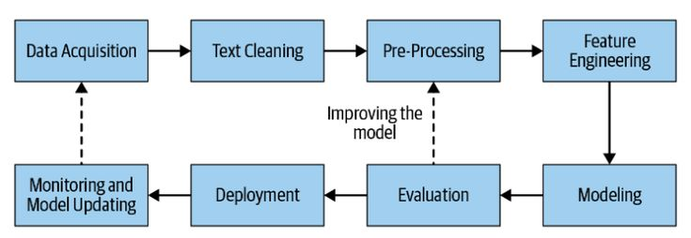
Natural Language Processing Pipeline
feel free to edit anything

Slide 7
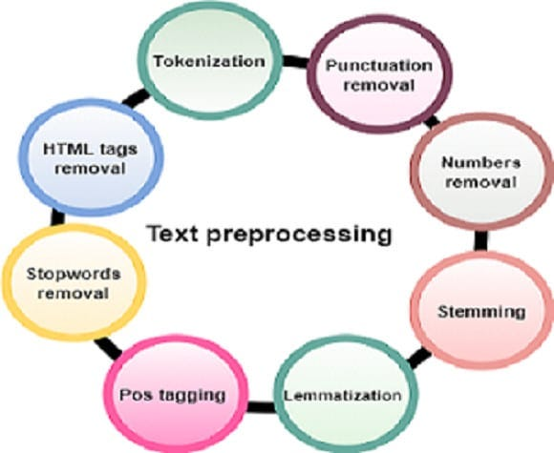
Preprocessing
"this is example text prior to pre-processing"
["this", "example", "text", "prior", "process"]

Slide 8
Feature Extraction
Lexical feature extraction
Text | Lexical feature 1 | Syntactic feature 1 | Stylistic feature 1
["this", "example", "text", "prior", "process"] | 1.35 | 44.1 | 14.3
["this", "example", "text", "prior", "process"]
Syntactic feature extraction
Stylistic feature extraction

Slide 9
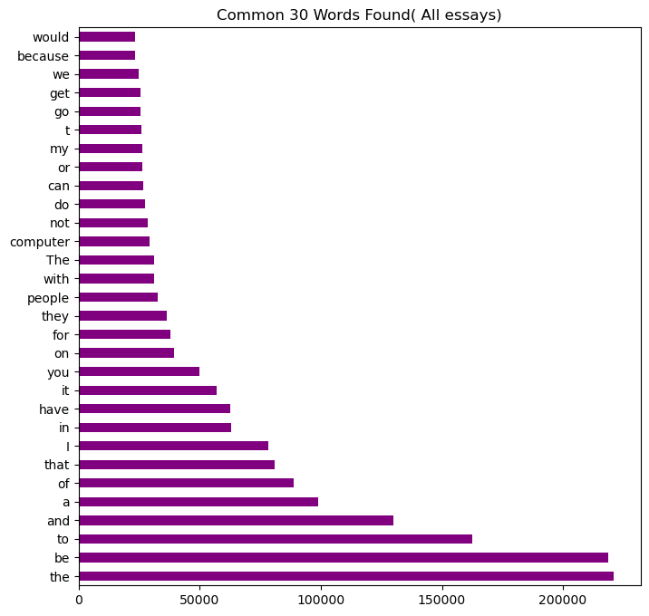
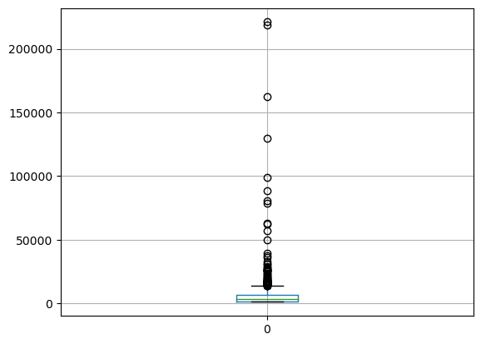
Most common words found in human-written essay
boxplot figure for human-written essay

Slide 10
summary statistics(human-written essay)
count 49885.000000 mean 97.345294 std 2092.043625 min 1.000000 25% 1.000000 50% 1.000000 75% 3.000000 max 220988.000000

Slide 11
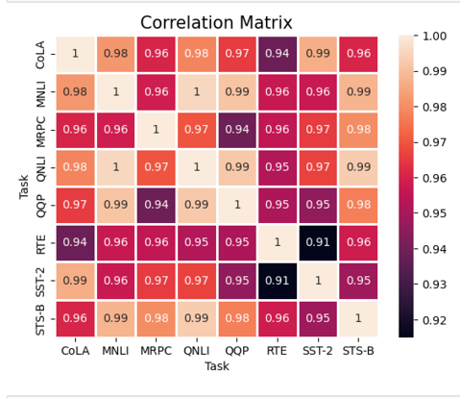
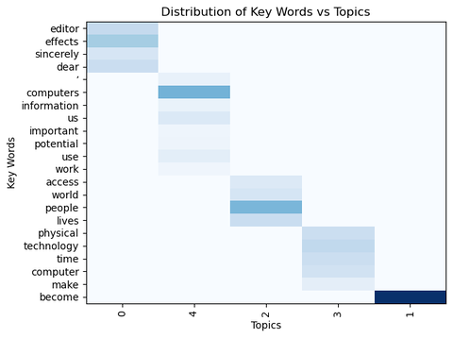
Draft* Data collection, cleanup, and exploration:
Figure 1: Brief note on importance and relevance
Figure 2: Brief note on importance and relevance

Slide 12
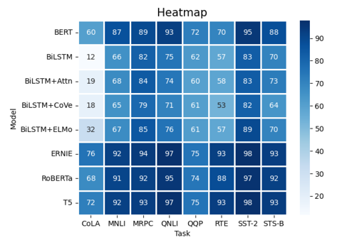
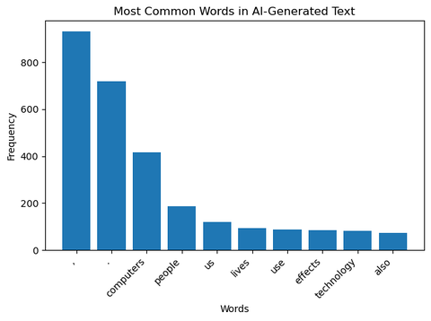
Figure 3: Brief note on importance and relevance
Figure 4: Brief note on importance and relevance

Slide 13
Draft* Features Analyzed:
The program extracts the following features from both sets of essays, compares them, and stores the results in an Excel file.
1. Lexical Features
- Total word count
- Average word length
- Average sentence length
- Type-token ratio (TTR)
- Stop word count
- Punctuation count

Slide 14
Draft* Features Analyzed:
2. Syntactic Features
- Average parse tree depth
- Parse tree depth variation
3. Stylistic Features
- Use of passive voice
- Readability scores (Flesch Reading Ease and Flesch-Kincaid Grade Level)
4. Semantic Features
- Sentiment analysis scores (polarity and subjectivity)

Slide 16
Draft* Results/conclusions:

Slide 17

Draft: Next steps:
To develop an automated essay scoring system that utilizes the features analyzed in this project.
To train the AI language model to generate essays that match the features of human-written essays.
To improve further by exploring more datasets and analyze them using different techniques to gain more insights.

