Slide 1
Data Visualization club Session FIVE
Christie Barron and Paul Steacy

Slide 2
AGENDA
Review the ideas about time in Ch. 31 of Wexler
View and discuss the dashboards we’ve built
Discussion questions from the email

Slide 3
A quick review OF Chapter 31, “Visualizing time”
We read Chapter 31, "Visualizing Time," from Wexler, S., Shaffer, J., and Cotgreave, A. (2017). The Big Book of Dashboards. (Hoboken, NJ: Ray Wiley and Sons).
Often, we examine data with an interest not just in what the values are, but also in how the values change from one time to another. Predicting future trends, recognizing efficient or inefficient steps in a process, and planning the progress of a project are all cases where we want to create visualizations that highlight the time dimension.
But, what is the best way to do that in any given case?
Whichever style of chart, and whichever level of detail you choose when visualizing a time series, you will emphasize a few things while obscuring many others. You need to know what story the data contains, and how you want to tell it, before you start building your chart.

Slide 4
A quick review OF Chapter 31, “Visualizing time”
Seven time-based questions to help us think about visualizing time.
How does today compare with the start of a time period?
Are there cyclical patterns in my data?
How can I look up trends across two time dimensions?
How can I look at rank, not value, over time?
How can I compare values of things that did not happen at the same time?
How can I show the duration of an event?
How can I focus on bottlenecks in a process?
Note that time can be treated as continuous data (e.g., x axis as timeline) or ordinal data (specific hours of the day, days of the week, or dates in the year as, e.g., bars in a bar chart or cells in a grid). Both ways of seeing time will be used when answering the above questions.
Nov 2023
Data Viz Club Session 5
Notes:
Dichotomous time based on two theoretically meaningful timepoints

Slide 5
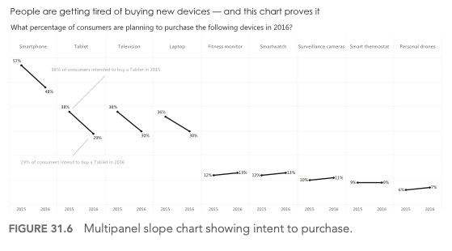
A quick review OF Chapter 31, “Visualizing time”
How does today compare with the start of a time period?
Slope chart, i.e., two dates joined by a line.
Nov 2023
Data Viz Club Session 5
Notes:
Multi-panel slope chart

Slide 6
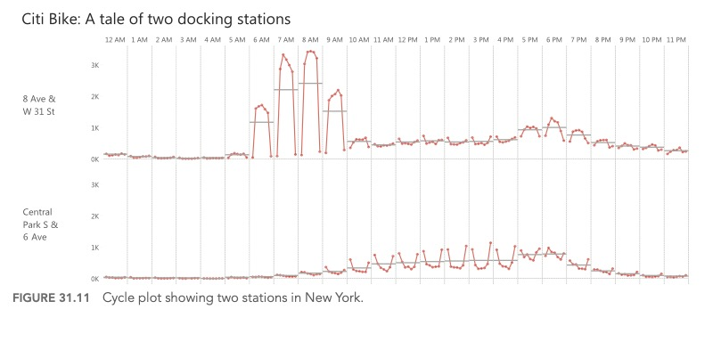
A quick review OF Chapter 31, “Visualizing time”
Are there cyclical patterns in my data?
Cycle plot, e.g., days-of-the-week timelines within an hours-of-the-day bar graph.
Nov 2023
Data Viz Club Session 5
Notes:
Cycle plot.
Book showed how we operationalize time matters (may need to drill down to minute-level data).

Slide 7
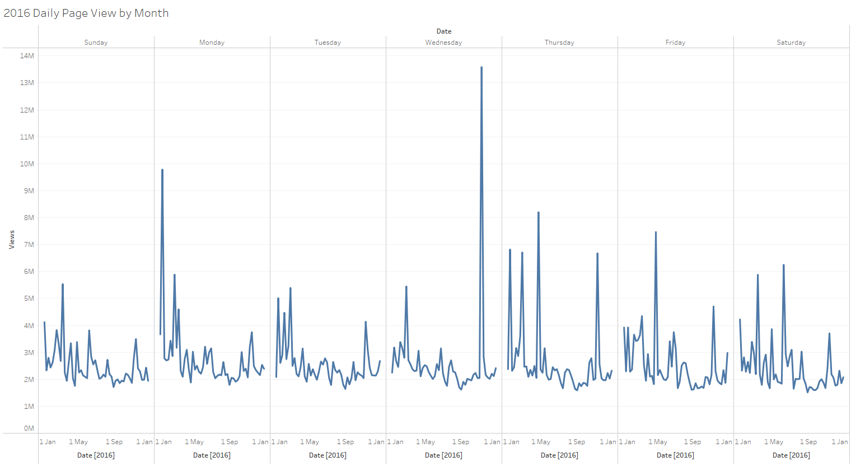
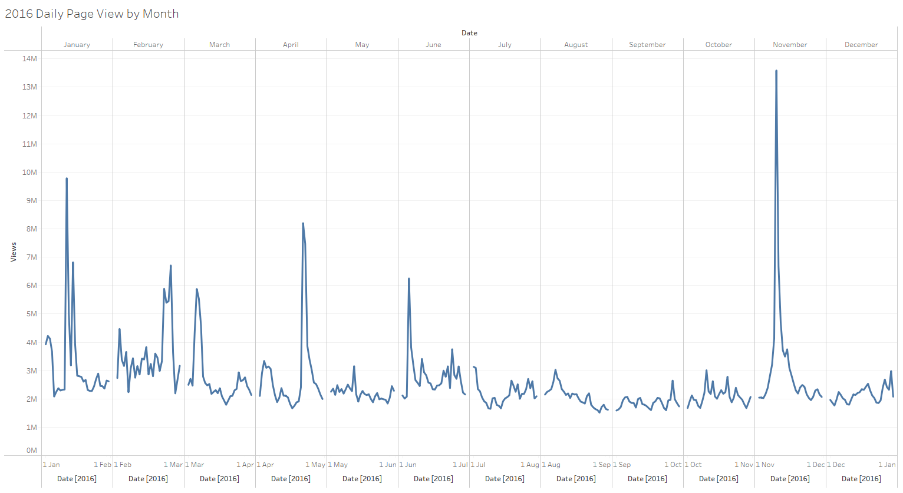
A quick review OF Chapter 31, “Visualizing time”
Are there cyclical patterns in my data?
Cycle plot, e.g., days-of-the-week timelines within an hours-of-the-day bar graph.
Nov 2023
Data Viz Club Session 5
Notes:
Cycle plot.
Book showed how we operationalize time matters (may need to drill down to minute-level data).

Slide 8
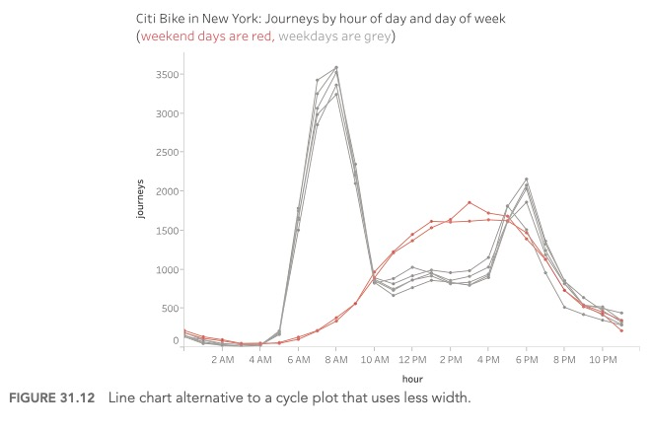
A quick review OF Chapter 31, “Visualizing time”
Are there cyclical patterns in my data?
Narrower line chart alternative to cycle plot. E.g., seven hours-of-the-day timelines superimposed on each other.
Nov 2023
Data Viz Club Session 5
Notes:
Cycle plot.
Book showed how we operationalize time matters (may need to drill down to minute-level data).

Slide 9
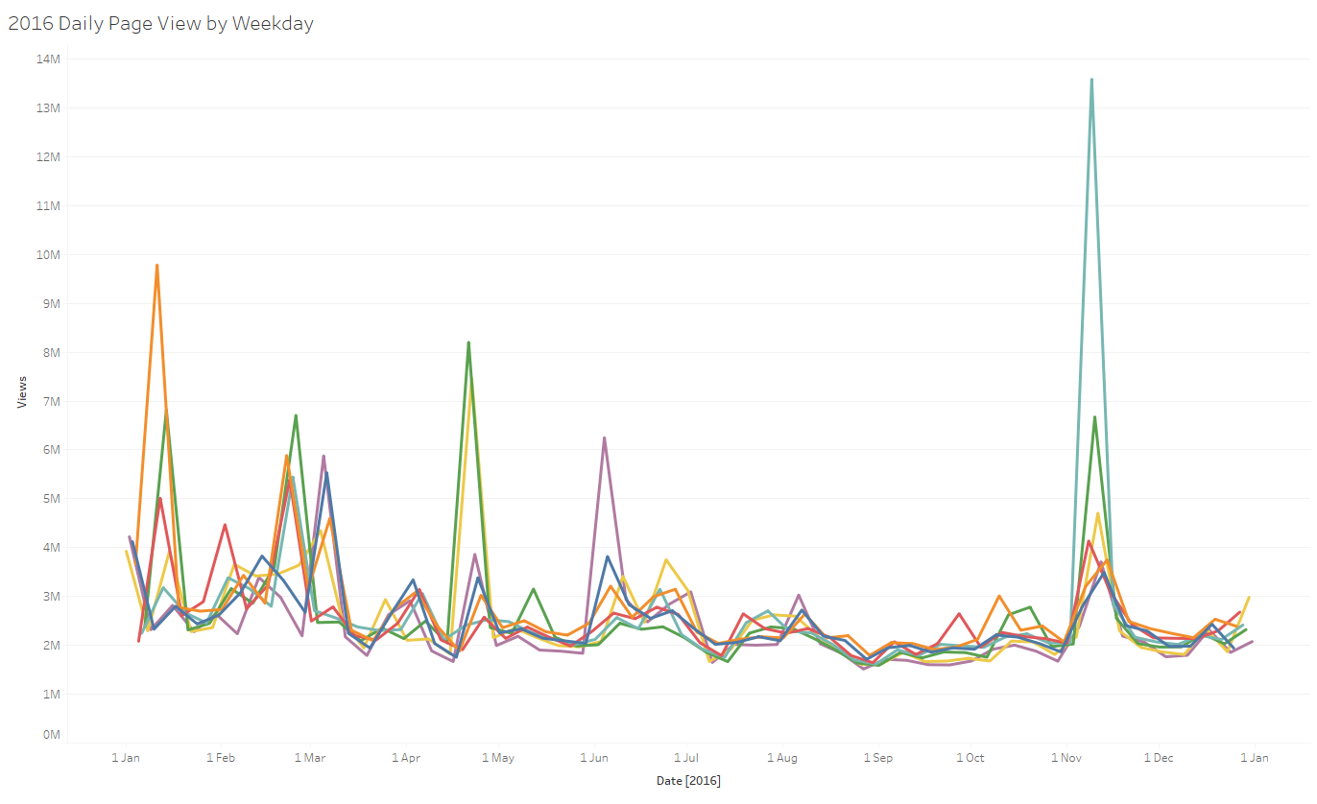
A quick review OF Chapter 31, “Visualizing time”
Are there cyclical patterns in my data?
Narrower line chart alternative to cycle plot. E.g., seven hours-of-the-day timelines superimposed on each other.
Nov 2023
Data Viz Club Session 5

Slide 10
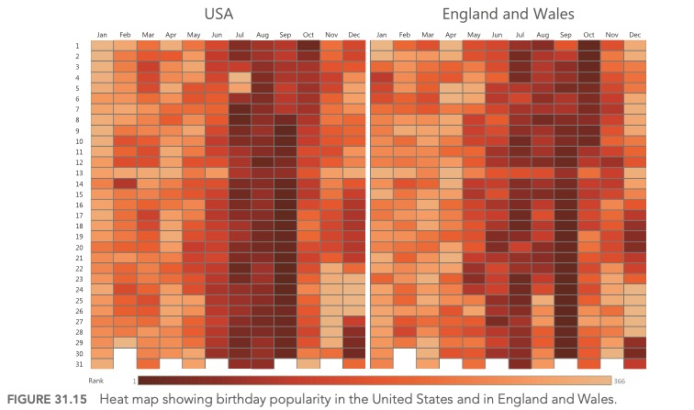
A quick review OF Chapter 31, “Visualizing time”
How can I look up trends across two time dimensions?
Highlight table/heat map.
Nov 2023
Data Viz Club Session 5
Notes:
Can operationalize time as day of month (1-31), weekday, week number (1-52), month (1-12), quarter (1-4), year, decade.

Slide 11
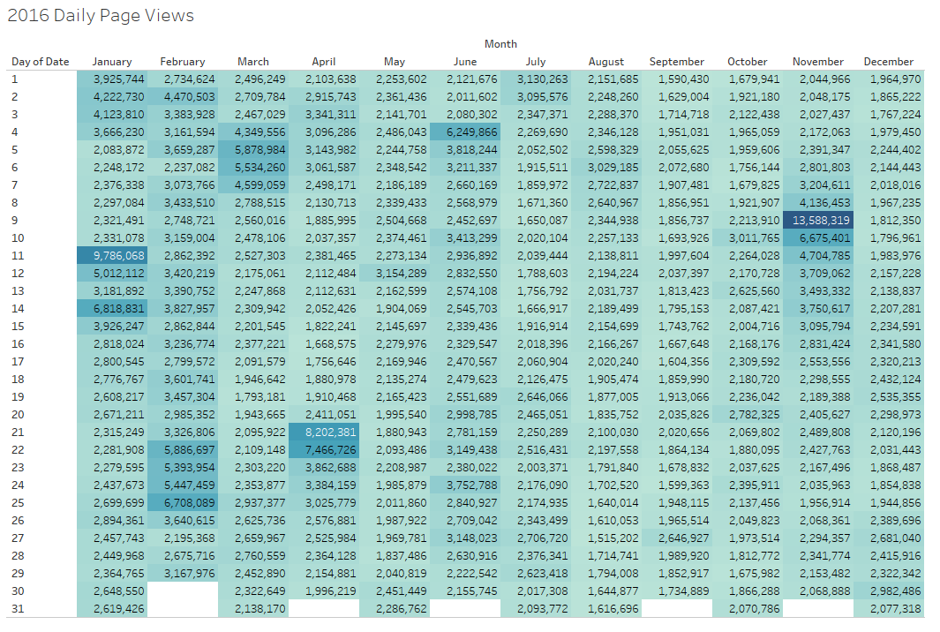
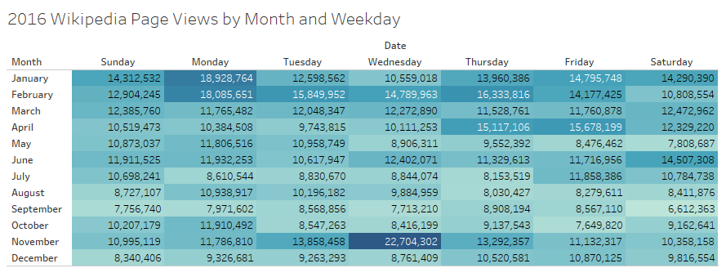
A quick review OF Chapter 31, “Visualizing time”
How can I look up trends across two time dimensions?
Highlight table/heat map.
Nov 2023
Data Viz Club Session 5

Slide 12
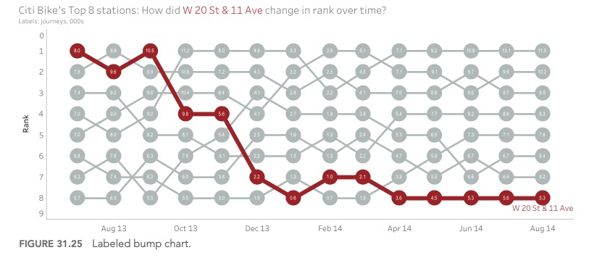
A quick review OF Chapter 31, “Visualizing time”
How can I look at rank, not value, over time?
Bump chart is best when you are interested strictly in rank.
Nov 2023
Data Viz Club Session 5
Notes:
When rank is more important (e.g., sports, Billboard Top 40).

Slide 13
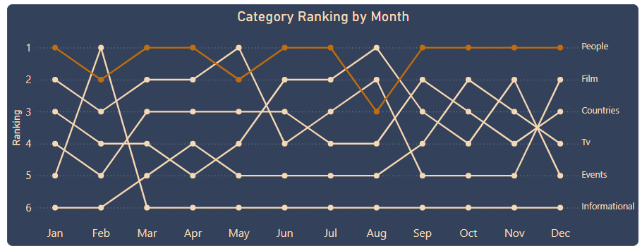
A quick review OF Chapter 31, “Visualizing time”
How can I look at rank, not value, over time?
Bump chart is best when you are interested strictly in rank.
Nov 2023
Data Viz Club Session 5
Notes:
When rank is more important (e.g., sports, Billboard Top 40).

Slide 14
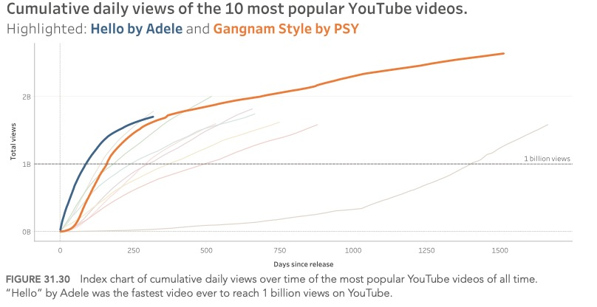
A quick review OF Chapter 31, “Visualizing time”
How can I compare values of things that did not happen at the same time?
Index chart: x axis uses units of time from meaningful event; not actual dates
Time since born (age)
Time since intervention delivered
Time since implementation
Time since first hired
Etc.
Nov 2023
Data Viz Club Session 5
Notes:
When trajectories over time are influenced more by a relative timepoint than absolute timepoint.

Slide 15
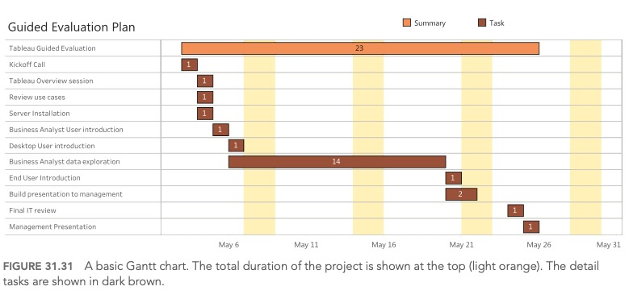
A quick review OF Chapter 31, “Visualizing time”
How can I show the duration of an event?
Gantt chart.
Nov 2023
Data Viz Club Session 5
Notes:
Duration of time

Slide 16
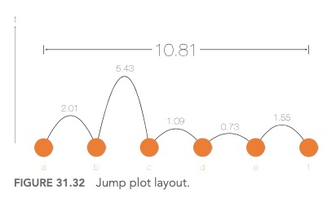
A quick review OF Chapter 31, “Visualizing time”
How can I focus on bottlenecks in a process?
Jump plot: sequence of points (e.g., milestones) on a timeline, height of the curve between points signifies amount of time between them.
Nov 2023
Data Viz Club Session 5
Notes:
X axis: sequential events over time (effectively ‘rank’ vs actual values)
Y-axis: duration of time elapsed between two checkpoints (hop). Bézier curves in this example. Y-axis can be threshold, meaning relative to theoretically-meaningful standard.

Slide 17
Viewing our visualizations
Nov 2023
Data Viz Club Session 5

Slide 18
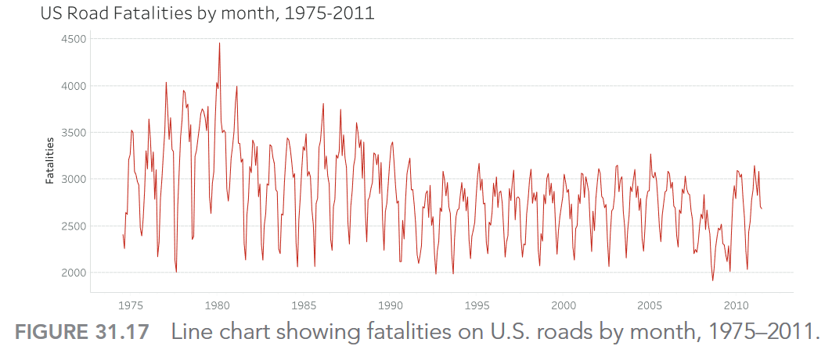
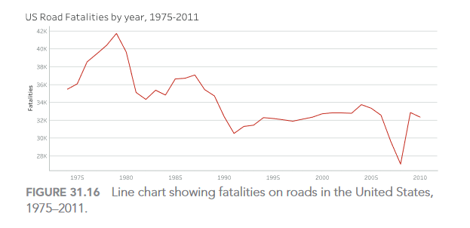
Questions for discussion
How can we best decide the granularity of time to select when visualizing time data?
Second, minute, hour, day of month (1-31), weekday, week number (1-52), month (1-12), quarter (1-4), year, decade
Nov 2023
Data Viz Club Session 5

Slide 19
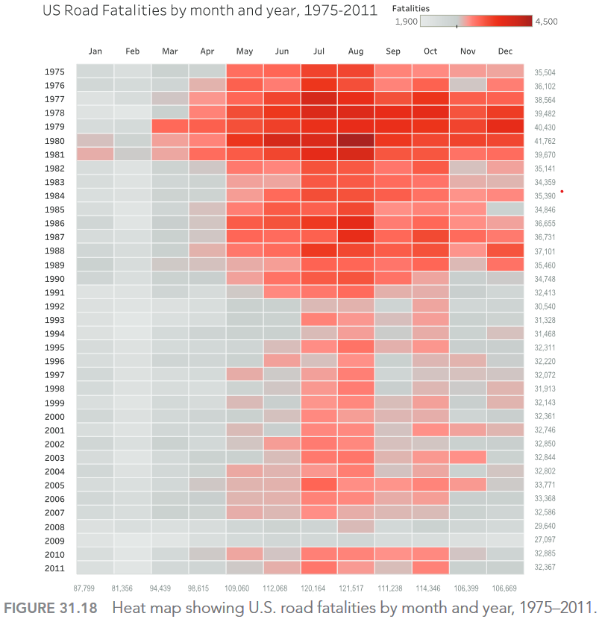
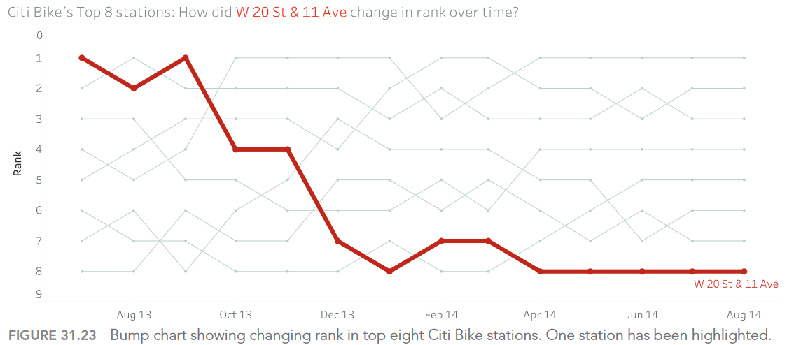
Questions for discussion
In what circumstances might we prefer each of these techniques exemplified by Wexler and colleagues?
Time series line chart
Heat map
Bump chart
Jump plot
Slope chart
Nov 2023
Data Viz Club Session 5

Slide 20
THANK YOU
Nov 2023
Data Viz Club Session 5

