Slide 1

ALDUCHWE | Proposition 21:
Predicting Homeless Populations Using Rent Control
Presented by Alvin Tang, Dustin Nguyen, Christie Ngo, and Wesley Tat
Notes:
ALDUCHWE
Your project title should be short and related to your research question. We have several teams doing the same proposition so do not call your project title “Proposition 21” because it doesn’t differentiate you and it doesn’t tell us anything about your research question. Imagine you are presenting at a conference, how would you title your talk so people would have an idea of what your project analyzed?

Slide 2
Proposition 21: What is it?
Prop 21 permits local governments to implement rent control first occupied over 15 years ago.
With an exception to landlords who own no more than two housing units with separate titles (Condos, Community Apartments).
Permits increase of rent up to 15 percent over three years at start of new tenancy.
Landlords have the freedom to increase rents substantial enough to receive financial return provided the increase in rent complies to rent control protocols.
Reasons of enacting the proposition include: High rent costs, Decreased Affordable Housing, and concerns of quality of life.

Slide 3
Proposition 21- The Facts
For
California has the worst housing affordability
Prevent Corporations from taking advantage of the people
Oppose
Gives rent boards unlimited power to add fees to housing
Repeals homeowner protections and treats everyone as a corporate landlords
Reduced funds for services that would increase the housing crisis

Slide 4
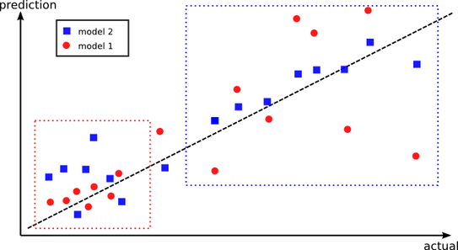
Intention
Inquire
How does rent restriction help the homeless crisis in California?

Slide 5

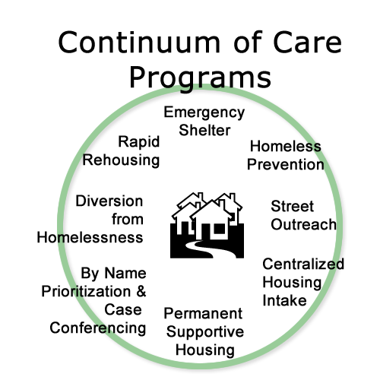


Data

Slide 6


Small Background:
Small Background:

Slide 7
Tools, Technology, Techniques
Developing the variables, coming up with a testable research question, looking for the data from open data sources
Applying a linear regression between each variable compared to homeless population
Using a combination of statistical skill, python skill, and scientific method to illuminate information about Prop 21.
Programming that allowed the data to be graphed. Python was used on Jupyter Hub and using Anaconda for the packages
A linear regression model to calculate each of the four variables to the homeless population and what the R-squared coefficient was.
Created a multivariate correlation graph, seeing how each variable related to homeless population.
Notes:
What tools, technologies, and techniques were used to analyze and visualize the data;
We used python, made linear regressions, singular and multivariate
The r-squared is the coefficient correlation which is suppose to show the strength of two variables. The proportion of variance is how the dependent variable is predictable from independent. Which is what the project seeks to see how variables affects homeless population and how rent control either fixes it or does not. The closer to 1 the r is, the higher the strength between the two is.

Slide 8
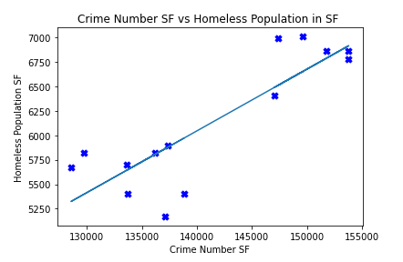
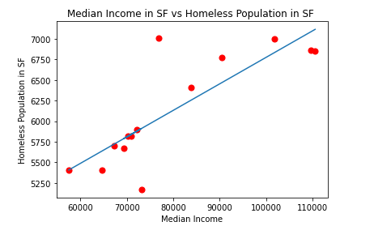
R-coefficient: 0.902
R-squared: 81.3%
y=-2781.296 + 0.06304x
R-coefficient: 0.824
R-squared: 67.8%
y=3559.318 + 0.03215x
Notes:
Idk but this is what it looks like with the logo if this is okay

Slide 9
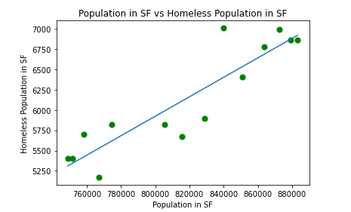
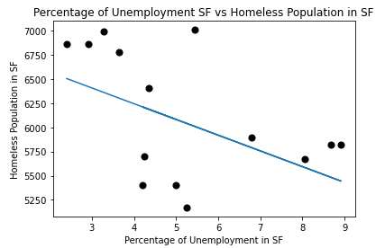
R-coefficient: 0.852
R-squared: 72.6%
y=-3657.846 + 0.1200x
R-coefficient: 0.496
R-squared: 24.5%
y=6895.387 -162.749x
Notes:
Interpret those findings

Slide 10
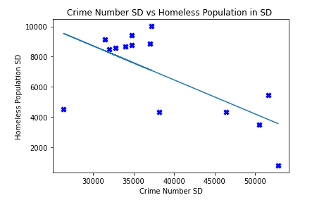
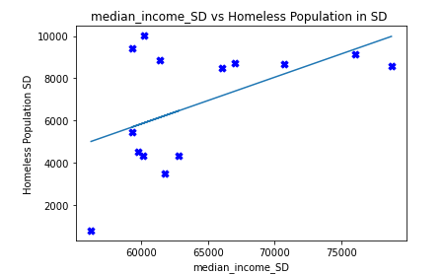
R-coefficient: 0.634
R-squared: 40.2%
y= 15485.603 - 0.2257x
R-coefficient: 0.732
R-squared: 53.6%
y=-7377.625 + 0.2204x

Slide 11
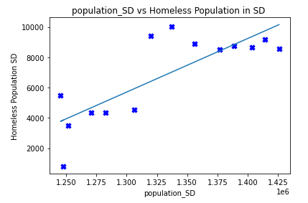
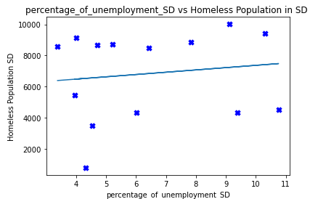
R-coefficient: 0.907
R-squared: 82.2%
y= -40265.781 + 0.03536x
R-coefficient:0.234
R-squared: 5.46%
y=5896.998 + 147.489x

Slide 12
Using Features that Correlate with Homelessness in Cities...
Can we predict the homelessness of another city with similar rent control?

Slide 13
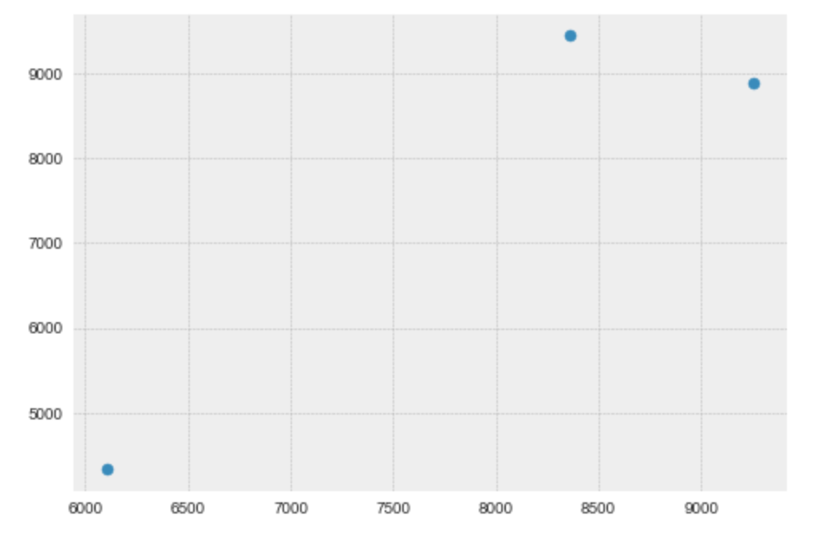
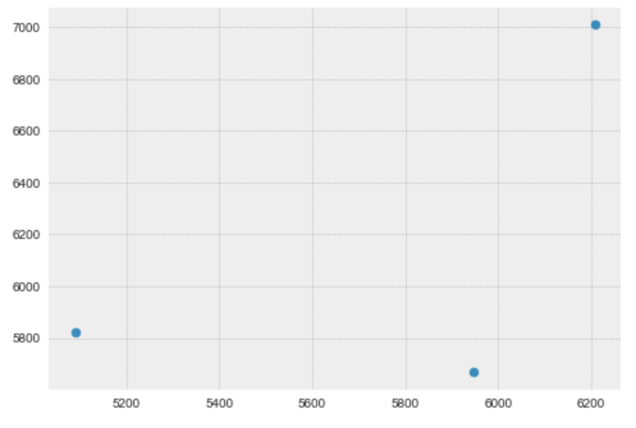
Training Models: sklearn train_test_split
Test size = 0.2, random_state = 0
Predictive Models on Test Sets
San Diego
San Francisco

Slide 14
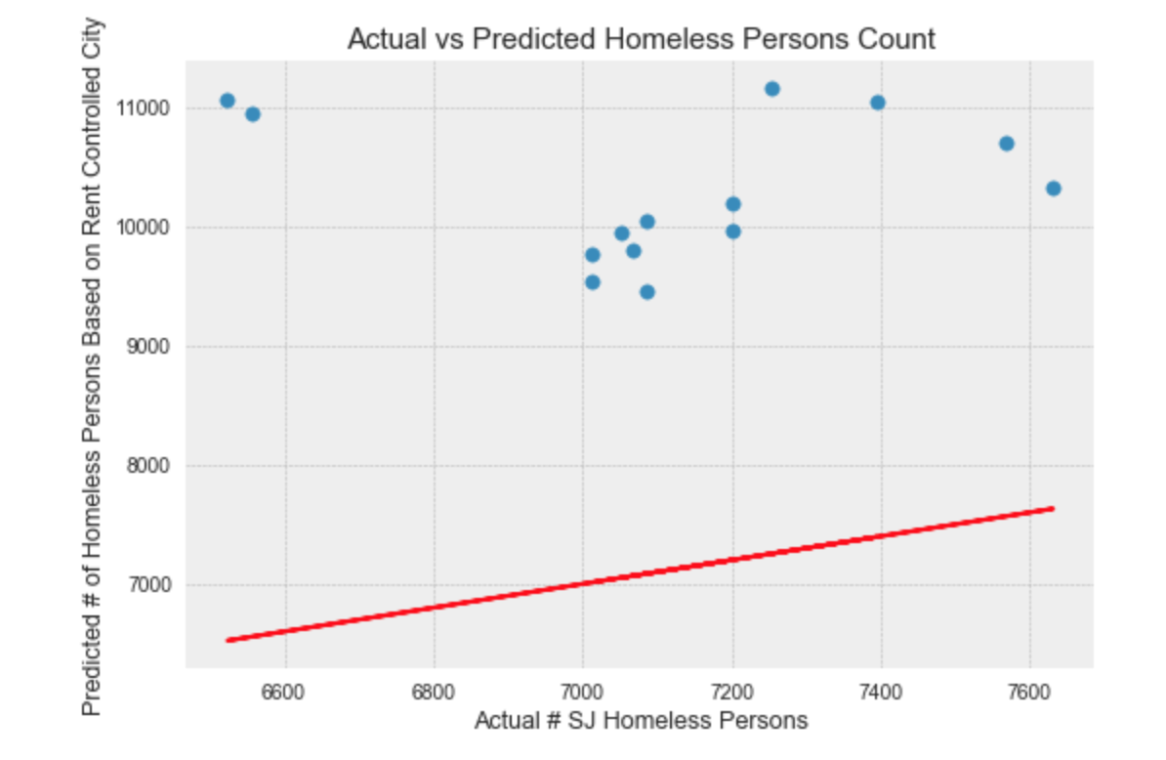

Slide 15
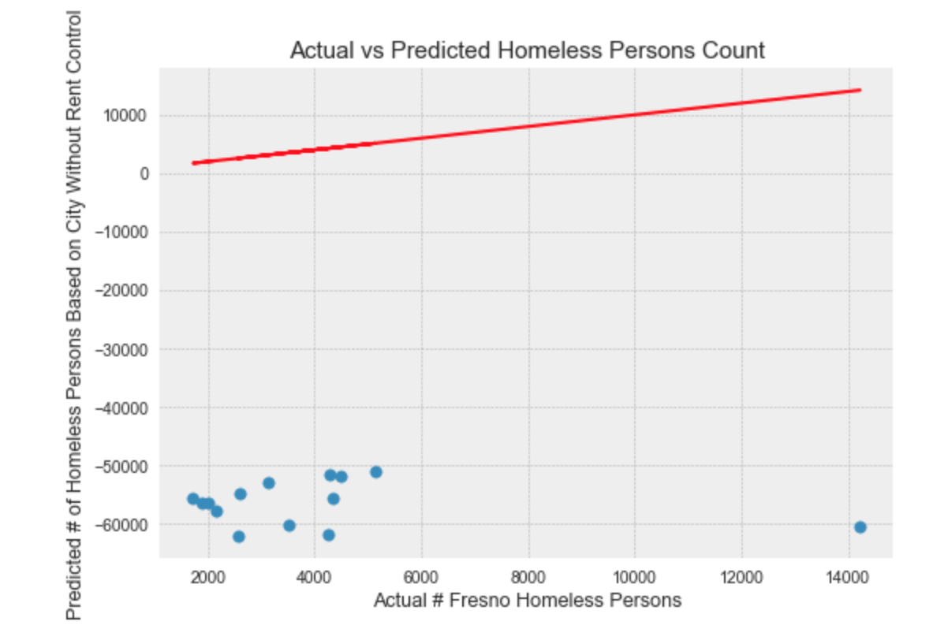
Negative Counts

Slide 16
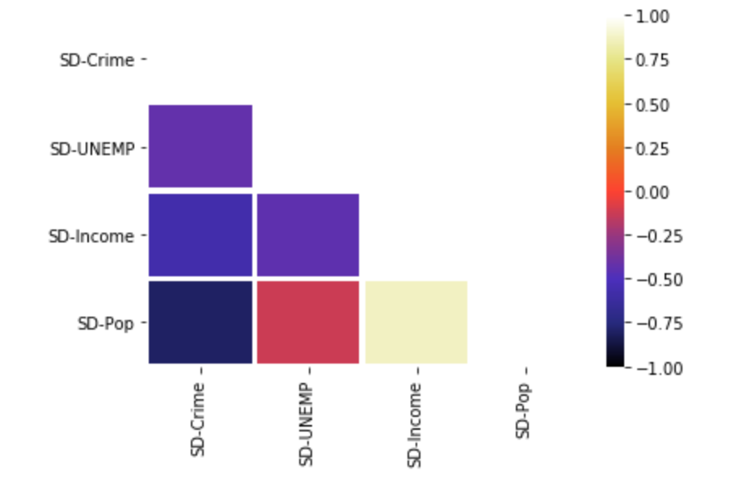
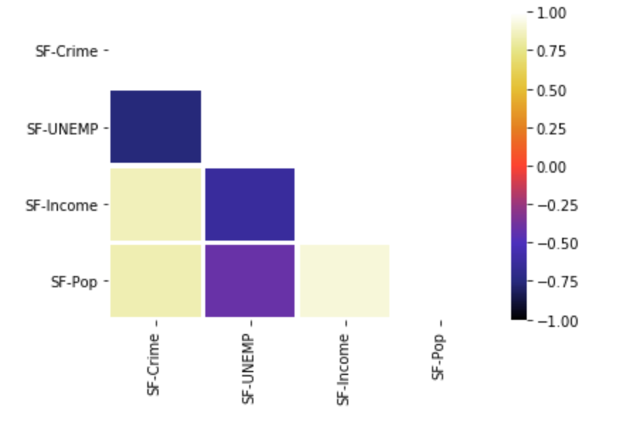
Collinearity Between Variables
Strong negative correlation between POPULATION and CRIME in San Diego
Strong positive correlation between POPULATION and INCOME in San Francisco

Slide 17
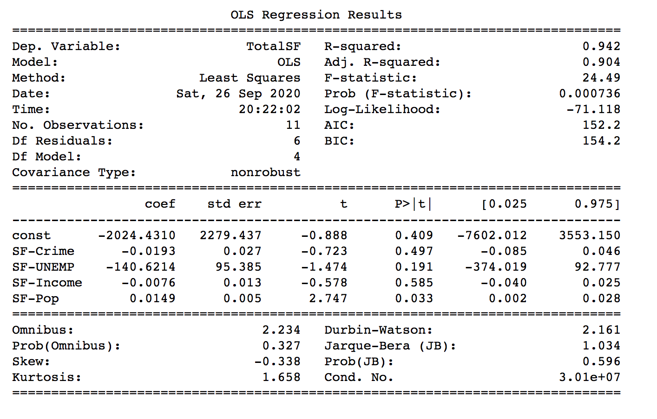
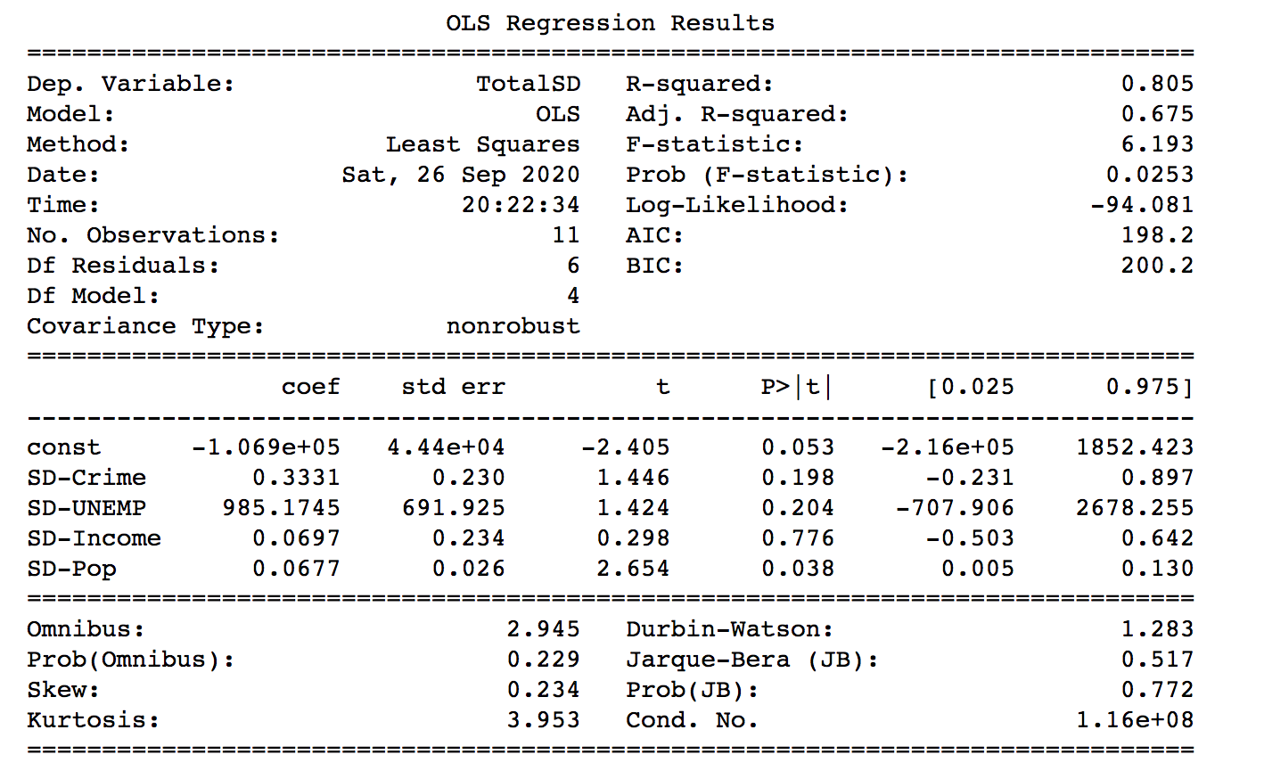
Population was the ONLY significant variable (p-value < 0.05)

Slide 18
Predictive Model Without Population as a Variable… Retraining our Predictive Models

Slide 19
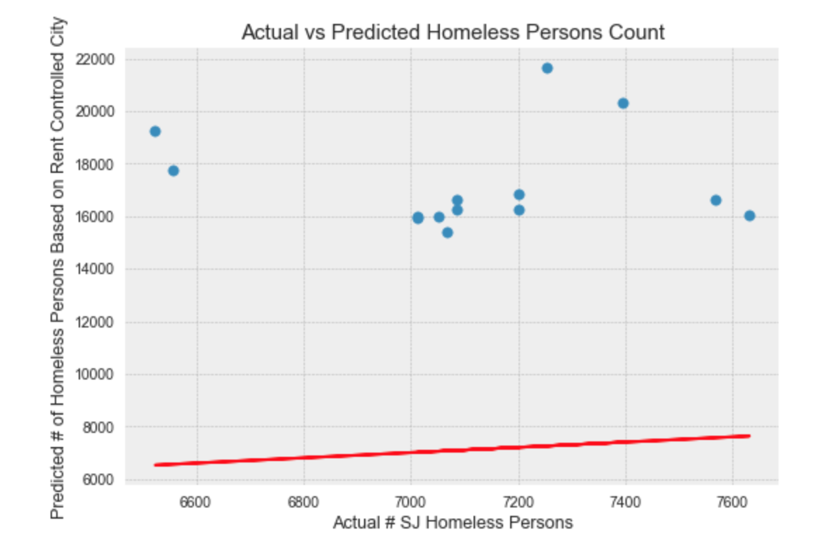

Slide 20
What Our Models Showed Us:
Features that we chose: median income, unemployment rate, and crime numbers did not draw conclusive relationships with homelessness based on the data we found
Linear regression may not have been the best model for our data
City population had the strongest correlation with homeless population in our model

Slide 21
Limitations
Dependent variable, homelessness, is influenced by a multitude of factors
Only selected systemic variables that had data available
Rent control varies in severity, but only 2 cities were chosen to model extremes
Datasets for each city modeled had inconsistency in recording
Data recordings did not go back far enough in terms of history
Notes:
Conclusion: Limitations to our research, limitation on getting data, talk about how this research could be applied in broader terms, and how it can be used in the future. Conclusion can be multiple slides
Finding data was difficult ;( Limitations ←

Slide 22
Takeaways
Training models on few data points (cities) led to less accurate models and more extreme influence from each variable
Rent control is a complex issue and cannot be used on its own to explain differences in cities’ homeless population
Cost of housing/other numerical data may be used as the independent variable for a more accurate instance of rent control’s effects on cities (based on data currently available)
Notes:
Conclusion: Limitations to our research, limitation on getting data, talk about how this research could be applied in broader terms, and how it can be used in the future. Conclusion can be multiple slides
Finding data was difficult ;( Limitations ←

Slide 23
Future Application
Further research into rent control strength allows it to be used as a measurement in predicting homeless populations
Given more access to data on affordable housing, average rent in counties, eviction notices, tax dollars going to support programs for the homeless can provide a more intricate model
Detailed following of rent control trends will lead to even more accurate models in the future (more years available as data)
Notes:
Conclusion: Limitations to our research, limitation on getting data, talk about how this research could be applied in broader terms, and how it can be used in the future. Conclusion can be multiple slides
Finding data was difficult ;( Limitations ←

