Slide 1
Truck Stop Partnership Channel Christie Wang September 2019

Slide 2




Truck Stop Partnership Channel
New channel staffs team at truck stops and offer incentives to truckers who sign up and complete FreightFirst onboarding process
GOAL
1) Increase trucker sign ups to effectively expand FreightFirst’s trucker base population
2) Diversify current trucker base by reaching trucker segment not previously targeted through two existing channels – third party leads and referrals
Approach
Measure truck stop partnership channel effectiveness in achieving these goals to evaluate & quantify the impact of this channel for FreightFirst by analyzing potential increased number of trucker signs ups, & translating sign ups to increased revenues, channel profitability, and growth opportunities for the platform
Key Metrics to Consider
Total accessible market of truckers that could potentially sign up from the truck stops
Total number of truck stops in the US (48 states that FreightFirst is currently present) and geographic location of truck stops
Total truck drivers in the US, with assumption that all truck drivers must frequent one or more truck stops along the way of their load path
Rate at which truckers sign up & complete onboarding process
Competitor market share: competition from similar businesses offering platform technology and competition from third party freight brokers
Focus on distinguishing factors between this channel from existing channels
Rate at which signed-up truckers complete first load = 20%
Trucker sign-up and onboarding process with FreightFirst and turnaround time
Trucker demographics, geographic location, specific load preferences, and available loads on platform
Focus on distinguishing factors between this channel from existing channels
Financial Considerations
Potential revenue
Increased trucker sign-ups expanding trucker base, lifetime value of trucker
Churn rate (are there any significant differences between churn rate of truckers who sign up from this channel versus others)
Channel Costs
Incentive costs to acquire trucker: sign up costs and first load cost
Cost of team staffed at truck stops
Additional platform and resources costs
Opportunity cost (to pursue other channels)
Ultimate profitability of channel

Slide 3
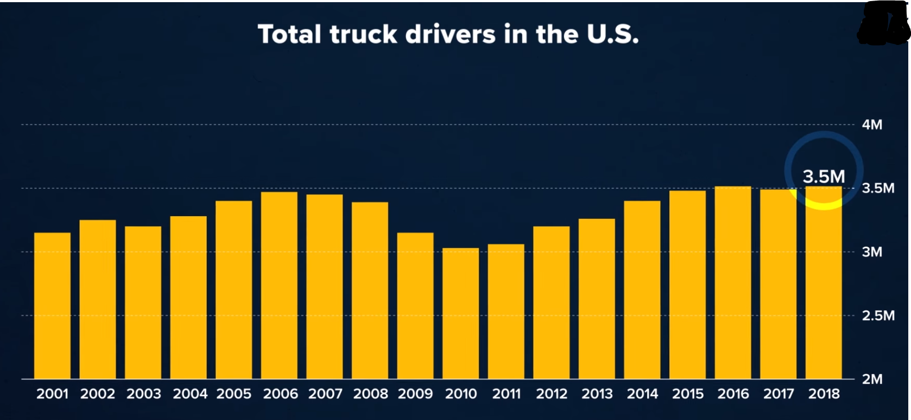
Truck Stop Partnership Channel
Looking at the given information and cost metrics, truck stop partnership channel performance per week and per year
From the currently live 10 truck stops, generates 500 trucker sign ups per week, 26,000 trucker sign ups per year
Total incentive for sign up cost $25,000, $1,300,000 per year
Total incentive for first load cost is $10,000, $520,000 per year
With 20% first load conversion rate, total number of truckers that booked first load = 100 per week, 5,200 per year
Cost (incentive only) / First Load = $350 / trucker that booked first load
Channel is currently achieving a cost / first load under its budget of $400 / converted first load trucker
Evaluate the ultimate potential of the channel using industry market data with the following underlying assumptions
In a year, 3.5M total truckers in the US, 250 truck stops (assuming these stops are all located in 48 states which FreightFirst is active in), average 14,000 truckers per stop
Market share percentage, considering platform competitors: DATMobile, Convoy, KeepTrucking, Amazon beta service with Relay, and alternatives such as third-party brokers assuming that none of these competitors are present at these truck stops, arrive at following:
Rate at which truckers sign up & complete onboarding process = 85%
Rate at which signed-up truckers book first load = 20%
Channel can attract 11,900 truckers to sign up of which 2,380 truckers book first load per stop in a year. With potential of expanding this partnership to all 250 stops, this channel can attract a total 2,975,000 truckers to sign up of which 595,000 truckers who book first load in a year
Increasing FreightFirst’s current 400,000 trucker population base by 644%
Defining the annualized lifetime value of trucker as $156.25 for FreightFirst, this equates to revenues of $92,968,750 in a year
*lifetime value of trucker derived from annual revenue of FreightFirst contribution from truckers and average revenue per trucker
Channel Cost $281,150,000:
Cost of incentives = $208,250,000, broken down to $148,750,000 sign up cost and $59,500,000 first load costs
Cost of staff: $64,800,000, considering 2 member team at each truck stop, 24 hour day staffing, 4,320,000 total required staffing hours for the 250 truck stops annually
Platform cost of implementing incentives and any additional costs to process signups and onboarding of new truckers, estimated additional 2% of current platform costs
Truck stop partnership channel has net loss of $(188,181,250)

Slide 4
Truck Stop Partnership Channel
ROAD TO PROFITABILITY
Increase the rate truckers sign up & complete onboarding process & rate signed-up truckers book first load
Decrease the $ amount of incentives given
Evaluate effectiveness of incentives (through A/B testing) and potential impact of decreased incentives to maintain same level of success conversion rates
Maximize the lifetime value of a trucker
Opportunity to decrease % revenue passed to carriers
Scenario 1
Scenario 2
In scenario 1, the increased signup & first load rates along with decreased incentive costs yield profit of $99,365,625
In scenario 2, the additional effect of increased annualized trucker LTV yield profit of $320,850,000

Slide 5


Truck Stop Partnership Channel
Growth Opportunities
Add diversity to current trucker base by reaching truckers not currently targeting by existing two channels
Truck stop advertising reaches all people who frequent truck stops including loaders, operating companies/shipper companies representatives
Ability to keep up with changing dynamic of trucker landscape by advertising in must frequented truck-stops
Potential to partner with FreightFirst Plus in offering promotion or free trial period to advertise at these truck stops
Potential Risks
Channel does not attract as many as truckers to sign up & onboard and book first load as targets
Channel becomes heavily saturated after first year and fails to attract many new truckers
High churn rates from trucker sign-ups brought on by incentives

Slide 6
Project Timeline
To pilot this project and roll out the truck stop partnership channel in four weeks, I propose using agile project management framework that facilitates open communication with all involved stakeholders
End of Week 3 – Third All Hands Meeting
Attendance:
Our team (Trucker operations team)
Human Resources
Signup and Onboarding Team
Advertising Team
Payment Team
Finance Team
Logistics Team
Agenda:
Review performance and feedback of 5 live truck stop locations launched
Analyze and pinpoint potential areas of improvement
Create game plan to implement areas of improvement
Workstream 1
Stakeholders: Trucker Operations Team, Human Resources, Signup & Onboarding Team
Goal: Hire externally (or internally) for headcount to be staffed at truck stops and train this staff to be knowledgeable about trucker criteria, signup, onboarding process for FreightFirst
12 days
Workstream 3: Signup and Onboarding Configuration
10 days
Workstream 5: Incentive Payment Processing
Workstream 2
Stakeholders: Trucker Operations Team, Advertising Team, Signup & Onboarding Team
Goal: Source necessary equipment for truck stop setup (laptops, signup paperwork, advertising materials, table, chairs, other accommodations, etc)
Launch of first 5 truck stops
2019
10 days
Workstream 2: Setup at truck stops
Sep
Oct
Sep 23
Week 1
Sep 30
Week 2
Week 3
Week 4
Oct 7
Oct 14
Oct 18
Final test run of first 5 stops
Review of initial launch & final test run of next 5 stops
14 days
Workstream 1: Team staffed at truck stops
Channel Launch of all 10 truck stops
4 days
Workstream 4: Incentive and additional headcount approval
7 days
Workstream 6: Truck Stop Location Decision Making
Workstream 3
Stakeholders: Trucker Operations Team, Signup & Onboarding Team
Goal: Implement any changes needed to support these trucker signups on current signup & onboarding platform and generate physical signup forms and get access to online website version
Potential challenges: Optimizing turnaround time from trucker signup to completion of onboarding process
Resolution recommendation: Minimize turnaround time by evaluating current pain points, increase requirement of trucker information provided initially to potentially ease verification process
Workstream 4
Stakeholders:
Trucker Operations Team, Finance
Goal: Evaluate and approve incentive cost and additional headcount expense
Potential challenges: Justify the incentive cost and analyzing effectiveness of incentives on attracting trucker sign-ups
Resolution recommendation: Leverage historical trucker signup data and A/B testing through current existing channels, along with accounting for differences to this channel, to evaluate effectiveness of incentives
Workstream 5
Stakeholders: Trucker Operations Team, Payments team
Goal: Implement payment processing of incentives
Potential challenges: Timeliness of incentive payment processing after truckers sign up and book first load
Resolution recommendation: Providing option of applying incentive as future credit in FreightFirst account, can be used to pay for gas, truck tire changes, etc
Workstream 6
Stakeholders: Trucker Operations Team, Logistics Team, External contacts who manage truck stops
Goal: With FreightFirst’s current transportation network, shipper & trucker base, strategically pick 10 truck stops that will provide most traffic for recruiting truckers. Contact truck stop location for necessary clearance to set up team there.
Potential challenges:
Complications and timeliness of obtaining all permissions/clearances to set up team at truck stops
Resolution recommendation: Research regulation, truck stop ownership company policies, and prepare clearances beforehand
End of Week 4 – Fourth All Hands Meeting
Attendance:
Our team (Trucker operations team)
Human Resources
Signup and Onboarding Team
Advertising Team
Payment Team
Finance Team
Logistics Team
Agenda:
Debrief & review performance of all 10 truck stops
Address any issues
For our team specifically: evaluate ways to optimize efficiency/further grow and scale platform to all truck stops in the US
Beg Week 1 - First All Hands Meeting
Attendance:
Our team (Trucker operations team)
Human Resources
Signup and Onboarding Team
Advertising Team
Payment Team
Finance Team
Logistics Team
Agenda:
Discuss new truck stop partnership details and goal launch date of Oct 18
Any questions and concerns can be addressed in follow-up meetings between involved stakeholders
Proposed timeline to launch channel segmented by 6 individual workstreams with proposed time frame
Mid Week 1 – Second All Hands Meeting
Attendance:
Our team (Trucker operations team)
Human Resources
Signup and Onboarding Team
Advertising Team
Payment Team
Finance Team
Logistics Team
Agenda:
Review details of channel and expected timeline of each workstream

Slide 7


Project Prioritization
Evaluate this project along with all other projects in team’s scope during the same timeframe window
Assign a priority score to each project based on consideration of following factors:
Team’s time and additional resources required to execute the project
Projected Revenue
Impact of project classified with High, Medium, Low and associated impact score, assigned considering projected revenues
High impact equates to score = 3, medium impact equates to score = 2, low impact equate to score = 1
Return on Investment (ROI) for the team as a function of team’s time to complete the project and impact score
Risk of project’s failure and occurrence of unforeseen outcomes classified with High, Medium, Low and associated risk score
High risk equates to score = 1, medium risk equates to score = 2, low risk equate to score = 3
Weighted Score = ROI (function of annualized time & Impact Score) * Risk Score
Higher weighted score indicates greater prioritization for project
Using example projects, see priority scorecard below:
Here, the truck stop partnership channel has weighted score of 36 and ranks 1st
Therefore, with respect to the sample projects, I recommend pursuing the Truck Stop Partnership Channel for its high value impact, return on investment, and low risk of failure

Slide 8
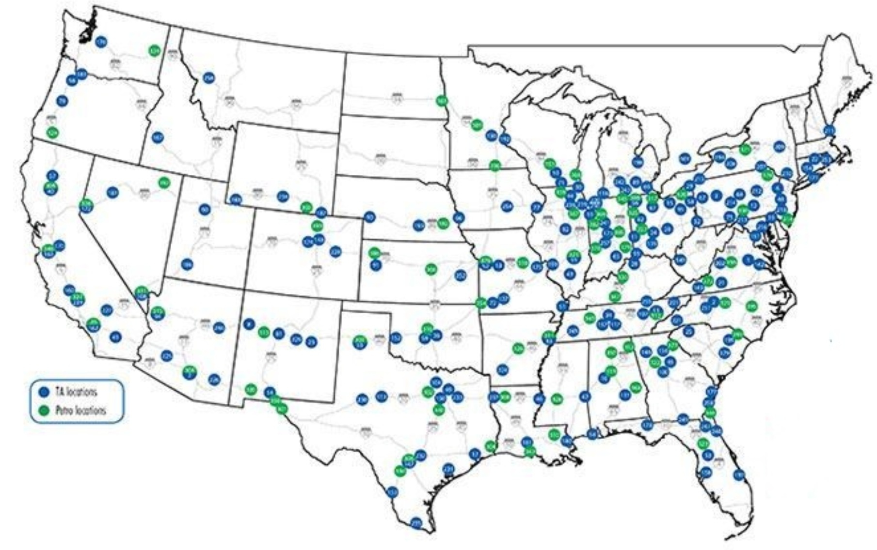
Growth and Expansion
2.Plan & Implement
3. Analyze
1. Finance
To launch the truck stop partnership nationwide and scale this operation efficiently, recommend a 3-stage approach
Cluster 1
Secure funding for capital needed to finance expansion by working with Finance team
Set targets for expected number of staff headcount, equipment, and materials needed
Identify and map out all target truck stops
Cluster by truck stop type based on location
For each cluster, create roll out batches
Truck stops with highest attraction potential are part of the first batch & implemented first, and rest of truck stops are rolled out incrementally
Key considerations when determining logistics of truck stop partnership channel for each cluster
Are incentives up to date with market specifically in the segment location?
Any special state-specific clearances required, any regulations to keep in mind?
Is there anything unique about this cluster or particular truck stop that the team staffed at the truck stops need to aware and trained on?
Scale out operationally
Host one inclusive training session to train all staff at once
Bulk order all equipment and advertising materials to get potential volume discounts
Locally specialized team for each cluster
Feedback process after each batch to obtain insights on performance of live truck stops to leverage for future batches
Continue to uphold areas of success & actively address pain points
Holistic Evaluation of Truck Stop Partnership Channel
Are the truck stop performing as expected?
What is the average rate at which truckers sign up & complete onboarding process?
Compare to target 85%?
What is the average rate at which signed-up truckers book first load?
Compare to base line 20%?
Is there opportunity to reach (if not already at 75%?)
What is the average churn rate from truckers that sign up from truck stops?
Compare to other two channels?
Are the current truck stops optimally located?
Looking at most popular travel routes, are there any overlapping truck stops?
What is the most strategic placement of truck stops along these routes?
Long term plan: Roll out to Germany, Netherlands
Cluster 2
This channel allows FreightFirst to expand its trucker base & transportation network, which combined with innovative technology, capital, & stamina will enable the platform to flourish in the highly-lucrative freight transportation industry especially as demand continuously trends higher supported by society’s dependence on package deliveries and the online marketplace

Slide 9

Thank You!
Questions?

