Slide 1
Light Case Study
Christie Wang
June 2019

Slide 2

Executive Summary
After reviewing light case study test city experiment data, recommend rolling out the light program to City 2 to effectively increase driver loyalty, reduce churn rate, increase number of completed trips, thus growing net revenue.
The experiment showed light program decreases the churn rate for drivers who accept the light which decreases the number of completed trips loss from normal driver churn loss. After carefully evaluating the costs, especially the cost of “Flashlight” initial investment, propose to implement in City 2 as its large number of completed trips retained will prove to be profitable, taking 6 months to breakeven. Through sensitivity analysis of key model assumptions of light cost per unit, number of lights needed, completed trips uplift, light proves to be profitable and a solid investment choice.
Key benefits are increased revenue and completed trips from building driver and rider loyalty base while risks include inaccurate test city results data, unforeseen scalability implementation costs, and safety & regulatory exposure.
Light is expected to generate $4.82M (additional 0.68% of total year) revenue and $872,540 (additional 0.44% of total year) net income, after 36 months, growing bottom line substantially.
Executive Summary
Experiment & Churn Curve Analysis
Breakeven Analysis
Sensitivity Analysis
Key Benefits & Risks

Slide 3
Experiment & Churn Curve Analysis
Key Assumptions:
Test City number of driver and average trips relationship is representative of Cities 1-5
PnL Data & Churn Curve Cities data is reflective for only drivers with 250+ lifetime trips who have been active for the past 7 days
Light do not have a maintenance cost and are fully functional for 36 months
Test City Experiment results carried out for 1 month can be applied for all future months
Light initial capex costs are the same for each city it is implemented in
Revenue per additional trip from Light uplift = average net inflow + average net booking per trip
Experiment Results:
In drivers that picked up light population, there was 13.86% better driver retention rate
Drivers that picked up a light completed 13.55% more trips
18% of eligible, notified drivers picked up a light
Average trips per driver is 139
Light program will decrease the driver churn rate observed over time, thus retaining a fixed 13.55% proportion of completed trips that would’ve been loss every month due to churn. As churn rates gradually converge, the driver population reaches steady state and the effect of light program reaches maximum impact. Factoring the costs of light program, especially the high initial “Flashlight” cost, the number of additional completed trips generated must be substantial enough to balance out & surpass the costs.
Due to its large monthly average completed trips and therefore higher volume forecasted trip uplift, propose to implement light in City 2.
Executive Summary
Experiment & Churn Curve Analysis
Breakeven Analysis
Sensitivity Analysis
Key Benefits & Risks

Slide 4
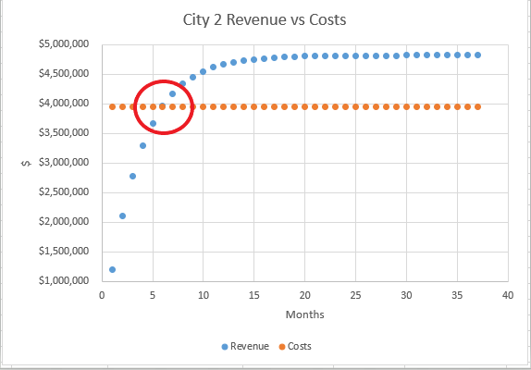
Breakeven Analysis
Revenue
Driver retention directly translates to increased number of completed trips
Given average trips per driver constant, driver churn rate = completed trips churn rate
How many additional completed trips per month?
=Average monthly completed trips * churn rate for month * 13.55% retention
Additional revenue for given month = additional completed trips * (avg net inflow + net booking per trip)
Costs
Fixed initial investment: (Flashlight cost, Lite up setup fee, tooling cost)
Variable Costs: (cost per light)
How many lights are needed?
-The average number of eligible drivers in each City
=Average completed trips / average trips per driver
-Given 18% of notified drivers pick up a light, number of lights to order to target entire eligible population
Two critical considerations in evaluating Light’s Cost-Benefit Analysis:
Number of lights to order
Additional completed trips per month generated
Light will take 6 months to breakeven after implementation in City 2.
In City 2, Light is forecasted to ultimately generate $4.82M revenue after 36 months, taking into consideration cost of $3.95M, produces $872,540 net profit.
Executive Summary
Experiment & Churn Curve Analysis
Breakeven Analysis
Sensitivity Analysis
Key Benefits & Risks

Slide 5

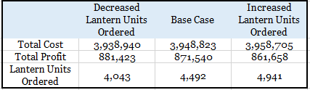
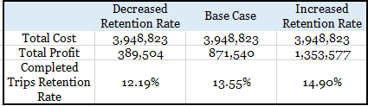
Sensitivity Analysis
Metric 1: light Cost
Tested impact of the metrics light per unit cost, number of lights needed, and retention rate of completed trips to City 2 revenues, costs, and profitability.
Metric 1: light Cost
Metric 2: light Units Ordered
Metric 3: Retention Rate of Completed Trips
Through these various scenarios, light proves to exemplify unwavering profitability in City 2 and signal to be solid investment choice.
Executive Summary
Experiment & Churn Curve Analysis
Breakeven Analysis
Sensitivity Analysis
Key Benefits & Risks

Slide 6
Key Benefits & Risks
Benefits
-Reduction in driver churn, translates to additional revenue from increased completed trips
-Increased demand from better rider/customer experience:
More drivers equates to lower wait times
Decreased probability of surge pricing
Improved pick-up experience
-Better marketing targeted to building driver and rider loyalty base
Risks
-Test city data not reflective of actual cities
-Safety concerns and regulation exposure from fostering bright light inside vehicle
-Unforeseen implementation or maintenance cost of light program due to scalability
-Cannibalism of driver base from additional requirement of housing light
Forward Outlook
This analysis could be improved with additional data regarding:
Driver demographic data with insights to percentage of drivers with 250+ lifetime trips in entire driver base
Experiment results reflective of longer time than one month to obtain more accurate retention rates
Relationship between driver retention and increased completed number of trips
More granular cost breakdown
Does it make sense to include initial capital expenditures for Flashlight and Lite Up for all cities of implementation?
What is marginal cost for each additional city of implementation?
Relationship between notified drivers and drivers that actually picked up light
Executive Summary
Experiment & Churn Curve Analysis
Breakeven Analysis
Sensitivity Analysis
Key Benefits & Risks

