Slide 1
Real Estate Case Study Christie Wang August 2019

Slide 2
Joining the Data
Join Process
Step 1
Create Unique Table for Spend_Data. Remove Duplicate Project Codes for later joining process.
Step 2
Create Unique Table for Building_Data. Fill in (30) null Project Id values by using the non-null project ids in a different row with the same Deal id, lease date, and property short code.
Step 3
Join Building Data, Spend Data, and TI Data together. Building Data + Spend Data on Project Id = Project Code. (Building Data + Spend Data) + TI Data on Deal Id = Deal UUID. Filter Data for 2016-2017 Data Only
Step 4
Select only relevant data to be used for Tableau.

Slide 3
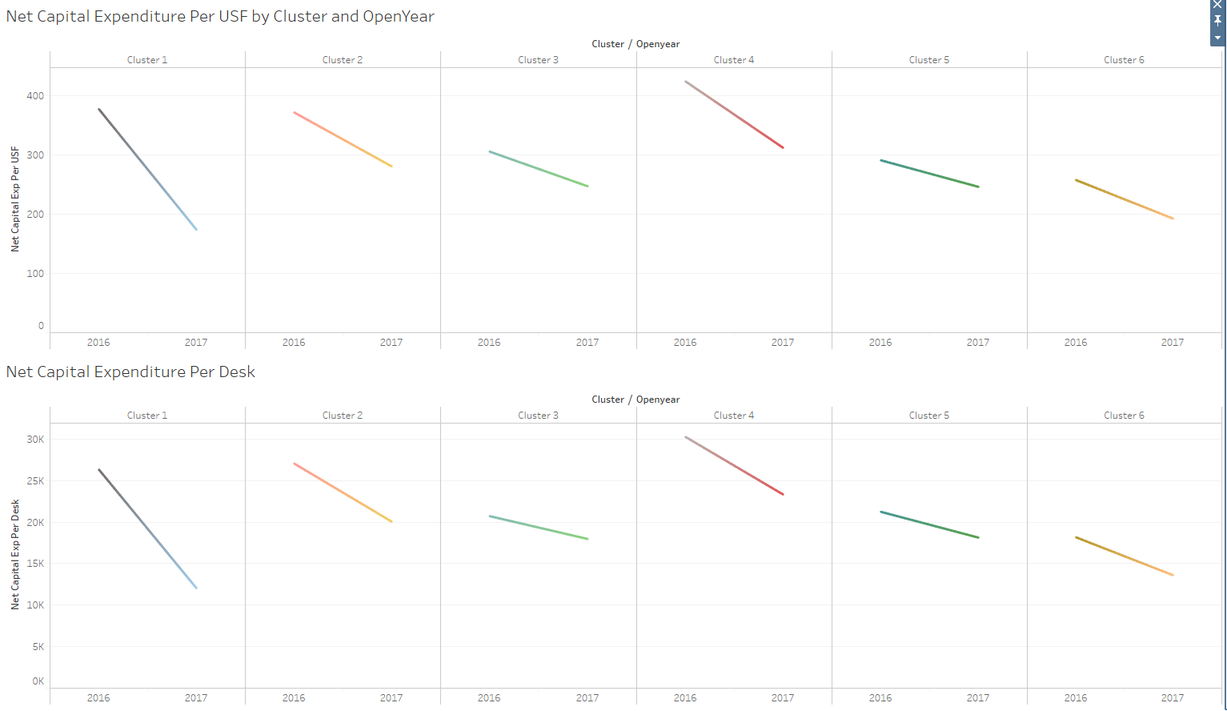
Question 1
For all 2016-2017 Data:
Over time for each cluster, we see that both Net Capital Expenditure per USF and Net Capital Expenditure per desk has decreased!
This shows that each cluster in 2017 is spending less per desk and per Usable Square foot than in 2016.
How did each Cluster perform per Desk & per USF (usable square feet) in 2017 compared to 2016? (*use open date to determine year)

Slide 4
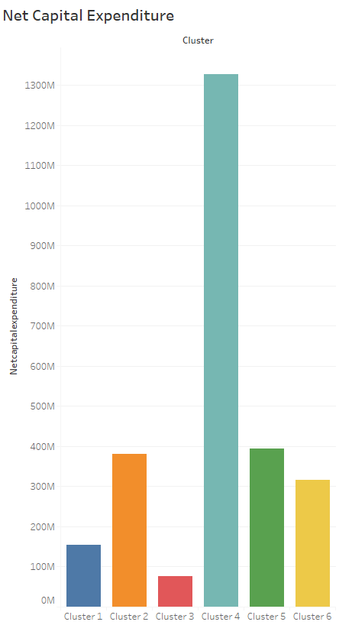
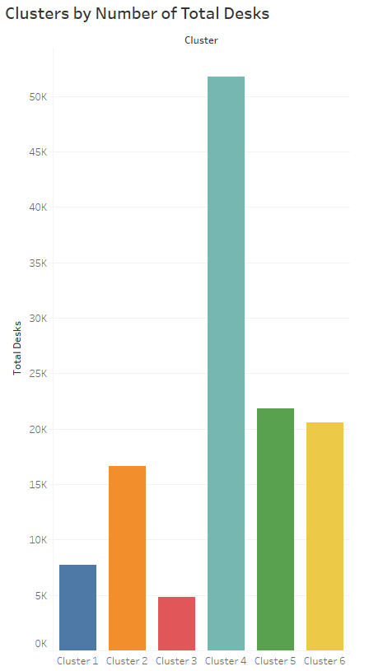
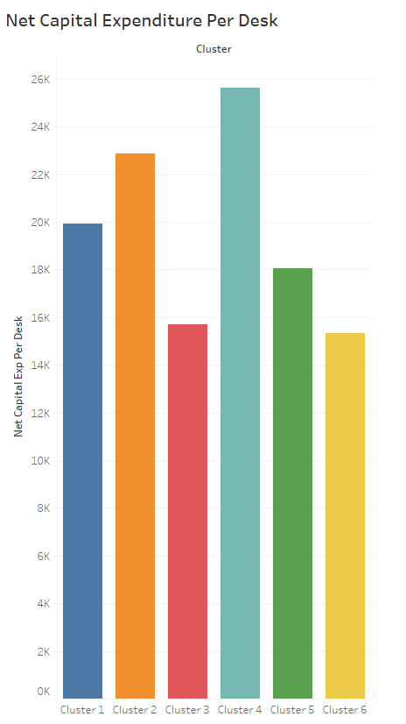
Question 2
For all 2016-2017 Data:
Cluster 4 Ranks highest for Net Capital Expenditure, Total Number of Desks, and Net Capital Expenditure per Desk.
Although Cluster 5 and 6 had strong numbers for Total Number of Desks and Net Capital Expenditure, Clusters 1 and 2 had the second and third highest Net Capital Expenditure per desk.
Cluster 3 had the lowest Net Capital Expenditure and Total Number of desks, but Cluster 6 had the lowest Net Capital Expenditure per Desk
These results show that Cluster 4 exhibits the highest Net CapEx, followed by Clusters 2 and 1, giving light to the relative expensiveness of the properties included in these three clusters
How do the Clusters compare to each other?

Slide 5
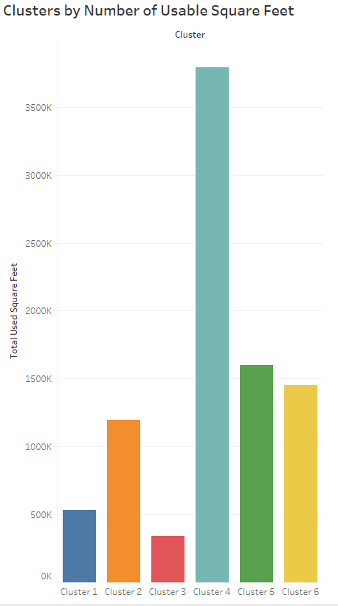
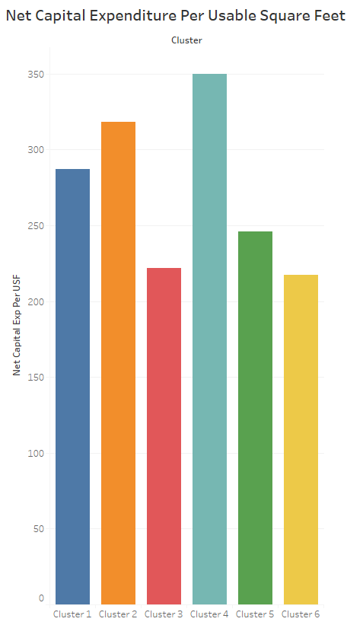
Question 2
For all 2016-2017 Data:
Cluster 4 Ranks highest for Net Capital Expenditure, Total Number of Usable Square Feet, and Net Capital Expenditure per Usable Square Feet.
Although Cluster 5 and 6 had strong numbers for Usable Square Feet and Net Capital Expenditure, Clusters 1 and 2 had the second and third highest Net Capital Expenditure per Usable Square Feet.
Cluster 3 had the lowest Net Capital Expenditure and Total Number of Usable Square Feet, but Cluster 6 had the lowest Net Capital Expenditure per Usable Square Feet
Similar to Net Capital Expenditure per Usable Square Feet, these results highlight the relative expensiveness of the properties included in Clusters 4, 2, and 1
How do the Clusters compare to each other?

Slide 6
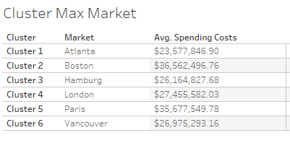
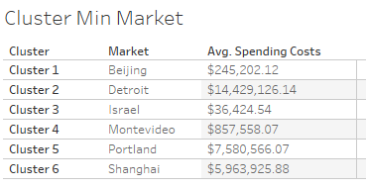
Question 3
Which markets in each Cluster are the cheapest and most expensive to build in?
For all 2016-2017 Data:
The Markets with the highest average spending costs in each cluster is denoted on the right in the “Cluster Max Market Table”. Boston has the highest average spending cost per project of all markets in all the clusters.
The Markets with the lowest average spending costs in each cluster is denoted on the right in the “Cluster Min Market Table”. Israel has the lowest Average Spending Cost per project of all markets in all the clusters.

Slide 7
Analysis Improvement Opportunities
Clarity around data quality issues present in dataset
Discrepancies around usable square feet and desk data where certain property floors have inconsistent relationships between the two (ex. Zero usable square feet with non-zero number of desks)
Negative capital expenses for projects found, can that be interpreted to indicate positive capital gains with partaking in this project?
Relationship of Deal UUID to Deal Code in TI Data, noticed Deal Code has last presentation date appended as last few digits, relationship of this presentation date to open date
Addressing nulls in data: more conclusive Spend Data to include capital expenditure of all projects and TI Data to include tenant improvement monies for all deals
Additional Areas of Improvement
Additional data regarding the types of projects to further segment and analyze net capital expenditures by types of projects within each cluster
Insights into logic behind how clusters are created and the grouping of properties
Further breakdown of capital expenditure spend and tenant improvement monies figures

