Slide 1
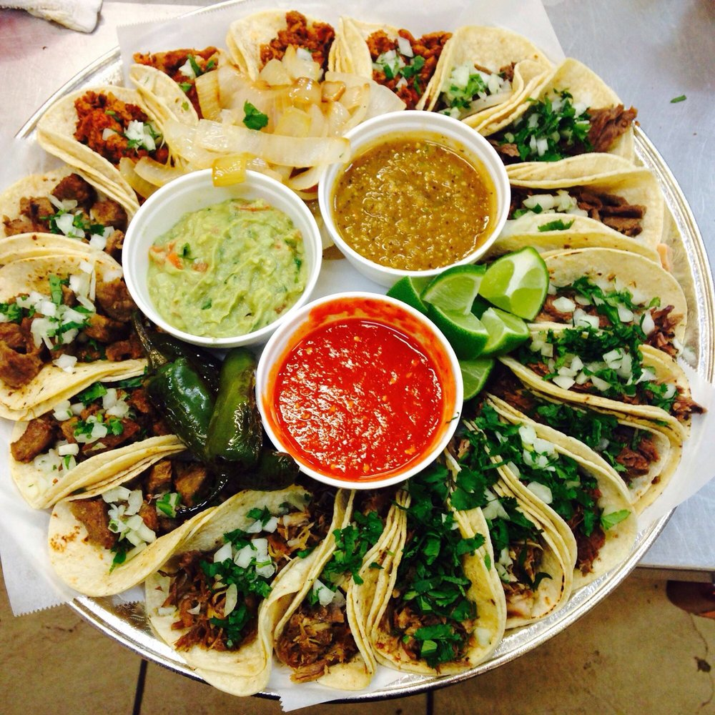
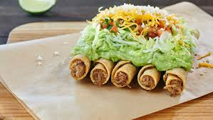
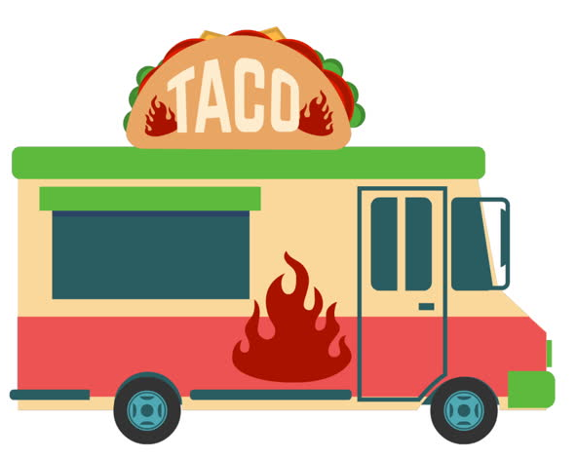
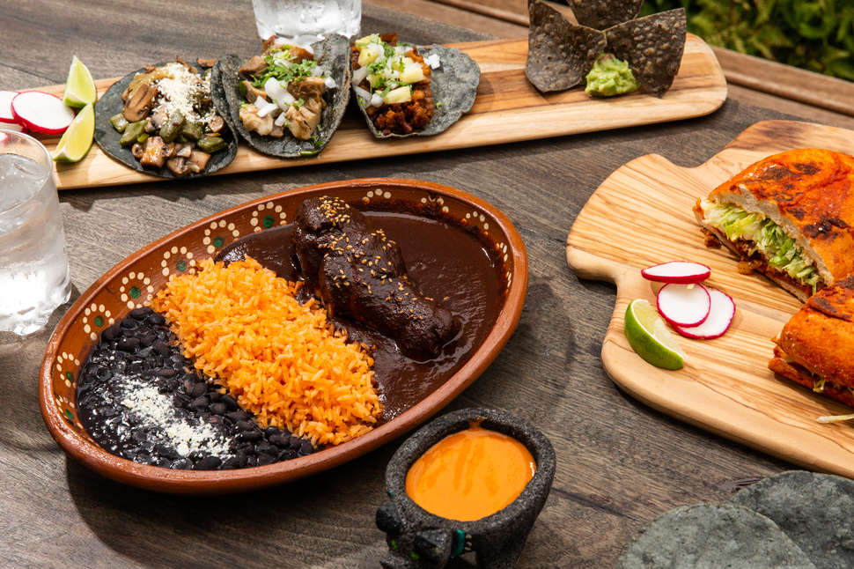
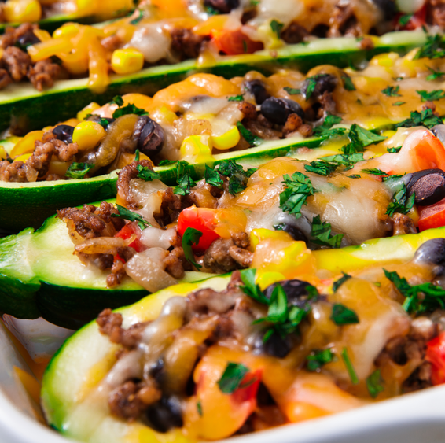
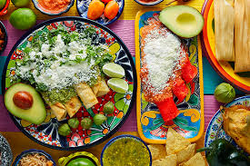
TACO-BOUT IT Investor Presentation Christie Wang July 2019

Slide 2
Company Overview
Launched in 2018, TACO-BOUT IT is a local taco food truck in New York City that serves 100% organic, high-quality, delicious tacos
One of the most popular food trucks in Midtown, servicing 36,000 customers in merely one year.
WHO WE ARE?
At TACO-BOUT IT our mission is simple: enhance and educate the palate with the freshest ingredients and flavors, bringing authentic Mexican flavors to satisfy the customer’s heart and soul.
We value creating big taste, while leaving a small environmental footprint!
All ingredients are locally sourced to minimize transportation waste and all leftovers are properly recycled into compost.
We only use biodegradable, 100% compostable, eco-friendly food packaging containers and utensils.

Slide 3
Financials and Company Valuation
After obtaining initial $500,000 funding,
Reported gross revenue of $360,000 and net income of $282,655 for the 2018 fiscal year
Expect 5% annual growth rate and strong cash flows
Assuming 4% perpetual growth rate and 10x EV/EBITDA multiple, value TACO-BOUT IT at $3,914,094
Strong financial results prove to be robust through in-depth sensitivity analysis that includes employing running Monte-Carlo simulation to measure the impact of key assumptions

Slide 4
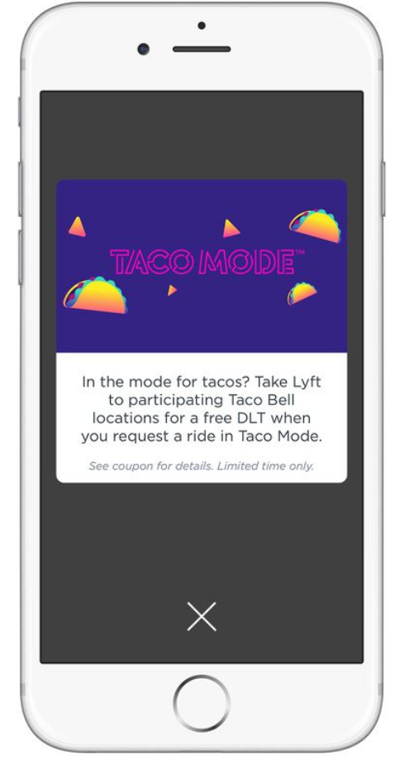
Growth and Opportunities
Potential Headwinds:
Subject to cyclical business cycle from potential lower levels of customer demand during the winter seasons
Exposed to price inflation of key ingredients due to variability of local markets
Growth Opportunities:
Launch a second truck location around the Union Square area to capture business among college-student demographics
Form partnerships with on-demand delivery platforms to expand potential customer base and make TACO-BOUT IT available to more communities
Develop and implement mobile application that allows customers to place orders ahead of time, get real time updates on their order status, and further enhance the customer rewards program
We are fully confident that TACO-BOUT IT will not only meet but exceeds its targets of continued revenue inflow, and successfully grow at 5% annual rate to continuously capture market share for the upcoming years.
Growth

Slide 5
Thank You!
Questions?

